Slide 1
Computers
Art 317
Parker

Slide 2
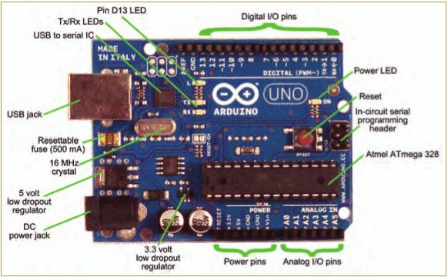
Arduino

Slide 3
Arduino
Check out: http://arduino.cc/en/Guide/HomePage
https://www.youtube.com/watch?v=nL34zDTPkcs

Slide 4
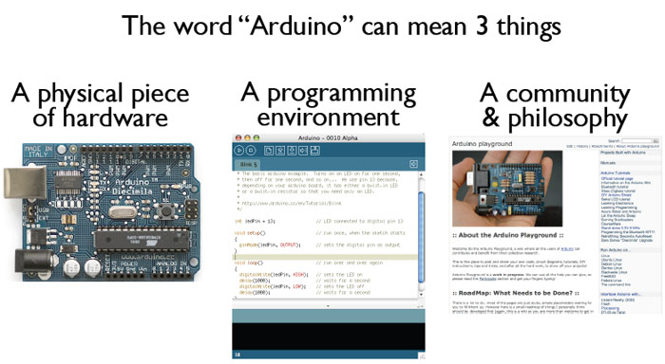
What is the Arduino
todbot.com/blog/bionicarduino

Slide 5
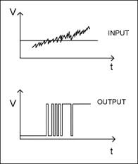
Digital Input/Output
1
Digital IO is binary valued—it’s either on or off, 1 or 0
Internally, all microprocessors are digital, why?
0

Slide 6
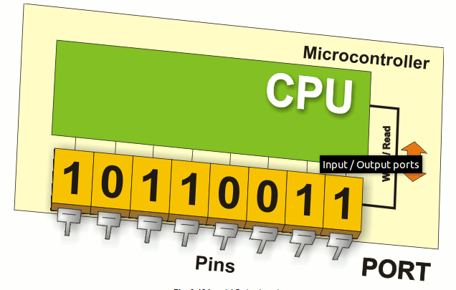
Arduino Digital I/0
www.mikroe.com/chapters/view/1
pinMode(pin, mode)
  Sets pin to either INPUT or OUTPUT
digitalRead(pin)
  Reads HIGH or LOW from a pin
digitalWrite(pin, value)
  Writes HIGH or LOW to a pin
Electronic stuff
  Output pins can provide 40 mA of current
  Writing HIGH to an input pin installs a 20KΩ pullup
Notes:
6

Slide 7
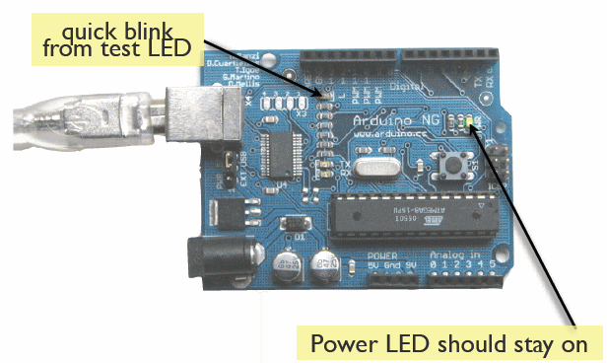
Try It: Connect the USB Cable
todbot.com/blog/bionicarduino

Slide 8
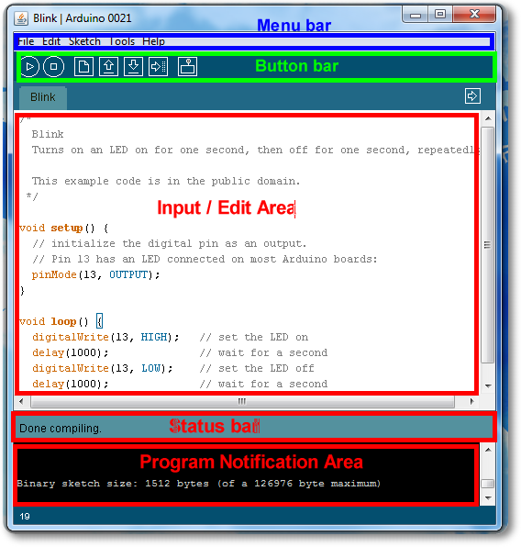
Arduino IDE
See: http://arduino.cc/en/Guide/Environment for more information

Slide 9
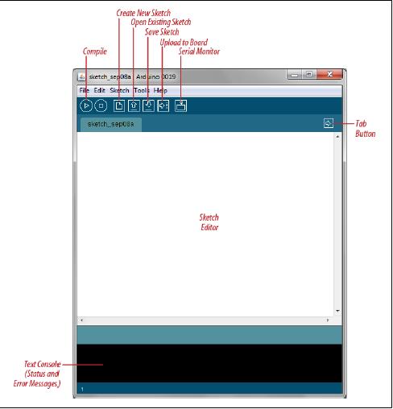
Arduino IDE

Slide 10
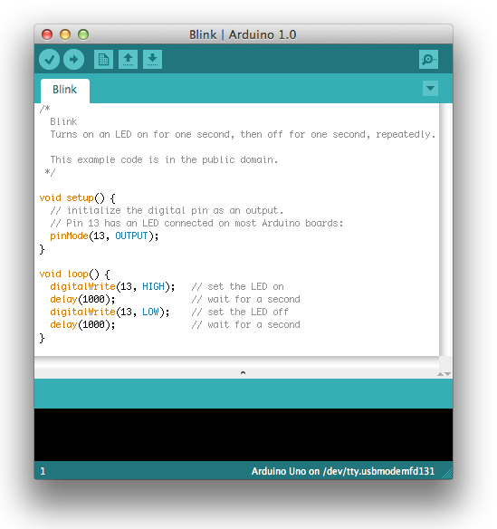
First Program

Slide 11
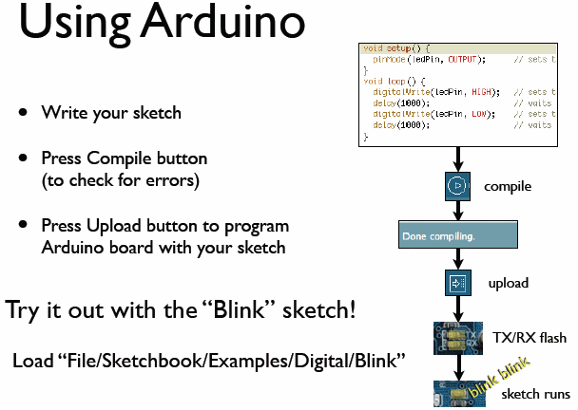
todbot.com/blog/bionicarduino

Slide 12
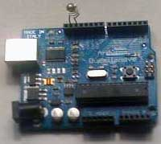
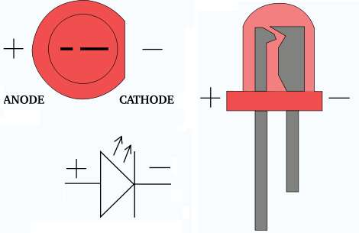
Add an External LED to pin 13
File > Examples > Digital > Blink
LED’s have polarity
  Negative indicated by flat side of the housing and a short leg
www.instructables.com

Slide 13
Arduino Code Basics
Arduino programs run on two basic sections:
void setup() {
//setup motors, sensors etc
}
void loop() {
// get information from sensors
// send commands to motors
}

Slide 14
SETUP
The setup section is used for assigning input and outputs (Examples: motors, LED’s, sensors etc) to ports on the Arduino
It also specifies whether the device is OUTPUT or INPUT
To do this we use the command “pinMode”
14

Slide 15
SETUP
void setup() {
pinMode(9, OUTPUT);
}
port #
Input or Output
http://www.arduino.cc/en/Reference/HomePage

Slide 16
Important functions
Serial.println(value);
  Prints the value to the Serial Monitor on your computer
pinMode(pin, mode);
  Configures a digital pin to read (input) or write (output) a digital value
digitalRead(pin);
  Reads a digital value (HIGH or LOW) on a pin set for input
digitalWrite(pin, value);
  Writes the digital value (HIGH or LOW) to a pin set for output

Slide 17
Arduino Timing
delay(ms)
  Pauses for a few milliseconds
delayMicroseconds(us)
  Pauses for a few microseconds
More commands: arduino.cc/en/Reference/HomePage

Slide 18
LOOP
void loop() {
digitalWrite(9, HIGH);
delay(1000);
digitalWrite(9, LOW);
delay(1000);
}
Port # from setup
Turn the LED on
or off
Wait for 1 second
or 1000 milliseconds

Slide 19
TASK
Using 3 LED’s (red, yellow and green) build a traffic light that
  Illuminates the green LED for 5 seconds
  Illuminates the yellow LED for 2 seconds
  Illuminates the red LED for 5 seconds
  repeats the sequence
Note that after each illumination period the LED is turned off!
19

Slide 20
DECLARING A VARIABLE
int val = 5;
assignment
“becomes”
Type
value
variable name

Slide 21
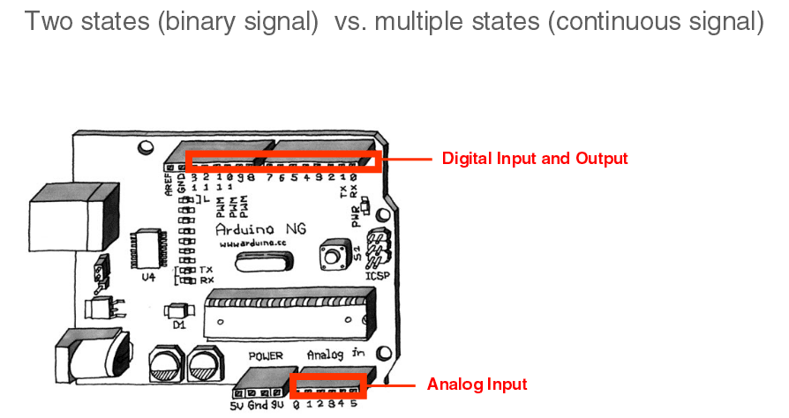
IO Pins
Image from Theory and Practice of Tangible User Interfaces at UC Berkley

Slide 22
Using Variables
int delayTime = 2000;
int greenLED = 9;
void setup() {
pinMode(greenLED, OUTPUT);
}
void loop() {
digitalWrite(greenLED, HIGH);
delay(delayTime);
digitalWrite(greenLED, LOW);
delayTime = delayTime - 100;
delay(delayTime);
}
subtract 100 from
delayTime to gradually
increase LED’s blinking
speed

Slide 23
Measuring Temperature
const int inPin = 0; // analog pin
void loop()
{
int value = analogRead(inPin);
float millivolts = (value / 1024.0) * 3300; //3.3V analog input
float celsius = millivolts / 10; // sensor output is 10mV per degree Celsius
delay(1000); // wait for one second
}

Slide 24
Audio output
tone(speakerPin, frequency, duration); // play the tone
delay(duration); //wait for the tone to finish

Slide 25
Conditions
To make decisions in Arduino code we use an ‘if’ statement
‘If’ statements are based on a TRUE or FALSE question

Slide 26
VALUE COMPARISONS
GREATER THAN
a > b
GREATER THAN OR EQUAL
a >= b
LESS
a < b
LESS THAN OR EQUAL
a <= b
EQUAL
a == b
NOT EQUAL
a != b

Slide 27
IF Condition
if(true)
{
“perform some action”
}
asdfadsf

Slide 28
IF Example
int counter = 0;
void setup() {
  Serial.begin(9600);
}
void loop() {
  if(counter < 10)
  {
      Serial.println(counter);
  }
  counter = counter + 1;
}

Slide 29
IF - ELSE Condition
if( “answer is true”)
{
“perform some action”
}
else
{
“perform some other action”
}
asdfadsf

Slide 30
IF - ELSE Example
int counter = 0;
void setup() {
  Serial.begin(9600);
}
void loop() {
  if(counter < 10)
  {
      Serial.println(“less than 10”);
  }
  else
  {
      Serial.println(“greater than or equal to 10”);
      Serial.end();
  }
  counter = counter + 1;
}

Slide 31
IF - ELSE IF Condition
if( “answer is true”)
{
“perform some action”
}
else if( “answer is true”)
{
“perform some other action”
}
asdfadsf

Slide 32
IF - ELSE Example
int counter = 0;
void setup() {
  Serial.begin(9600);
}
void loop() {
  if(counter < 10)
  {
      Serial.println(“less than 10”);
  }
  else if (counter == 10)
  {
      Serial.println(“equal to 10”);
  }
  else
  {
      Serial.println(“greater than 10”);
      Serial.end();
  }
  counter = counter + 1;
}

Slide 33
BOOLEAN VARIABLES
boolean done = true;

Slide 34
Using Variables
int delayTime = 2000;
int greenLED = 9;
int redLED = 10;
int yellowLED = 11;
int delayTime = 5000;
int yellowTime = 2000;
void setup()
{
pinMode(greenLED, OUTPUT);
pinMode(redLED, OUTPUT);
pinMode(yellowLED, OUTPUT);
}

Slide 35
Using Variables
void loop()
{
digitalWrite(greenLED, HIGH);
delay(delayTime);
digitalWrite(greenLED, LOW);
digitalWrite(yellowLED, HIGH);
delay(yellowTime);
digitalWrite(yellowLED, LOW);
digitalWrite(redLED, HIGH);
delay(delayTime);
digitalWrite(redLED, LOW);
}

Slide 36
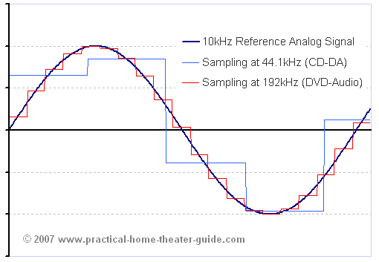
Analog Input
Think about music stored on a CD---an analog signal captured on digital media
  Sample rate
  Word length

Slide 37
Analog to Digital Conversion
What is analog ?
It is continuous range of voltage values (not just 0 or 5V)
Why convert to digital ?
Because our microcontroller only understands digital.

Slide 38
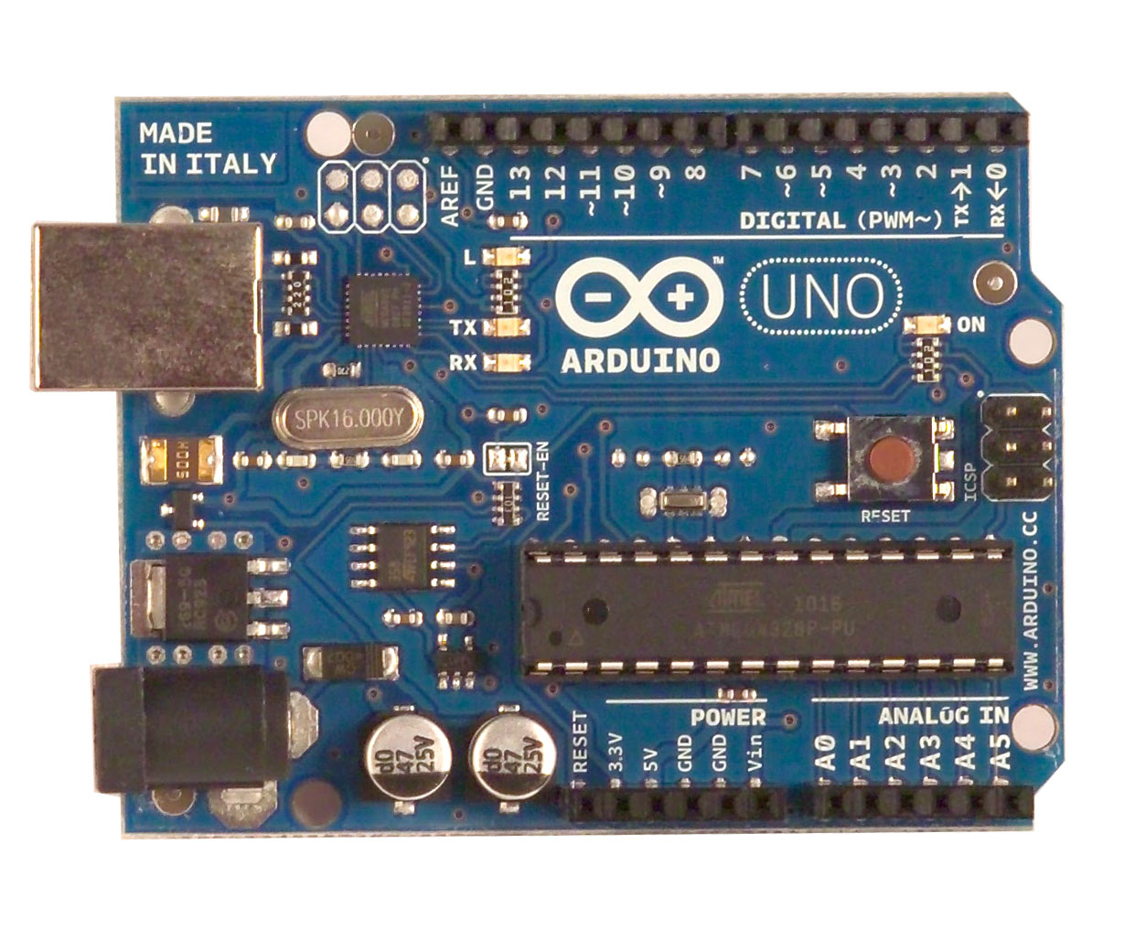
ADC in Arduino Uno

Slide 39
Arduino Analog Input
Image credit: Tod Kurt
Resolution: the number of different voltage levels (i.e., states) used to discretize an input signal
Resolution values range from 256 states (8 bits) to 4,294,967,296 states (32 bits)
The Arduino uses 1024 states (10 bits)
Smallest measurable voltage change is 5V/1024 or 4.8 mV
Maximum sample rate is 10,000 times a second

Slide 40
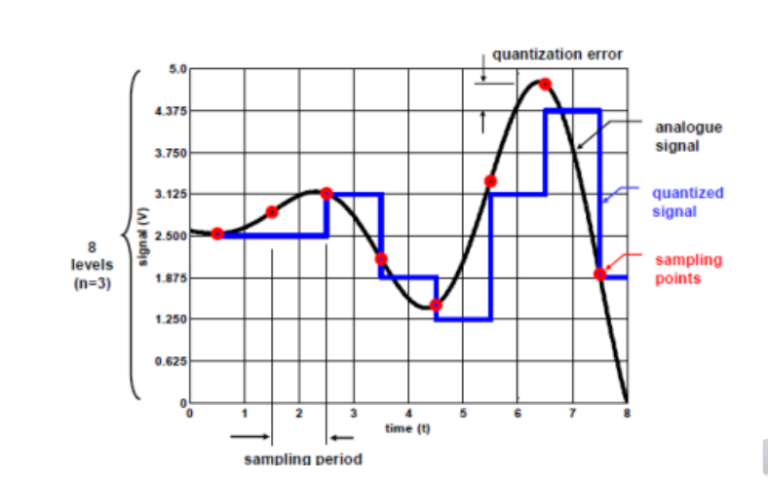
Quantanization the signal

Slide 41
ADC in Arduino
The Arduino Uno board contains 6 pins for ADC
10-bit analog to digital converter
This means that it will map input voltages between 0 and 5 volts into integer values between 0 and 1023

Slide 42
Reading/Writing Analog Values
analogRead(A0); // used to read the analog value from the pin A0
analogWrite(2,128);

Slide 43
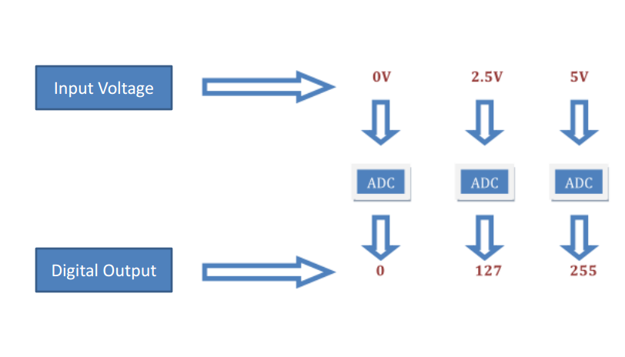
Converting Analog Value to Digital

Slide 44
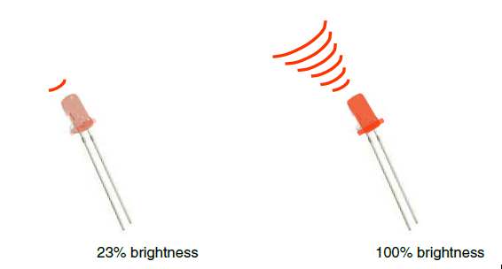
Analog Output
Can a digital device produce analog output?
Image from Theory and Practice of Tangible User Interfaces at UC Berkley
Analog output can be simulated using pulse width modulation (PWM)

Slide 45
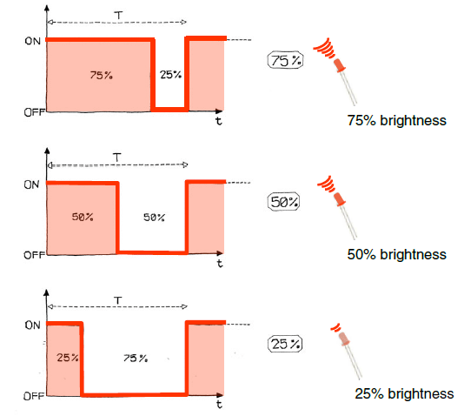
Pulse Width Modulation
Can’t use digital pins to directly supply say 2.5V, but can pulse the output on and off really fast to produce the same effect
The on-off pulsing happens so quickly, the connected output device “sees” the result as a reduction in the voltage
Image from Theory and Practice of Tangible User Interfaces at UC Berkley

Slide 46
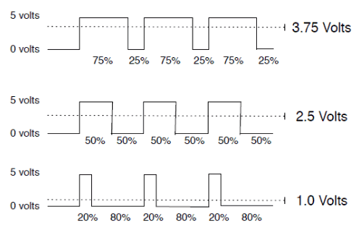
PWM Duty Cycle
output voltage = (on_time / cycle_time) * 5V
Image credit: Tod Kurt
Fixed cycle length; constant number of cycles/sec

Slide 47
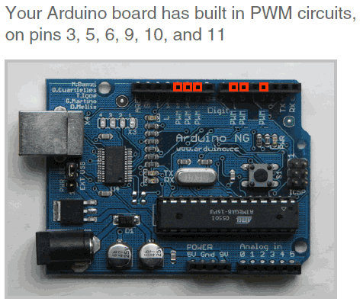
PMW Pins
Command: analogWrite(pin,value)
value is duty cycle: between 0 and 255
Examples:
analogWrite(9, 128)
for a 50% duty cycle
analogWrite(11, 64)
for a 25% duty cycle
Image from Theory and Practice of Tangible User Interfaces at UC Berkley

