Slide 1
Electricity
Lecture 2

Slide 2
Last time …
We talked about electricity. Charges, concepts.
It is amazing how many things we can make electricity do for us. It makes things hot, it makes things cold. It lights up. It makes things move and stop, allows us to transmit and receive information, and it does arithmetic for us.

Slide 3
Electricity
Problem: some numbers are involved.
We need to know, sometimes, how much current is needed, how much voltage is needed to do a job. And we need to know how to make that happen.
If you ever want to know WHY we are doing something or talking about something please ask.

Slide 4
Electricity
In electricity, we know something is flowing.
Engineers say it is positive charges, everyone else says negative charges. It does not matter.

Slide 5
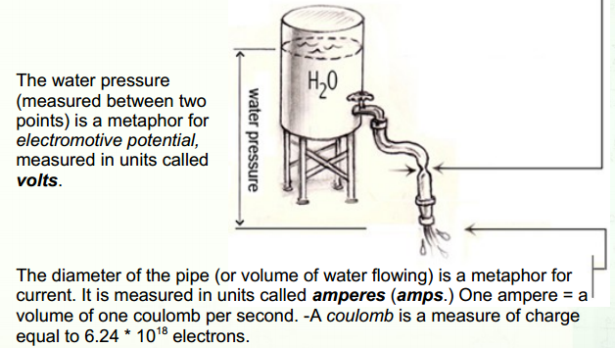
Electricity

Slide 6
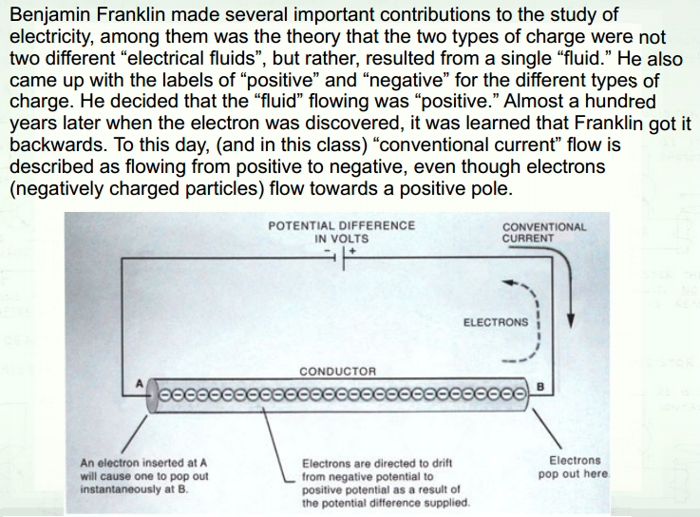

Slide 7
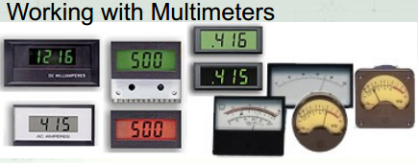
Measuring Electricity?
There are many ways to measure electricity.
Don’t let the numbers get in the way. They are constraints, like colours and speeds and pressures. There is nearly always a range of what is acceptable.

Slide 8
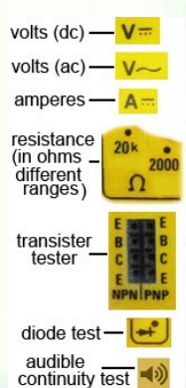
Measuring Electricity
The multimeter (DMM) or digital volt meter (DVM) is critical.
We can’t see what’s happening, unlike a drawing or painting. We infer what’s going on by measuring things.

Slide 9
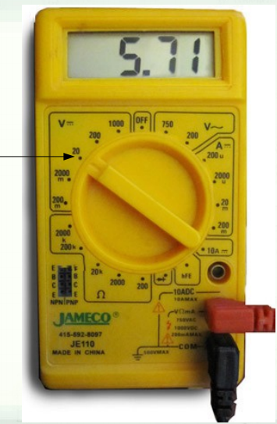
Measuring Electricity
This is a cheap one.
We will be manually selecting both the type of meter and the range within which you will be measuring.

Slide 10
Measuring Electricity
Start by selecting the range you think is closest to the value you will be measuring.
Always start at the highest value: 100 volts, then 200, then 20 etc.

Slide 11
Measuring Electricity
In this example, we’re measuring something I think is around 6 volts, so I start in the range of 0 – 20 volts.
I'm measuring dc current, so I select the range in the area next to the “V” with a dashed line. (The “V” with the wavy line is volts of ac)

Slide 12
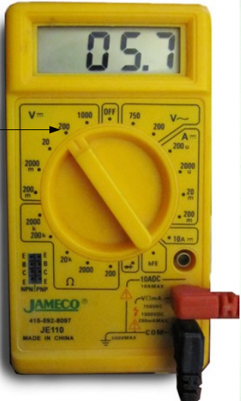
Meters
If I move dial to the 0 – 200 volt range, the meter displays the same value, but it moves over one decimal place to make.
And notice we’re losing some
resolution (the hundredths place) in the process. Selecting the range closest to the value you are measuring will give you the most precise measurement (most decimal places.)

Slide 13
Meters
We went from 0-20 to 0-200.
We might need an extra digit.
Let’s step up one again.

Slide 14
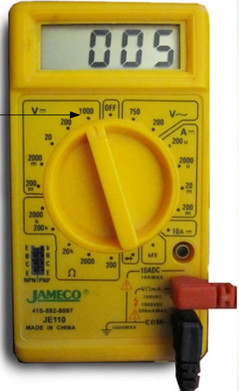
Meters
We went from 0-200 to 0-1000.
The meter is displaying the same value, but it moves over one decimal place to make room for a sign (+ or -) and larger, four digit number.
And notice I'm losing some
resolution (the tenths place) in the process.

Slide 15
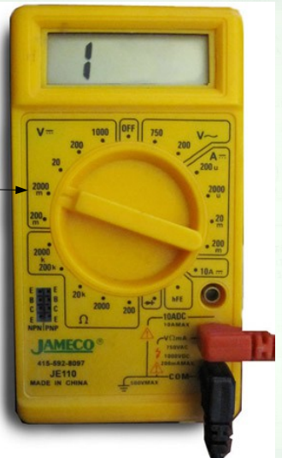
Meters
Going down:
The range below 0 – 20 volts has a small letter “m” indicating that it is a range measuring millivolts (thousandths of a volt.)
Note: 0 – 2000 thousandths of a volt is the same as measuring 0 – 2 volts.
1??

Slide 16
Meters
The voltage we are measuring is 5.71 volts, the meter displays a numeral 1 at the left of the display.
5.71 V is bigger than 2V
This is what the display looks like when it is measuring a value that is “out of range.”
Each meter indicates this in a different way:
“E”, “Error”, flashing, or smoke.

Slide 17
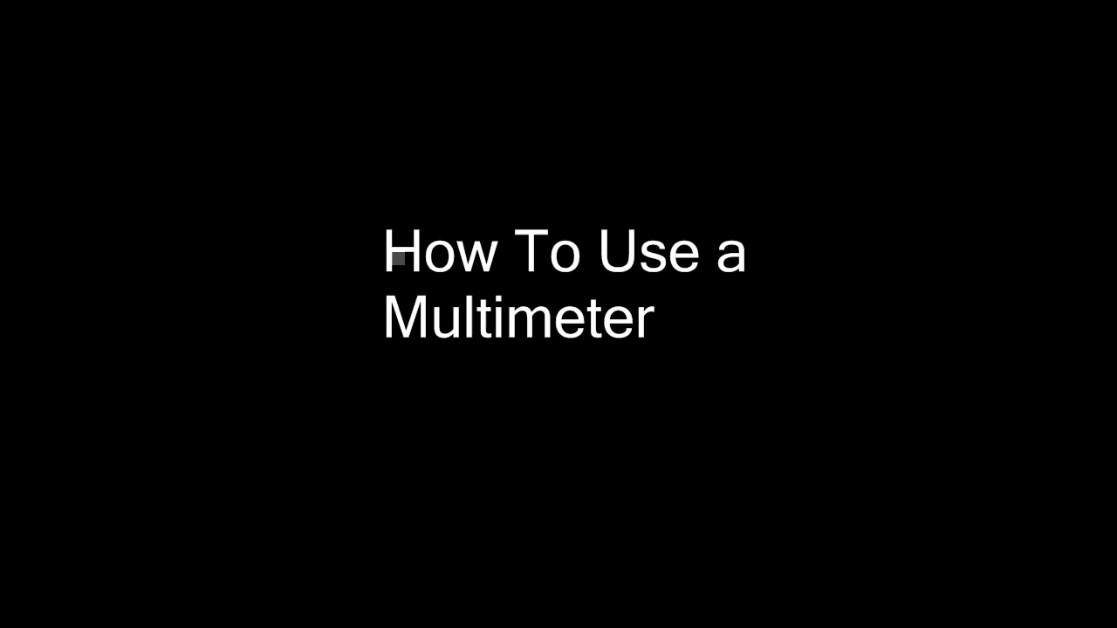

Slide 18

AC? DC?

Slide 19
What uses AC, what DC?
Most things actually use DC.
It gets converted into DC inside the device (TV, Radio, computer, etc)
AC is better for transmitting over distances
AC
Vacuum cleaner
computer
Television
Stove
Fridge
DC
Radio
CD/DVD/AM
Lights
Pumps
Notes:
AC: motors, high current DC: electronics, low current

Slide 20
Voltage as a function of Time
This is a critical measurement, and is best shown as a graph.
If voltage (or current) changes, it can be drawn with time as horizontal and voltage (or current) vertical.

Slide 21
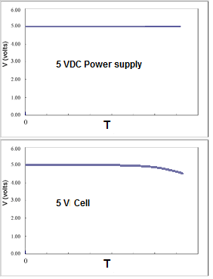
Voltage as a function of Time
As we’re seen, direct current (DC) voltages stay the same.

Slide 22
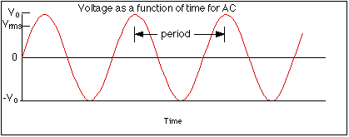
Voltage as a function of Time
As we’re seen, alternating current (AC) voltages vary with exceptional regularity.

Slide 23
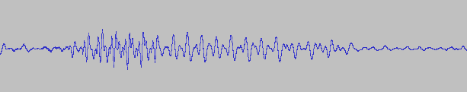
Voltage as a function of Time
Sound, captured with a microphone and converted into voltages, varies in ways that cannot be predicted.

Slide 24
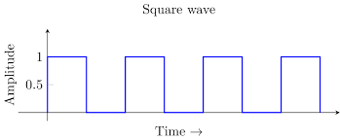
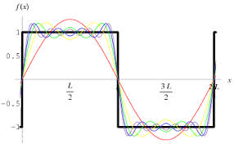
Voltage as a function of Time
Signals are patterns of voltage vs time. They can be representations of music, voice, data, and circuit characteristics. Can also be constructed. IE music synthesizer.

Slide 25
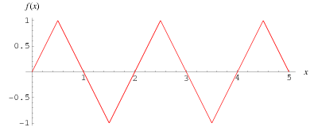
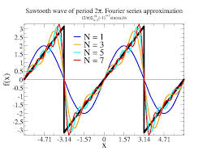
Voltage as a function of Time
Signals are patterns of voltage vs time. They can be representations of music, voice, data, and circuit characteristics. Can also be constructed. IE music synthesizer.

Slide 26
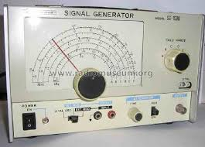
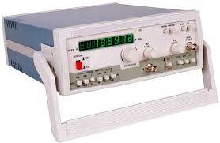
Signals
A synthesizer constructs musical waveforms from sine waves.
A signal generator generates signals of a specified type to test circuits.
One specifies the kind (square, sine, etc) amplitude (volts) and frequency (Hz).

Slide 27
Signals
Signal generators can be pricy. Today we have computers and cell phones!
http://www.dr-jordan-design.de/signalgen.htm
http://www.nch.com.au/tonegen/

Slide 28
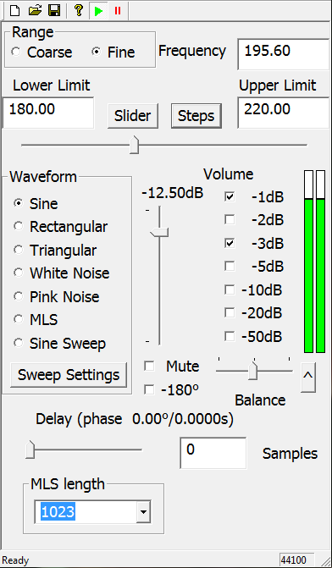
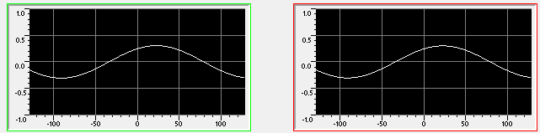
Generator
Here we’re generating a sine wave at 195.6 Hz.
Signal display on Goldwave

Slide 29

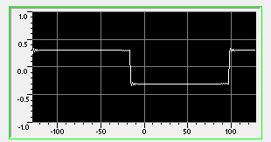
Generator
Here we’re generating a square wave at 195.6 Hz.
Signal display on Goldwave

Slide 30
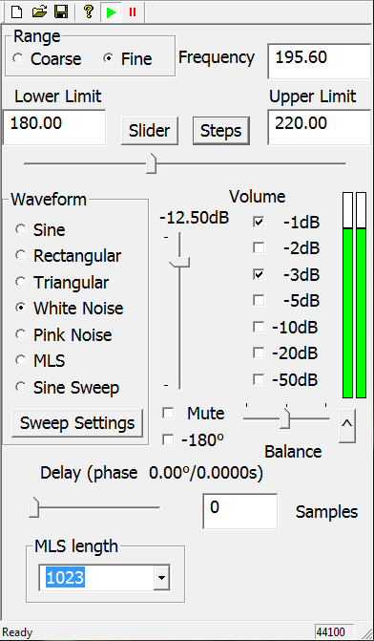
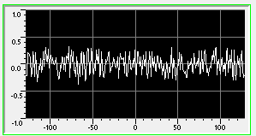
Generator
Here we’re generating a noise signal.
(Frequency makes no difference here)
Signal display on Goldwave

Slide 31
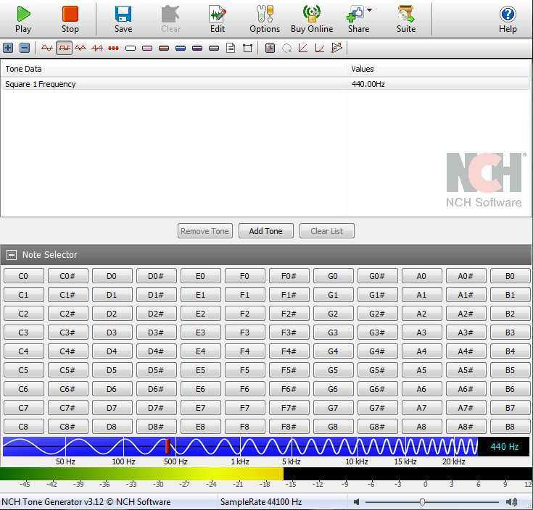
NCH Tone Generator
Based more on a musical concept.

Slide 32
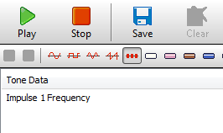
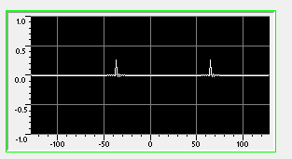
NCH
In addition to the previous functions, it can do Pulses:

Slide 33
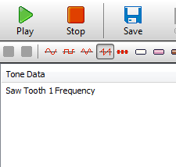
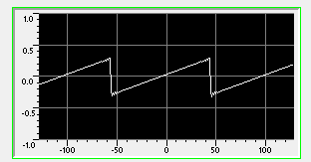
NCH
In addition to the previous functions, it can do sawtooth waves:

Slide 34
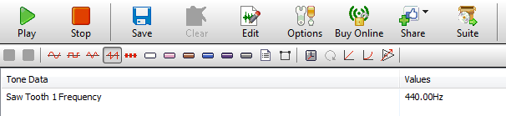
NCH
Noise:
White pink brown blue violet grey

Slide 35
Noise
White – all frequencies, random
Pink – has a frequency spectrum such that the energy or power per Hz is inversely proportional to the frequency of the signal
Brown - a lot of energy at low frequencies
Blue – More energy at high frequencies
Violet – More HF noise than blue
Grey - subjected to a psychoacoustic equal loudness curve, giving the listener the perception that it is equally loud at all frequencies.

