Slide 1
Interface
Art 251

Slide 2
Interfaces in Art
The key elements of controlling a user interface are:
The knowledge of how to use a device that can permit a human to communicate with a computer.
A keyboard is a standard communication device, as is a mouse. A touch screen uses the same methods as does a mouse: identifying a location on a screen and characterizing motion and button clicks. More complex input devices include microphones (for sound), cameras, pressure sensors, capacitance (touch), heart rate, and a variety of other biometric and electromagnetic sensing devices.

Slide 3
Interfaces in Art
The use of the data from the input device to control the nature of the artwork.
Any device can be used to control color, shape, brightness, motion, and other properties of the objects within a piece, and can be used to trigger events that the artist devises.

Slide 4
Interfaces in Art
An insight into how to create an interesting visual presentation of objects that will control the work.
The creative part.

Slide 5
Button
A button on a computer interface is a good analogy of a real-world push button and illustrates the fundamentals of how any interface on a computer will operate.
An actual button takes a number of physical forms, but is essentially a piece of conductor (metal) that can be bent to make an electrical contact with a wire. When the button is depressed the connection is made and electrical current can flow to some device like a lamp or a bell. Often when the button is released the contact is broken again, but some buttons have a latching mechanism that keeps them in the on state until pressed again.

Slide 6
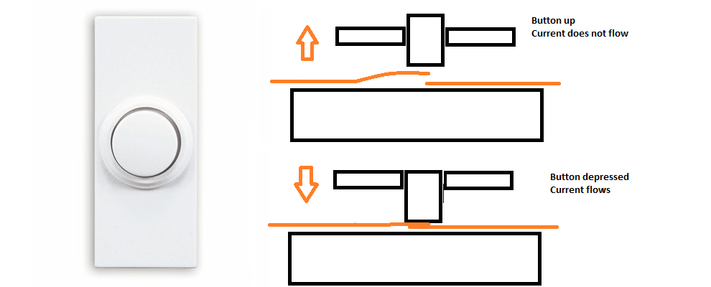
Button

Slide 7
Button
The computer button is simply a graphical object on the screen that is intended to look like a button. It’s often just a rectangle or circle. If it is drawn on a touch screen then it can be operated by the user’s finger, and will turn on when touched.
If there is no touch screen then the mouse is used in the manner that we all understand: the cursor is moved over the mouse button on the screen and the mouse button is depressed. The mouse button is actually a real-world momentary contact button, as described above. So, a real button is used to turn on a mouse activated computer interface button. Buttons are ubiquitous on the Internet and in interactive software generally. Let’s see how they work.

Slide 8
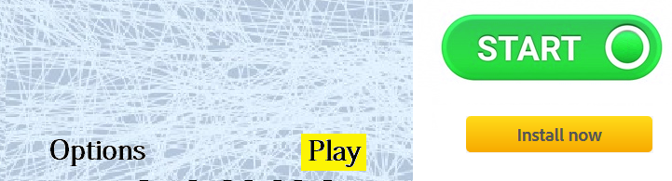
Button

Slide 9
Mouse Gestures
Most modern computer interfaces use the mouse for user input.
The keyboard is used for entering text, of course, but the mouse or a device that uses the mouse interface is used for most other things.
Consider an interface that can draw lines by using mouse clicks. The first click defines one end of the line, and the next click defines the other end. It is convenient to see the line that is being drawn, so after the initial point is defined a line is drawn to (mouseX, mouseY). Moving the mouse changes the size and direction of this line until the mouse button is pressed again.

Slide 10
Position
The button is a good example of using mouse position as input, as is the line drawing program. It is a fundamental property of a mouse in terms of its avatar, the cursor. Position is very easy to extract, and once we have it there’s a lot we can do to use position to affect a display
Speed
Speed is the change in position with time. It is measures, on a screen, in pixels per frame, or pixels per second. To measure speed we could use two consecutive mouse positions (x0,y0) and (x1,y1), then determine the distance d between them and the speed is d/framerate.

Slide 11
Mouse Gestures
Direction
This is more difficult to measure than is speed, but is still based on positions. Imagine that the mouse is in the center of the drawing area. If it moves right as indicated by the next mouse position being to the right of the previous one then call this direction x+1, and if it mores left call this x-1. Similarly, if the next Y position is lower in the screen (greater Y value) then this is the y+1 direction, and upwards is the y-1 direction.

Slide 12
Use of Color
Color
The mouse cursor is always the same color, unless changed by the programmer, so by using color as a feature we do not mean that. We might mean the color that the cursor is positioned over. For example, if the graphics window displays an image, then the color under the pixel could be selected by a mouse click, which could signal some event that depended upon that color.

Slide 13
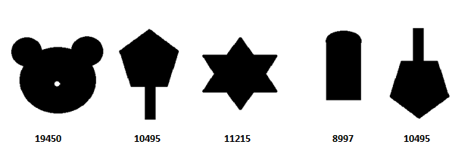
Shape
The shape of the mouse cursor does not normally change, so again when using the shape feature and the mouse to control input we must mean some feature or set of features that can be represented by mouse positions. A complicating factor is that shape, as a feature, is a quite complex thing. Here are some shapes:

Slide 14
Shape
How could each shape be characterized using some simple collection of values? It’s a very hard problem. Even simply deciding whether two shapes are the same can be hard. In the image above, the second and the final shapes are really the same. This is obvious to most human viewers, but it would requite a complex computer program to determine that fact.
So, what could we mean when we suggest that we want the mouse input to reflect shape? The first idea is to determine which shape the mouse is over top of. The implication is that there would be a small set of shapes that are possible, and the program simply has to determine which shape is involved.

Slide 15
Orientation
Direction has been defined to mean the direction of motion. Orientation could be defined as the direction something is facing.
The implication is that the object has a preferred side that defines its front side.
An example is a tuning knob as you might find on a console radio. Another, more modern, example us the direction that an avatar is facing in a computer game. The orientation of the avatar dictates which parts of the game are visible. For an example that is easy to code the tuning know will do.

Slide 16
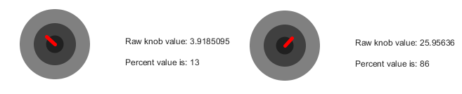
Orientation

Slide 17
Count
How many?
Here we are talking about how many of something there are. How many of what? Anything, really. We could count mouse clicks or screen touches.

Slide 18
Distance
Distance can be measured in many specific ways, but it always refers to how far away something is from you or how far apart two things are from each other.
Let’s use an example that has a fixed point at the center of the drawing area and changes something as a function of the distance of the mouse from that point, perhaps the size of a circle. Again, this is simply an example, and many aspects of an artwork could be modified using the same scheme.

Slide 19
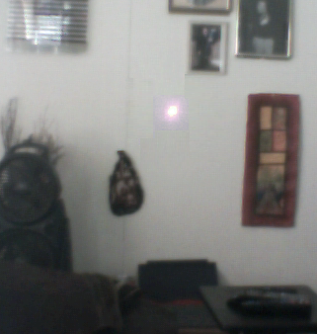
Using the Camera - Vision
Position
When using position as input in a general sense, a key question is “the position of what”? The idea would be to identify something in the scene that will be located, and its position used to control some aspect of a work. It is quite difficult to recognize general objects in an image. It’s always a good idea to keep things as simple as possible. As a first example we’ll not be identifying cows or trees or furniture, but something very simple and obvious. We will locate the spot made by a laser pointer and use it to draw lines in the drawing area.

Slide 20
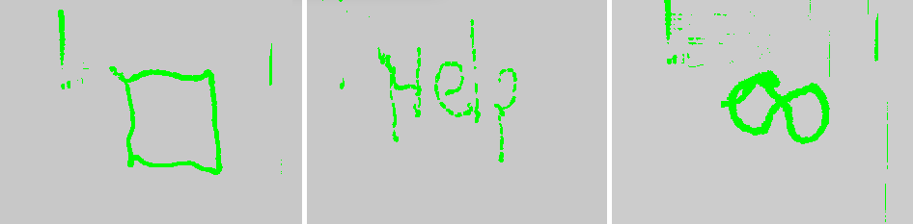
Position of a laser spot

Slide 21
Speed and Direction
Measuring spend and direction both involve first finding a position, so we may as well describe both things in one section. With a deeper understanding of the process based on having done an example already (the laser pointer) let’s do something more complex and practical. Let’s use the position of a human face or hand or other flesh toned area as the basis for the input.

Slide 22
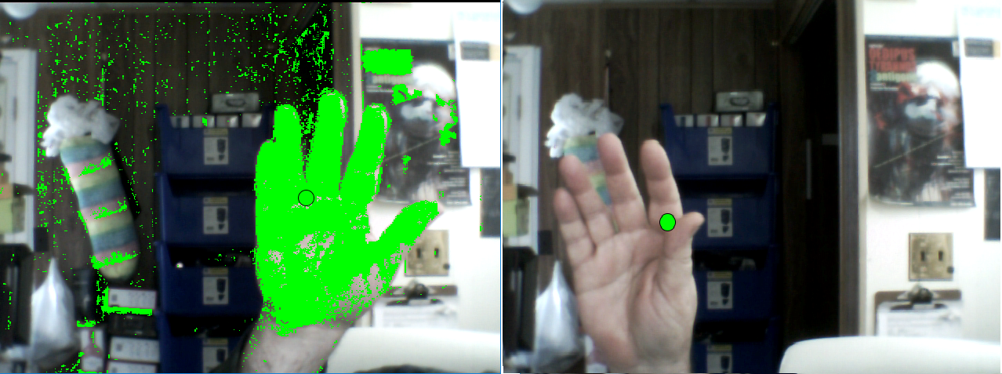

Slide 23
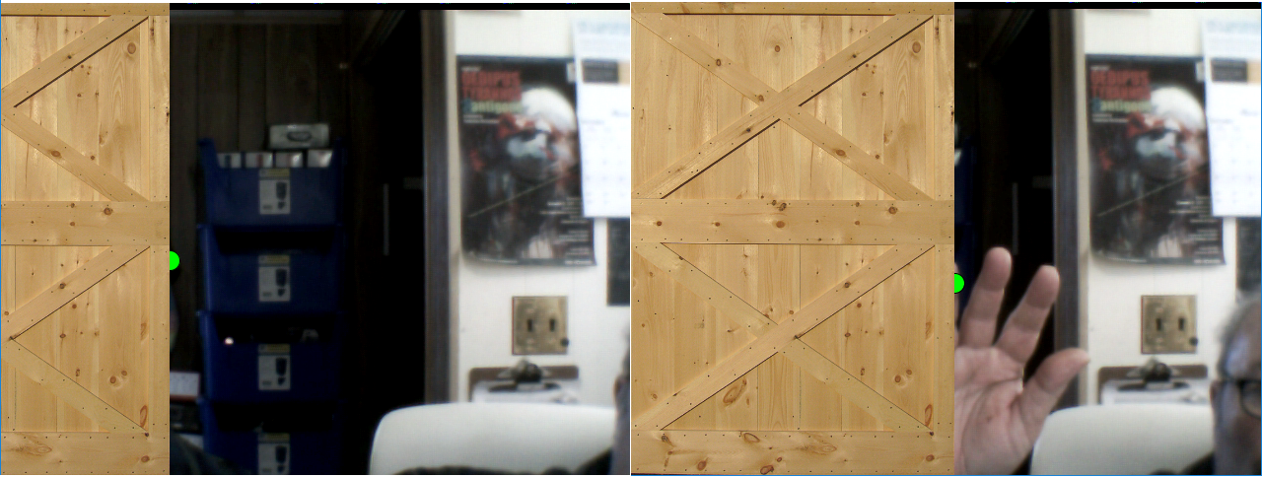
Position

Slide 24
Color
Imagine using a cell phone or PC camera to take pictures which would then be analyzed for color content. Some aspect of the colors in the image could be used to modify an art work. This sort of thing was described in Chapter 1, where the colors in an image were used to create fireworks having the same dominant colors.

Slide 25
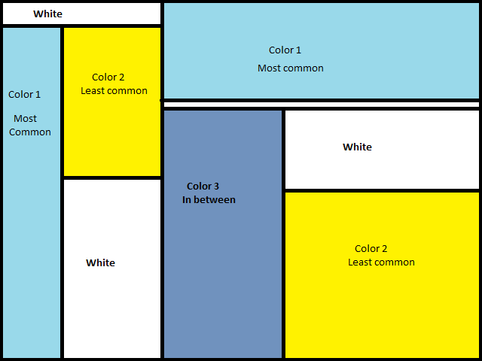
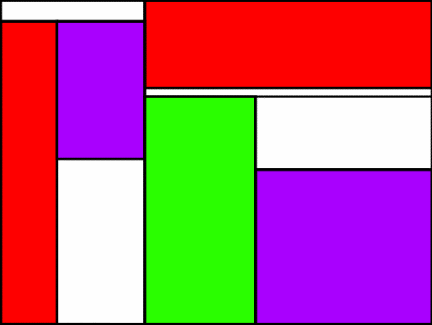
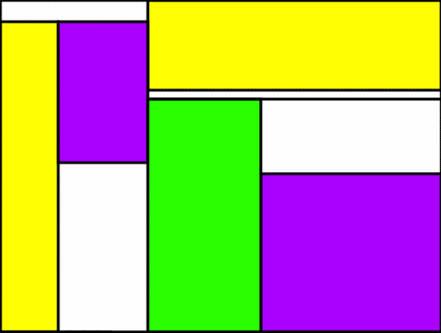

Slide 26
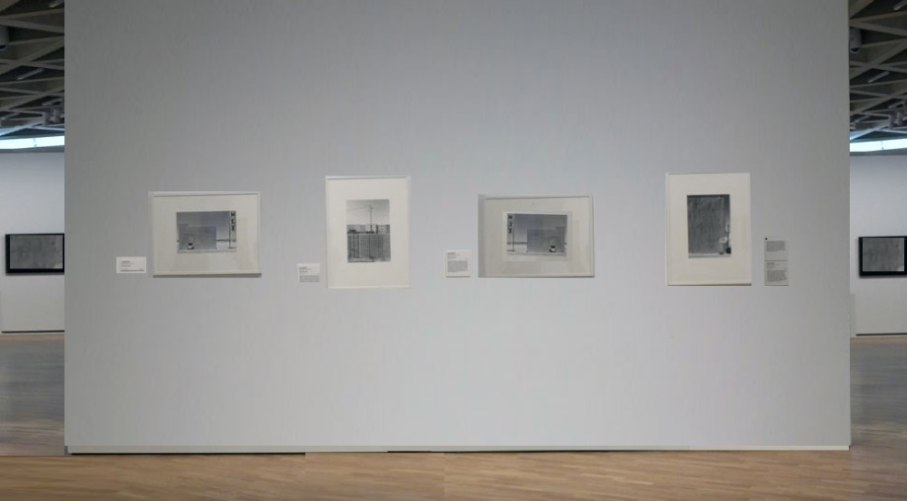
Shape

Slide 27
