Slide 1
Generative art
L19
Dr. J Parker

Slide 2
Do you have to be a programmer?
No.
But it does help.

Slide 3
Do you have to be a programmer?
No.
But it does help.

Slide 4
Do you have to be a programmer?
X
X
Photoshop, Paint, Gimp – Image creation and editing tools. (not really)
AI software – artist simulation tools
Processing, PyGame – Programming tools for generative art. (fully)

Slide 5
Here’s the thing.
Can a computer be an artist?
No.
A computer can render images.
It can save them, display them.
It can’t communicate human feelings.

Slide 6
Here’s the thing.
Generative art is the art of the algorithm.
A human decides what the artwork is to be, what it is to communicate, and how. That is the algorithm.
If someone simply uses a computer to draw, that’s not generative.

Slide 7
Here’s the thing.
Generative art is the art of the algorithm.
If a human simply chooses two images to ‘merge’, that’s not generative.
If a human tells the computer to make a picture, that’s not generative.

Slide 8
AI Art is not generative.
Generative art MUST have a human component that contributes to the mix.
Ideally, the creative impetus is provided by the human. An AI does not know what it is like to be human, to know fear or hate.
It knows how to follow a set of general rules that can render images. It is more independent than most generative methods.

Slide 9

Machine Learning

Slide 10
Playcanvas
An HTML5 interactive code generator.

Slide 11
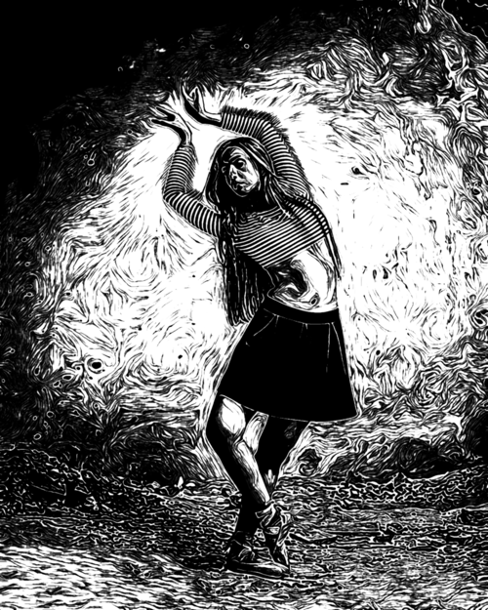
Inkwork
Inkwork instantly transforms your photos into unique and expressive ink drawings.
https://www.codeorgana.com/inkwork

Slide 12
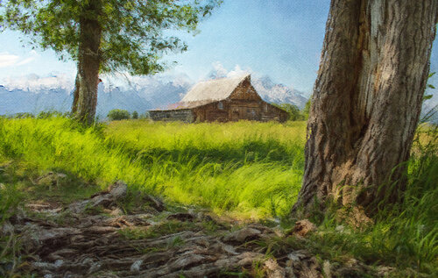
Brushstroke
Transforms your photos and videos into beautiful paintings in one touch.
https://www.codeorgana.com/brushstroke

Slide 13
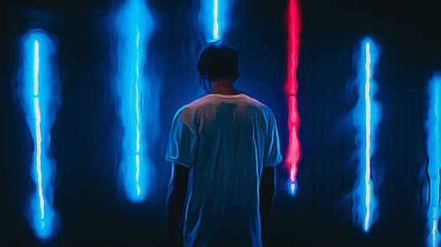
Animatix
Turns your photos into captivating animations and cartoons. It uses real-world animation techniques to breathe life into your still photos, adding motion that makes their edges and color come alive. https://www.codeorgana.com/animatix

Slide 14
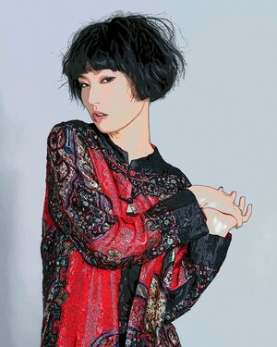
Toon Camera
Turns your world into a live cartoon
https://www.codeorgana.com/tooncamera

Slide 15
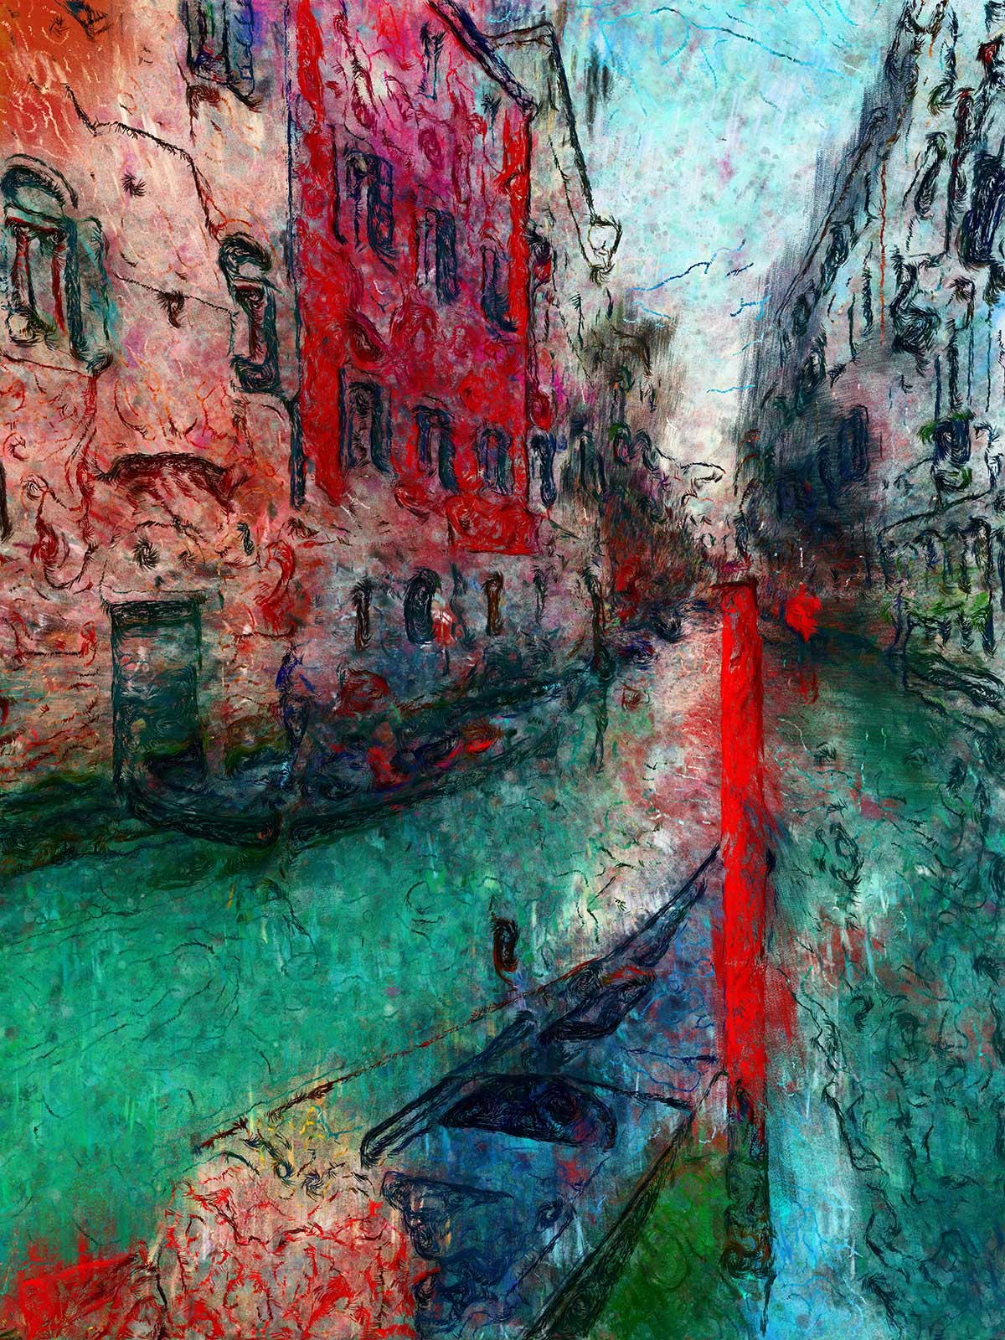
Oilist
Give Oilist an image and it will automatically generate a genuine and unique work of art based on it. Painted for you in real time! Participate or spectate, it’s up to you.
http://3dtopo.com/

Slide 16
Generative Art
Generative art is that it is not a movement or a style.
A style would permit a positive assessment of a work as belonging or not to a particular class or genre on inspection. It would involve visual elements, for example, and characteristic image transformations that would allow works to be classified. Styles are often distinctive and recognizable, although in some instances the distinctions can be subtle.
Cubism, for example, can be identified with some reliability, and even has some fairly clear properties that can be used to define it: the use of multiple views of a subject simultaneously in a single rendering, for instance.

Slide 17
Generative Art
Fauvism, as another example, is characterized by the fact that color is used as a compositional element independent of objects in the scene, at least independent of its representational role, and uses simple forms and saturated colors.
However, generative art can’t be identified easily by its colors, lines, shapes, or viewpoints. It is characterized largely by how it is made.

Slide 18
Generative Art
Generative art can be thought of as constructivist.
Constructivist art was about how materials behaved. How is plastic different from steel, and glass distinct from stone? In constructivism, the form taken by an artwork is defined by its materials, and not the reverse.

Slide 19
Generative Art
Generative art can be thought of as constructivist.
Constructivist art was about how materials behaved. How is plastic different from steel, and glass distinct from stone? In constructivism, the form taken by an artwork is defined by its materials, and not the reverse.
An artist often takes materials like oil and tints and creates painted renderings, transforming the raw material into a painting or drawing or sculpture.

Slide 20
Generative art uses a computer as an enabling technology.
It is not the automatic creation of art by computer, but is a way for the artist to create meta-art.
An artist will describe the work to be created as a product of their imagination, and then instruct the computer on how to build it. Thus, any style of art can be created. Generative art defines how.

Slide 21
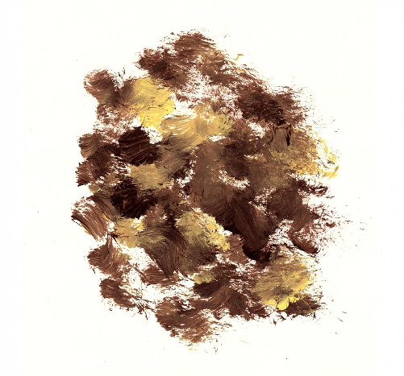
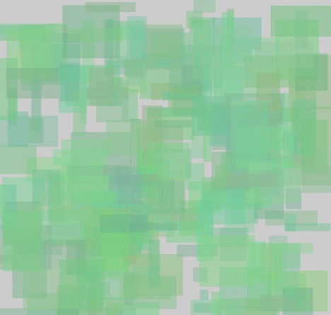
Generative art uses a computer as an enabling technology.
Which one is a painting and which is generative? The style of the work does not always betray the method by which it was constructed.

Slide 22
Roger Ebert
“I do not believe collaborative art cannot be art. I cite cathedrals and tribal dances as collaborative works of art. But they begin with an auteur with an original vision -- whether that be a king, an architect, or a choreographer. The film director usually has the original vision.

Slide 23
Roger Ebert
Bah

Slide 24
A generative artist is a computer programmer.
At least he or she has some of the skills that a programmer has, including the ability to express their intentions in a computer language to at least some degree, to be able to communicate with other programmers using their particular patois, to be able to use typical computer interfaces, and to fathom the advantages and limitations of computer and digital representations for their art form.

Slide 25
A generative artist is a computer programmer.
This places a generative artist in the same general category as a practicing physicist, archaeologist, sociologist, or generally any profession in the 21st century.
All use computers, and all will be at the whim of some other programmer somewhere if all they do is operate predefined software tools like Photoshop or Final Cut.

Slide 26
A generative artist has a visual concept
Math is a different tool, and an exceptionally valuable one too. It is true that computers represent everything manipulated by them as numbers, and this means that a programmer does need to be able to identify numerical representations for everyday things like sounds and colors. There is a clear difference between numbers and mathematics, though, and the level of math needed to be a programmer is not as advanced as many people believe.
A knowledge of calculus, for example, is relatively rare even amongst programmers unless their University degree required it. It is uncommon to need such math while developing a typical program. Some algebra is very useful, and most high school graduates have some. More about that later but suffice to say that the level of proficiency in algebra required to be a programmer is minimal. One simply needs to understand the use of names in place of numbers and the generality of an algebraic expression.

Slide 27
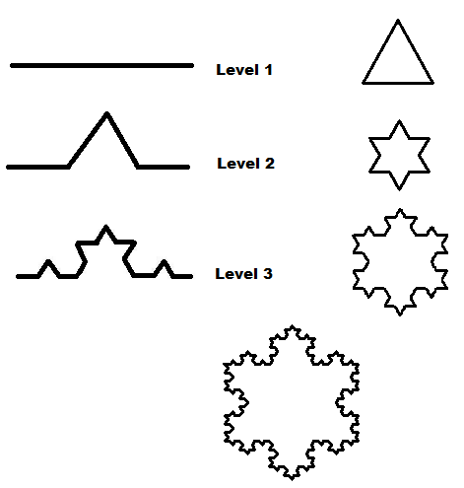
Mathematics.
As an obvious example of mathematics being used in art, consider the case of fractals.
A fractal has been described as "a rough or fragmented geometric shape that can be split into parts, each of which is (at least approximately) a reduced-size copy of the whole
The simplest example is something called the Koch snowflake, which begins as an equilateral (all three sides equal in length) triangle. Now on each existing edge add an equilateral triangle in the center with sides 1/3 as long as the original edge and pointing outwards. Now do it again, and again. Forever.

Slide 28
A generative artist has a visual concept
Rather than painting or drawing it, they describe it to a computer.
The description begins as a general idea and is probably expanded using sketches. It then must be converted into a sequence of operations that a computer can perform, a step-by-step description of the process leading to the creation of the conceived image.
The need to describe the artwork in great detail distinguishes a generative artist from others. A painter describes their work by painting it.
The final generative artwork is the result of the generative artist’s vision, and the description stage is equivalent to the painting or drawing that another form of artist would do. Visual artists all start with a vision, and the next step labels them as one sort of artist or another.

Slide 29
Basic Principles of Generative Art
Generative art is the art of the algorithm. The artist must define how the work is constructed, in careful and very specific terms. The description can include a random component, but one that has been designed into the algorithm so as to enhance some aspect of the work, rather than to have the machine ‘create’ something. In other words, the randomness must be very specifically applied to some aspects of the creation of the work.

Slide 30
Basic Principles of Generative Art
2. The machine (computer) is relegated to the role of renderer, not creator. The artwork is defined well enough by the artist that their view is the one being visualized.

Slide 31
Basic Principles of Generative Art
3. The computer is used as a tool, but in such a way that there is a programmable element. This precludes drawing made using Paint or Illustrator or Photoshop from being classed as generative.

Slide 32
Basic Principles of Generative Art
4. Generative art can be interactive (responsive to the viewer) and/or dynamic (changing with time) but does not have to be.

Slide 33
Basic Principles of Generative Art
5. Randomness in a generative work is under the control of the artist. The ultimate work is not completely random but can use randomness (as is the case in reality) to make variations in the rendering. No two drawings by the same artist are the same, but they have similar characteristics.

Slide 34
Basic Principles of Generative Art
6. Two artists may have the same idea in mind, but their algorithms may differ in places so that the results differ too. Both may be satisfied with the result, even though the visual result differs.

Slide 35
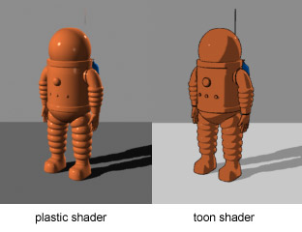
Design
Artists sometimes spend a great deal of time working out how their painting or drawing will be laid out on the paper. They will draw sketches with the elements of the piece put in different places or seen from different perspectives. When they are happy with the result the final work can be started. This is a design phase, called a study in the art community. Not all artworks and artists do this, but for generative art it is an absolute necessity.

Slide 36
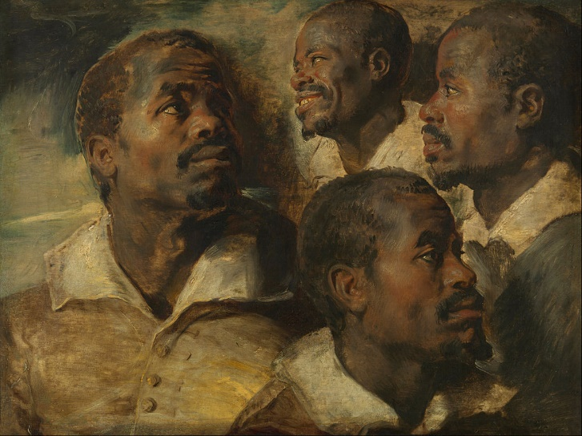
An example of a study (Rubens, Four Studies of a Head of a Moor)

Slide 37

Draw a set of lines emanating from a single point that are 2 degrees apart and where each line is a small amount longer than the previous one.

Slide 38
This description is not unambiguous.
The number of lines to be drawn is unspecified
The initial line length is unspecified.
Is the angle changing in a clockwise or counter-
clockwise direction?
What are the foreground (line) and background colors?
What are the coordinates of the lines’ common point?

Slide 39
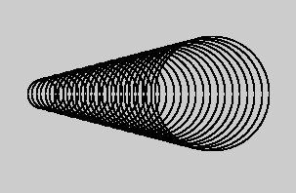
Draw a set of circles of increasing radius where the center points differ by 6 units in a horizontal direction.

Slide 40
Again, there are many ways this could be drawn from this description.
What is the initial center and radius, how much does the radius increase each time?

Slide 41
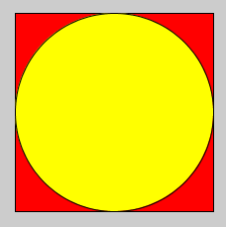
Draw a red square and then a yellow circle so that the two shapes share a center point and the circle touches the square in four places.

Slide 42
How big should the square/circle be? Where located in the drawing area?

Slide 43
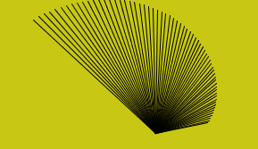
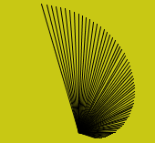
When writing a program to draw something the image needs to be described in great detail.
This is not true of drawing and painting using other media.

Slide 44
How to Start A Generative Artwork
“I have a detailed image in my mind.”
In this case the artist knows what they want to create. It could be something as simple as a still life or landscape, or it could be abstract. But they have a picture in their head that they wish to put on paper (or the screen
The artist must therefore devise a method (algorithm) for rendering the scene the way it is imagined.

Slide 45
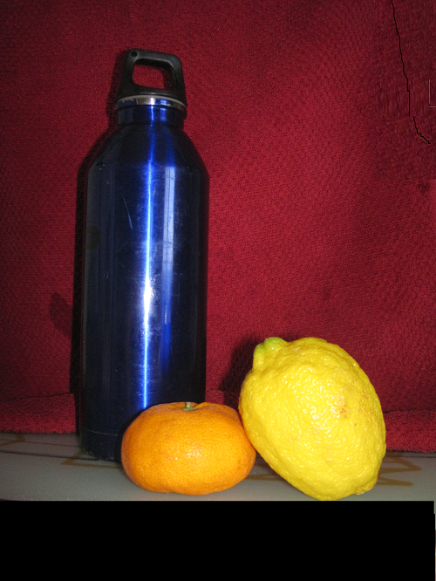
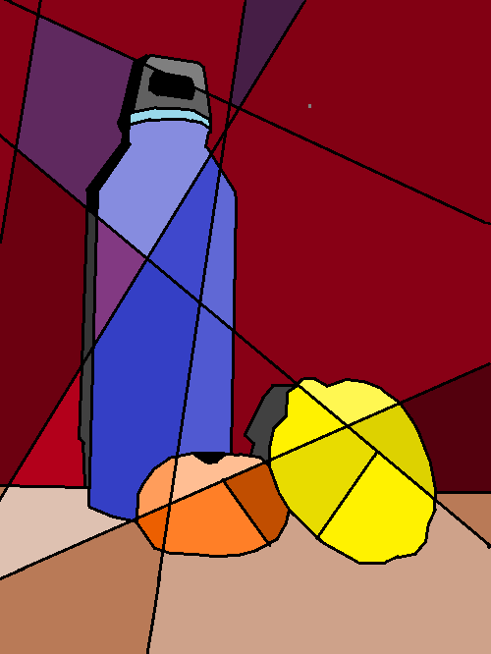
The cubist-style piece in here was done by first sketching the scene and then dividing the sketch into polygonal regions. Each polygon was thin filled with a color similar to that seen in the scene

Slide 46
How to Start A Generative Artwork
“I have and actual image and wish to change it or use it”
This process is more common than the previous one. Working with actual images (photographs) involves a standard set of techniques.
Think of these as transformations, in which image elements are modified systematically to produce new visual effects. An example would be to take an image of, say, a sunflower and try to make it look as if it has been painted by an impressionist.

Slide 47
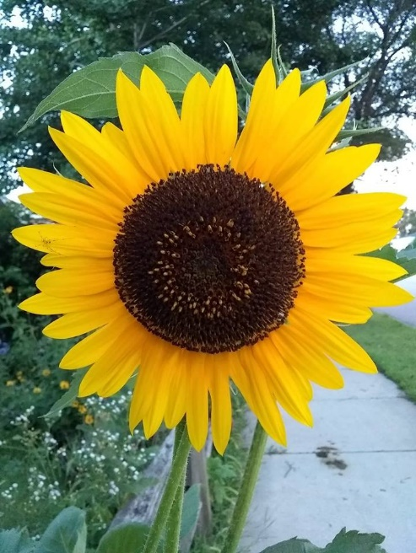
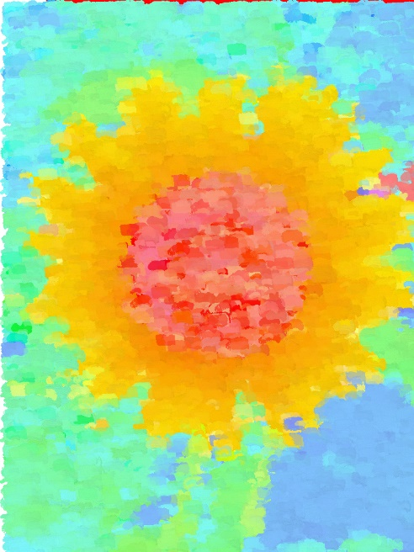

Slide 48
“I wonder what would happen if …
“This is the domain of educated speculation. Artists with a good imagination and a grasp of algorithms and representation can visualize geometries and colors that would be difficult to paint or draw, but that have an instantiation in a digital space. Sometimes an idea works, sometimes it does not.
This is where generative art shines. A computer permits someone (an artist) to make mistakes, fix them, and try again many times an hour. The first idea may not be a winner but being able to see what it looks like and then being able to change it in a few minutes and try again makes it possible to force an idea into success.

Slide 49

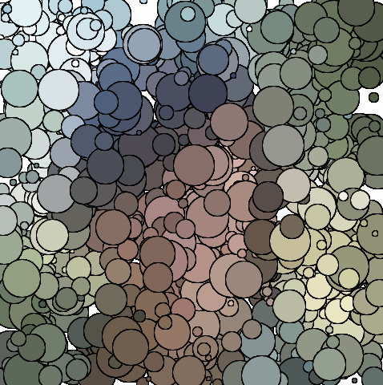
Consider: what would an image be like if each point on an image were replaced with a circle that was filled with a color that was the average of the colors within that circle? Sounds interesting.

Slide 50
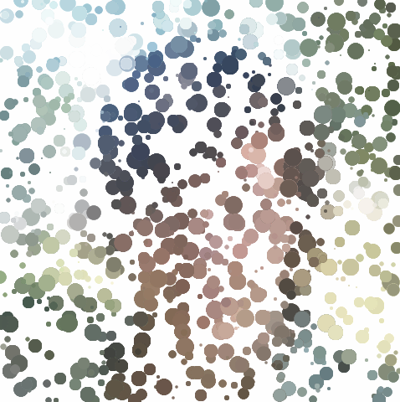
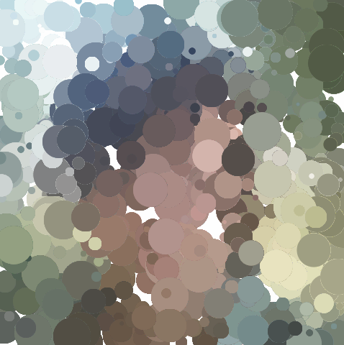
Better. But perhaps the circles are too large? Let’s make them smaller - these are between 5 and 55 units in radius.
OK, perhaps when the circles get smaller we should have more of them. Right now there are 1000. Let’s try 9000:

Slide 51
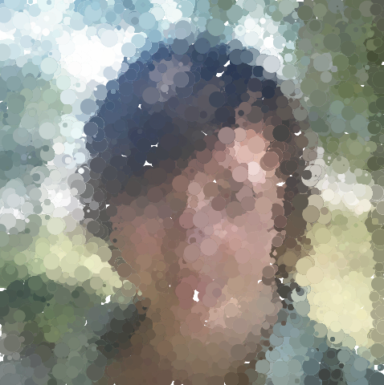
OK, perhaps when the circles get smaller we should have more of them. Right now there are 1000. Let’s try 9000. There are a few white (unpainted) regions. Increasing the number of circles to 20000 will solve this problem in many cases but takes more time.
If using 20000 circles does not work, simply run the program again. It may work this time. Things here have a random aspect.

Slide 52
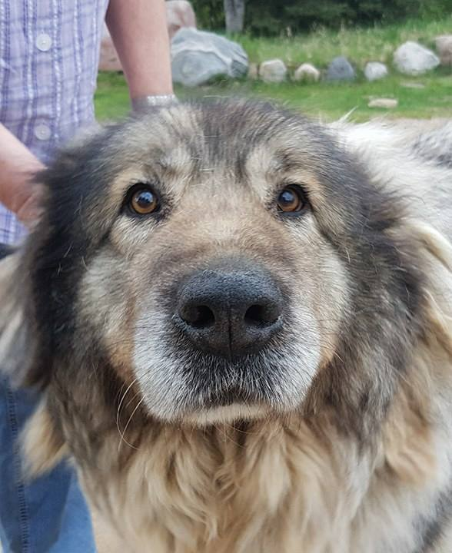
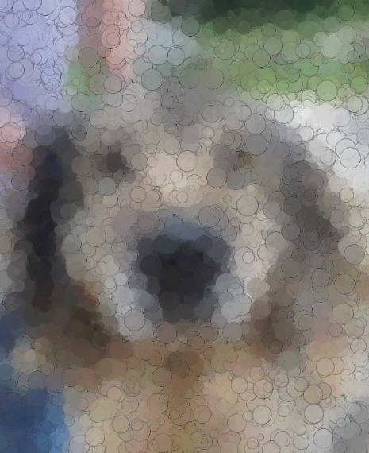

Slide 53
“Make a static image into something dynamic.”
This is a variation on #2, but in a new dimension not yet explored: time.
A motion picture or animation consists of multiple still images (called frames) that are displayed in rapid succession. The concept is called persistence of vision and refers to the fact that an image stays in our perception for a brief moment after it is no longer there.
A good deal of generative art is dynamic, or animated, or reactive. In particular, we can take a single still image and make it more dynamic by adding things to it or manipulating elements of the image with time.

Slide 54
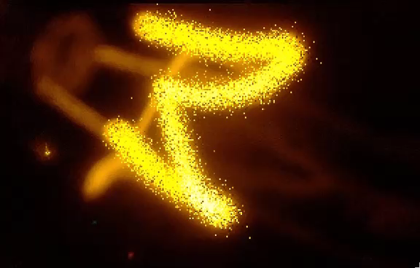
“Make a static image into something dynamic.”

Slide 55
“Allow the viewer to contribute.”
There are many ways for a viewer to contribute to a work, some more intentional than others.
Obviously, buttons and sliders, mouse motions and keyboard inputs are standard inputs to a computer and offer the user very intentional and obvious choices.
Drawing a line with the mouse, clicking on an object, controlling motion with a key press – these are standard interface methods these days.

Slide 56
“Allow the viewer to contribute.”
What about using the motion of the user to direct a visual or auditory activity?
Using the speed or position of bodies or parts, the number of people in the room or the colors of their clothing are only some ways that the audience can become essentially a part of the work.
The originality and effectiveness of the ideas an artist uses for this means the different between something that is ordinary and something that is exciting.

Slide 57
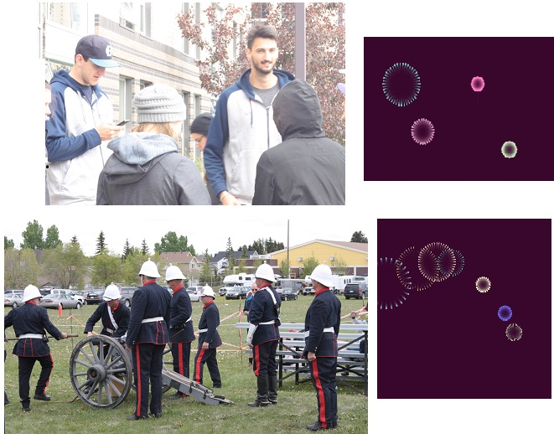
Consider a piece that draws simulated fireworks. It looks at the audience using a camera, identifies how many people appear to be in the scene, and then uses that number to create the same number of fireworks in the display. It may be a little while before people notice what is happening, but they will eventually

Slide 58
Merge different forms, such as sound and pictures
Sound is like animation, in the sense that it is time dependent. To be glib, if there were no such thing as time then all of the musical notes would happen at once.
An image can be the inspiration for sound, or it can be an interface for sound creation, or it can simply be a vehicle.
People are wearing colored clothing, and those colors dictate the colors used in a graphic. Why not have them also dictate sounds as well? Certain color ranges could, for example, correspond to certain musical notes. Each note is the foundation for a scale, and notes on a particular scale are known to ‘go together’, as it were.

