Slide 1
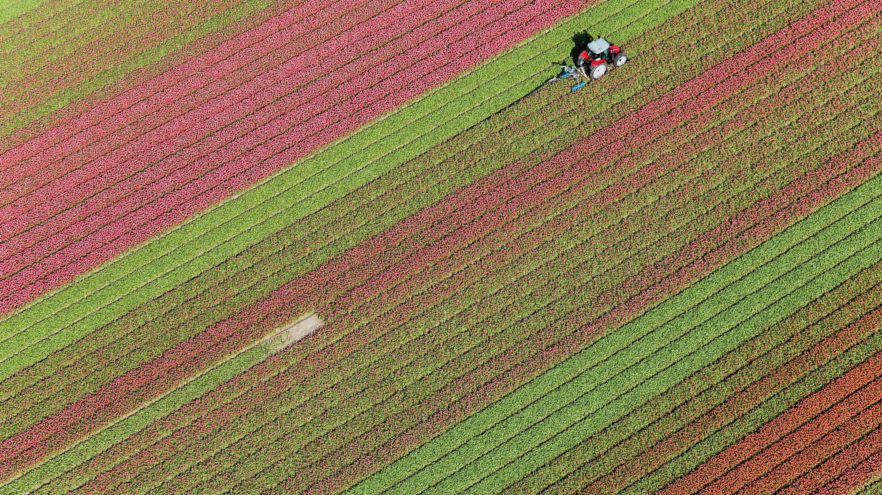
Art 311 – Generative Art
Dr. J Parker

Slide 2
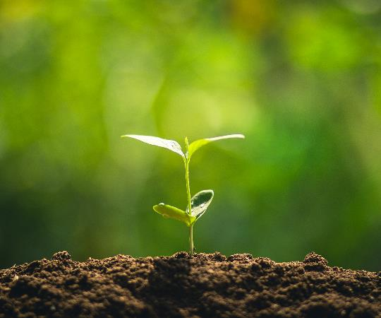
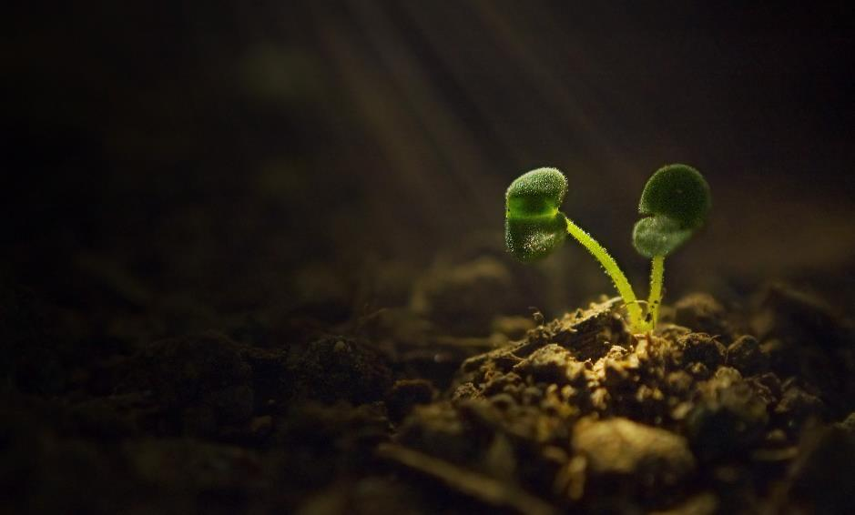
We have seen examples of generative art
Art made by a computer but designed by an artist.
What you have seen in one type – visual, created by code.
Could be made by a robot. Electro-mechanical devices. Etc.
Key element - algorithm

Slide 3
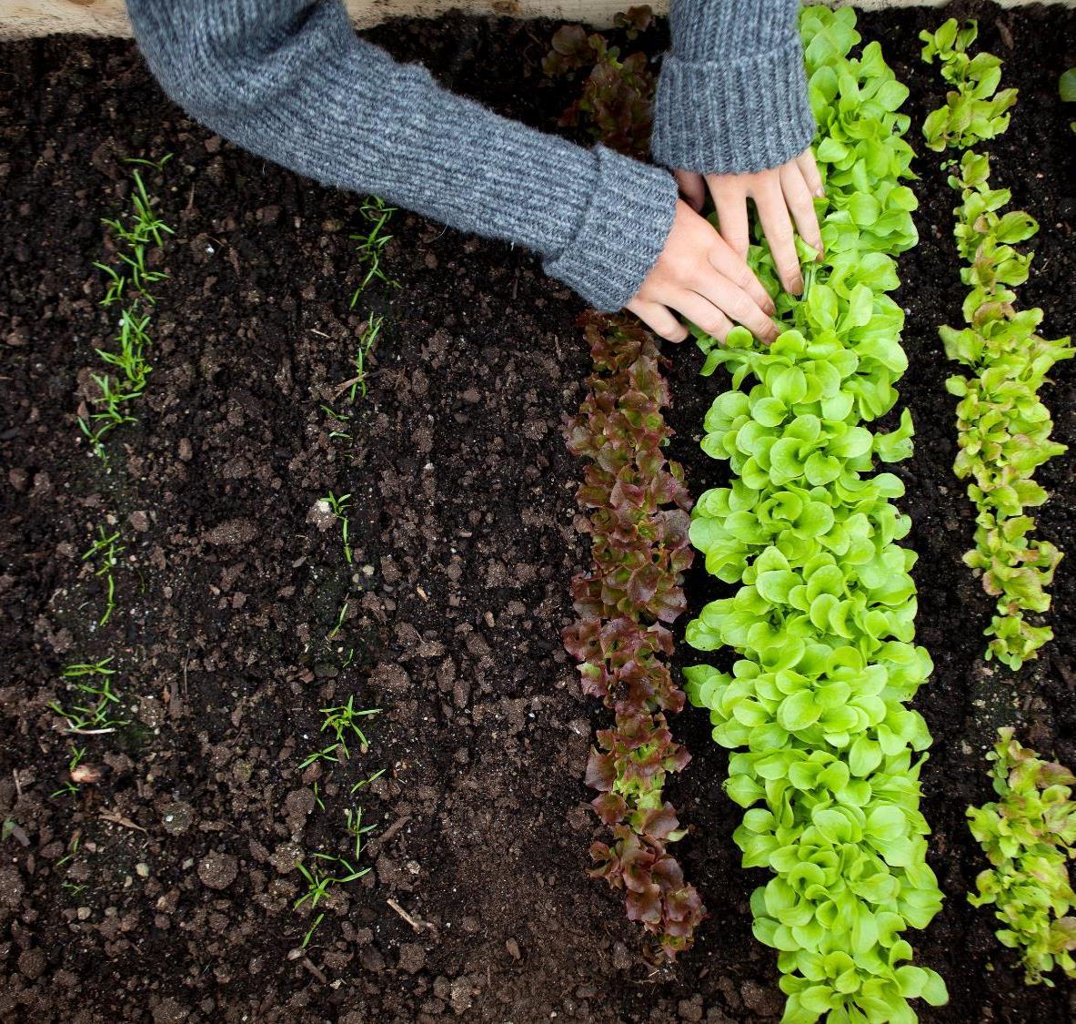
The art of the Algorithm

Slide 4
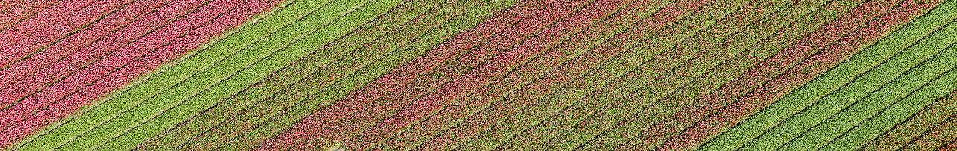
Algorithm
A step by step process for accomplishing a specific task.
NO steps left out, no room for interpretation
BUT
Random elements can be introduced

Slide 5
Algorithm
Find the smallest element in a list of numbers:
7 2 9 5 1 6
Let the smallest be the first value (in this case 7)
Is the 2nd value smaller? If so, let smallest equal this value (in this case 2)

Slide 6
Algorithm
Find the smallest element in a list of numbers:
7 2 9 5 1 6
Is the 3rd value smaller? No (it is 9)
Is the 4th value smaller? No (it is 5)

Slide 7
Algorithm
Find the smallest element in a list of numbers:
7 2 9 5 1 6
Is the 5th value smaller? Yes. If so, let smallest equal this value (in this case 1)

Slide 8
Algorithm
Find the smallest element in a list of numbers:
7 2 9 5 1 6
Is the 6th value smaller? No.
Is the 7th value smaller? There is NO 7th, so we are done. Smallest is 1.

Slide 9
Draw a square
From a point some where in the upper left of the page, draw a horizontal line to the right of length w/4 where w is the width of the page.
From there, draw a line down the wage of length w/2.
From there draw a horizontal line to the left of length w/2
From there draw a line up the page of length w/2

Slide 10
Randomness
No two painters paint in exactly the same way, and so no one subject will be rendered identically by two different artists. This is a natural and expected characteristic of art. Indeed, no two paintings of the same subject by the same artist will be identical.

Slide 11
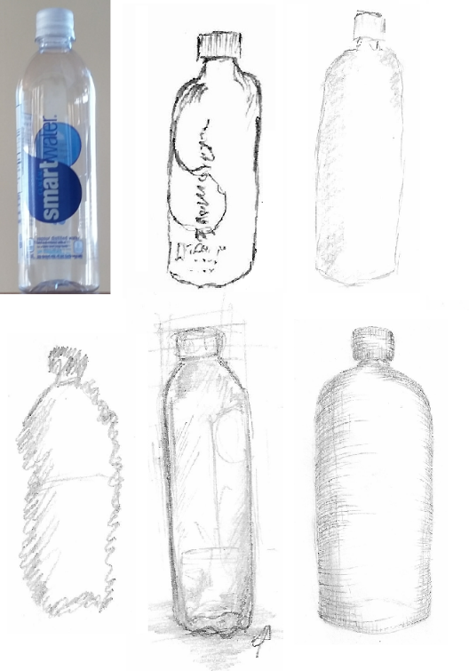
Each object in the sketch represents the same actual object, but looks very different. The goal of an artistic rendering is usually not the faithful recording of a scene, which is the domain of illustration.
It is to convey the idea of a scene or object as perceived or interpreted by the artist. It is to communicate emotion rather than data, feeling rather than logic.

Slide 12
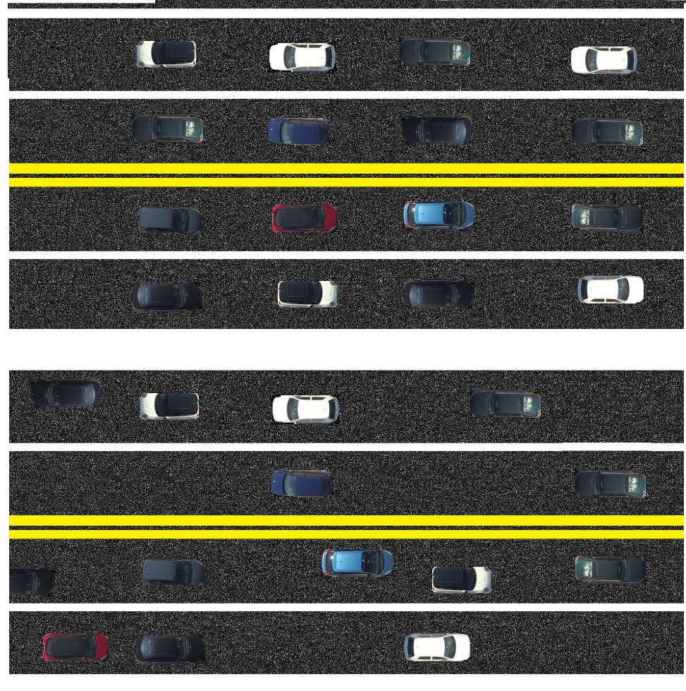
The real world is an incredibly complex place full of events that are related to each other, but we rarely know what those relationships are. As a result, a lot of the world seems random.

Slide 13
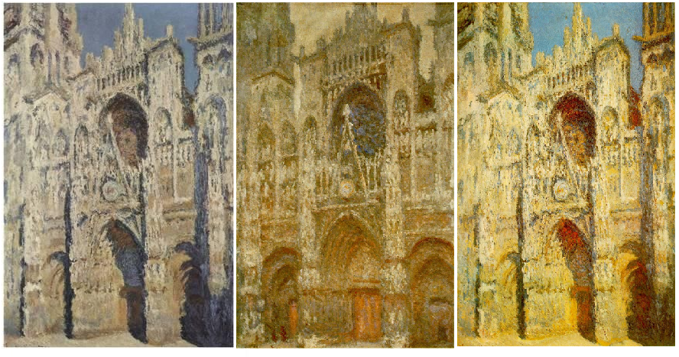
The Rouen Cathedral by Monet
He painted 30 canvases in which the subject was the same church in Rouen, Normandy, at different times of day and different lighting, but from the same point.

Slide 14
Random
For something to be random it must be unpredictable. There are degrees of randomness as well. The weather is only partly predictable, for example. The exact time of the arrival of the letter carrier at your door is unpredictable, although it is probably known approximately. So it is with art. There are many aspects of art that are unpredictable to a greater or lesser extent, and that unpredictability is often due to the fundamental unpredictability of humans themselves.

Slide 15
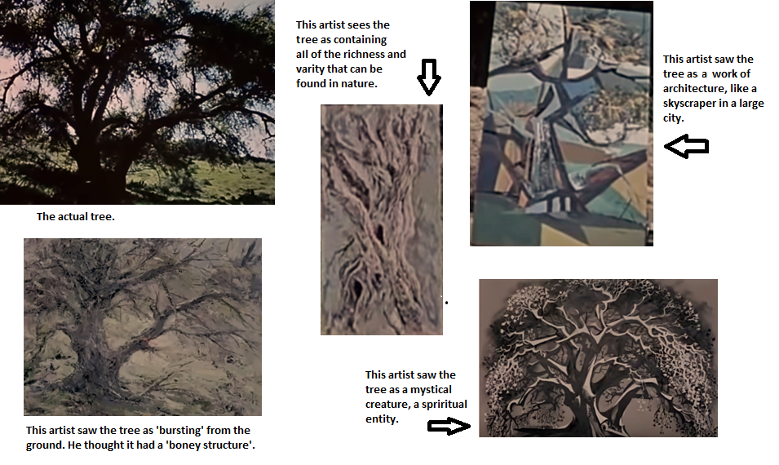
Four Artists Draw the Same Tree

Slide 16
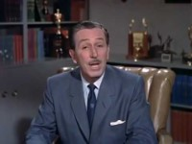
Four Artists

Slide 17
Random
For something to be random it must be unpredictable. There are degrees of randomness as well. The weather is only partly predictable, for example. The exact time of the arrival of the letter carrier at your door is unpredictable, although it is probably known approximately. So it is with art. There are many aspects of art that are unpredictable to a greater or lesser extent, and that unpredictability is often due to the fundamental unpredictability of humans themselves.

Slide 18
Randomness
Things are only random with respect to a standard or each other.
We cannot know if the number 3 is random. That question has no meaning.
We can ask if the sequence of numbers “3 6 3 1 9 6 6 3 0 5” is random because now there is a context: 10 digits drawn from a set of 10.

Slide 19
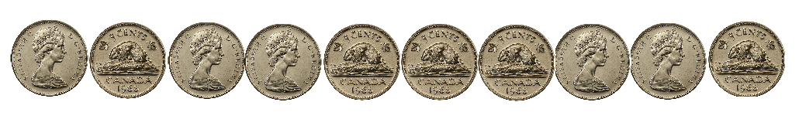
Randomess
One way that numbers could be tested for randomness is to use them to create known random situations and see if the result makes sense. For the sequence above, we could say that a number less than 5 represents a coin toss of ‘heads’, and the digits 5-9 represent a toss of ‘tails’. In that case we have:
3 6 3 1 9 6 6 3 0 5
H T H H T T T H H T

Slide 20
Randomness
How does this help us?
Let’s start small. Use random numbers to toss one coin, and do it a million times. Computers can do that.
We should get about 500000 heads and 500000 tails.

Slide 21
Timeline
We got 500034 heads and 499966 tails.
Is that close enough? 34 ‘errors’.
34/1000000 is 0.0034%. Pretty good. WE get to decide how good it has to be.
For art, a non-critical application, a few % is fine.
For gambling or medical applications we could demand .1% or better.

Slide 22
Randomness
FYI, here is the program:
int heads=0, tails=0;
for (int i=0; i<1000000; i++)
{
if (random(100)<50) heads = heads + 1;
else tails = tails + 1;
}
println (heads, tails);

Slide 23
Randomness
One run is not really good enough.
We could do 10 runs and average the results.
We get:
499544 500456 500151 499849 500056 499944 500331 499669 499843 500157
500243 499757 500216 499784 500119 499881 499803 500197 499634 500366
Final:
499994 500006 Down to 6 in 1 million.

Slide 24
Randomness
int heads=0, tails=0;
int h=0, t=0;
for (int k=0; k<10; k++)
{
for (int i=0; i<10000000; i++)
{
if (random(100)<50) heads = heads + 1;
else tails = tails + 1;
}
println (heads, tails);
h = h + heads; t = t+tails;
heads = 0; tails = 0;
}
println (h/10, " ", t/10);

Slide 25
Randomness
Basically, just use the random numbers to create something whose probabilities are known.
Dice
Poker hands (the poker test)
Roulette
Etc.

Slide 26
Timeline
Title
Title
If you don’t see the Notes pane or it is completely minimized, click Notes on the task bar across the bottom of the PowerPoint window.
To display Presenter view, in Slide Show view, on the control bar at the bottom left select the three dots, and then Show Presenter View.
Title
During your presentation, the speaker notes are visible on your monitor, but aren't visible to the audience.
To start a presentation, go to the Slide Show tab, and select From Beginning.
The Notes pane is a box that appears below each slide. Tap it to add notes.

Slide 27
Random Number Generation
A computer can’t flip a coin. How can it create ‘random’ numbers?
Remember, unpredictability is what we are after. So here’s a question: what is the 2nd last digit of 20973/26? Unless you do the division, it is hard to predict (It’s 0).

Slide 28
Random Number Generation
The commonly accepted method for many years was the multiplicative congruential method. The formula is:
X_{n+1} = (aX_{n} + c) mod m
where a, c, and m are specified.

Slide 29
Random Number Generation
This means that the next random number is the current one multiplied by a and added to c; then divide by m and use the remainder. The values of a, c, and m are important, and good values are:
a = 1664525
c = 1013904223
m = 2³²
We know ways to determine whether a, c, and m are ‘good’ for this.

Slide 30
Let’s start with X₀ = 19823. Then the next 5 values are:
X₁ = (aX₀ + c) = (1664525*19823+ 101390422) mod (2³²) = 3945012226
X₂ = (aX₁ + c) = (1664525*3945012226+ 101390422) mod (2³²) = 1285499769
X₃ = (aX₂ + c) = (1664525*1285499769+ 101390422) mod (2³²) = 3399966340
X₄ = (aX₃+ c) = (1664525*3399966340+ 101390422) mod (2³²) = 1903908883
X₅ = (aX₄+ c) = (1664525*1903908883+ 101390422) mod (2³²) = 3198484054

Slide 31
These may be random, but don’t look very useful right now. But remember: they all will be smaller than M, so dividing them by M will result in a number between 0 and 1, not including 1:
X₁ = 3945012226 -> 0.918519735801965
X₂ = 1285499769 -> 0.299303738633170
X₃ = 3399966340 -> 0.791616351343691
X₄ = 1903908883 -> 0.443288330687209
X₅ = 3198484054 -> 0.744705101009458

Slide 32
A number between 0 and 1 is quite useful. For example, flipping a coin means HEADS is a n umber less than 0.5, and TAILS can be any number >= 0.5. When we test these random numbers by using coin flips we get 499963 heads and 500037 tails in a million flips. That’s pretty good.
Want to roll a die? Take random number X and computer y = X*6; if y<1 then the roll is a 1; if y is between 1 and 2 the roll is a 2; and so on.

Slide 33
Random Elements in Art
Random Element #1 - The Artist’s Physical Location
The physical loc ation that an artist selects for viewing their subject is referred to as the point of view.
The location of the artist in the scene is defined by the artist as the viewpoint they like best; as such it is unpredictable, and so is a random parameter of the work.

Slide 34
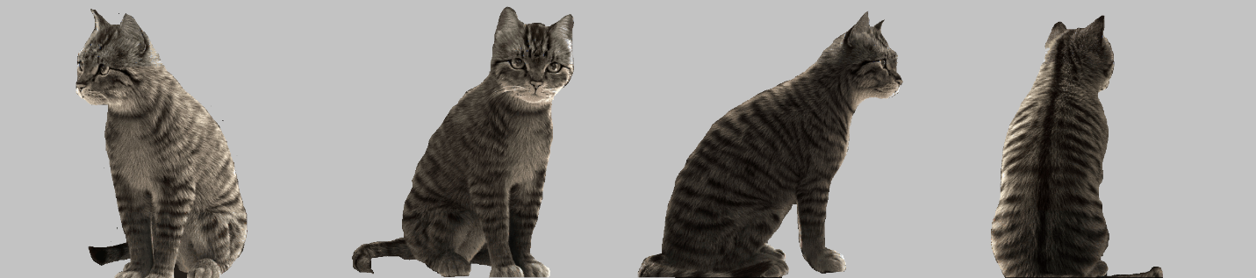

Slide 35
Of course, the cubists some of that Cubists sometimes drew or painted objects unfolded from 3D to 2D, painting one view over or next to another instead of using the third dimension in a traditional manner. Multiple views of an object can be seen at the same time.
Distance could be represented as colors as opposed to as size changes: reds and browns for foreground objects, and blues for the background.

Slide 36
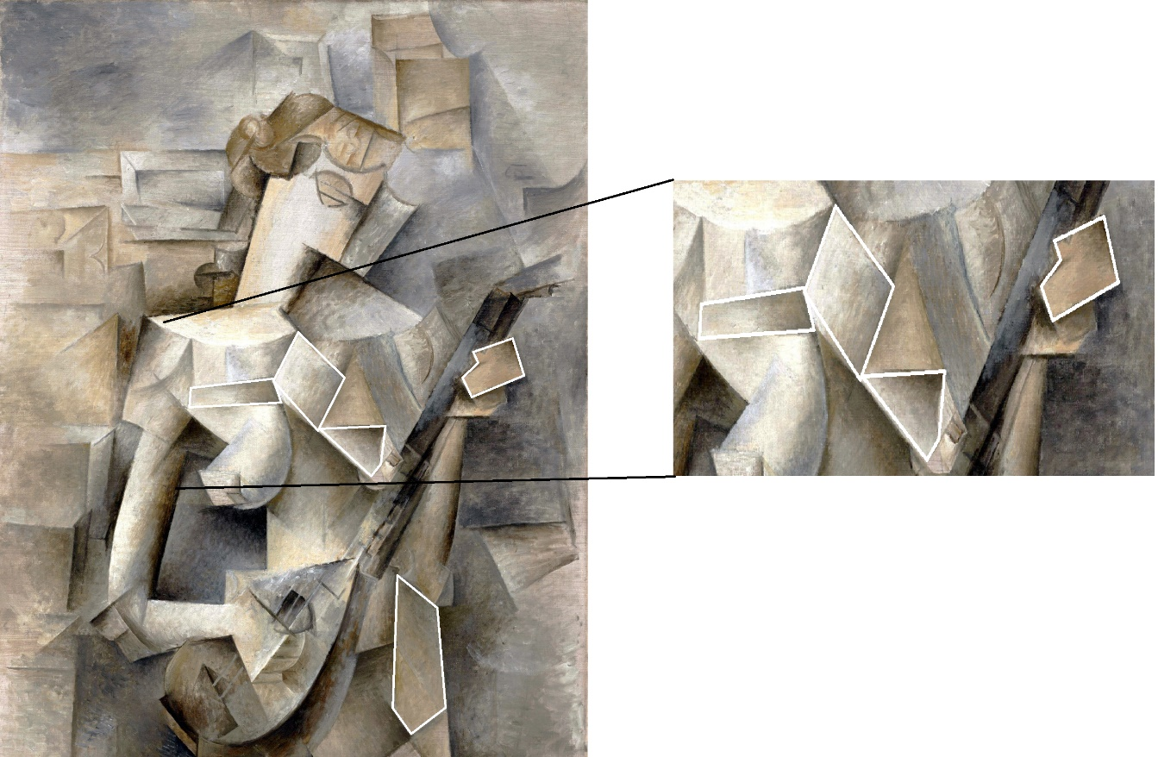

Slide 37
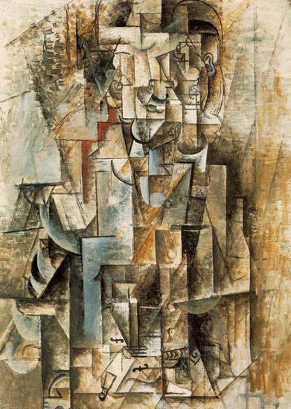
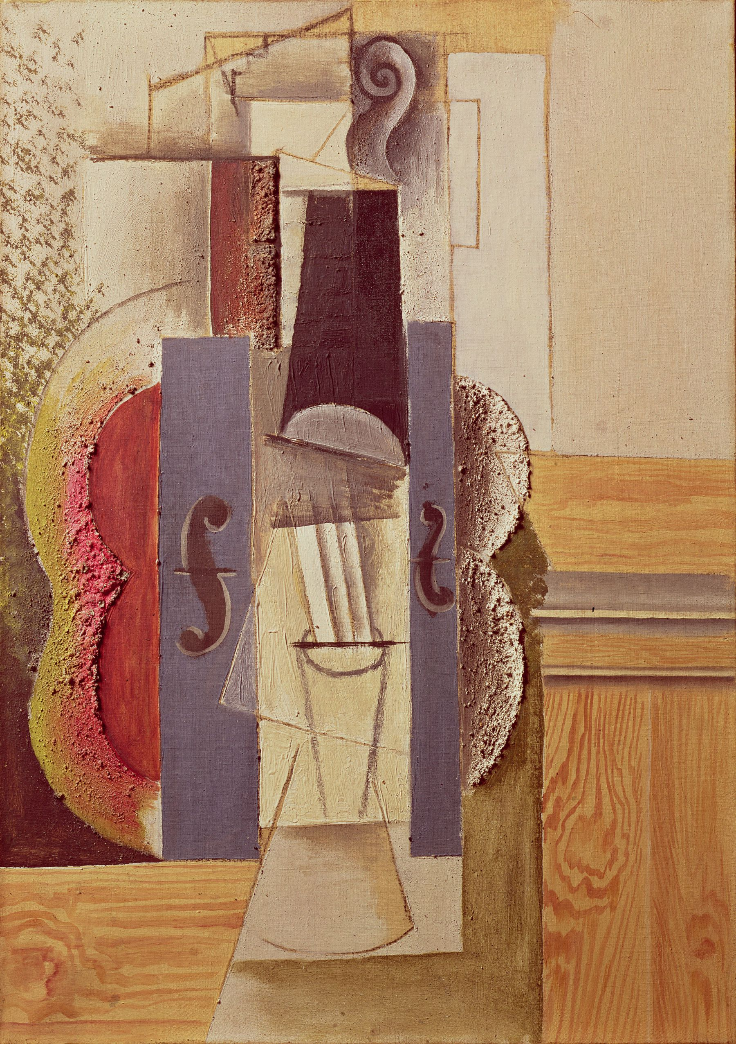

Slide 38
Explicit Randomness - Dada
A Dadaist, Jean (Hans) Arp was one of the first artists to make randomness and chance part of his work. He generated the form first, and tried to reduce the intervention of the conscious mind.

Slide 39
Dada
Dada was an artistic and literary movement that began in Zürich. It arose as a reaction to World War I and the nationalism that many thought had led to the war.
Its output was wildly diverse, ranging from performance art to poetry, photography, sculpture, painting.
Dada's aesthetic was marked by its mockery of materialistic and nationalistic attitudes.

Slide 40
Dada
Dada was the direct antecedent to the conceptual art movement, where the focus of the artists was not on crafting aesthetically pleasing objects but on making works that often upended bourgeois sensibilities and that generated difficult questions about society, the role of the artist, and the purpose of art.

Slide 41
Dada
Artists like Hans Arp were intent on incorporating chance into the creation of works of art. This went against all norms of traditional art production whereby a work was meticulously planned and completed. The introduction of chance was a way for Dadaists to challenge artistic norms and to question the role of the artist in the artistic process.

Slide 42
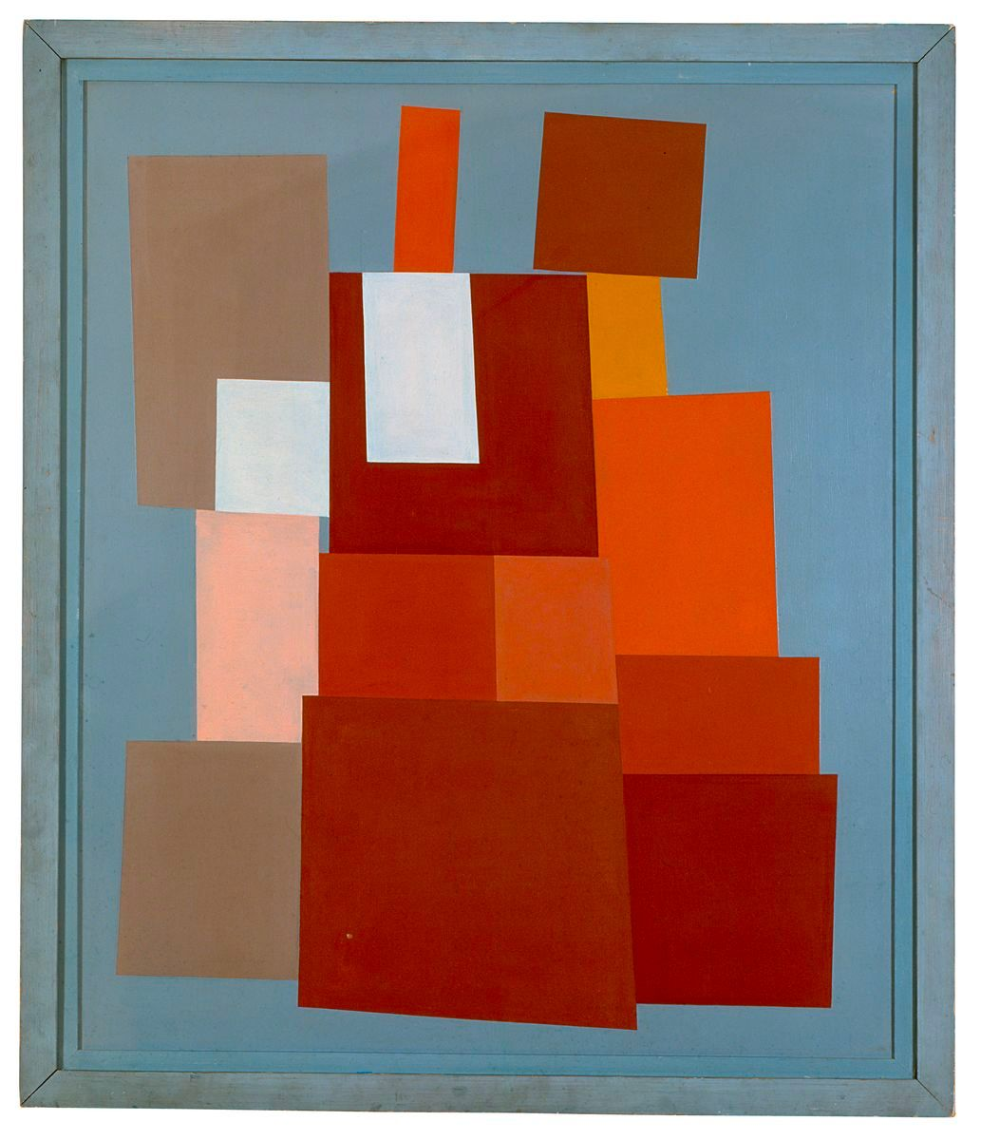
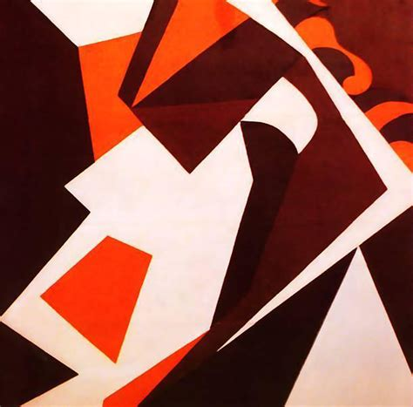
Hans Arp

Slide 43
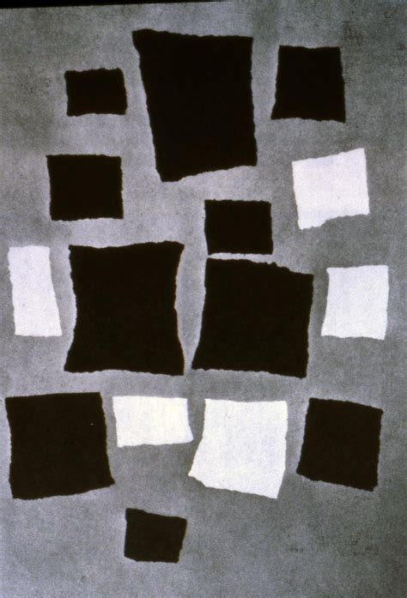
Hans Arp
For example, he dropped bits of paper onto a surface to see what would be produced.

Slide 44
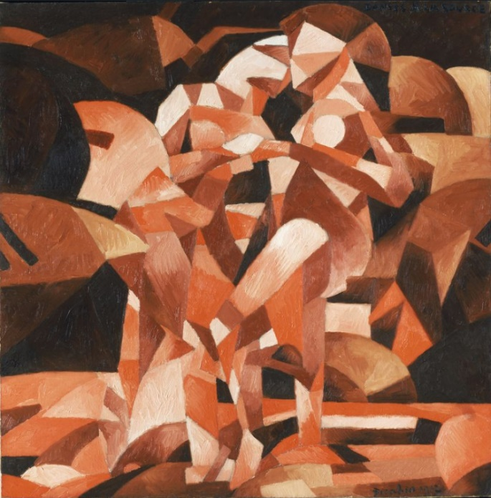
Francis Picabia
Dances at the Spring a Dadaist work.

Slide 45
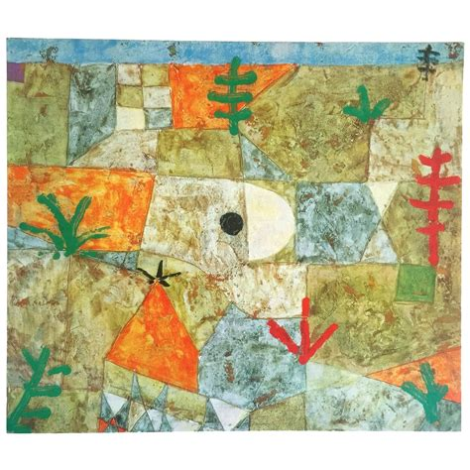
Paul Klee

Slide 46
Paul Klee
A component such as a line, he thought, had “no goal”. The artist could not avoid thinking of the line in a certain way, as having a purpose and destination, but the line itself did not. Thus, the artist has to give up some control. It is ‘an active line on a walk, moving freely without a goal. A walk for walk’s sake’. This sounds very much like a mathematical concept called a drunkard’s walk or random walk in which a line starts at some point and moves in a random direction at each step.

Slide 47
Jackson Pollock

Slide 48
Jackson Pollock

Slide 49
Fred L. Whipple – Father of Generative Art
He devised a method that he referred to as stochastic painting. The word stochastic means “involving chance, or a random variable.” Stochastic paintings have colors and shapes that are organized with random components, but in an explicit way. They are designed to be random.

Slide 50
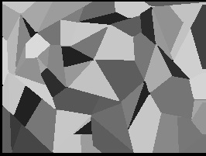
Fred L. Whipple – Father of Generative Art
First we create a table of random number pairs.
1. The first pair give and on a canvas coordinate system for the starting point.
2. The first of the second pair, taken as a decimal of 360, gives a direction from the starting point; the second, multiplied by a unit distance, say a centimeter or half an inch, measures a distance in this direction.
3. From the end of the first line the first number of the next pair measures a distance; the second, multiplied by , measures an angle turned counter clockwise from the tip of the previous line.

Slide 51
Fred L. Whipple – Father of Generative Art
4. Successive lines are developed by successive number pairs from the ends of the previous lines or from the outer sides of closed areas.
5. We now must have a rule for closing the areas. I first tried a rule that produces areas that are all triangles or polygons with no internal angles greater than . I chose to join the figure at the end of a line when any projection of a line was pointed towards the originating side of the polygon. This rule leads frequently to several lines radiating from a point, which gives some sense of three-dimensionality to the final painting. (Fig 0.8)
6. At the edges of the canvas I first adapted the simple rule of extending the line by equal-angle reflection.

Slide 52
Fred L. Whipple – Father of Generative Art
7. When the canvas is completely covered, the choice of colors can be made by successively numbering each closed area by a number taken in sequence from a random-number table. The nature of the painting can be quite affected by ruling that contiguous areas may or may not receive the same color. In Figure 1.8 I chose to eliminate contiguous areas of the same color thereby ending up with colored areas all of polygonal character.
8. If the tubes of paint are numbered successively, in any order, ten random numbers distribute the ten colors among the numbers from 0-9.
9. The remainder of the operation, as in any number painting, permits the painter to choose textures and shades at will. Or, if he wishes, he can mix a certain amount of white with the paint for each area by means of a second random number in each area.
This is, by anyone’s standards, an algorithm. It underlies modern generative art.

Slide 53
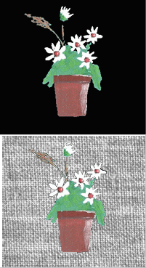
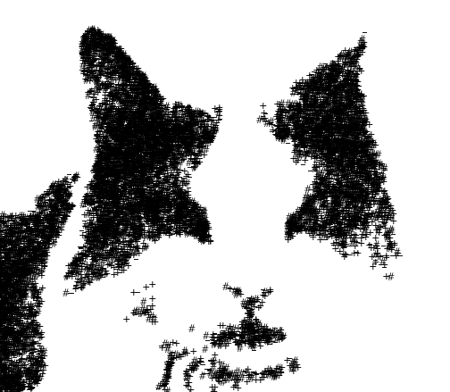
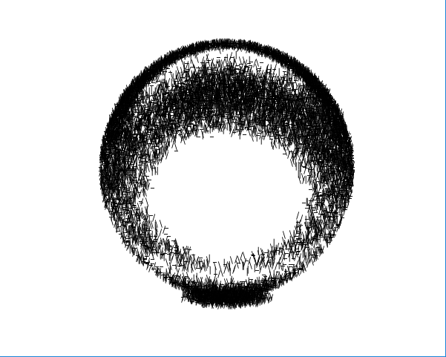
Random Texture and Shading

Slide 54
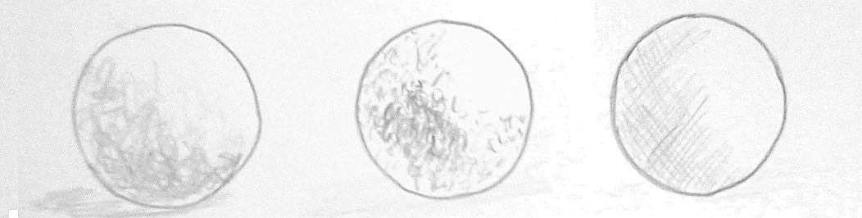


Slide 55

Complete Randomness Is Not Interesting
The English word that is used to describe sound that is random is noise.

Slide 56
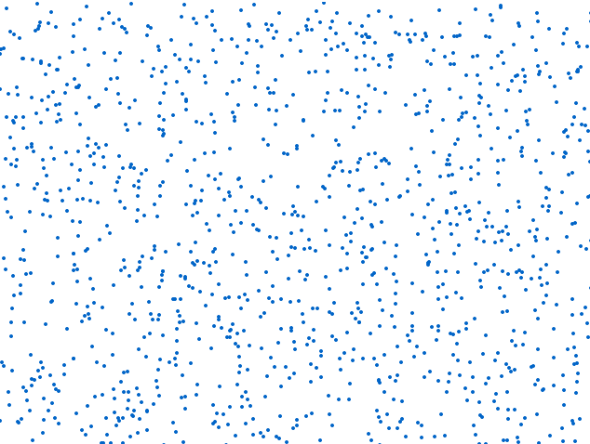
Small randomly positioned circles
Making the dots larger and creating random spacing between them is an improvement, but there is little for the human pattern recognizer to lock onto. It’s still pretty boring.

Slide 57
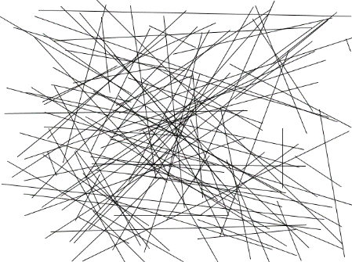
Random lines
Lines are an orderly set of points.
The points are arranged into a structure that we recognize. Most people find the set of lines in here, in which line endpoints are places in random positions, more interesting than simple dot images.
A mixture of random and order.

Slide 58
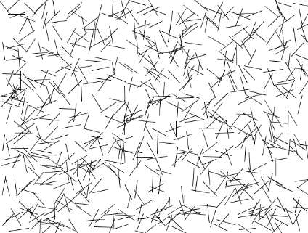
There is an amount of randomness that seems most pleasing.
Lines are an orderly set of points.
Making the lines smaller adds interest to the collection. When the lengths of the lines are restricted to a smaller range it introduces more order. Many people find the resulting image more pleasing, if not exactly high art.

Slide 59

Non-Random Lines
It seems that as more structure is added some kind of peak interest is arrived at, a point at which adding more structure to the work actually detracts from its appeal. When the piece consists of well-organized lines in perfect rows and columns any resemblance to what people think of as art seems to be minimal again.

Slide 60
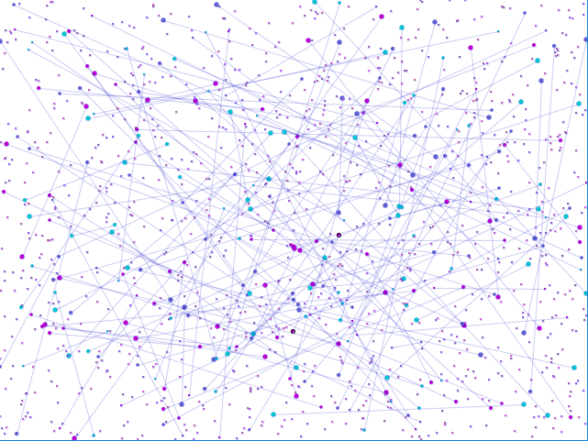
A combination of random aspects and artist control
Mixing random values of spatial and color components can work very well. Here the random line endpoints are drawn as small colored circles, where the size and color vary. The background has a number of spots in random positions and with random colors within a specified range. This now begins to look like a work that Pollock might do if he had worked in the generative domain. Chaos and order under the control of the artist is what we seem to require.

