Slide 1
Neural Networks
AI
J Parker
Art 251
2026

Slide 2
Neural Networks
This can be tricky.
I’m not going to do all the math (as usual) but will try to convey the basic ideas.
A neural network or artificial neural network (ANN) is a collection of interconnected nodes.
Each node is an exceptionally simply computing device.

Slide 3
Neural Networks
Why?
In the 1950s we built computers based on ideas about how the brain worked.

Slide 4
AI and Art
Canva
David bowie riding a cat

Slide 5

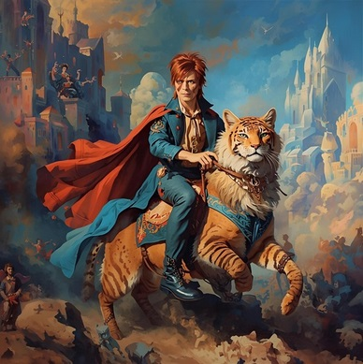

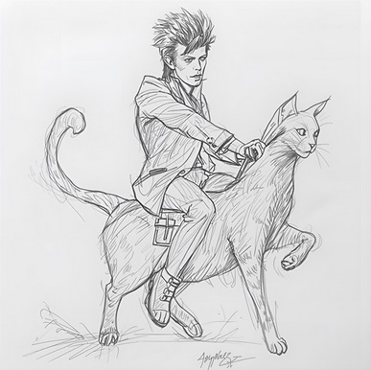
AI and Art Canva

Slide 6
AI and Art
Deepai

Slide 7
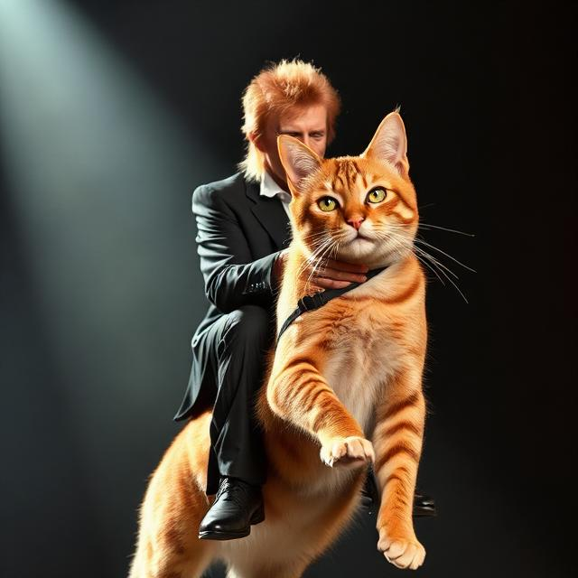
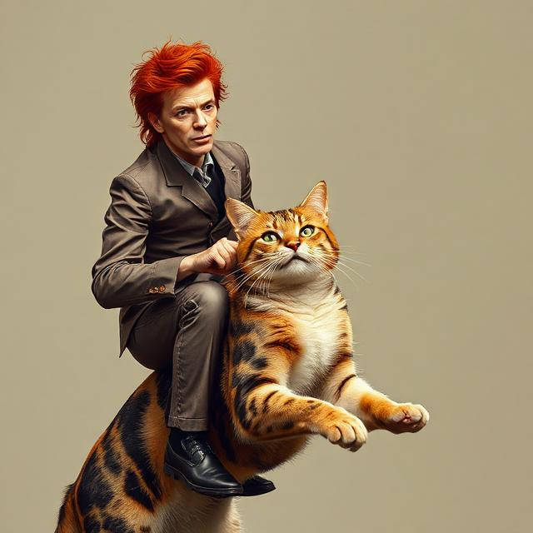
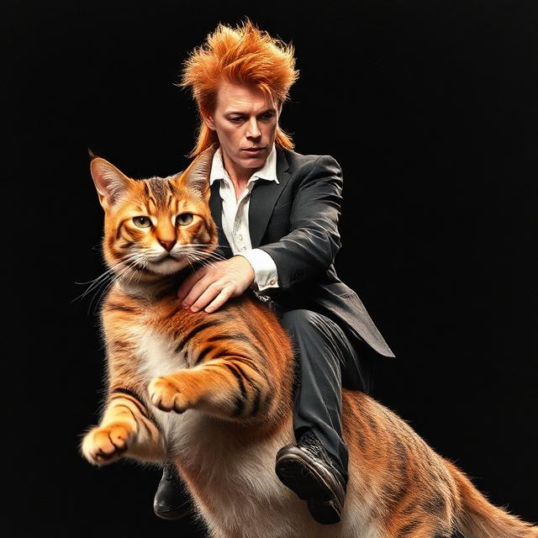
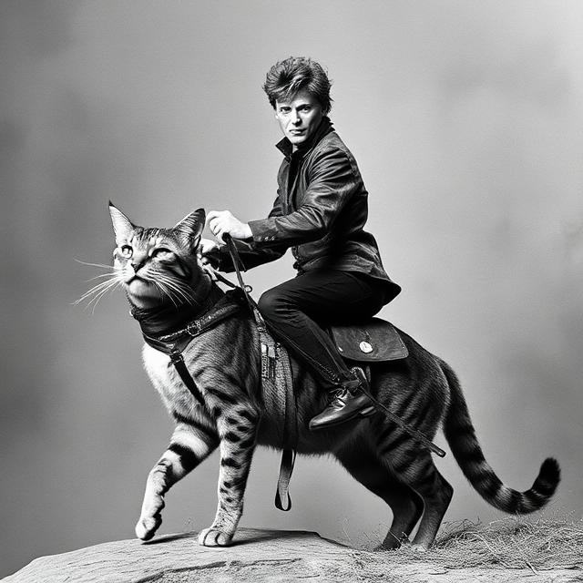
AI and Art

Slide 8
AI and Art
Google gemini

Slide 9


AI and Art

Slide 10
AI and Art
Nightcafe

Slide 11
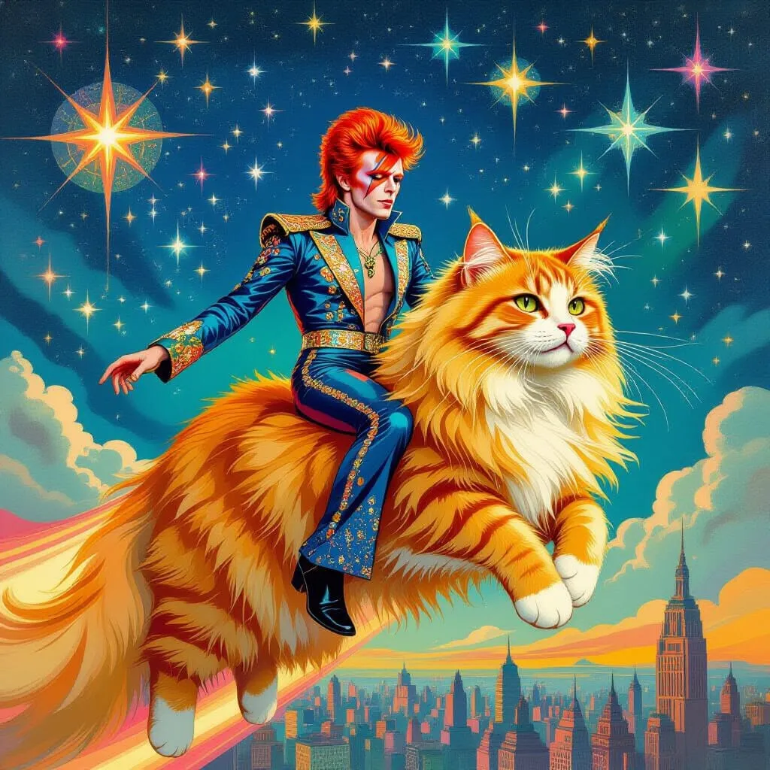

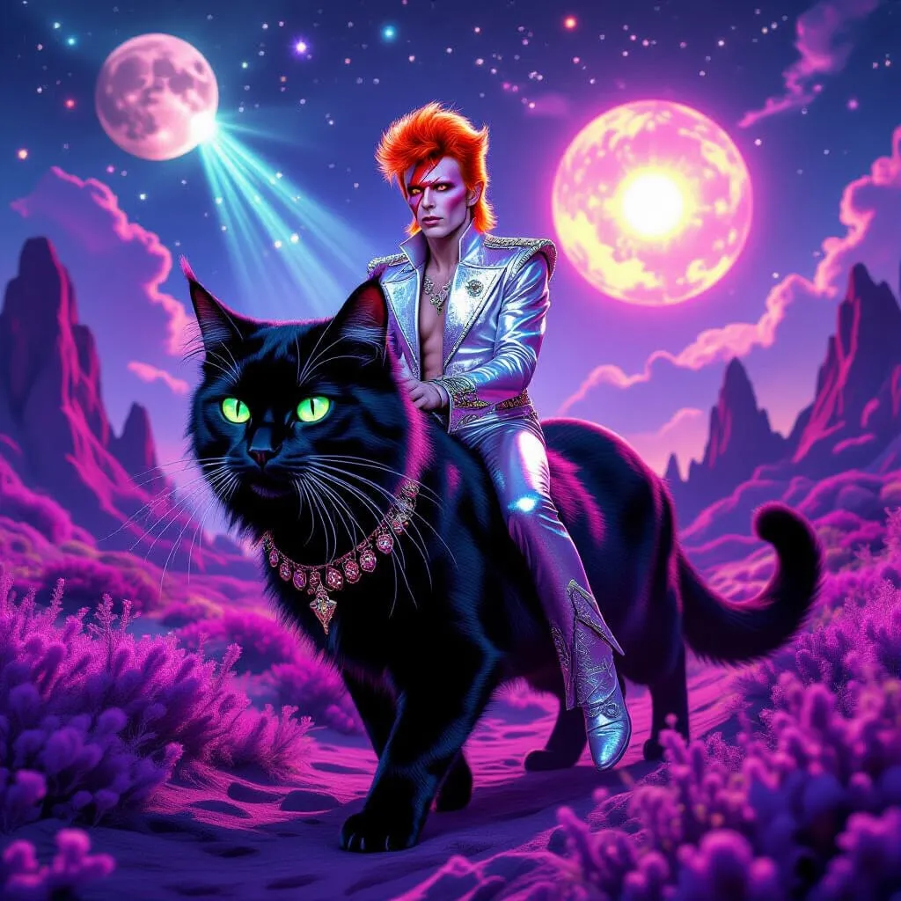
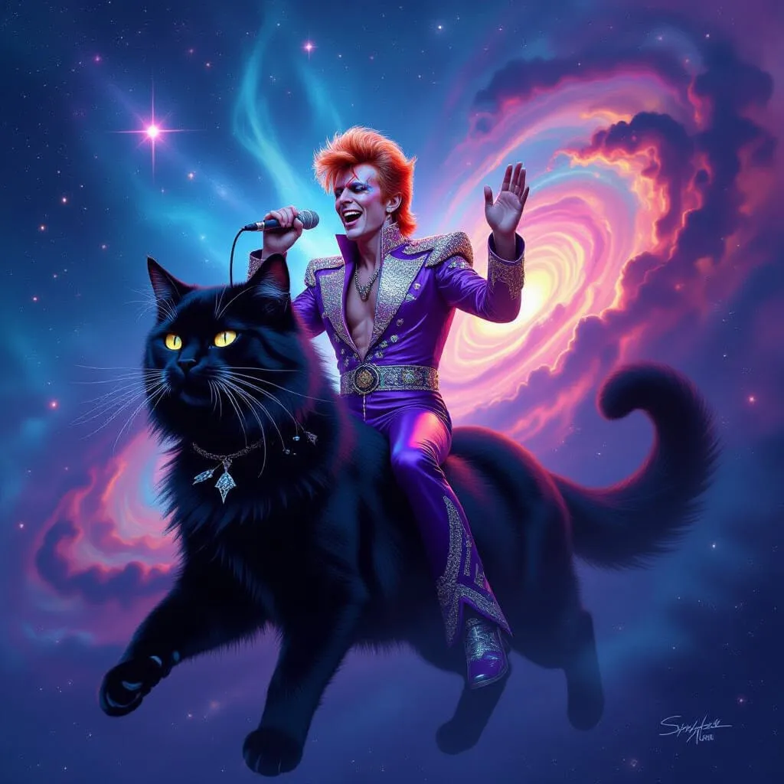
AI and Art

Slide 12
AI and Art
perchance

Slide 13




AI and Art

Slide 14
AI and Art
oreate

Slide 15
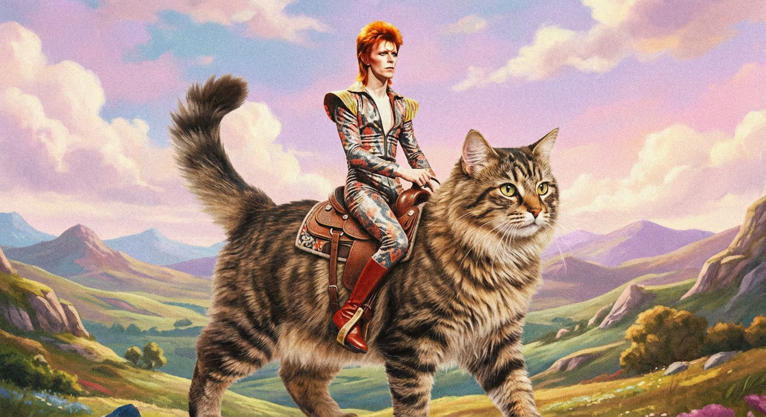
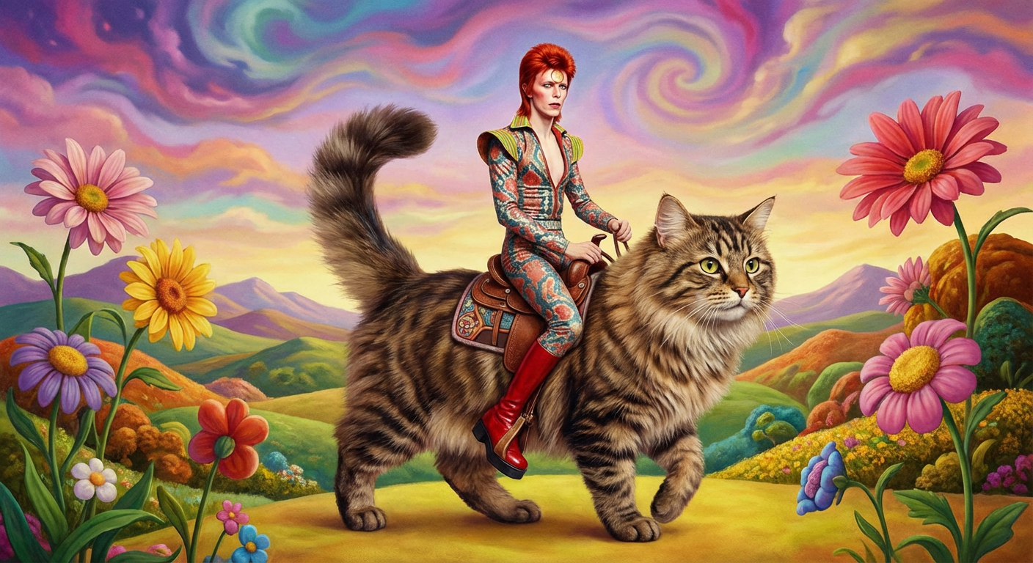
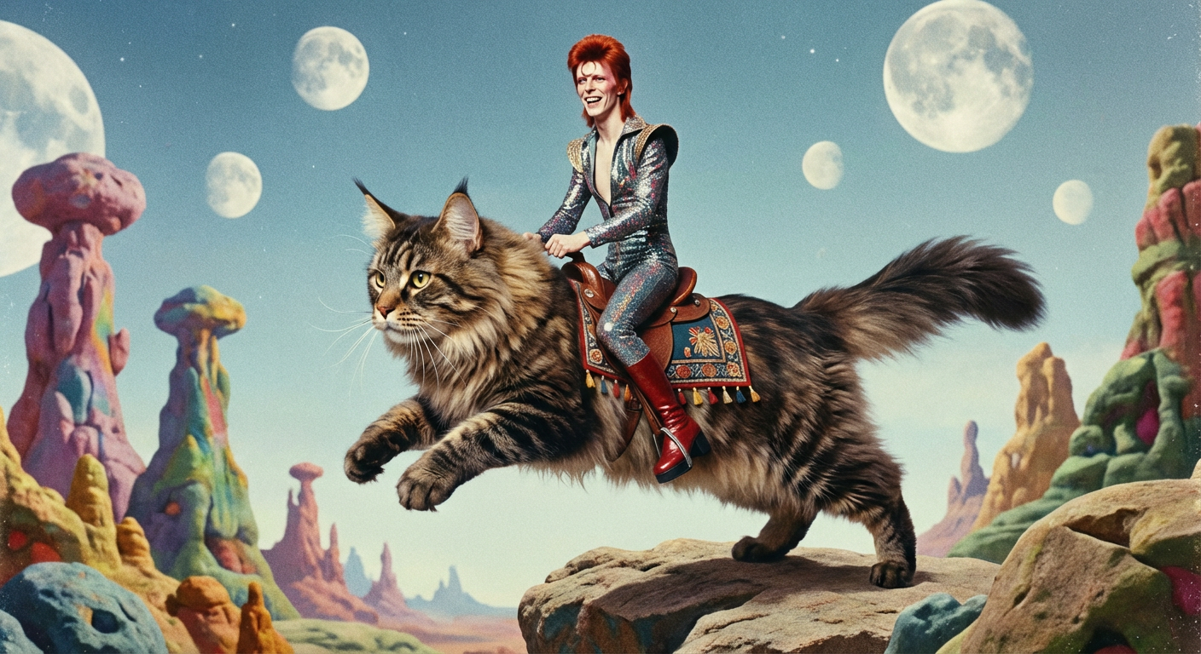
AI and Art

Slide 16
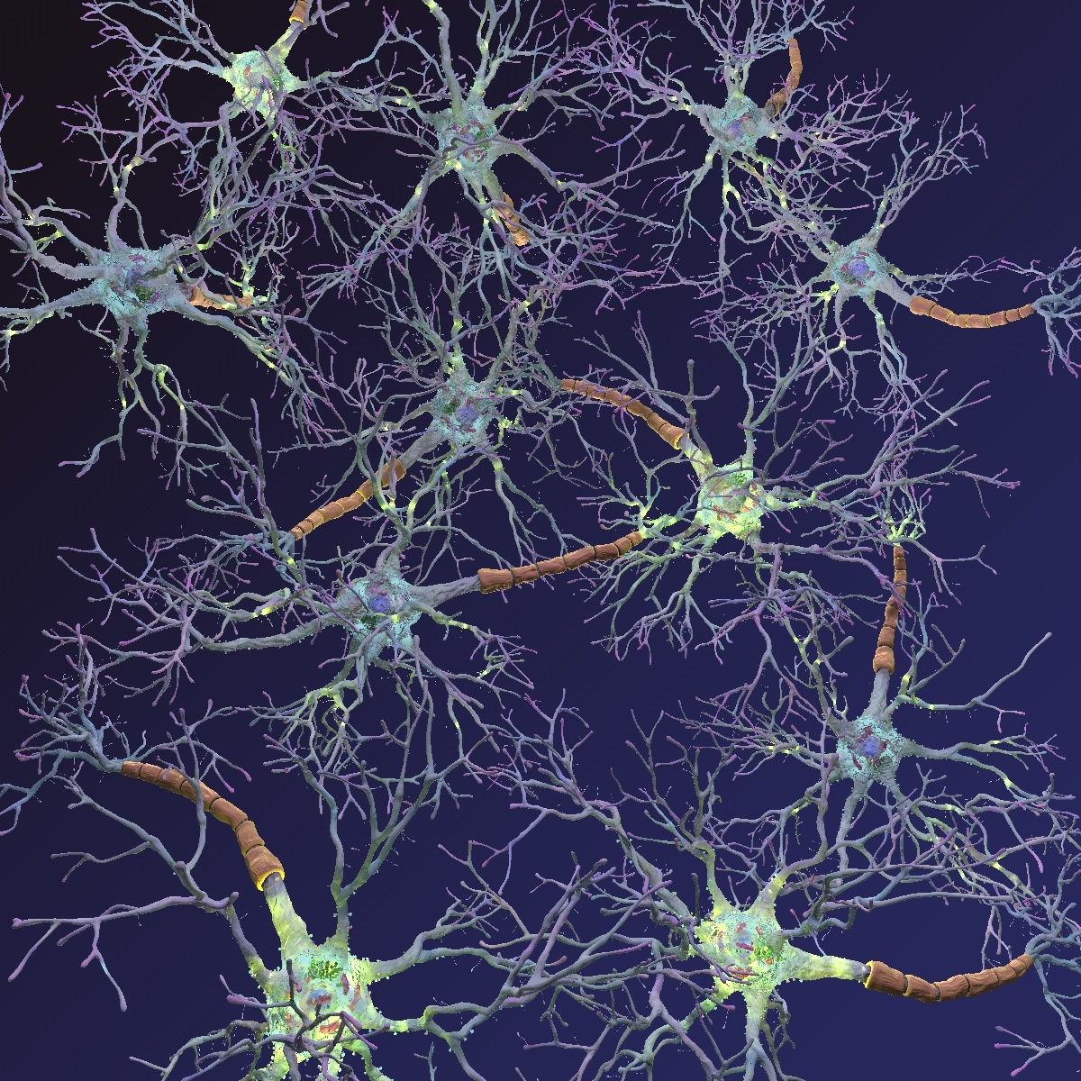
We looked at the brain and saw many neural cells (neurons) connect to each other in complex ways.
We said ‘let’s do that!’

Slide 17
However …
In fact a neuron is a very complex thing. It’s like a small computer, not an elementary logic gate.
Still, neural networks have developed further and are good to know about.

Slide 18
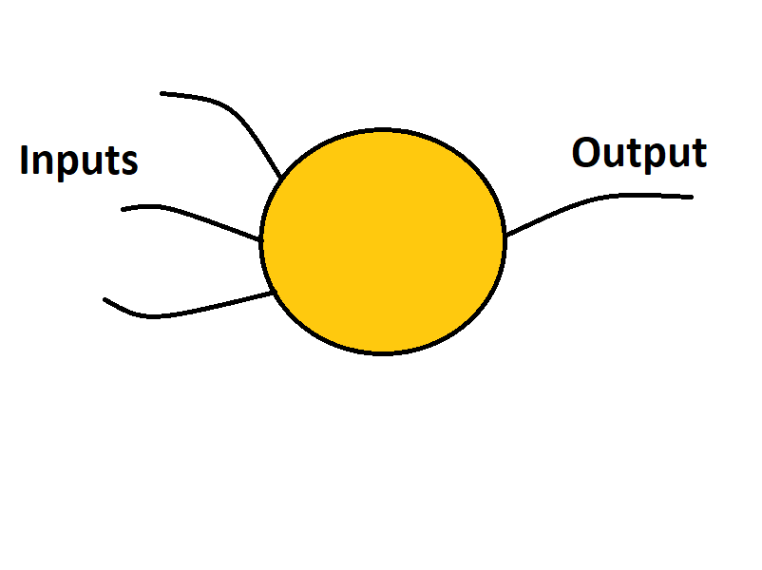
Nodes
A node has some number of inputs and an output.
A node is not a physical circle or anything. It’s a piece of software.

Slide 19
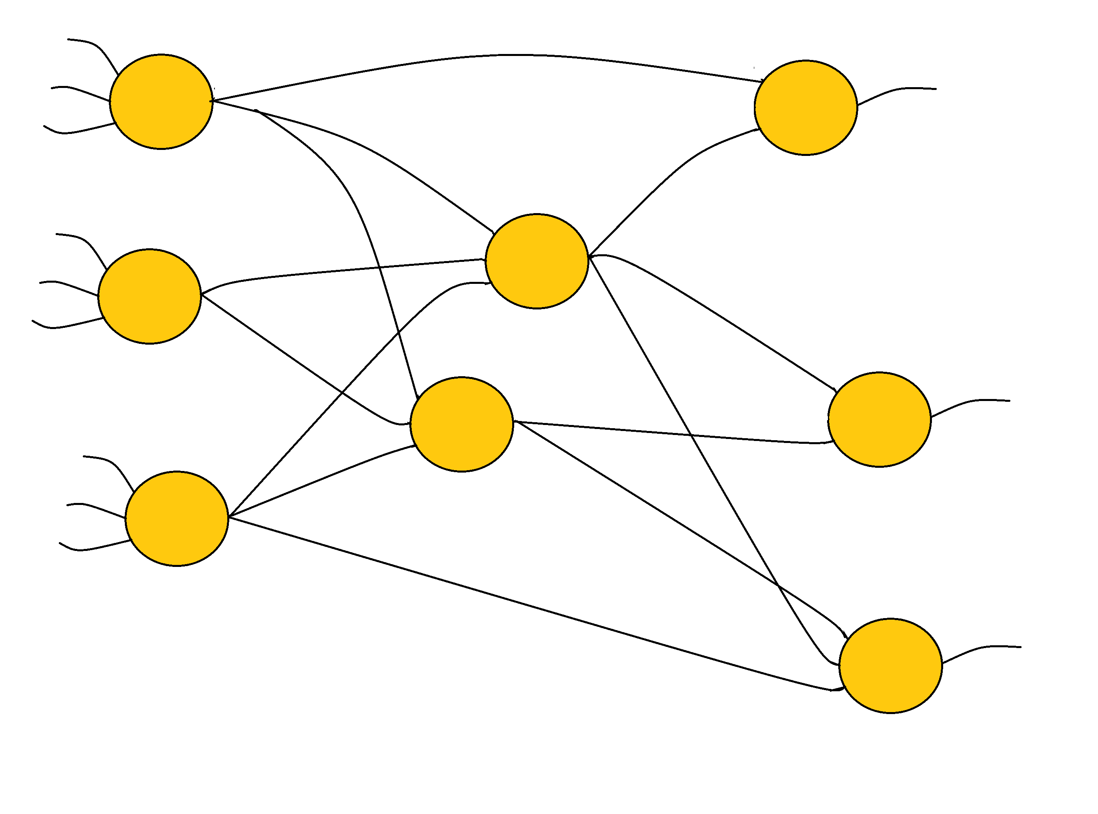
Nodes
Nodes are connected.
This means that the output of a node feeds data to the input of some other node.

Slide 20
See what they are doing here?

Slide 21
A Node
A node in a neural network does a simple thing.
It sums its inputs and creates an output based on that. The output is not the sum, it is some function of the sum of the inputs.

Slide 22
Weighted sum
Moreover, the sum is weighted.
Let’s say we have 3 inputs a, b, and c.
Each input has a weight (a number) wa, wb, and wc
The weighted sum is:
a*wa + b*wb + c*wc

Slide 23
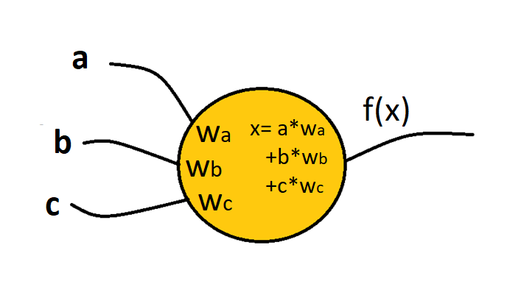
One node does a trivial calculation.
The function x is called the activation function, and can be as simple as a threshold:
F(x) = 1 if x <= 0.5
0 if x > 0.5

Slide 24
Weights
So what are the values of the weights?
The inputs are data, provided by the problem.
Where do the weights come from?

Slide 25
AHA!

Slide 26
Weights
The weights are critical, and determining them is how a neural network learns.
They start out with random values.
We then apply data to inputs for a problem that we know the answer to. We adjust the weights depending on whether the node produces the right answer.

Slide 27
Supervised Learning
We give the network known situations and adjust weights repeatedly until it gets the right answer the expected number of times.
This is the training phase of the network. It’s what we call learning.
The neural net software itself adjusts the weights automatically in the training phase.

Slide 28
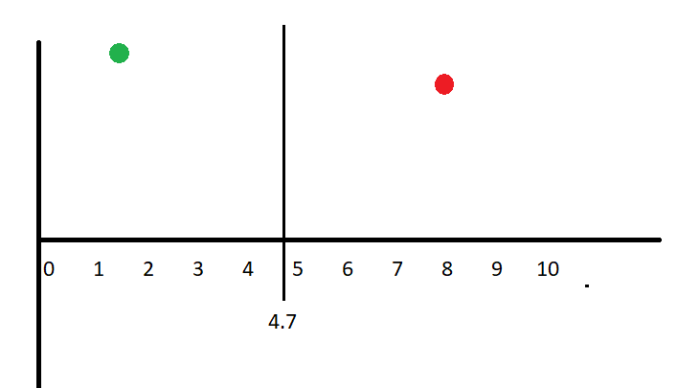
A simple problem:
Question:
Which side of the vertical line does a particular point reside?
Revised question:
Is the point (x, y) on the left of the line x=4.7?

Slide 29
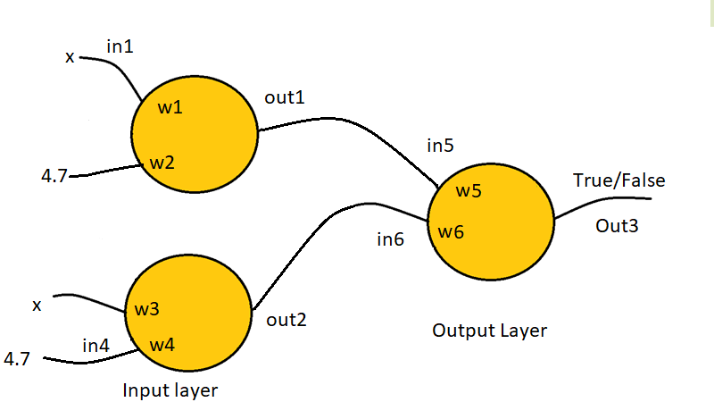
Our starting network:

Slide 30
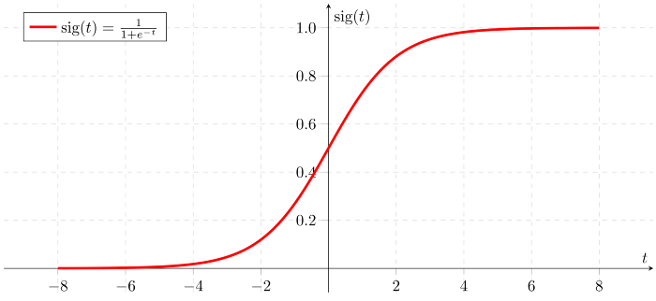
Activation function (logistic)

Slide 31
Changing weights
When we get the output O we compare it to the correct output C:
Z = C – O
We feed this back to the weights like so:
di = η*(C-O)*Xi (Looks nasty but it’s just the product of 3 numbers)
Where η is the learning rate parameter (set it to 0.01)
Xi is input value i.
Then change weight i Wi = Wi + di
Then do it again with new training data.

Slide 32
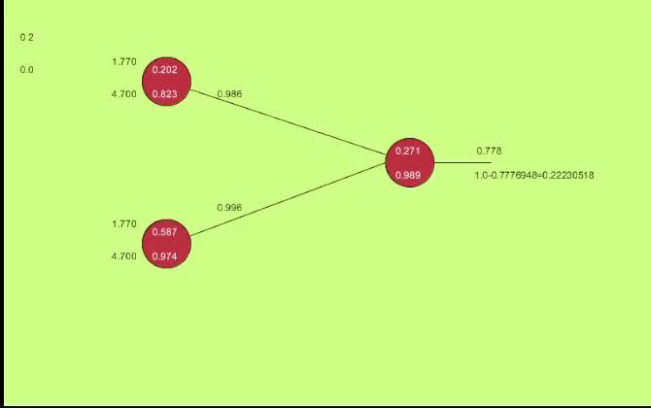
Training

Slide 33
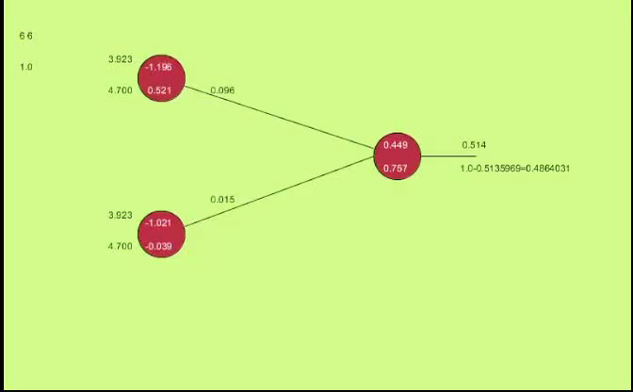
Working

Slide 34
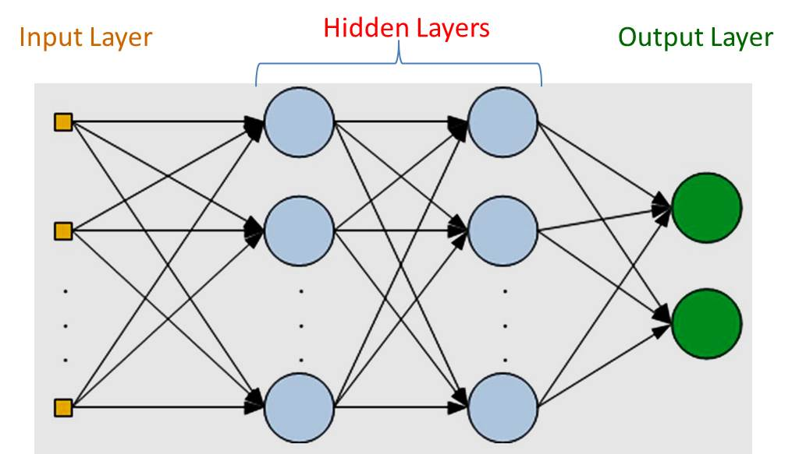
Neural Net in Use

Slide 35
I have problems …
We don’t really know what the net is learning.
Training data is critical.
Microsoft, IBM, and Face++: all three services worked better on male faces than female faces, and on lighter faces than darker faces. All the companies’ services had particular trouble recognizing that photos of women with darker skin tones were in fact women.

Slide 36
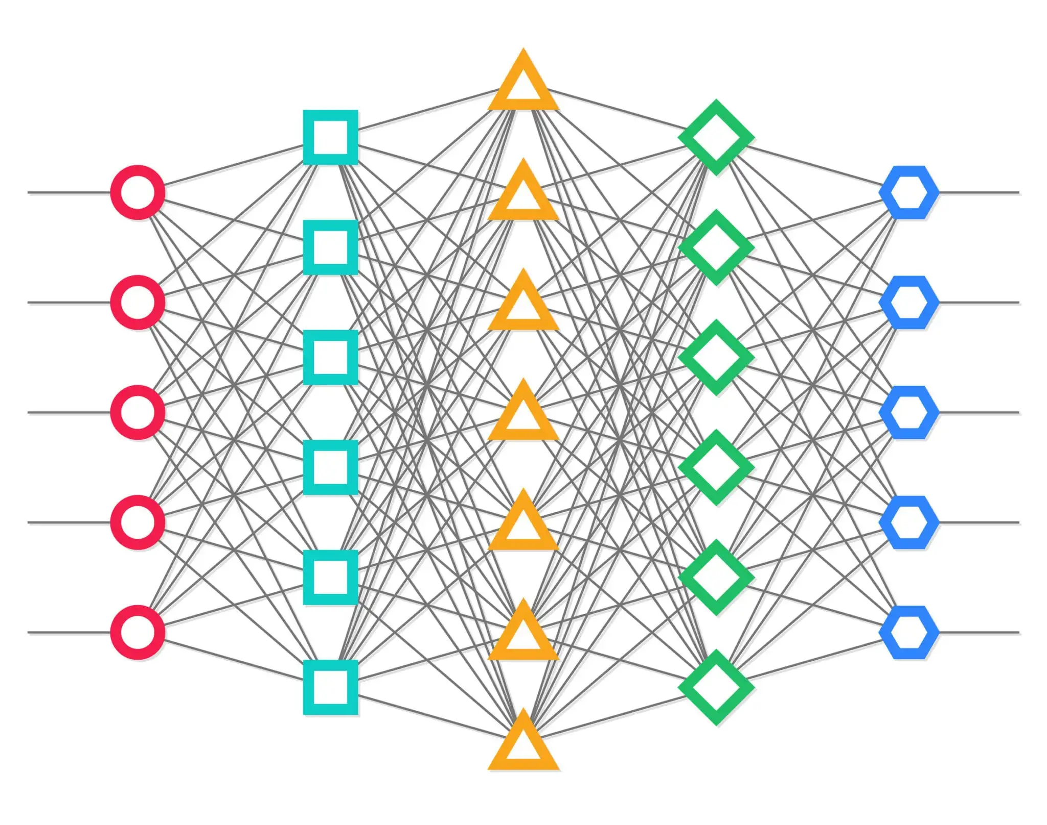
Deep Learning
Basically:
Lots of layers.

Slide 37
Generative Neural Networks
In a GAN setup we have two neural networks locked in a game.
There are two players:
The generator tries to produce data that come from some probability distribution.
The discriminator acts like a judge. It gets to decide if the input comes from the generator or from the true training set.

Slide 38
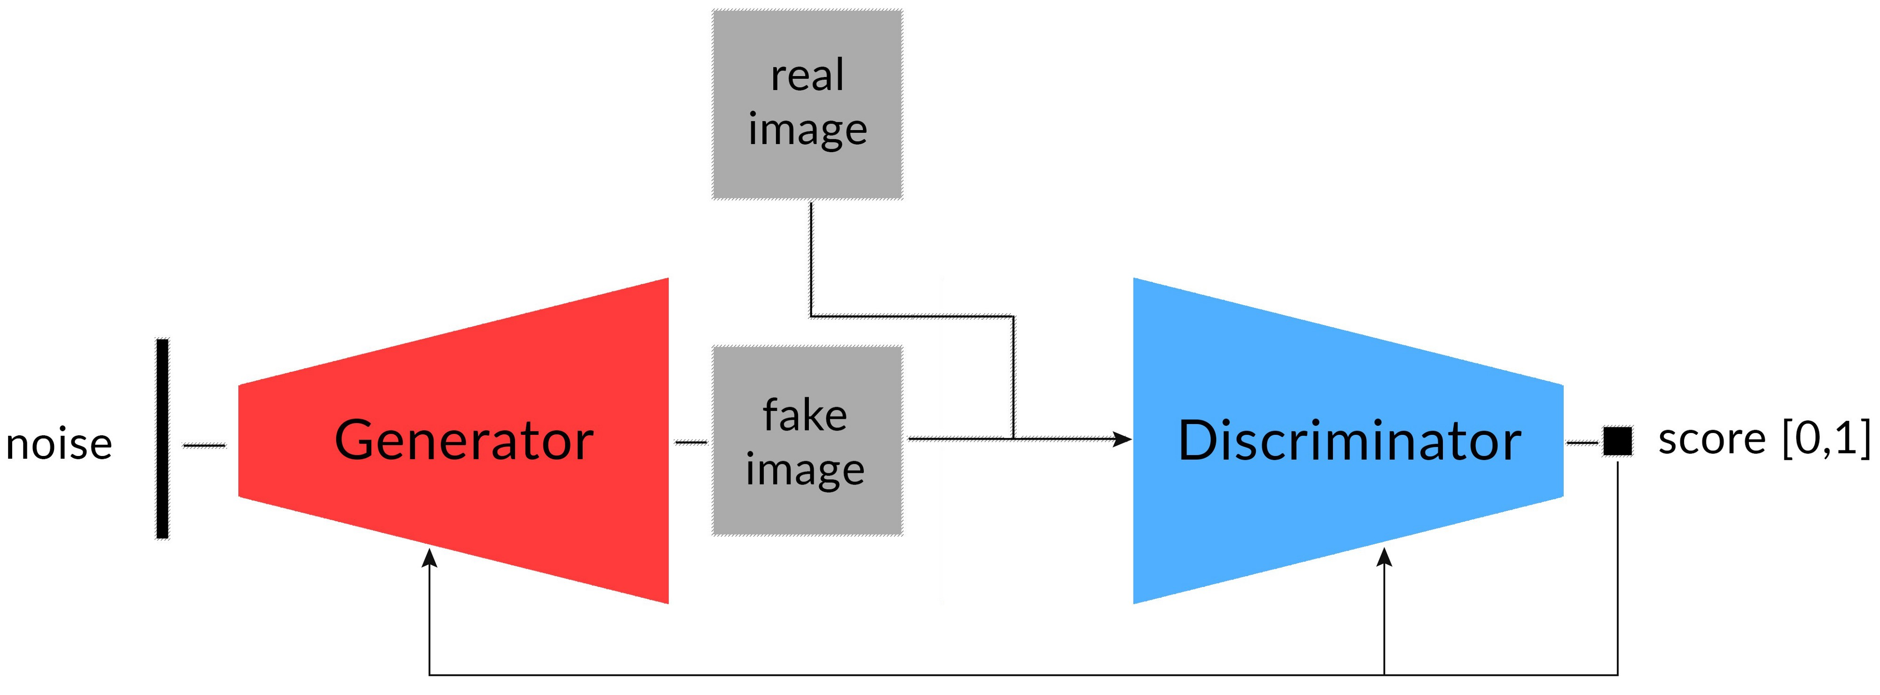
Why did we do all this?
Generative Adversarial Networks (GANs)

Slide 39
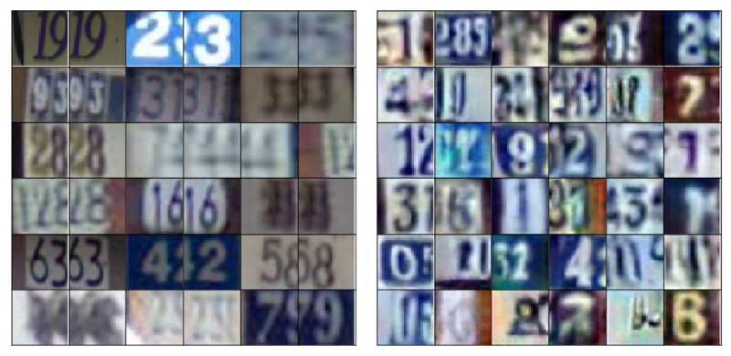
Gans
Real Generated

Slide 40
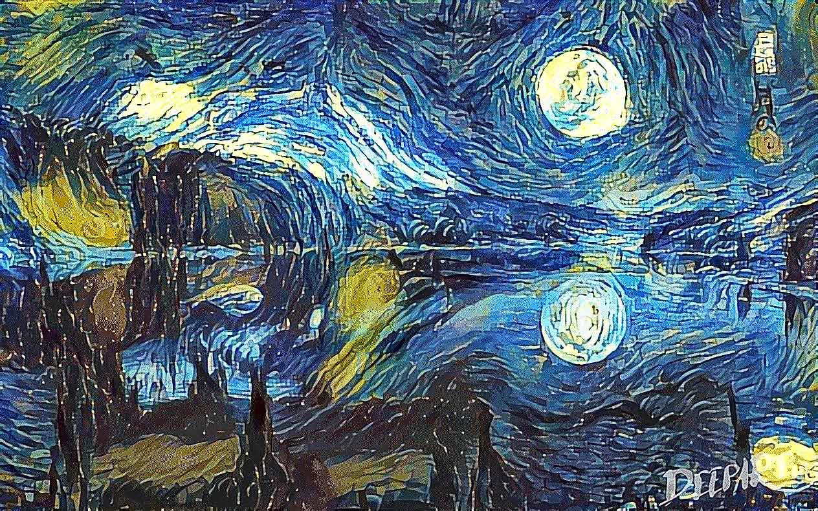
Why did we do all this?
Generative Adversarial Networks (GANs)

Slide 41
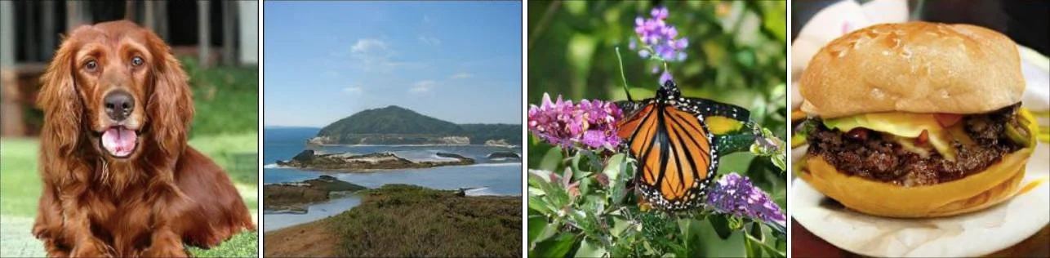
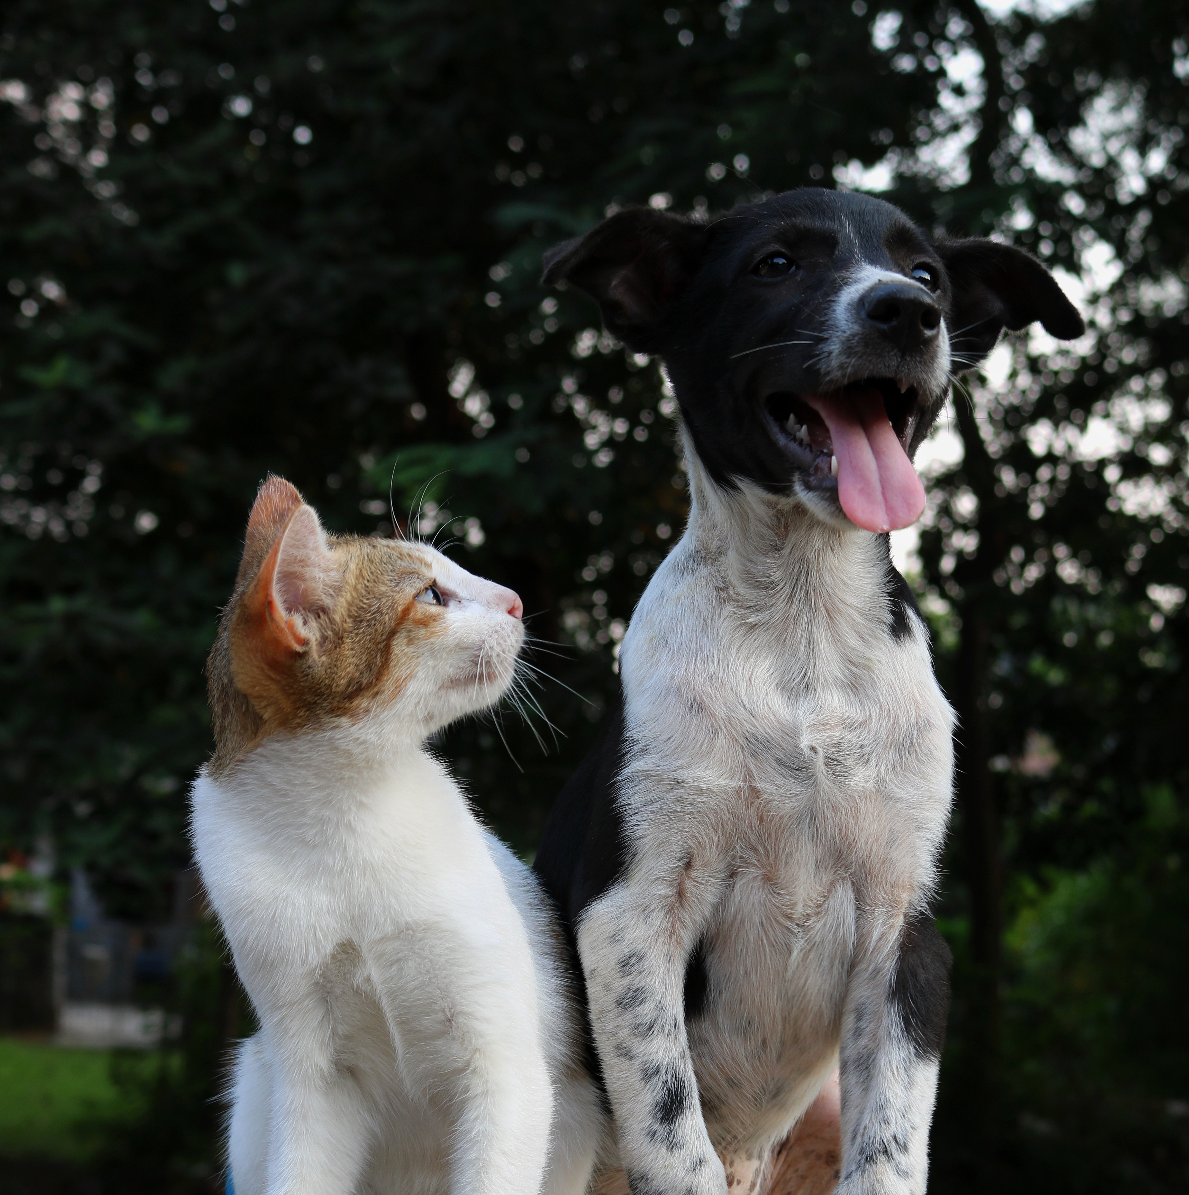

Slide 42
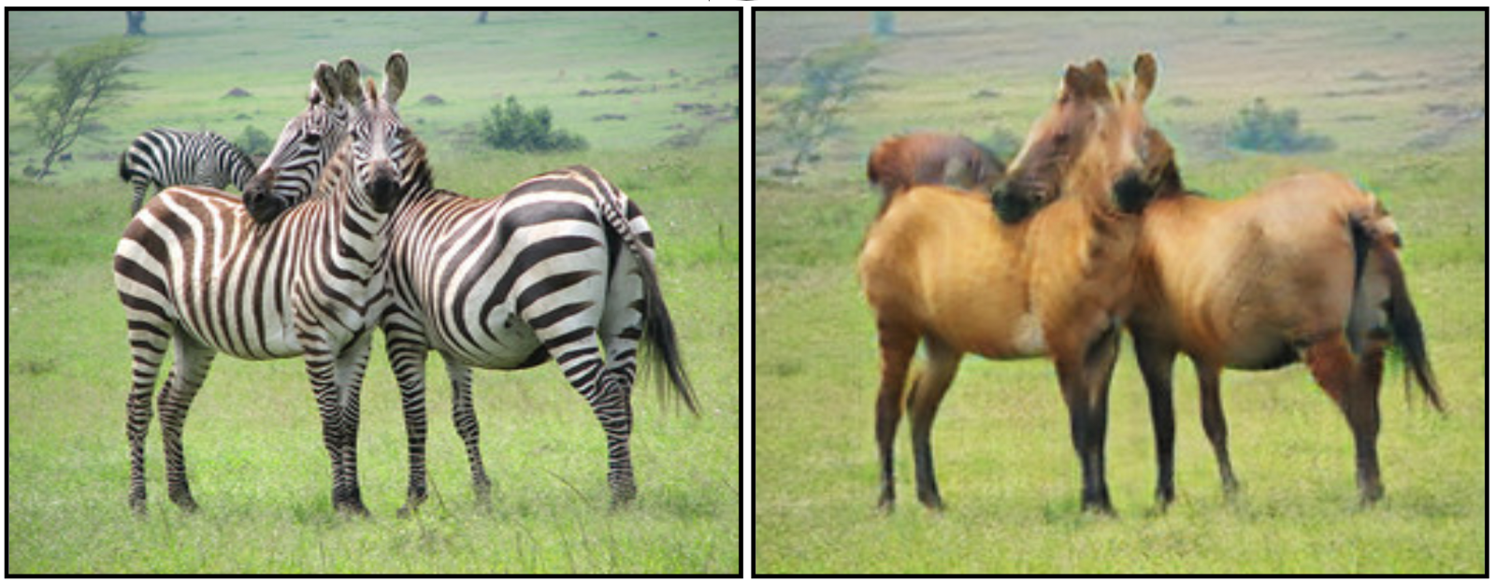
GANs
Generative Adversarial Networks (GANs)

