Slide 1
Animation – Basic movement
Animation is about movement.
Living things move in a different way from non-living things, and all have a
‘natural’ motion from the perspective of a human viewer.
What follows are some basics of motion.

Slide 2
Animation – Basic movement
Laws of Motion (due to Newton)
Inertia. Every object that has weight will remain in its current state
of motion until a force is applied to it.
Force

Slide 3
Animation – Basic movement
Laws of Motion (due to Newton)
2. Constant acceleration. An object accelerates in the direction of the force
applied to it. The greater the force, the greater the acceleration. For a given force,
the greater the mass of the object the smaller will be the acceleration.
( F = m*a )

Slide 4
Animation – Basic movement
Laws of Motion (due to Newton)
3. For every action there is an equal and opposite reaction. If a force is applied
to an object, the object reacts with an equal and opposite force on whatever
applied the force.
If your kick a ball, it pushes back on your foot.
What do all of these rules mean in the context of animation?

Slide 5
Animation – Acceleration
Let’s look at acceleration.
This is when the speed of something is changing – getting faster or slower..
0 sec 1 sec 2 sec 3 sec 4 sec
Acceleration is created by a force. Gravity …

Slide 6



Animation – Important Law of Motion
Things that change position a small amount between frames are moving slowly.
Things that change position a large amount between frames .are moving quickly.
Explain Galileo.

Slide 7
Animation – Important Law of Motion
A thrown ball.

Slide 8
Animation – Important Law of Motion
A thrown ball.
Wrong

Slide 9
Animation – Important Law of Motion
A thrown ball.
Correct

Slide 10
Animation – Important Law of Motion
An incline
Correct – ball accelerates
Down the incline

Slide 11
Animation – Important Law of Motion
Animating this: Key drawings!
Draw the start and end of the sequence. How much time does this represent (I.E. how many drawings?)
A
Correct – ball accelerates
Down the incline. Let’s say ½
Of a second, or 7 drawings.
B

Slide 12
Animation – Important Law of Motion
Animating this: Key drawings!
Draw the start and end of the sequence.
Frame 1
(key)
A
Frame 4
(middle of the tweens)
Frame 7
(key)
In-betweens
B

Slide 13
Animation – Important Law of Motion
Animating this: Key drawings!
Draw the start and end of the sequence.
Frame 1
(key)
A
Frame 4
(middle of the tweens)
Frame 7
(key)
In-betweens
B

Slide 14
Animation – Important Law of Motion
Animating this: Key drawings!
Draw the start and end of the sequence.
Frame 1
(key)
A
Frame 4
(middle of the tweens)
Frame 7
(key)
In-betweens
B

Slide 15
Animation – Important Law of Motion
Animating this: Key drawings!
Draw the start and end of the sequence.
Frame 1
(key)
A
Frame 4
(middle of the tweens)
Frame 7
(key)
In-betweens
B

Slide 16
Animation – Important Law of Motion
Animating this: Key drawings!
Draw the start and end of the sequence.
Frame 1
(key)
A
Frame 4
(middle of the tweens)
Frame 7
(key)
In-betweens
B

Slide 17
Animation – Important Law of Motion
Animating this: Key drawings!
Draw the start and end of the sequence.
Frame 1
(key)
A
Frame 4
(middle of the tweens)
2
3
4
5
Frame 7
(key)
6
This gives a constant speed
B

Slide 18
Animation – Important Law of Motion
Animating this: Key drawings!
Draw the start and end of the sequence.
Frame 1
(key)
Frame 4
(middle of the tweens)
A
Frame 7
(key)
Slow-in: motion speeds up as time
Progresses (closer at the beginning)
B

Slide 19
Animation – Important Law of Motion
Animating this: Key drawings!
Draw the start and end of the sequence.
Frame 1
(key)
Frame 4
(middle of the tweens)
A
Frame 7
(key)
Slow-in: motion speeds up as time
Progresses (closer at the beginning)
B

Slide 20
Animation – Important Law of Motion
Animating this: Key drawings!
Draw the start and end of the sequence.
Frame 1
(key)
Frame 4
(middle of the tweens)
A
Frame 7
(key)
Slow-in: motion speeds up as time
Progresses (closer at the beginning)
B

Slide 21
Animation – Slow out
Animating this: Key drawings!
Draw the start and end of the sequence.
Frame 1
(key)
Frame 4
(middle of the tweens)
A
Slow speed
Slow-out: motion speeds up as time
Progresses (closer at the beginning)
Accelerates out of a key frame
Frame 7
(key)
B
Fast speed

Slide 22
Animation – Important Law of Motion
Animating this: Key drawings!
Draw the start and end of the sequence.
S = 1/2at² Let t=0.5 sec
Solve for a (=8)
Tween 4 is at t=0.25:
S = 8/2* 0.25*0.25 = 4*0.0625
S = 0.25 (1/4 of the way down!)
A
4
We can calculate the position
Of each tween, but here’s a rule:
It’s more important to look right than to
Be right.
B

Slide 23
Bounce
Slow out
A
B

Slide 24
Bounce
Slow in
B
A

Slide 25
Bounce
Slow in AND slow out
2
1
3

Slide 26
Pose To Pose
What we have been calling ‘key-frame’ animation.
Make the first drawing, the next one need not be the next frame, but is the next important position or pose.
The in-betweens are filled in later (sometimes by lesser artists or those learning the trade).
Pros:
Leads to an industrial approach (factory, assembly line)
Can more easily synchronize key moments in the action with specific frames.
Easier in 2D animation to ensure that characters and proportions remain constant.
Cons:
Action can be inconsistent (many artists)

Slide 27
Straight Ahead
Animator makes the first drawing, then goes on to the next in sequence in a frame-by-frame manner.
Stop-Frame is an example of where this is used exclusively. Also flipbooks.
Pros:
Artistic, live, unencumbered by rules. Good for a lot of action.
Cons:
A lot of pressure on the animator. Requires a great deal of concentration.
Hard to correct
A slow distortion of objects and proportions is possible.
Specific timing is hard (lip synch)

Slide 28
More complex movements

Slide 29
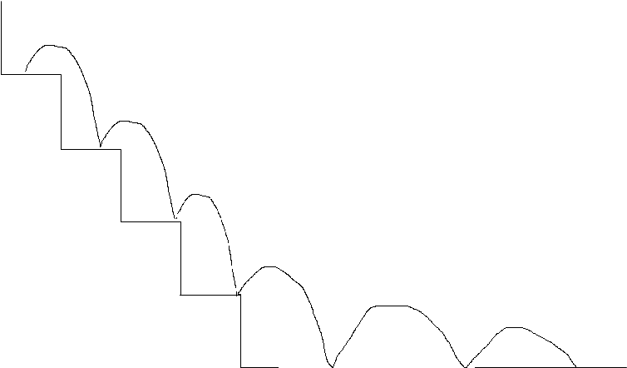
More complex movements
Each stair is a bounce as we did before.

Slide 30
More complex movements
2
Each stair is a bounce as we did before.
1
3
2
1
3
2
2
1
3
2
1
3
1
3
2
2
1
3
2
1
3
1
3

Slide 31
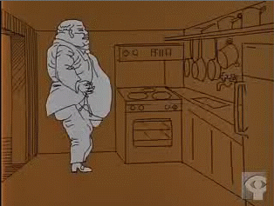
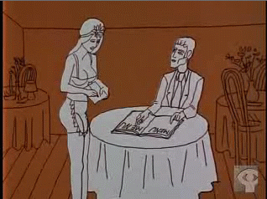
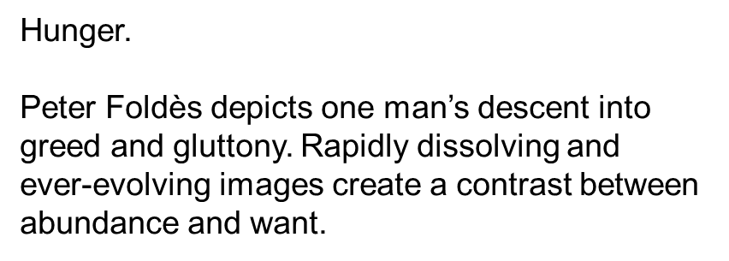
Examples
One of the first films to use computer animation, this satire serves as a cautionary tale against self-indulgence in a world still plagued by hunger
and poverty.
https://www.youtube.com/watch?v=vwU3UARE6yc

Slide 32

Examples
This animated film about the pesky blackfly is based on the song of the same title, written and sung by Canadian folk singer Wade Hemsworth, with back-up vocals by the McGarrigle sisters. It recounts Hemsworth's battles with this quintessential "critter" during a summer of surveying in Northern Ontario.
https://www.youtube.com/watch?v=qjLBXb1kgMo

Slide 33

Examples
A small bird lands on a telephone wire and makes itself comfortable, only to have a second small bird land next to it. The two birds quickly start to squabble as others land on the wire and join in. They are interrupted when a large, gangly, awkward-looking bird sitting on top of the pole honks to them. Soon, the small birds start mocking the large one by puffing up their feathers to resemble its plumage and imitating its honk. They then slide farther out along the wire and chatter suspiciously among themselves, ignoring the large bird's attempts to befriend them until it settles in the middle of all of them out on the wire.
https://www.youtube.com/watch?v=tjUDblaW-Vc

