Slide 1
Space
Art 251
Composition

Slide 2
What is Space?
The arrangements of the previous elements creates the space in the work, and the process is called composition.
"Composition is the art of arranging in a decorative manner the diverse elements at the painter's command to express his feelings." - Henri Matisse in "Notes of a Painter."

Slide 3
What is Space?
Space can be described as area in a two dimensional canvas.
It includes the space between objects in a painting, space around the main scene, and certain kinds of space.
It is about spatial relationships between things, the distance between objects and their relative positions on the 2D canvas.

Slide 4
Empty Canvas
An artist once referred to a canvas as the white terror, because many new artists are afraid to put marks on an empty canvas.
But it is where we often begin.
The canvas does not have to be white, but it starts out without artist-made marks. An artist has some idea about what they wish to do with this empty space.

Slide 5
Design
Imagine:
You look out of a farmhouse window and see a person, a girl who cannot walk due to polio, crawling towards the house. She hates wheelchairs and crawls everywhere.
This inspires a painting. We could paint what we see, or imagine some other view point.
You decide to paint it from behind the girl as she makes her way to the house.

Slide 6
Design
The farm will be farther away from the viewer than the girl is, and perhaps it would even be in the background. This would place it in in the upper part pf the image.
Why?
Thats a general rule of composition using space, and the artist knows this – although it can be changed.

Slide 7
Design
The girl will be in the forground, and is in fact the focus or emphasis of the painting, the most important thing from the artist’s point of view.
If a painting has no focus then the viewer’s eye feels lost, wandering across the canvas looking for a place to rest.

Slide 8
Design
The girl will be in the forground, and is in fact the focus or emphasis of the painting, the most important thing from the artist’s point of view.
If a painting has no focus then the viewer’s eye feels lost, wandering across the canvas looking for a place to rest.
The remainder of the painting is relatively unimportant except that if it were absent then the painting would make no sense.

Slide 9
Initial
Next, we can place some of the objects, starting with the focus.
Any photographer knows better than to place the principal object in the exact center, so the position of the girl should be moved.
But to where? Artists and photographers have been using something called the rule of thirds for helping with this.

Slide 10
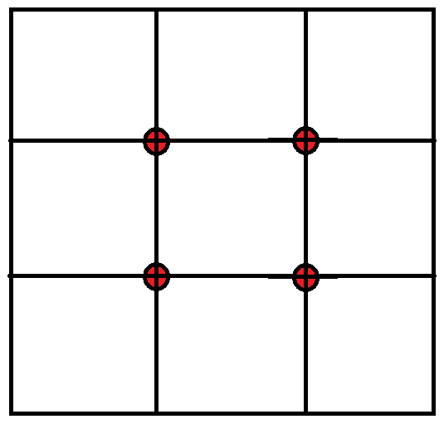
Rule of Thirds
We divide the canvas into three equal parts horizontally and vertically, and place the focus at or near the intersection of two of the dividing lines.

Slide 11
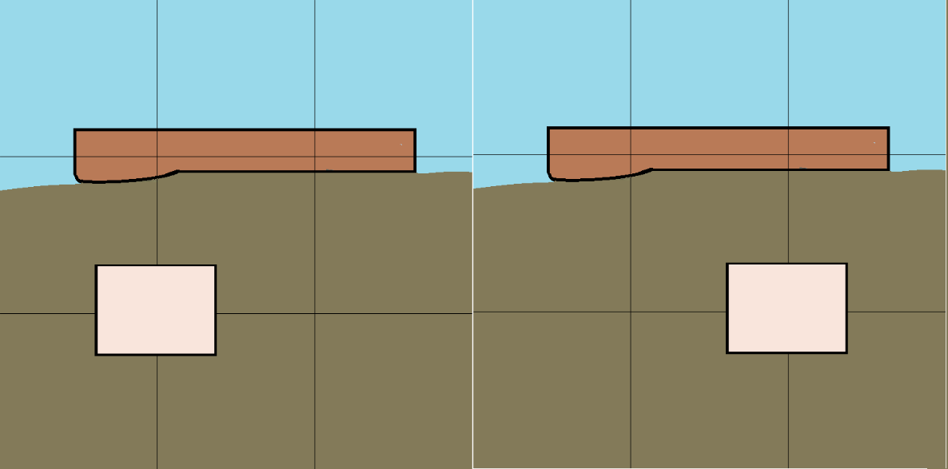
Rule of Thirds

Slide 12
Initial
The blue area is probably sky, brown is where the farm will be located, roughly, the girl will be in the pink box, and the green is the rest.
A painter usually will do this in their head, possibly making crude, quick marks on the canvas as an outline.
The girl must be in the lower part of the image; she’s in the foreground. Let’s choose the left image; it does not matter at this point.

Slide 13
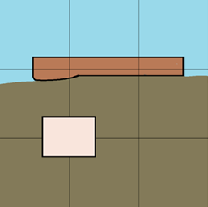
Initial
Let’s choose the left image; it does not matter at this point.
A painter usually will do this in their head, possibly making crude, quick marks on the canvas as an outline.
The girl must be in the lower part of the image; she’s in the foreground. Let’s choose the left image; it does not matter at this point.

Slide 14
Initial
The farm house will be in the brown area on the opposite side of center from the girl.
She’s crawling towards it, moving diagonally across the scene.

Slide 15
Initial
We can place other buildings at the same level in different locations depending on our imagining of the scene or the buildings in the actual scene.
The green region is hay or grass, the blue will be sky. We can now fill in some of those areas and sketch in the building and girl.

Slide 16
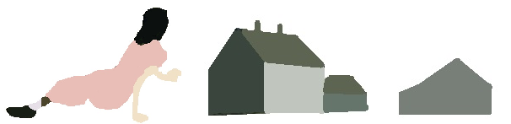
Objects

Slide 17
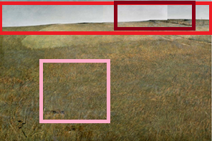
Roughing in

Slide 18
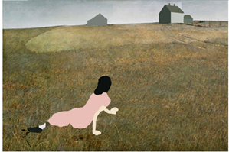
Roughing in

Slide 19
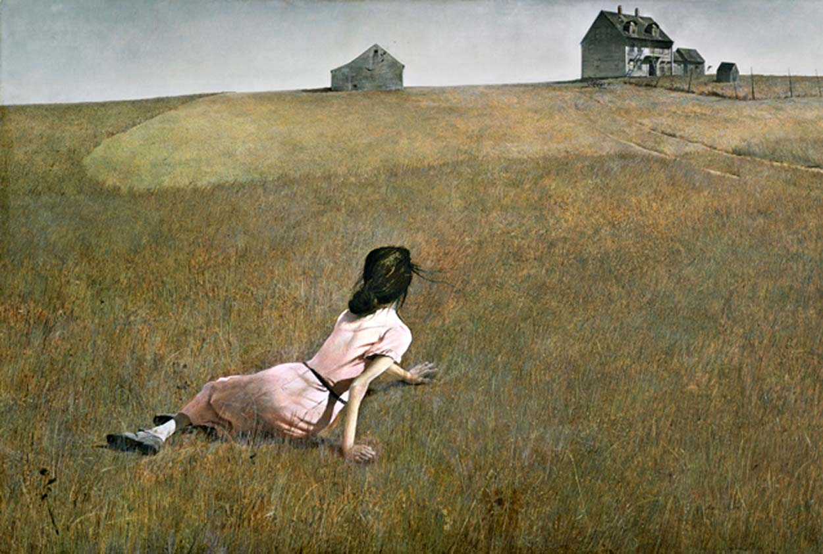
Christina’s World by Andrew Wyeth

Slide 20
Positive and Negative Space
Positive space consists of the shapes or objects of interest, and negative space is the space between them.
In Wyeth’s painting Christina, the barn, and the house comprise the positive space, and the field and sky are the negative space.

Slide 21
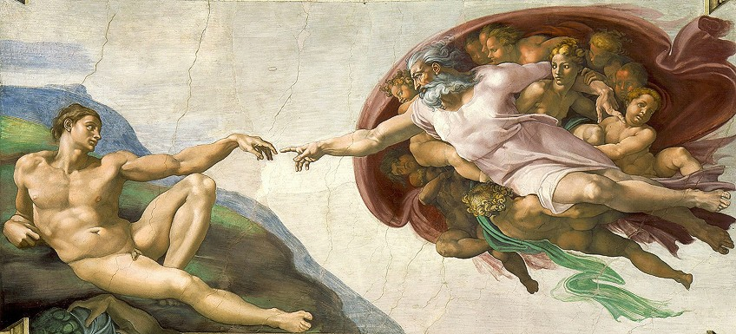
Creation of Adam

Slide 22
Positive and Negative Space
The figures of God and Adam take up half or less of the overall work but fill the positive space and are the important things to be seen.
The negative space (background) is relatively empty. It contains no objects of importance.
The gap between the finger or God and that of Adam creates a sense of anticipation of an event about to occur. The open space in the painting actually draws our attention to the focal points. Negative space can be critical to the composition, in that it often draws the eye to the areas the artist wants you to focus on.

Slide 23

Three Dimensional Space
Here we are talking about providing an illusion of the third dimension with using 3D coordinates. A simple example of this is to use overlapping objects. Here we see a green square and a black circle. The entire green square is seen, while part of the circle is covered, implying that the square is in front of the circle.

Slide 24

Three Dimensional Space
Objects that are larger are often perceived as being nearer than objects that are small, especially when they are the same shape. This can change if the object is recognizable by the viewer, because they will have an idea of the actual size of the object.

Slide 25

Three Dimensional Space
Objects that are placed higher on the canvas will seem further away than lower objects. This is likely related to our perception of vanishing points and the horizon.

Slide 26
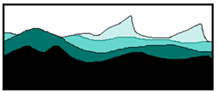
Three Dimensional Space
Distant objects tend to be cooler in color temperature and/or have a lighter value. Our normal perception of the distortion cause by the atmosphere is responsible for this.

Slide 27

Three Dimensional Space
Our ability to see fine detail decreases with distance, so far away objects should be given less detail than near ones. This effect increases when used with one of the others, such as size, in many circumstances. Being able to see the fuzz on a peach or the dimples on an orange improves as the object becomes nearer, but obviously the size will also increase in those situations

Slide 28
Deep and Shallow Space
Deep and shallow space refers to the degree of a third dimension (depth) a picture plane has. Deep space can be a full three dimensional representation, with a foreground, middle ground, and background. Viewers can see the subject matter that is further away as well as closer to us.
An example is the Renaissance Delivery of the Keys. Here we see the illusion of depth created using size, position, color, overlapping objects various techniques, atmospheric perspective, and vanishing point.

Slide 29
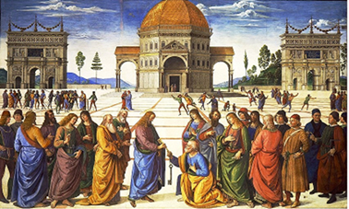
Delivery of the Keys by Pietro Perugino

Slide 30
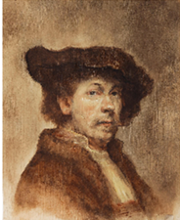
Deep and Shallow Space
Early human artworks were all examples of shallow space, either because ancient artists didn’t know how to render the third dimension or because they didn’t want to. Gradually deep VS shallow space became a choice, and became a characteristic of certain types of art.
Portraits and still life paintings are typical examples of shallow space

Slide 31
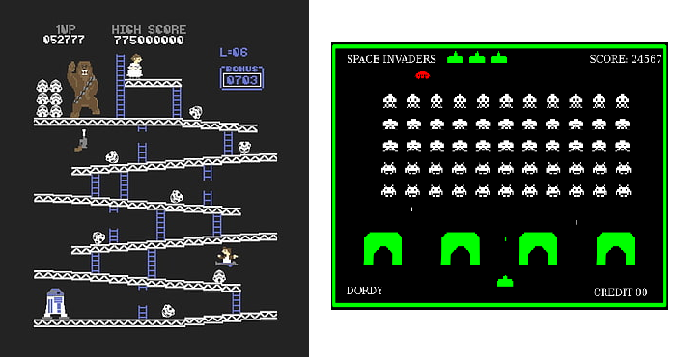
Deep and Shallow Space
In the past few decades a dominant example would be the video game. In some games like Pacman or Tetris the game play takes place in two dimensions, so the artwork reflects this.

Slide 32
Digital Image Space
As digital artists we are most interested in digital images specifically, and how the space element is reflected there, and used in design. What are the characteristics of digital images that affect our use of space?
What we’ll call digital image space is really hypothetical, or imaginary. A canvas has fixed dimensions; a digital image can be as large as we can imagine, and can contain as many colors as our computer memory allows. These colors don’t even have to be real, which is to say we could have colors in a digital image that cannot be seen by humans.

Slide 33
Digital Image Space
In digital terms, a space is mathematical. It contains all possible relationships and values. This is hard to understand, but let’s consider a 2 by 2 pixel image that can have either black or white values only there are a total of 4 pixels here, each having two possible values. The total number of possible images of this kind is 16, which is 4² – the number of pixels to the power of the number of pixel values.

Slide 34
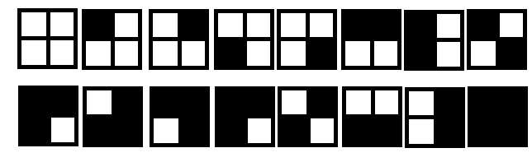
Digital Image Space

Slide 35
Digital Image Space
For a 256 by 256 image with 8 possible grey levels there would be (256*256)⁸, or 3.4x10³⁸ different images. Some number of those would be images of your face, and the face of everyone you ever met.
Is that mind boggling? If so, then ask how many faces could be painted on an empty canvas. That would be the real image space, and is a lot larger.

Slide 36
Digital Image Space is Inaccurate
Digital images are samples of reality, having limits in resolution and value and color range.
We cannot magnify the image very much to reveal new information. It is a common trick in movies of the police procedural genre to magnify a poor image to reveal a license plate or text on a document.

Slide 37
Motion Blur
We have devised ways to reorganize pixels so as to enhance specific objects of interest. We have seen edge detection, for one example, but it does go further than that. Images can be improved, if only approximately.
Imagine that you are in a moving vehicle and take a photograph of a building.
While the shutter is open the scene changes, and the result is a photograph that is blurred in (at least) the horizontal direction. What this really means is that each pixel in the image is the sum of some number of pixels in the correct (unblurred) image in the horizontal direction

Slide 38
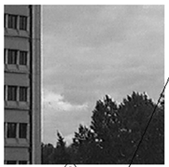
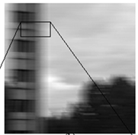
Motion Blur

Slide 39
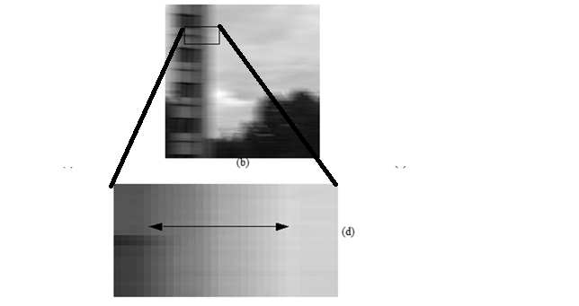
Motion Blur

Slide 40
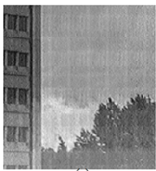
Motion Blur
We can reduce the degree of blur seen in the photo by attempting to undo the motion and its effect on each pixel. This can be done, not perfectly, but pretty well, using mathematical operations on the image given an estimate of what kind of blur there is. This process still only uses quantized pixel values, though, and does not create new information. It simply reorganizes what is already there

Slide 41
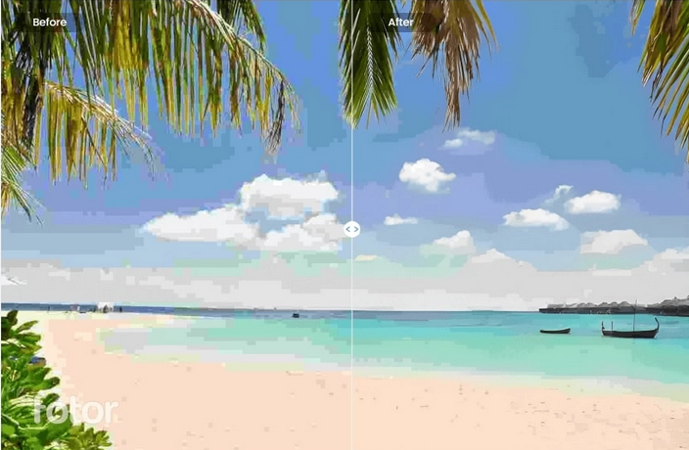
Digital Images are Distorted for Convenience
The JPEG and GIF formats for storing images on files both represent an image only approximately. In neither case can a pixel be extracted from the file directly – the image in the file must be decoded first, because the original pixels have been passed through a compression algorithm that permits the overall file size to be reduced.

Slide 42
Digital Images are Distorted for Convenience

Slide 43
Digital Image Space Is Malleable
The word malleable means “easily controlled or influenced” or “adaptable”. This is a key feature of digital image spaces for generative art.
In the digital space, all pixels are temporary. Indeed, one can think of them as they might in quantum, mechanics, where they could be in all states (colors) at the same time until we ‘collapse’ it into one image, which happens when we print it.

Slide 44
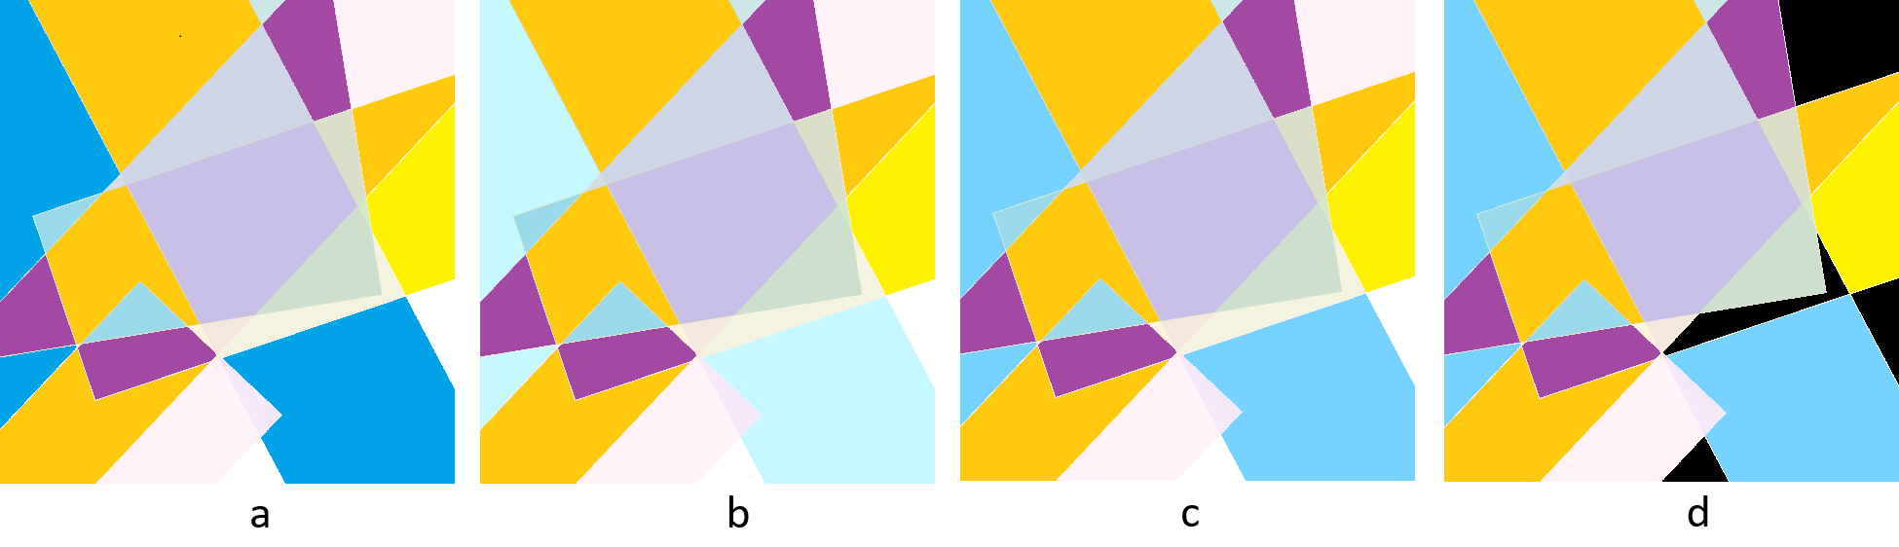
Digital Image Space Is Malleable
Here is a simple artwork.
The artist decides that the dark blue is the wrong color – it’s too dark. So, she lightens it Oops. Too much.
Try a sky blue Better. Now, the white regions near the left edge bother her. She turns them black.
Better yet. This would be a very difficult process using oil paint or acrylics.

Slide 45
Digital Image Space Is Relative
We have learned how to evaluate the size of things using visual cues. Humans are pretty good at this. Something ten feet from us can be evaluated very accurately for size and proportion, but as distance increases the precision with which we can do this decreases. Sometimes we use perspective or size compared to other objects.
None of these things are necessarily the same in digital image spaces. We can play games with size, proportion, perspective, shapes, and anything else we choose. Digital images do not tell the truth unless all of the parameters of it are known.

Slide 46
Digital Image Space Can Be Imaginary
A generative artwork always begins in the mind of the artist. To some degree that’s true of all art, but in the case of generative art the artist is forced to consider not just the visual they are designing, but also how it can be created and represented starting with nothing at all. From nothing, the artist conjures electrons to do her bidding, eventually creating photons for the final representation.
In some sense the image (the scene, really) does not exist.

Slide 47
The Tesseract
A tesseract is a 4-dimensional cube (also called a hypercube) and is an object that can’t exist in reality, and is a good example of what we mean when we say that digital image space is imaginary. We can, using digital methods, render such an object as if it existed.
We have seen how to project a 3D object onto a 2D plane so that we can display it on a screen or paper. Displaying 4D objects means reducing the dimensions from 4 to 3, then to 2. And, of course, 4D objects are very difficult to visualize in one’s head. That’s why we use a cube – it’s a very simple shape.

Slide 48
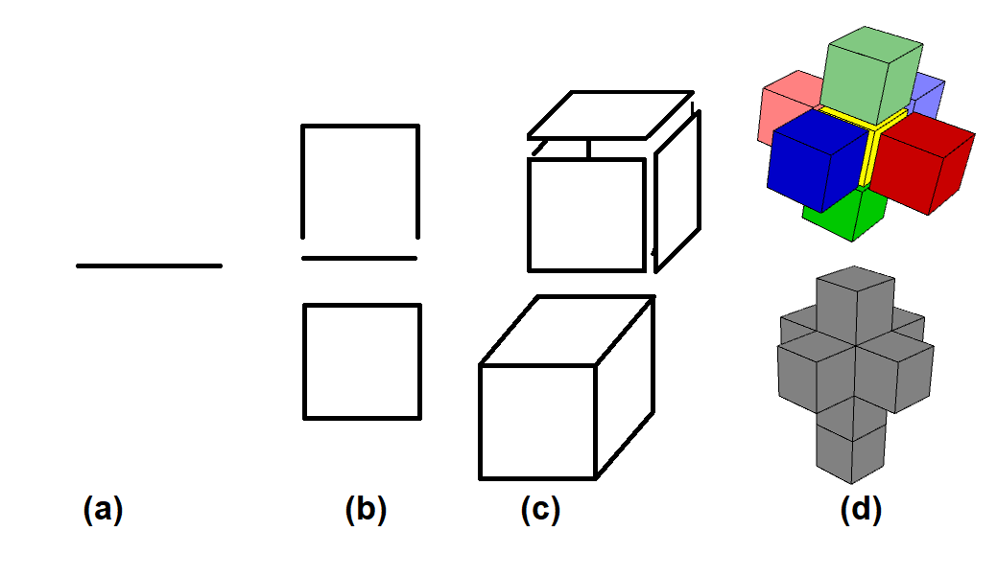
The Tesseract

Slide 49
The Tesseract
The 4th dimension is difficult for us to grasp because it is completely foreign to our perception, and yet it is possible to implement and manipulate as a digital space. We could create four dimensional displays or games, for instance. These would behave in strange new ways from our point of view.
Objects will be sliced in strange ways and can even vanish. The only thing we can do is to use 3D to 2D analogies to explain this behaviour.

Slide 50
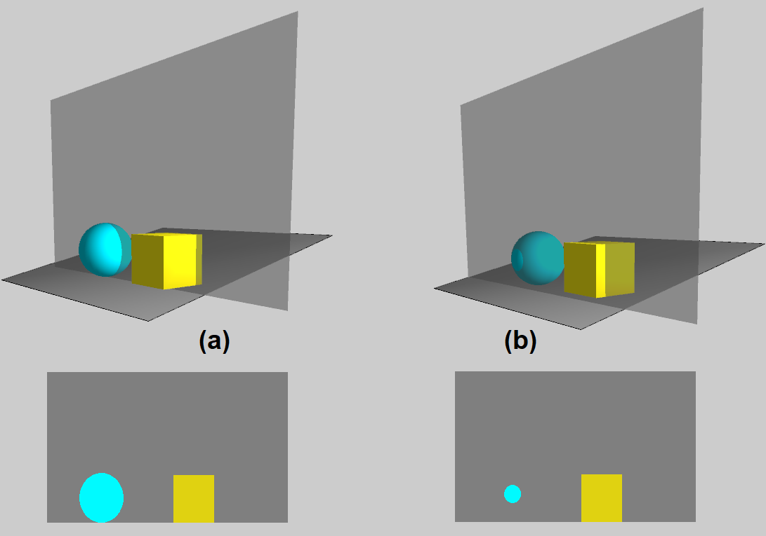
The Tesseract
.
From the point of view of a 2D observer, the sphere and the cube look like a circle and square resting on the bottom of the image. When the viewing plane moves forward, the sphere is cut at a different place and the circle now appears to be floating above the lower plane

Slide 51
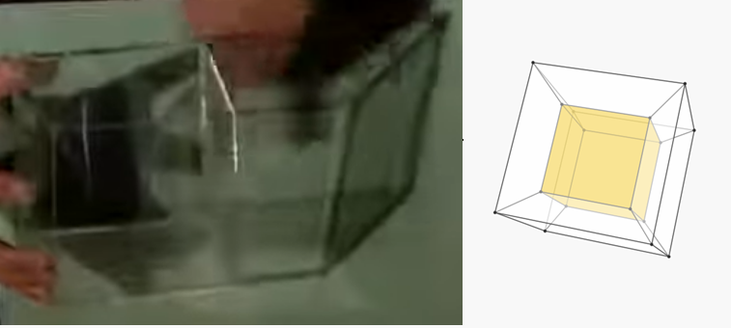
The Tesseract

Slide 52
Digital Image Space is Outside of Time
A photograph or painting is captured at a point in space and time, and that cannot be changed. When we look at a painting, it is unmoving and silent. As was pointed out in the book Ways of Seeing, historically paintings were relevant in the context in which they were displayed – churches and homes, for example.
Now paintings are treated as images, and can be stored, transmitted, and displayed anywhere. They are still static, though.
A digital image is not necessarily representative of any specific time, and can in fact change as a function of time as the artist choses (Chapter 9).

Slide 53
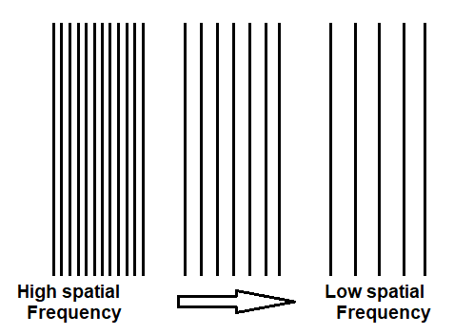
Visual Response
The human visual system is complex and consists of many parts, each of which modifies the input in some way. An important concept is that of is spatial frequency, which is a measure of how often a repeating component occurs, or could occur, per unit distance. In computer vision and physics these repeating components are often viewed as sine waves, but they can be any repeating element.

Slide 54
Visual Response
This is important because any real physical system like the human visual system can only respond to a limited range of spatial frequencies, just as the human ear can respond only to a limited range of audio frequencies.
When confronted with data that is outside of the defined range, the system can respond inappropriately or incorrectly. Sometimes the result is what we call an optical illusion.
We can filter certain frequencies so the we only see, for example, high or low frequencies.

Slide 55
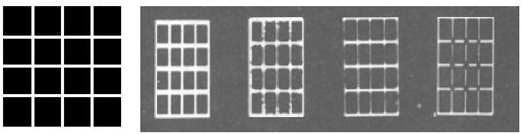
Optical illusions

Slide 56
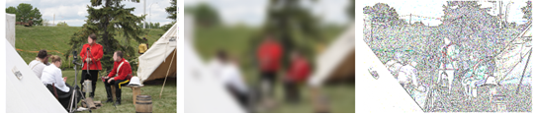
Spatial Frequencies

Slide 57
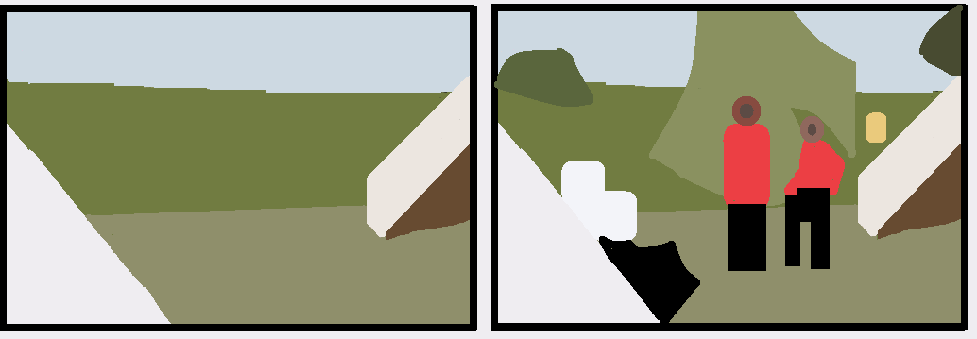
Spatial Frequencies

Slide 58
Visual Response
This is important because any real physical system like the human visual system can only respond to a limited range of spatial frequencies, just as the human ear can respond only to a limited range of audio frequencies.
When confronted with data that is outside of the defined range, the system can respond inappropriately or incorrectly. Sometimes the result is what we call an optical illusion.
We can filter certain frequencies so the we only see, for example, high or low frequencies.

Slide 59
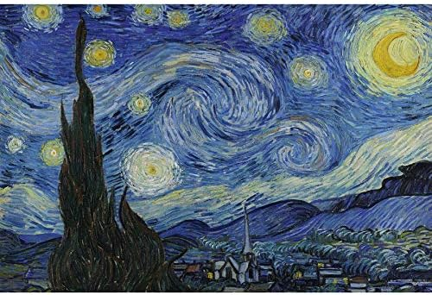
Visual Response
It has been suggested, for example, that Vincent Van Gogh may have suffered from lead poisoning, which swells the retina and causes a halo around lights, as seen in the painting Starry Night.

Slide 60
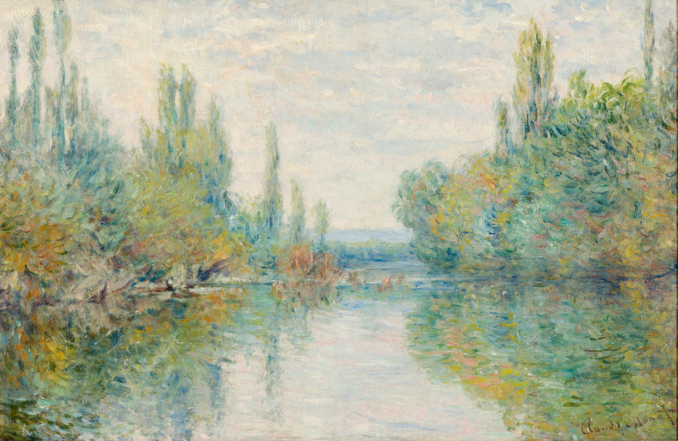
Visual Response
Claude Monet had cataracts later in life, blurring the images that he saw (Waterlillies) and Degas (1834-1917) probably had a retinal disease that caused macular damage, also creating a visual blur.

Slide 61
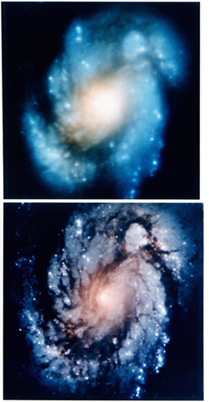
Blur
When the Hubble space telescope was first placed into orbit it produced poor images because the mirror had been built to the wrong specifications. Knowing what the mirror actually looked like permitted the images to be mathematically corrected. (Figure 8.20). This is done though a complex process called deconvolution. Basically we observe what the distortion is on a single pixel and assume the same distortion happened at all pixels, then undo it.

Slide 62
Space in Abstract Composition
The rules of composition apply to all 2D visual artworks, including generative ones. Generative works can begin with an existing image, and that image is somewhat fixed and has already had some composition rules applied to it.
There are composition forms that we can apply to more abstract artworks, the ones we simply make up in our heads. These are arrangements of visual elements that we can apply to our generative works, although not through an algorithmic process.

Slide 63
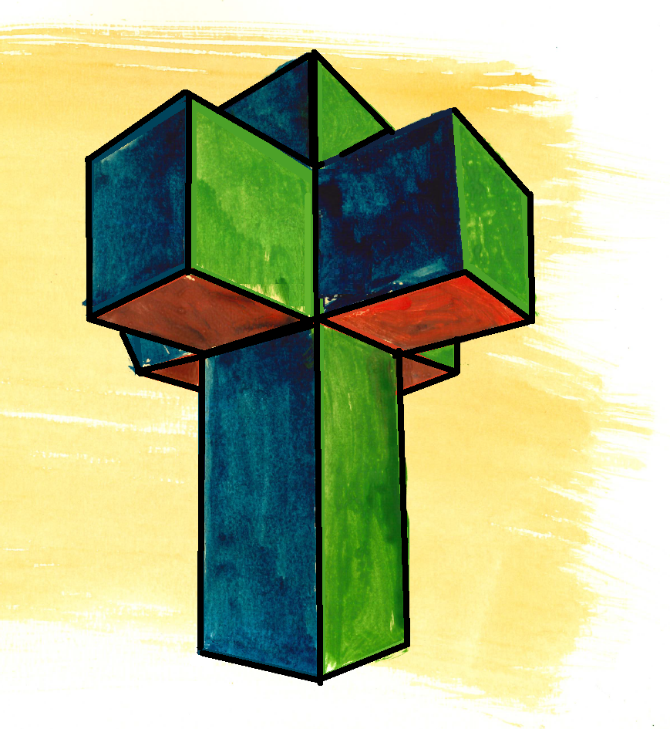
Cruciform Composition
This is an arrangement that uses intersecting lines and shapes that are organized loosely into a cross shape. It’s not about religion. We use it to create a sense of stability and balance. There is a power in the geometry of the cross, and that is used to support the theme and evoke specific emotions.

Slide 64
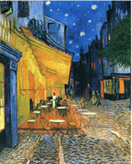
Asymmetrical, or Unbalanced Composition
Variously referred to as asymmetrical, or unbalanced, this arrangement creates visual interest and conveys tension. It is characterized by a departure from the usual symmetrical balance seen in many artworks, opting instead for an arrangement of elements that defies expectations. It often gives a sense of movement and instability.

Slide 65
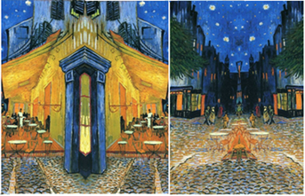
Asymmetrical, or Unbalanced Composition

Slide 66
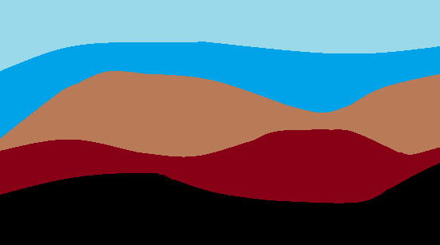
Horizontal Composition: High and Low
A horizontal composition creates a sense of calm and balance. These often use horizontal shapes that span the width of the canvas, and this leads to a feeling or stability. The term high refers to the placement of the horizontal elements near the top of the artwork, and low places them at the bottom. The high/low location of these horizontal elements have an impact on the viewer’s emotional response to the artwork.

Slide 67
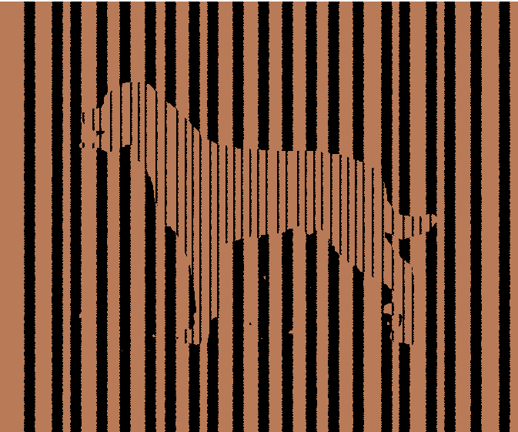
Vertical composition implies concepts like stability and growth. This style employs vertical elements that draw the viewer’s eye upwards, often creating a sense of elevation or expansion. Vertical compositions can symbolize various themes, from the growth of living things like trees to the sense of being enclosed. There can be an implied religious message because of the viewer’s gaze being drawn upwards.

Slide 68
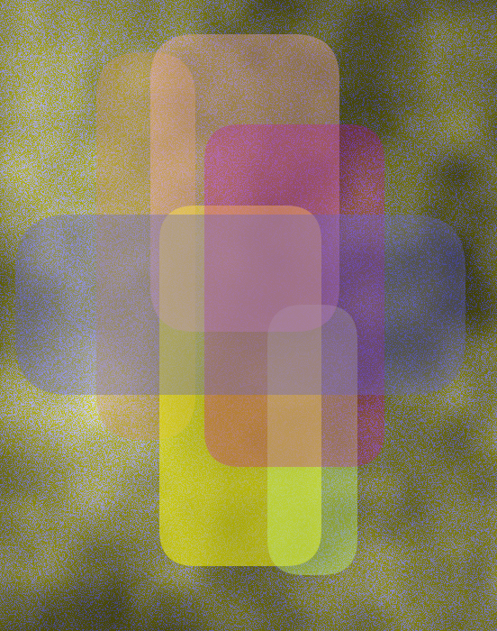
Overlapping Frames
This is sometimes called frame-in-frame composition. It is an approach in abstract art that creates depth through a layering of objects. It involves the careful placement of shapes that intersect or enclose each other, forming an overall pattern that goes beyond any single layer. It allows artists to explore depth and relationships between objects. It can provide an interesting and complex visual appearance

Slide 69
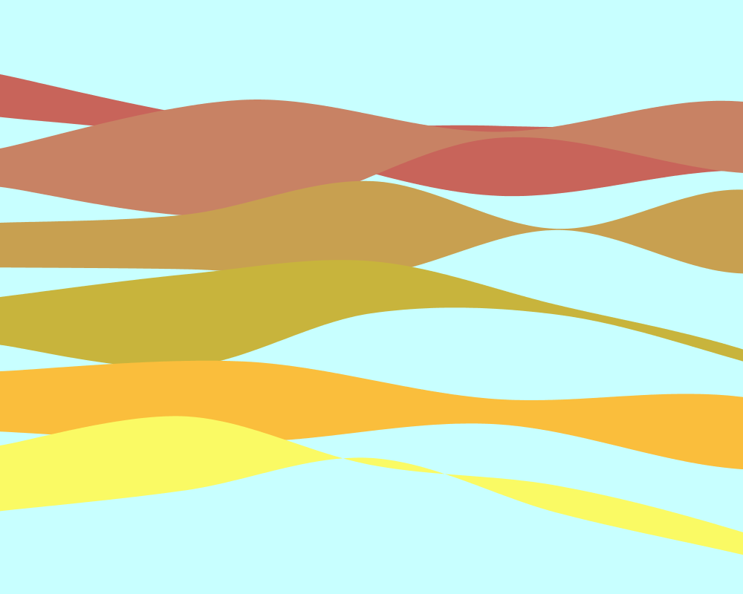
Curvilinear Composition
The curvilinear composition in abstract art uses more organic forms. Lacking the rigidity of straight lines, it gives a more natural appearing interpretation of shapes that imply calm, peace, and nature. Curves also imply movement making them a useful conveying life and peaceful energy.

Slide 70
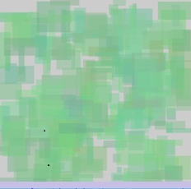
Constellation or Group Mass Composition
The constellation or group mass composition in abstract art refers to an arrangement where the many elements are grouped together to create a cohesive whole. This either creates a focal point or distributes mass of objects across the canvas. If the individual elements are placed carefully the artist can explore space, connection, and relationships. The group mass composition is often characterized by the scattered but connected parts, which can invite the viewer to explore the relationships between them.

Slide 71

Diagonal Composition
Diagonal composition in abstract art is a powerful tool for creating a sense of dynamism and movement. By using diagonal lines and forms, artists can convey action, tension, and directional flow within their works. This compositional style is particularly effective in suggesting instability and change, contrasting with the stability often associated with horizontal and vertical lines.

Slide 72
Golden Section or Golden Ratio
The Golden Section or Golden Ratio is a mathematical relationship that has been used in art for centuries to create aesthetically pleasing compositions. Mathematically it is, approximately 1:1.618, and is found in nature frequently. It is most commonly connected with the Fibonacci sequence, in which each number of the sum of the previous two. Starting with the sequence 1,2, then next value is 1+1=2, then 2+1=3, then 3+2=5, then 8, 13, 21, and so on.

Slide 73
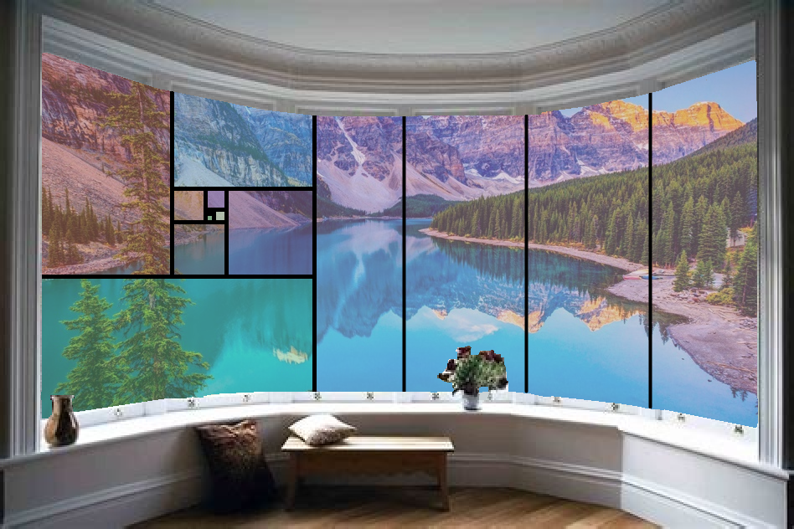
Diagonal Composition
Artists believe it gives a sense of harmony in visual designs. In abstract art, the it can be applied as an algorithm for the placement of elements within a composition, thus creating a natural sense of equilibrium and focus.

Slide 74
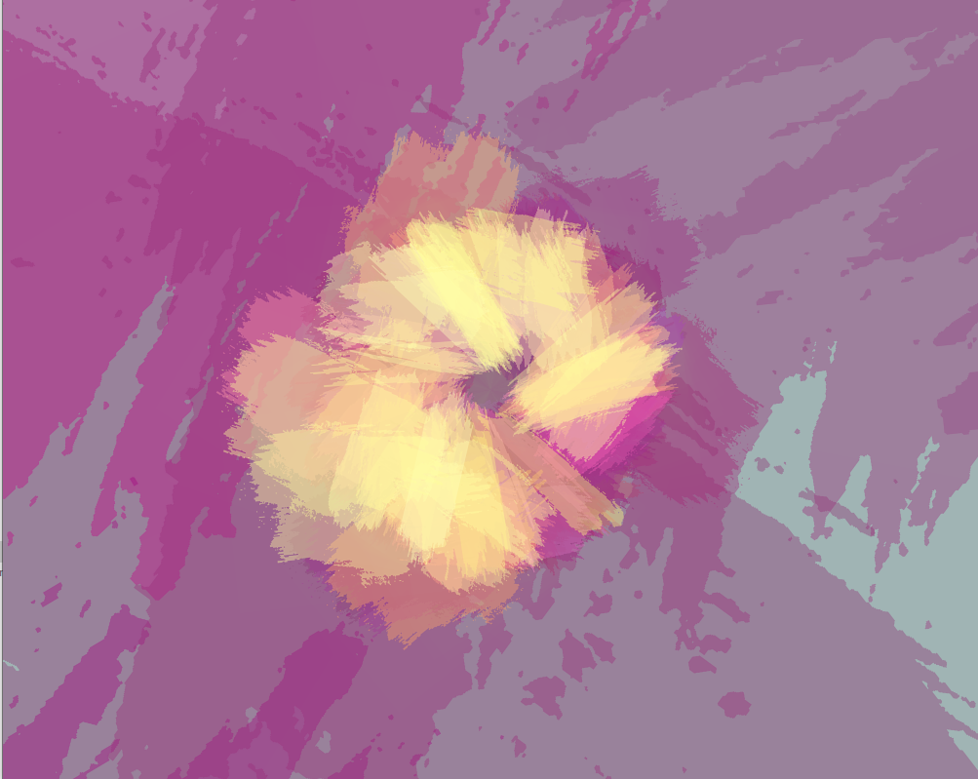
Centred Composition
Centered compositions place the focus and center of mass in the center of the canvas, as opposed to the usual offset or rule of thirds. This can give a sense of balance in an abstract artwork within the artwork. It can create a feeling of equilibrium and stability. A centered composition draws the viewer’s eye to the middle of the painting, where the connection to the surrounding shapes and colors forms a pattern to be explored.

Slide 75
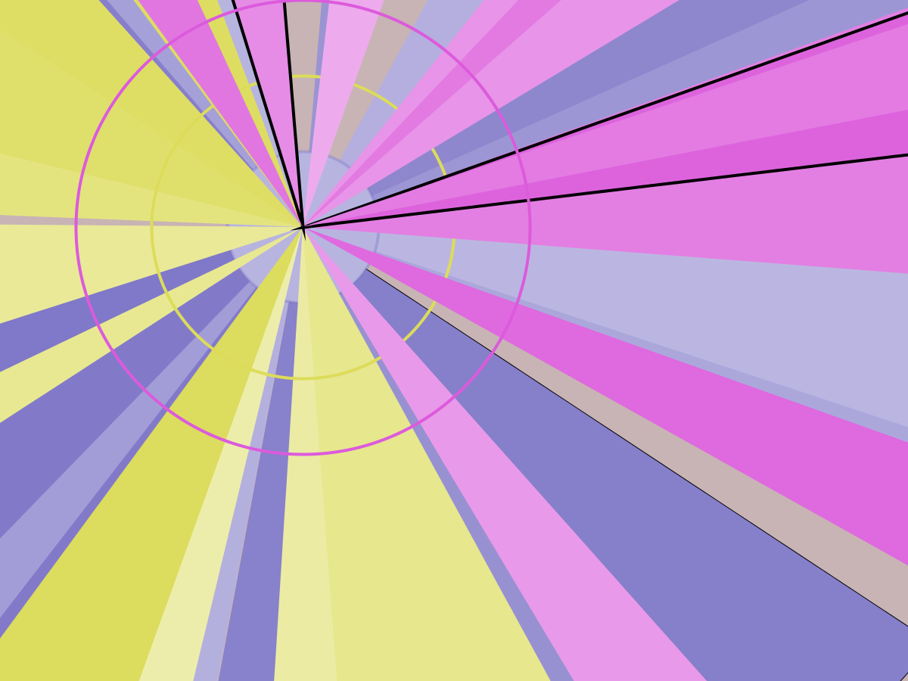
Diagonal Composition
Radiant or radiating compositions in abstract art use lines and forms that emanate from a central point, creating a sense of energy and focus. This compositional style often suggests movement and expansion, drawing the viewer’s eye towards the center and then outward along the radiating elements. It can be used to convey a range of themes, from the idea of a dynamic universe to the concept of cyclicality and motion.

Slide 76
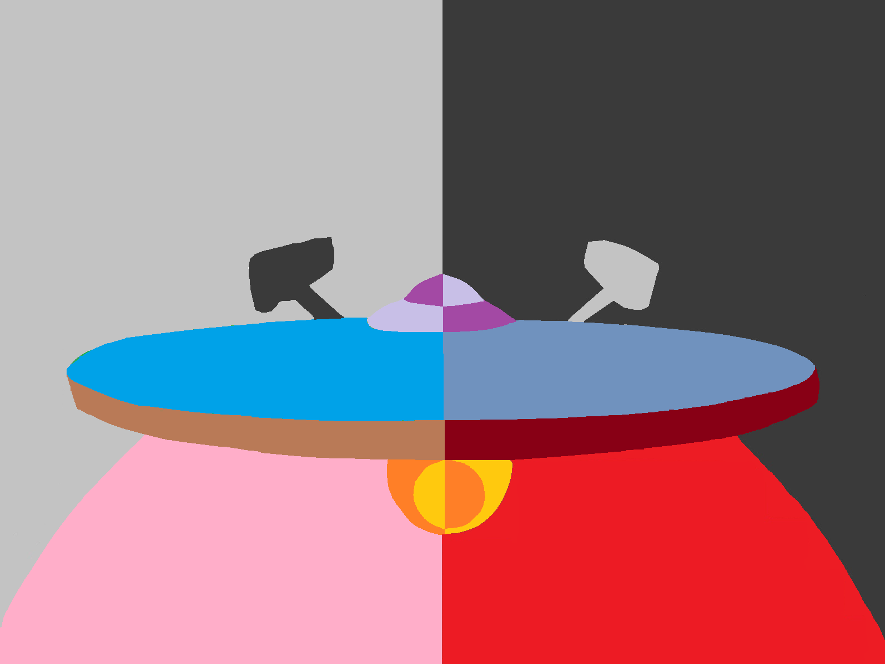
Balanced Composition
Balanced composition in abstract art refers to the harmonious arrangement of forms, colors, and textures that creates visual equilibrium. This balance can be achieved through symmetry, repetition, or the strategic distribution of visual weight across the canvas. It plays a crucial role in engaging the viewer and guiding their eye through the artwork, often resulting in a composition that feels stable and aesthetically pleasing.

Slide 77
3-Spot or Triangular Composition
The 3-spot or triangular composition in abstract art is a design principle that relies on the placement of three key elements in a triangular arrangement. This compositional style offers both stability and dynamism, guiding the viewer’s eye through the artwork and creating a sense of coherence and balance.

Slide 78
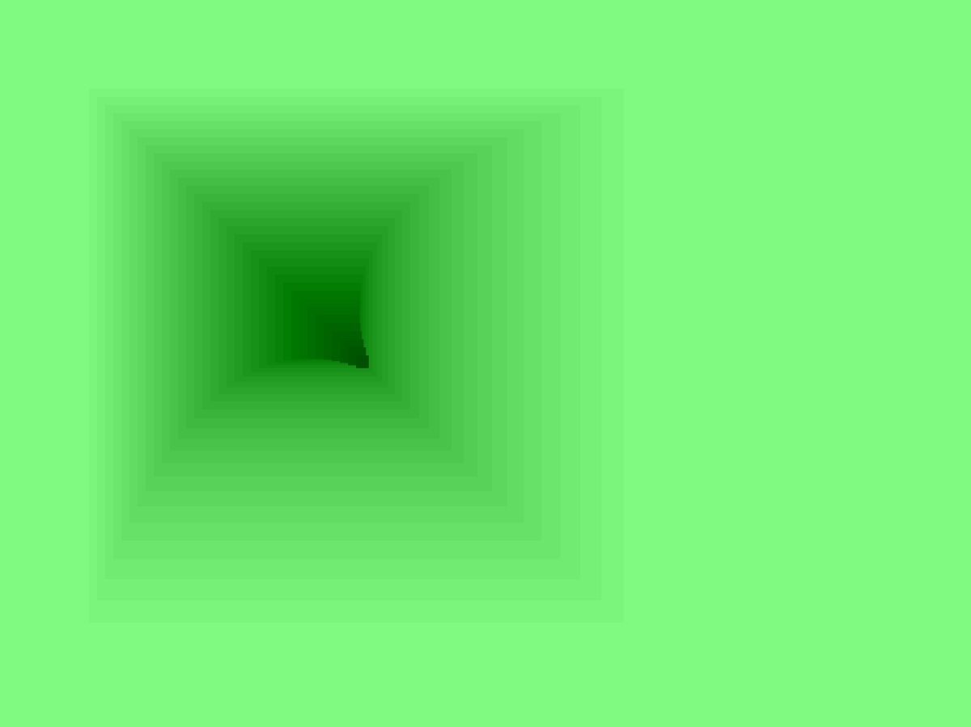
Tunnel Composition
Tunnel composition in abstract art is a technique that creates an illusion of depth and perspective, guiding the viewer’s eye through a tunnel-like passage within the canvas. This approach often uses central, receding forms surrounded by framing elements, creating a sense of three-dimensionality and leading the viewer into an imagined space beyond the physical boundaries of the artwork.

Slide 79
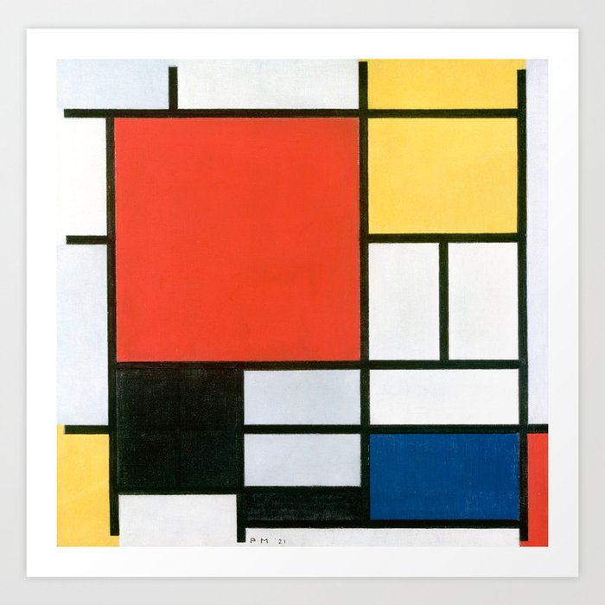
3-Spot or Triangular Composition
The L or rectangular composition in abstract art is a technique that uses L-shaped or rectangular arrangements to guide the viewer’s eye through the canvas. This compositional style can create a sense of structure, depth, and spatial harmony, allowing for a dynamic interplay between form and space.

Slide 80
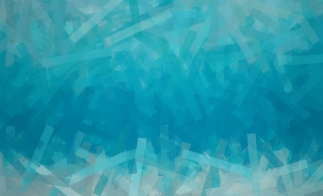
Pattern Composition
Pattern composition in abstract art is characterized by the repetition and rhythm of patterns, creating a rich visual experience through systematic yet dynamic arrangements. This compositional style often involves the meticulous application of motifs, exploring themes of order, chaos, and the interplay between them.

Slide 81
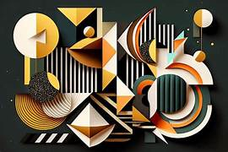
Pattern Composition
Patterns in abstract compositions can vary in complexity and style, ranging from geometric forms to more organic shapes, and are used to create depth, movement, and texture within the artwork.

Slide 82
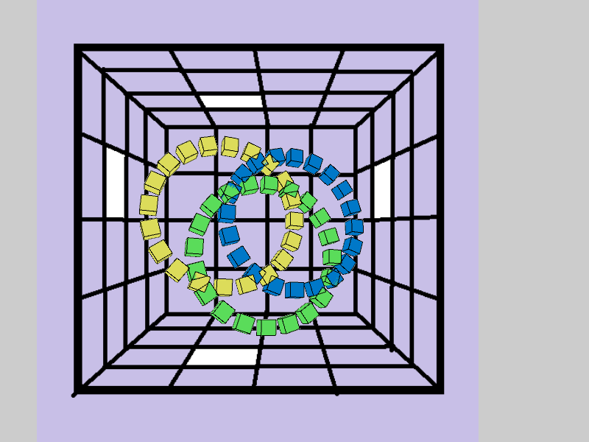
O or Circular Composition
O or circular composition in abstract art focuses on the use of circular forms, which can symbolize various concepts such as wholeness, continuity, and infinity. They often create dynamic visual experiences by drawing the viewer’s eye around the canvas in continuous motion. These compositions can evoke the rhythmical and cyclical patterns found in nature and the universe, making them powerful tools for abstract expression.

Slide 83
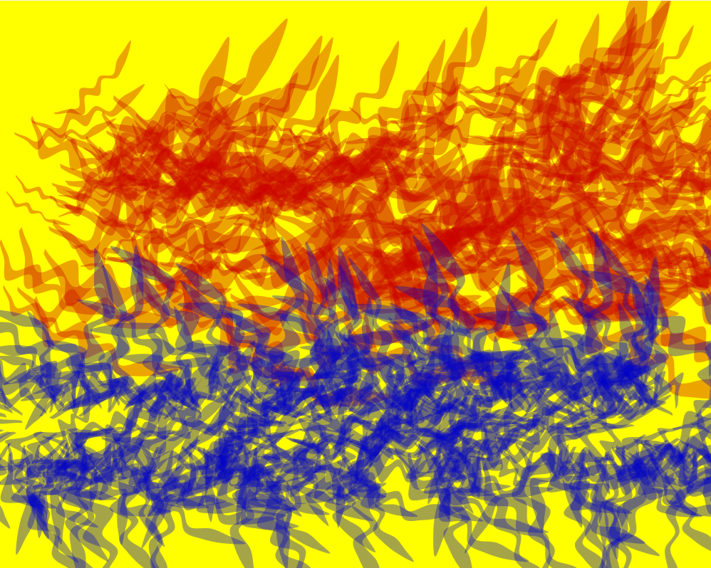
S or Compound Curve Composition
The S or compound curve composition uses flowing smooth curves, helping create a dynamic visual experience. These compositions can suggest natural forms and movements. The overlap and interrelationships of curves can suggest depth, adding to the visual complexity of the artwork.

