Slide 1
Form
Art 251
The Third Dimension

Slide 2
What is Form?
FORM is the third dimension.
It is the element of art that has volume.
Artists with two working eyes see in 3D and render in 2D as a matter of nature and training, but a generative artist must be able to imagine objects in 3D and manipulate them in abstract ways before rendering.

Slide 3
What is Form?
The world is 3d
The canvas is 2d.
The big problem here is that of representing a third dimension on a
two-dimensional surface.
Another problem is the viewpoint: where is the artist standing in 3D and where are they looking?

Slide 4
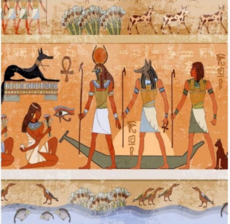
Form
Ancient art did not represent 3D at all.

Slide 5
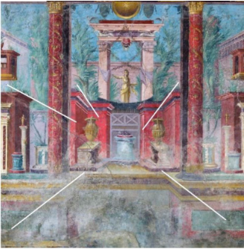
Form
Some Roman paintings from the 1st century BC show a knowledge of convergent projection, which is not quite one-point perspective

Slide 6
Form
When drawing in two dimensions, as we almost always do these days, we consider the horizontal (X) and vertical (Y) directions as being principal.
When drawing or painting a real scene, we instinctively draw what we see, which has perspective built in –
that’s how we always see things.

Slide 7
Form
When we draw a scene, the objects within it are usually three dimensional, but we can only see part of it, the part that faces us.
This is a critical difference between 2D and
3D.
There are parts of the 3D image that we don’t know about. If we, the artists, changeposition, then we can see more of the object, but parts we could see before are hidden now.

Slide 8
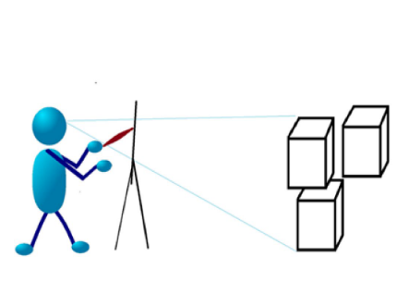
Form
The place from which we are looking at the scene is the viewpoint and is a critical part of 3D rendering.
Not only is the location important, but also critical is the direction we are facing. We can’t see things behind us at all

Slide 9
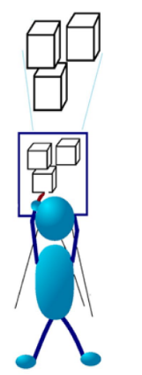
Form

Slide 10
3D Coordinates
When we specify a point in two dimensions, we use two numbers: the X and the Y coordinates.
A line, for example, is drawn from (x0, y0) to (x1, y1).
In three dimensions, we use three coordinates: X, Y, and Z. We can think of these as width, height, and depth.
We might draw a line in a program as:
line (x0, y0, z0, x1, y1, z1)

Slide 11
3D Coordinates
We obviously can’t draw all three coordinates on a computer screen directly, but as we suggested before, we can imagine the third coordinate, Z, to be projecting into the screen, and we would first have to transform (x0, y0, z0) into two coordinates
(a0, b0) on a plane (which is to say the canvas or screen).
We would also have to transform (x1,y1) into (a1,b1) and then draw the line between (a0,b0) and (a1,b1).

Slide 12
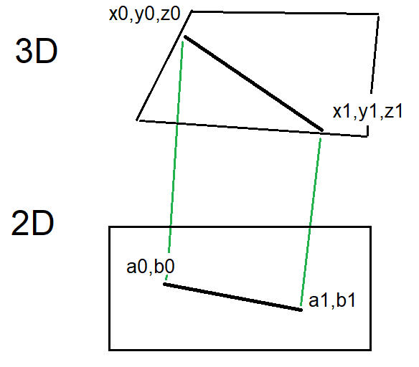
3D Coordinates

Slide 13
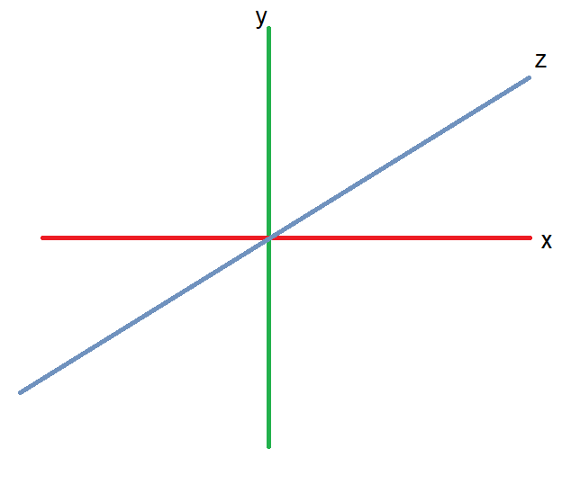
Form
The magic is in the transform, which is a mathematical projection of the three-dimensional coordinates onto a plane. This projection, called the perspective projection or perspective transformation, has been known for a long time.

Slide 14
Coordinate systems
Coordinate systems have an origin (0,0,0) and directions. The three axes are perpendicular to each other (90 degrees).
Right angles.

Slide 15
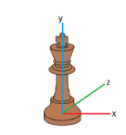
Object Coordinates
A single object has its own system of coordinates. We define vertices on the object relative to its origin, which is usually either the upper left corner of the object or its center.

Slide 16
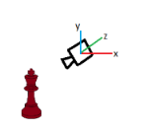
Camera Coordinates
The camera is the place from which we are viewing the scene, and so these are also called viewpoint coordinates.
Here the location from which we are seeing the scene is being the origin (0, 0, 0), and we identify all other positions relative to that position.

Slide 17
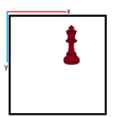
Screen Coordinates
These are always two-dimensional coordinates and refer to a location (pixel) on the display where the image is being displayed on the screen.
The origin is almost always the upper left corner of the 2D projection of the scene.

Slide 18
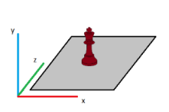
World Coordinates
These are coordinates we defined in the scene used as the basis for the image. The origin (0, 0, 0) can be anywhere in the 3D volume being viewed, and objects are located according to their positional relation to that location.

Slide 19
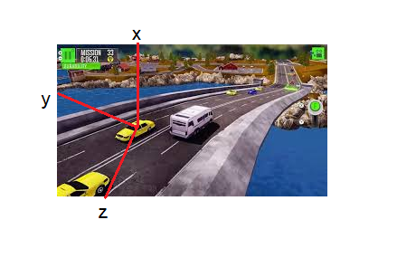
Coordinates
Think of the ‘world’ of the 3D graphics universe as a video game. Image a driving game and a car.
World coordinates are the location of car in the game ‘world’.

Slide 20
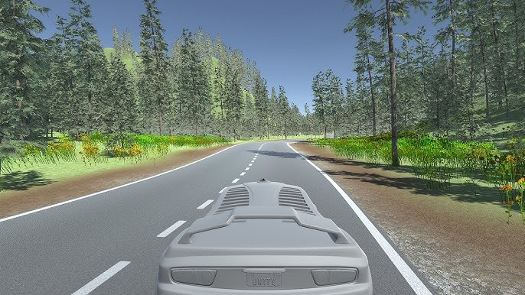
Coordinates
Think of the ‘camera’ coordinates of the game as the specific point of view of your avatar.

Slide 21
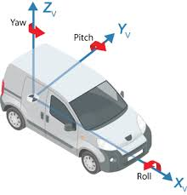
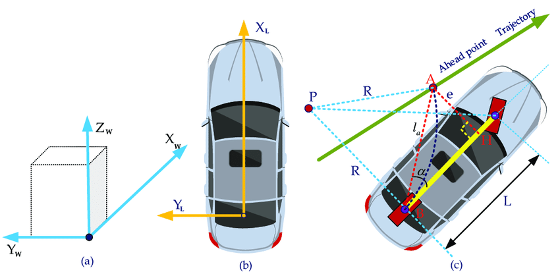
Coordinates
Think of the ‘object’ coordinates of the car as the specific point where your object might rotate (as the car turns, for instance).

Slide 22
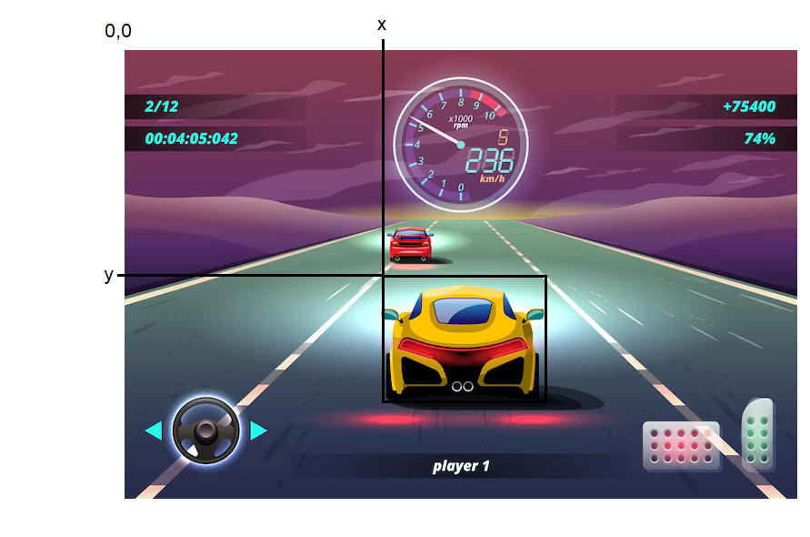
Coordinates
Think of the ‘screen’ coordinates of the car as the specific point one the screen where it is drawn.

Slide 23
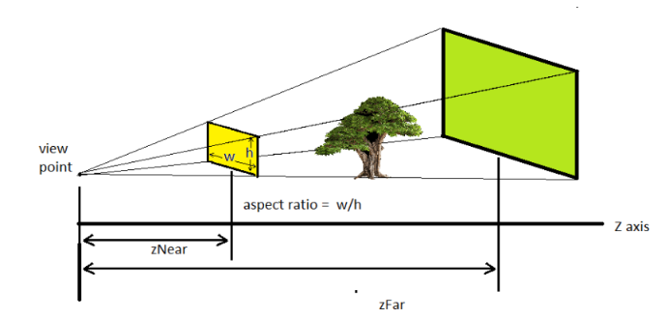
Perspective

Slide 24
Perspective
zNear and zFar are the near and far clipping planes, and represent the closest and farthest points that we can draw.
The vertical field of view (fov) is an angle in radians, and represents the angle between the extents of what we see without moving.
Horizontally, humans have a 120-degree horizontal region where we can see things properly in 3D and a vertical FOV angle of 60 degrees.

Slide 25
Perspective
The width and height of the drawing surface (w and h) are the number of pixels in the drawing area, and the aspect ratio is w/h.
For example, aspect = 2.0 means the viewer's angle of view is twice as wide in x as it is in y.
These really define the change in size (scale) between the scene and the rendering.

Slide 26
Viewing Transformation
What can be seen from the viewing position?
Our eyes are located at some set of 3D coordinates that we’ll call (eyex, eyey, eyez).
We will be looking at a specific point in 3D in the scene (centerx, centery, centerz) (or (lookatX,
lookatY, lookatZ)
We also need to say what direction is UP.

Slide 27
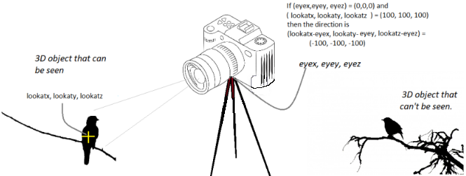
Viewing

Slide 28
Viewing Transformation
In a video game when the player’s avatar moves, these
values change accordingly so that the game scene is viewed from the new location.
In non-animated applications, these values are constant for the entire execution of theprogram

Slide 29
Changing Viewpoint
In a video game when the player’s avatar moves, the viewpoint (eyeX, eyeY, eyeZ) must to be modified
If the change is that they are looking someplace else, then the point we are looking at (centerX, centerY,
centerZ) will be modified, and we will seem to rotate around that point.

Slide 30
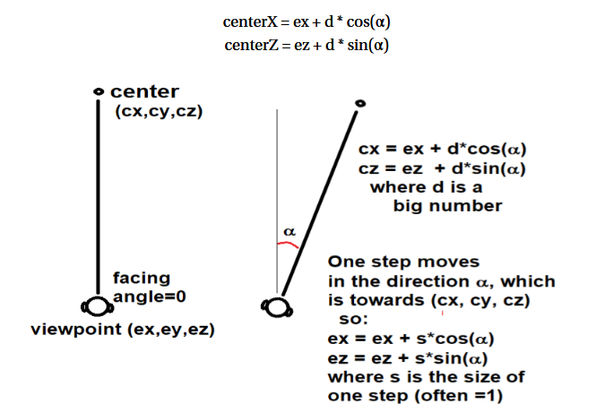
Changing Viewpoint w/s moves a/d rotates
Don’t worry about the math

Slide 31
Basic Drawing – A Cube
Using only lines:
First, set up the 3D projection and viewing transformation, as needed.
Then: each side of a cube is a square, which is 4 lines.
Right?

Slide 32
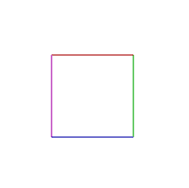
Basic Drawing – A Cube
Let’s draw the first square at (0,0,0) and make it 100 pixels per side.
The first square could be:
line 0,0,0 to 100, 0, 0 (red)
line 100, 0, 0 to 100, 100, 0 (green)
line 100, 100, 0 to 0, 100, 0 (blue)
line 0, 100, 0 to 0,0,0 (magenta)

Slide 33
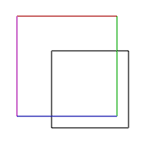
Basic Drawing – A Cube
Now draw a second square
Offset by 100 in the Z
direction
line 0,0,100 to 100, 0, 100 (red)
line 100, 0, 100 to 100, 100, 100 (green)
line 100, 100, 100 to 0, 100, 100 (blue)
line 0, 100, 100 to 0, 0, 100 (magenta)

Slide 34
Basic Drawing – A Cube
The square at z=100 seems bigger than the one at z-0 because positive z extends towards you out of the plane of the drawing area.

Slide 35
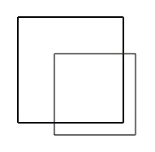
Basic Drawing – A Cube
Now:
We could draw 4 more squares
OR
We could connect the corners using 3D lines.

Slide 36
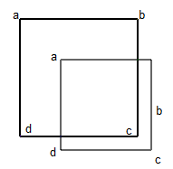
Basic Drawing – A Cube
Now:
Here’s how they should connect

Slide 37
Basic Drawing – A Cube
Now:
Connect a’s
line 0,0,0 to 0, 0, 100

Slide 38
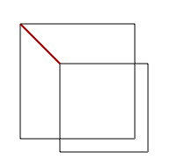
Basic Drawing – A Cube
Now:
Connect a’s
line 0,0,0 to 0, 0, 100

Slide 39
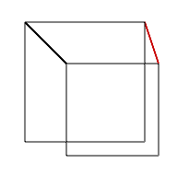
Basic Drawing – A Cube
Now:
Connect b’s
line 100, 0, 0 to 100, 0, 100

Slide 40
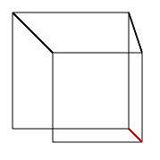
Basic Drawing – A Cube
Now:
Connect c’s
line 100, 100, 0 to 100, 100, 100

Slide 41
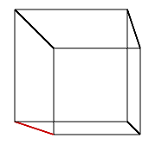
Basic Drawing – A Cube
Finally:
Connect d’s
line 0, 100, 0 to 0,100,100

Slide 42
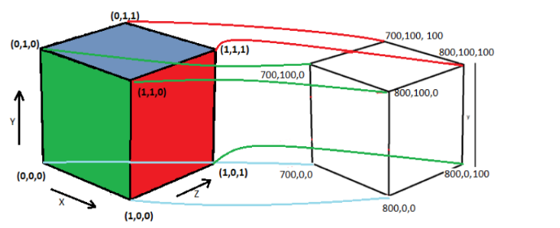
Unit Cube

Slide 43
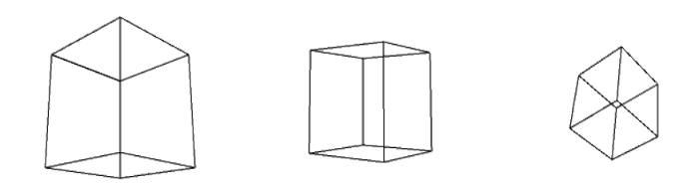
Points of view
eye
300, 150, 300 300, 50, 400 400, 450, -300,

Slide 44
Points of view
eye
300, 150, 300 300, 50, 400 400, 450, -300,

Slide 45
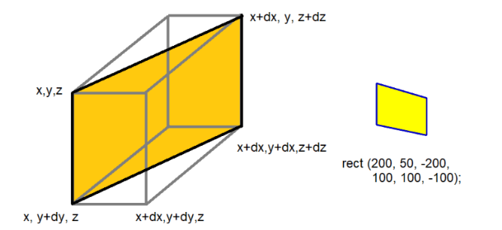
Off-axis rectangle

Slide 46
Perspective – Most Basic
X' = (x*cz)/(cz+z);
y' = (y*cz)/(cz+z);
For viewpoint at (0,0,-cz)
Which is along the Z axis

Slide 47
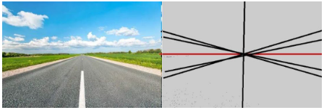
One-point Perspective
An artist will sometimes use a vanishing point to accurately draw perspective. That’s the point where lines perpendicular to the canvas will seem to meet.

Slide 48
Perspective - Cube
1. Draw a square.
2. Draw construction lines from the corners of the square to the
vanishing point.
3. Draw a second square towards the vanishing point, using the
construction lines as a guide.
4. Draw lines connecting the corresponding corners of the two
squares, following the construction lines.
5. Erase the construction lines.
6. (Optional) erase the hidden lines

Slide 49
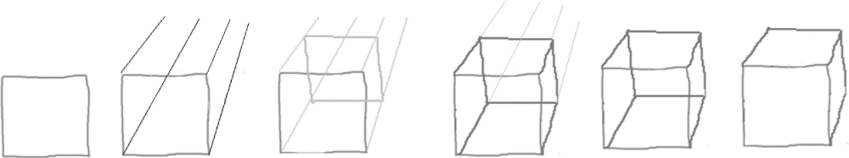
Perspective

Slide 50
One Point Perspective and Computer Graphics
The tools do not exist for using vanishing points to create 3D renderings using a graphics library.
We CAN do it using Paint or photoshop, but not with a traditional graphics system.

Slide 51
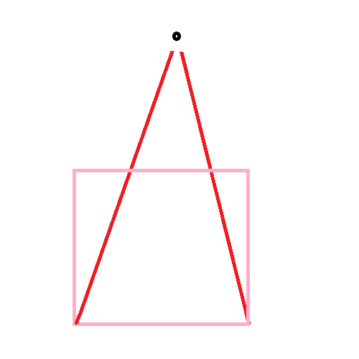
One Point Perspective and Computer Graphics

Slide 52
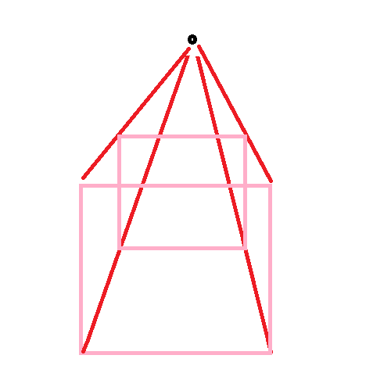
One Point Perspective and Computer Graphics

Slide 53
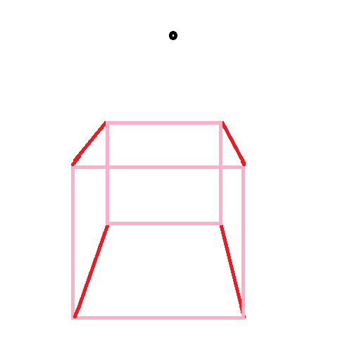
One Point Perspective and Computer Graphics

Slide 54
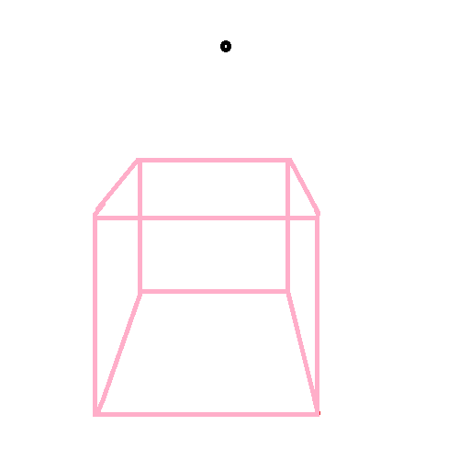
One Point Perspective and Computer Graphics

Slide 55
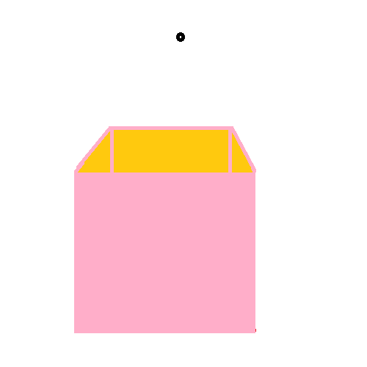
One Point Perspective and Computer Graphics

Slide 56
One Point Perspective and Computer Graphics
My new scheme using CG drawing ops:

Slide 57
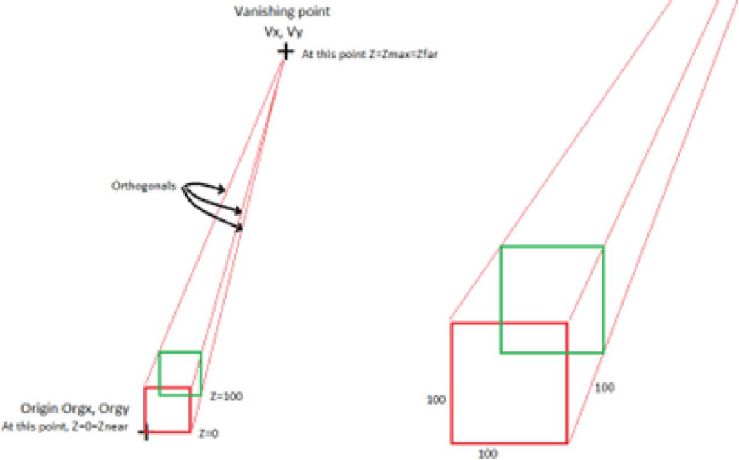
One Point Perspective and Computer Graphics
My new scheme using CG drawing ops:

Slide 58
One Point Perspective and Computer Graphics
Math alert – you won’t have to memorize this
The maximum Z coordinate is Zfar. So this Z value is the fraction dz = Z/
Zfar of the total possible distance (to the vanishing point), and dz has a value between 0.0 and 1.0. At the vanishing point everything is squished into a single point, X and Y coordinates as well. This means that X and Y values have an effective maximum also.
AsZ increases towards Zfar, the X values all approach Vx and the Y values approach Vy.

Slide 59
One Point Perspective and Computer Graphics
Math alert – you won’t have to memorize this
If we assume that the rate at which they change as a function of Z is the same, then we can produce a formula, and therefore a computer function, that allows us to convert the 3D coordinates to 2D.
So we have:
Xnew = (Vx-x)*dz + x
Ynew = (Vy-y)*dz + y
Which is to say that the change we should apply to X is related to the fraction of the distance this point is towards its maximum applied to its distance to the maximum, and ditto for Y.

Slide 60
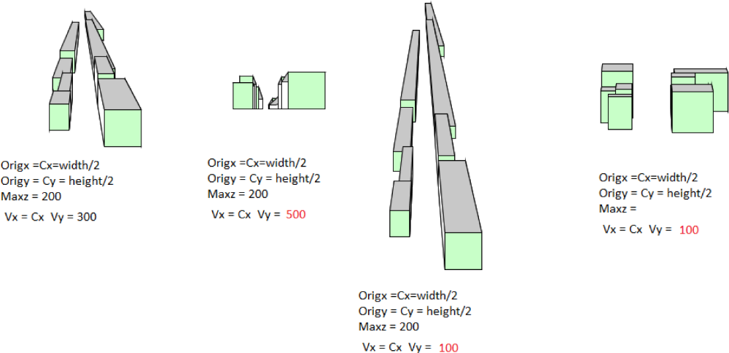

Slide 61
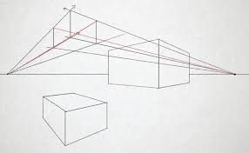
Two- Point Perspective
There are two vanishing points.

Slide 62
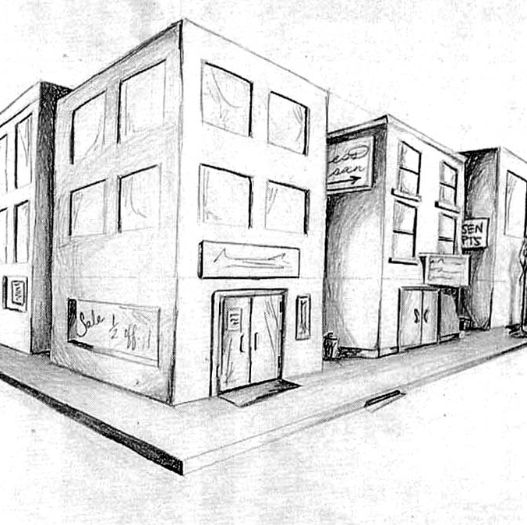
Two- Point Perspective
There are two vanishing points.

Slide 63
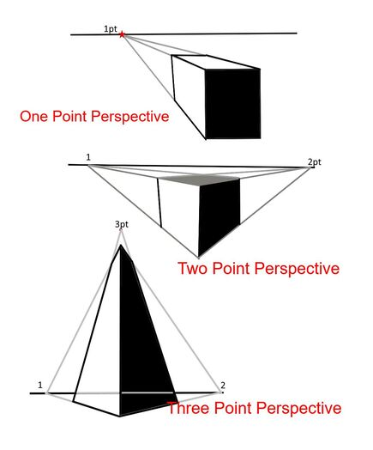
Three - Point Perspective
There are three vanishing points.

Slide 64
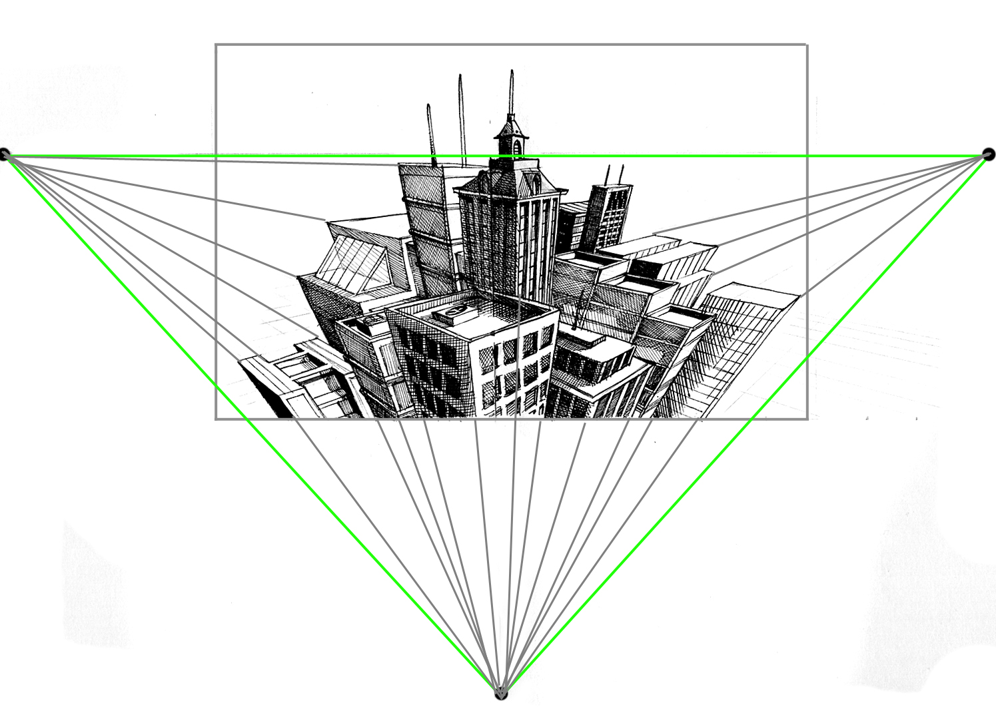

Slide 65
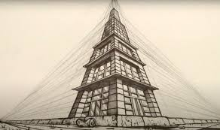

Slide 66
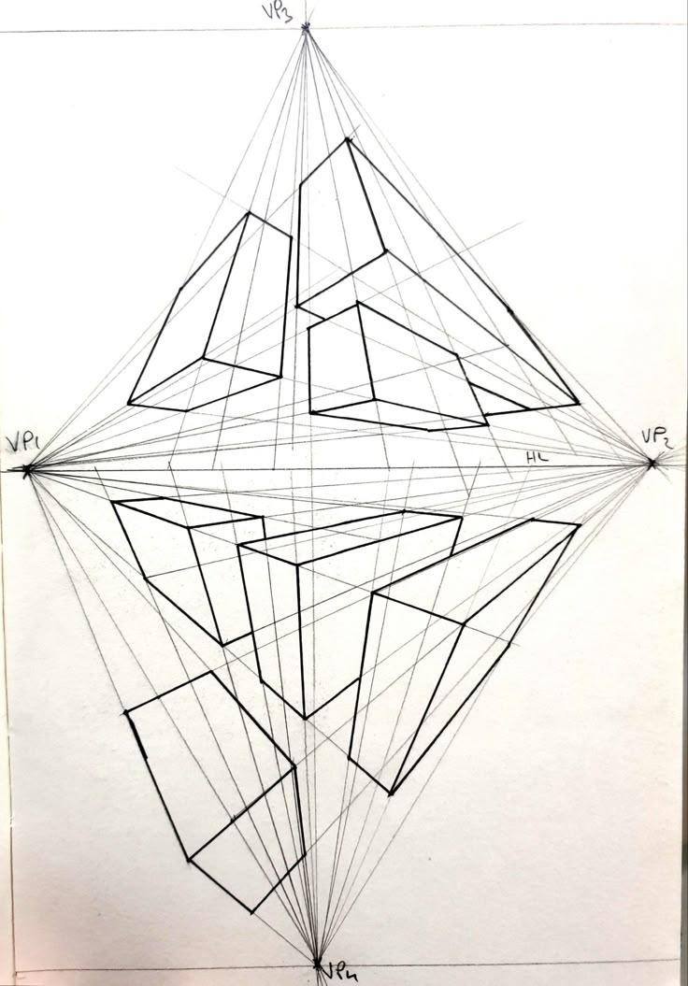
Four - Point Perspective
Has a vanishing point above AND below the horizon

Slide 67
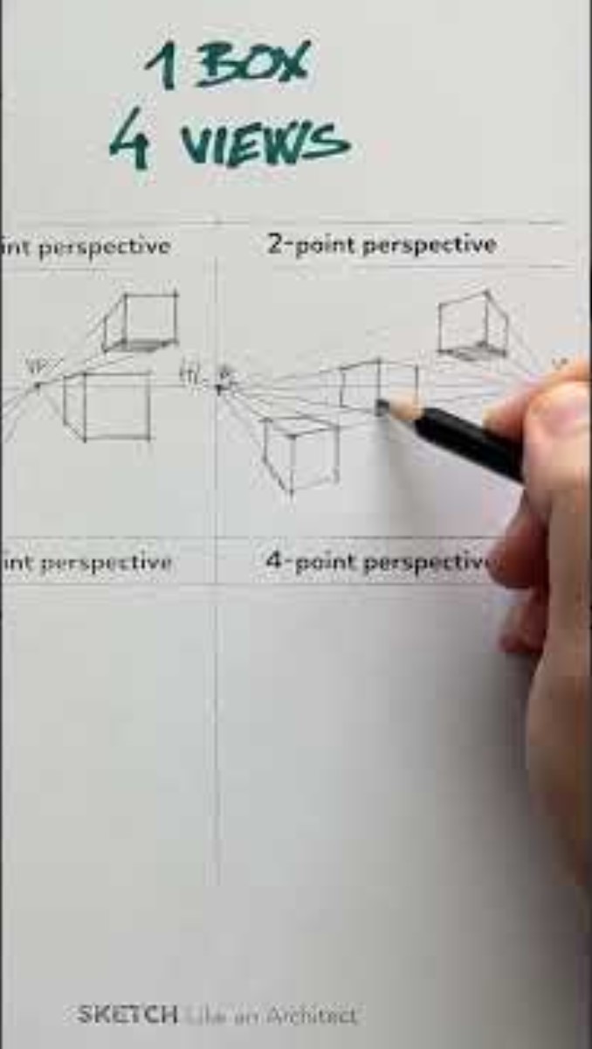

Slide 68
Geometric Transforms in 3D
Translation
Easy. Translation in 3D is the same as in 2D but with one extra dimension. We simply add a translation value to each coordinate, and the values can be different in each dimension.
X’ = x+dx
Y’ = y+dy
Z’ = z+dz

Slide 69
Geometric Transforms in 3D
Scale
Easy. Scale in 3D is the same as in 2D but with one extra dimension. We simply multiply each coordinate by a scale, and again these values can be different in each dimension.
X’ = x*dx
Y’ = y*dy
Z’ = z*dz

Slide 70
Geometric Transforms in 3D
Rotation
Not Easy.
There are now three coordinate axes about which a rotation can be performed: the X, Y, and Z axes. In 2D, rotations are performed about the origin, so there’s really one axis.

Slide 71
Geometric Transforms in 3D
Rotation
Not Easy.
Let’s consider the X axis; the others will be very similar. A rotation of θ degrees around the X axis is accomplished by modifying the (x,y,z) coordinates of the original point to:
x’ = x
y’ = y*cos(q) – z*sin(q)
z' = y*sin(q) + z*cos(q)

Slide 72
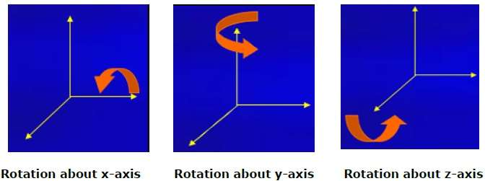
Centre of Rotation
Rotations all take place using the global origin.

Slide 73
Rotation about centre - 2D

Slide 74
Centre of Rotation
What if we wish to use object coordinates? As before, translate the origin to the object centre.

