Slide 1
Texture
Art 251

Slide 2
What is Texture?
Although there is no agreement on a formal definition of texture, a major characteristic is the repetition of a pattern or patterns over a region.
The pattern may be repeated exactly, or as a set of small variations on the theme, possibly a function of position.
There is also a random aspect to texture that must not be ignored - the size, shape, color, and orientation of the elements of the pattern (sometimes called textons) can vary over the region.
Sometimes the difference between two textures is contained in the degree of variation alone, or in the statistical distribution found relating the textons.

Slide 3
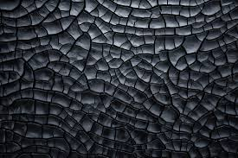
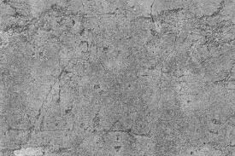

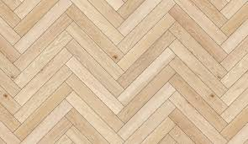
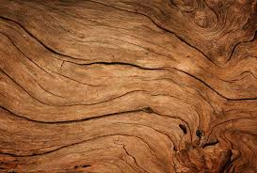
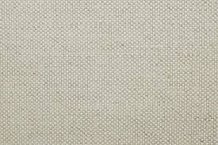
Texture

Slide 4
Texture and Shading
Shading and texture are used by the human visual system as ways to determine shape of three dimensional objects, so their use in accurately rendering objects like trees is critical.
Shading is the use of color or intensity variations across an area being drawn to illustrate shape. In particular it is used to simulate the effect of illumination on the object.
Texture amounts to the surface detail of a real object. Wood, cloth, metal, and stone have tactile (touch) and visual texture, and they help humans identify objects and their shapes and orientations.

Slide 5
Applying Textures
A digital texture is usually an image, a photograph or drawing of a texture pattern.
The texture is placed within a specified area, which is usually a polygon, by copying the image pixel-by-pixel into that area.
This is referred to as texture mapping.

Slide 6
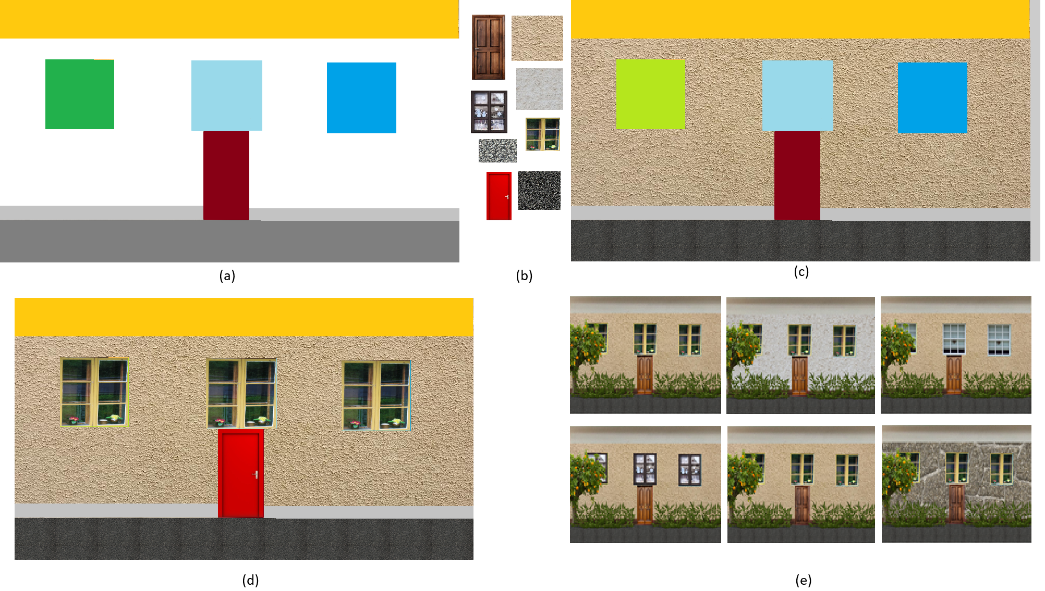
Texture Mapping

Slide 7
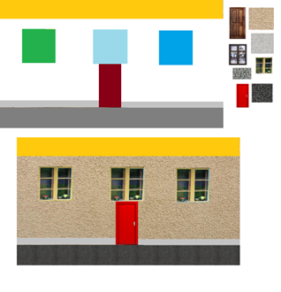
Texture mapping
A first step is be to copy the background textures, like the stucco, onto the areas where they belong.
In this case we’ll do that using color for simplicity, but that’s not usual practice.
Here, the white pixels in the house image will be replaced by pixels from the stucco image and the grey pixels from the lower portion of the image will be replaced by pixels from a concrete texture image.

Slide 8
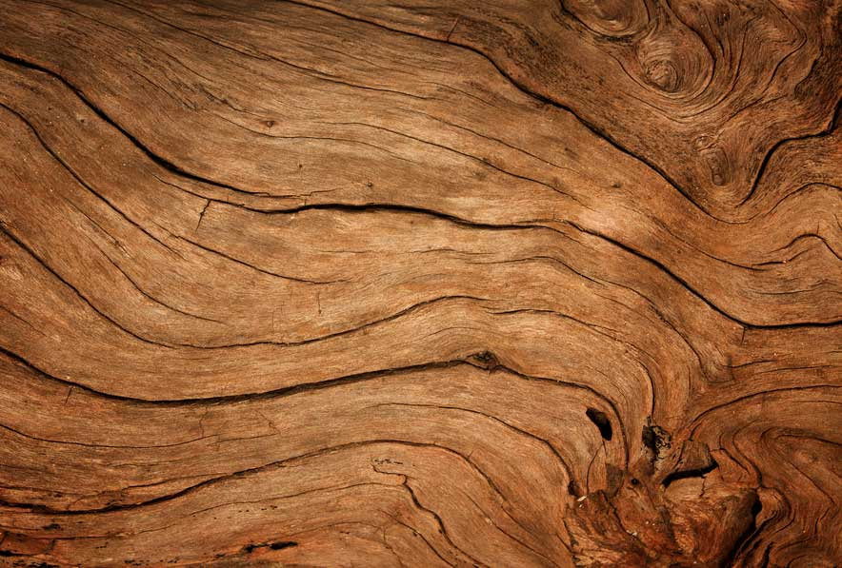
Mapping
The texture images must fit into the rectangle provided.
If the texture is larger than the rectangle, then only part of it will be copied; if the texture is smaller than the rectangle then it will be repeated so as to fill it.

Slide 9
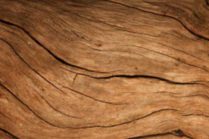
Mapping
If the texture is larger than the rectangle, then only part of it will be copied

Slide 10
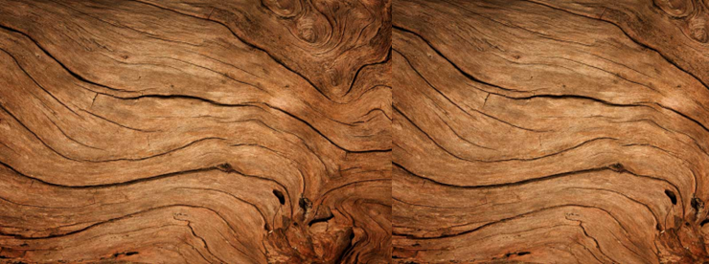
Mapping
If the texture is smaller than the rectangle then it will be repeated so as to fill it.

Slide 11
Aspect Ratio
The aspect ratio of an image is its width divided by height.
This image is 884x587.
Aspect ratio is 1.5:1, or 3:2. Or simply 1.5
Scaling the image should keep the aspect ratio the same.
.

Slide 12
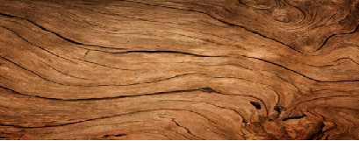
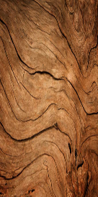
Aspect ratio
Distortions result from bad scaling

Slide 13
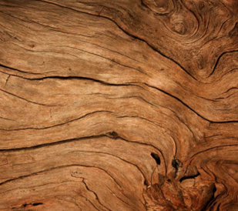
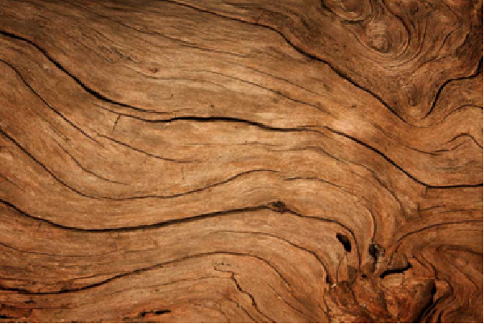
Aspect Ratio – Larger X
If we want the 884x587 image to be 1200 pixels wide, how many pixels high should it be?
1.5 = 1200/h => h = 1200/1.5 =800
So making it 1000 x 800 pixels would make it look right
.

Slide 14
Aspect Ratio – Smaller X
If we want the 884x587 image to be 400 pixels wide, how many pixels high should it be?
1.5 = 400/h => h = 1200/1.5 = 267
So making it 400 x 267pixels would make it look right
.

Slide 15
Aspect Ratio – Larger Y
If we want the 884x587 image to be 1000 pixels high (y), how many pixels wide (x) should it be?
1.5 = w/1000 => w = 1000*1.5 = 1500
So making it 1500 x 1000 pixels would make it look right
.

Slide 16
Aspect Ratio – Smaller Y
If we want the 884x587 image to be 200 pixels high, how many pixels wide should it be?
1.5 = w/200 => w = 1.5 * 200 = 300
So making it 300 x 200 pixels would make it look right
.

Slide 17
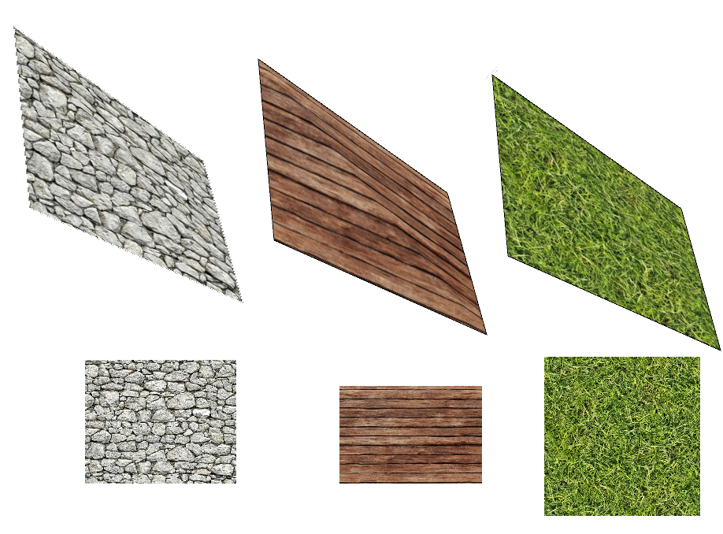
Sometimes we have to consider foreshortening, or the third dimension

Slide 18
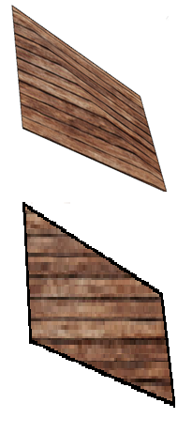
Bad 3D

Slide 19
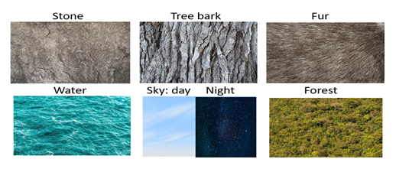
Natural Textures
Natural textures are those that we encounter in daily life, and that lend reality to scenes and images.

Slide 20
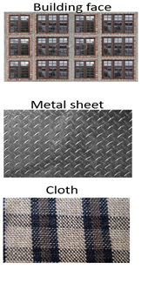
Human Textures
Also lend reality to human images.

Slide 21
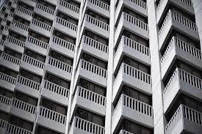
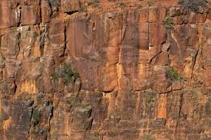
Textures from nature tend to have a higher degree of randomness than other kinds, containing few consistent structural elements and few geometric shapes.
Human based textures tend to have linear features and sharp boundaries, with repeating patterns.
Human textures can also contain natural ones: a stone wall has a human texture pattern consisting of smaller stone (natural) textures.

Slide 22
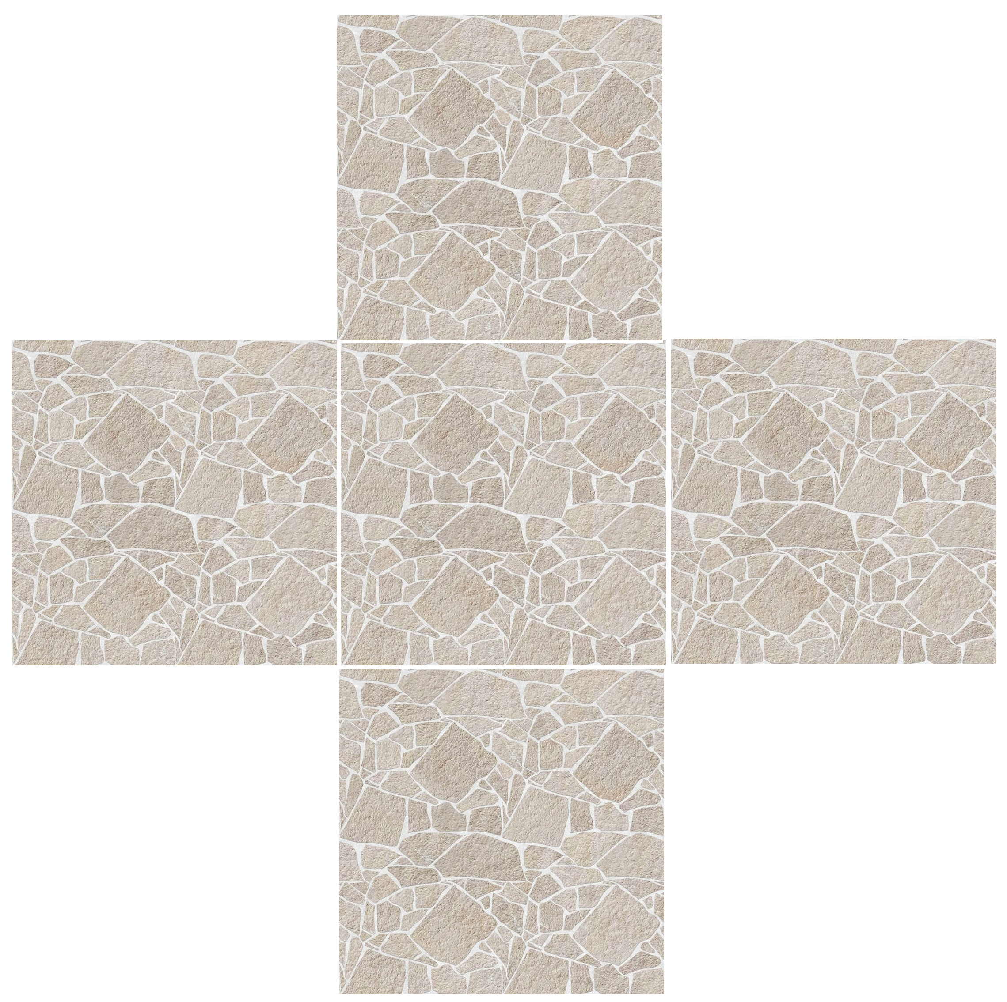
When tiling, the left and right edges of the texture need to align with each other or the join where the two texture images meet will be visible. The same applies to the upper and lower edges.
Also called seamless textures.

Slide 23
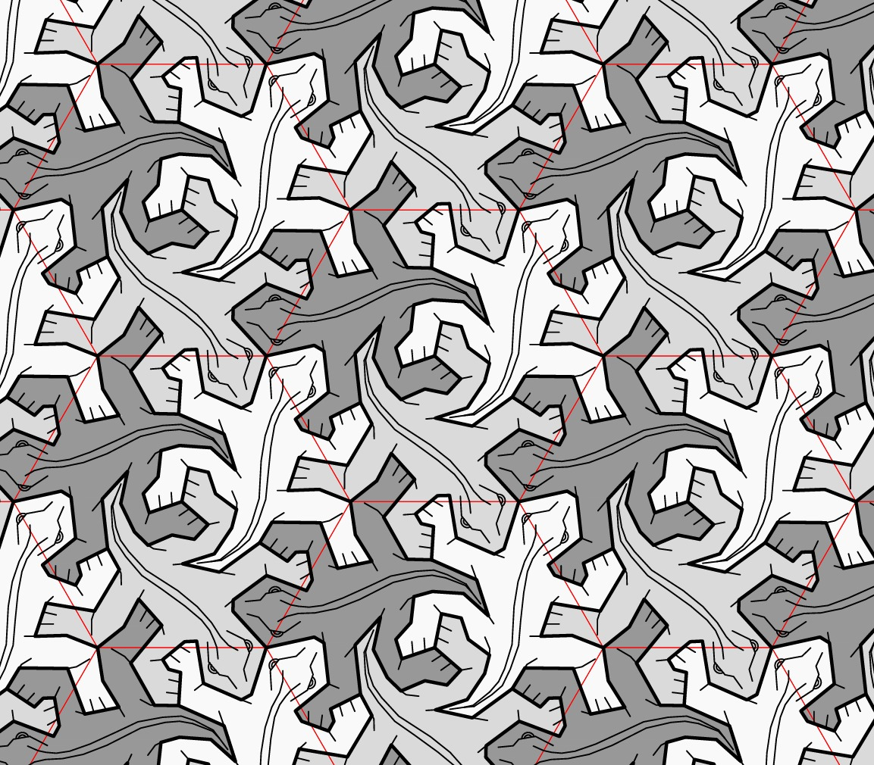
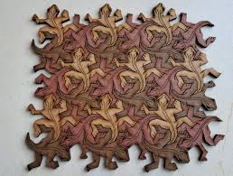
Escher was good at this.
Filling a space or area with a shape is called tessellation.

Slide 24
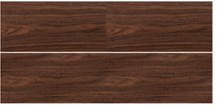
Reflection
The simplest way to create a texture that can be repeated (tiled) without an obvious seam is to reflect it across the right side and the bottom

Slide 25
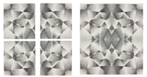
Reflection

Slide 26
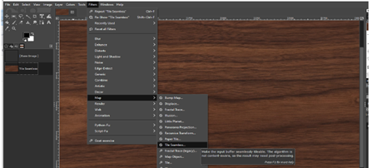
GIMP

