Slide 1
Shape 1
Art 251

Slide 2
What is Shape?
All objects have a shape, and much of visual art is involved in the representation of objects.
Line, value, and colour are all basic to defining shape. Thus, shape is possibly the most important element in art.
In the simplest sense, Shape is a flat area surrounded by edges or an outline.

Slide 3
Objects
A human artist will view a scene as an arrangement of objects, but a computer first ‘sees’ them as pixels, simple spots of color arranged in a pattern.
A human can apply an interpretation to an object because they know what it is. They have seen things like it before. We can paint a horse as angry or sad, busy or idle, engaged or bored, whatever the subject’s actual demeanor. It is, first and foremost, a horse.

Slide 4
Objects
So: an object in an image is a collection (set) of pixels that are related by a logical connection rather than a physical one.
The pixels may not form a single connected region
The pixels may not be the same color ormay even be wildly different colors.
Multiple examples of the same object in the same scene can be various sizes.
The object may be three dimensional and thus we can view it from multiple orientation that make them appear very different.

Slide 5
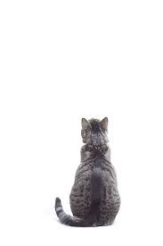
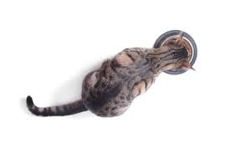



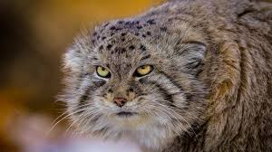
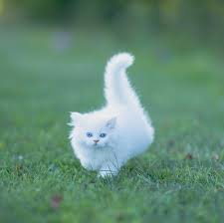
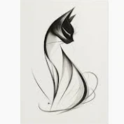
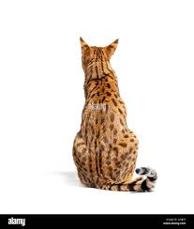
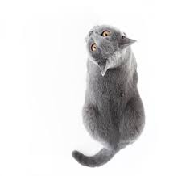

Cats

Slide 6
Features
One way to define a shape is to say it is a collection of features that define some object arranged in a specific manner.
A feature is some aspect of something that we can measure or calculate from measurements. It can be as simple as length, for example, or color.

Slide 7
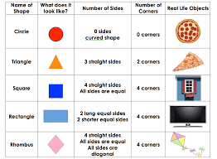
Features
Here are a variety of features.
There are many more

Slide 8
Geometric Shapes
A geometric shape can always be characterised in a word or two. There are details in parameters like size, but the shape itself is always obvious: circle, square, triangle, and so on.
Moreover, geometric shapes have precise mathematic characterizations that can be used to draw them or recognize them.

Slide 9
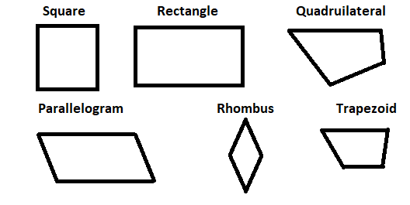
Polygons
A polygon is a shape enclosed by straight lines.
We refer to a polygon that is composed N lines as an N-gon, but the common ones have special names like triangle and rectangle.

Slide 10
Circles
We can define a circle as a curve everywhere equidistant from a given fixed point (the centre).
The distance is the radius.

Slide 11
Circle
We could draw a circle on a computer by setting all pixels that are a distance r from the center pixel (cx, cy).
.
void draw1(int cx, int cy, int r) { for (int i=0; i<width; i++) for (int j=0; j<height; j++) if ((int)dist(cx, cy, i,j) == radius) setPixel (I,j) }

Slide 12
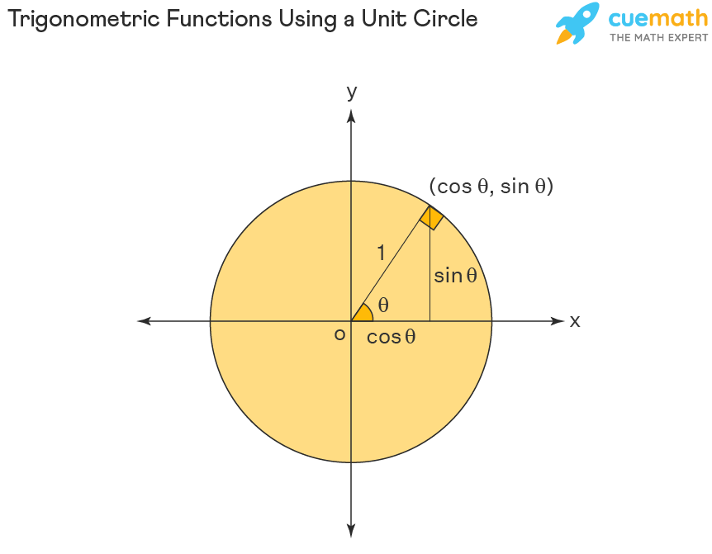
Circle
This is an awful method (algorithm) because it looks al all pixels in an image to draw any circle, which makes it very slow.
We can draw a circle as a polygon with lots of sides.
We can use math (trigonometry).

Slide 13
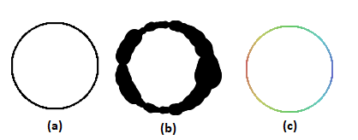
Circle variations: b) Line thickness c) Colour

Slide 14
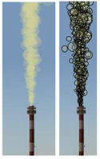
Circles in Art
Smoke
The chimney is an image;
we make the smoke using many small circles placed randomly and filled with a smoke color. The circles get larger as y decreases this time, and begin at the location of the chimney mouth.

Slide 15

Circles in Art
Drips
…such as paint or water running down a surface.
It is made by drawing multiple circles of decreasing size as the y coordinate increases, and positioning the center randomly from its previous x position, making a smoothly jagged path. The effect is more impressive if animated.

Slide 16
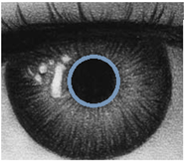

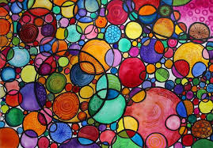
Circles in Art
Many things are circles
The pupil of an eye.
Water droplets

Slide 17
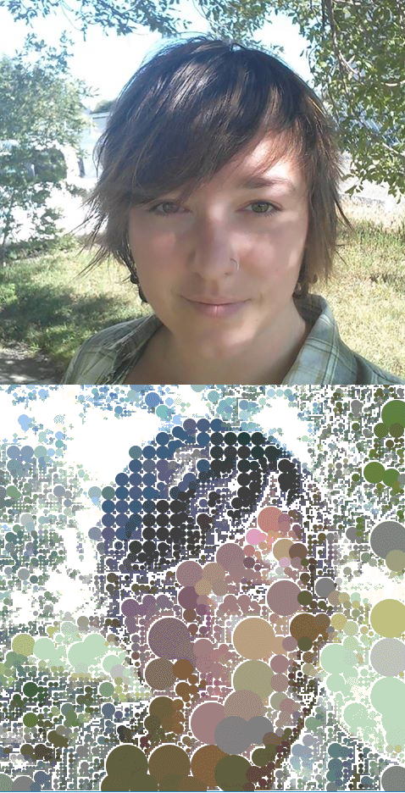

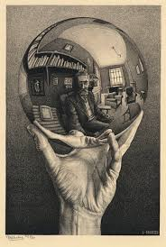
Circles in Art
And circles can be used in many ways.

Slide 18
By the way:
a circle has a mathematical equation that we can use for drawing it. That equation is:
(x-cx)² + (y-cy)² = r²
where (cx,cy) is the center and r is the radius.

Slide 19
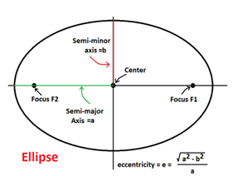
Ellipses and Ovals
To many people, an ellipse and an oval are the same thing. Not true, although they have a similar appearance.

Slide 20
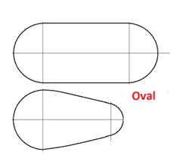
Ellipses and Ovals
An oval can actually have many possible appearances.
(Olympic oval!)

Slide 21
Oval
An oval has two circles, one at each end, so we could specify it that way: using the two centers and the two radii.

Slide 22
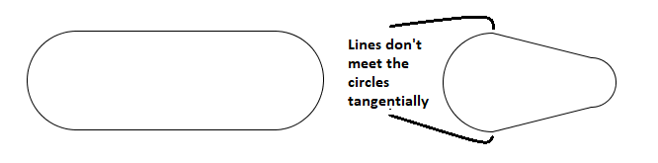
Oval
The circles are joined by lines that are tangent to the circles.

Slide 23
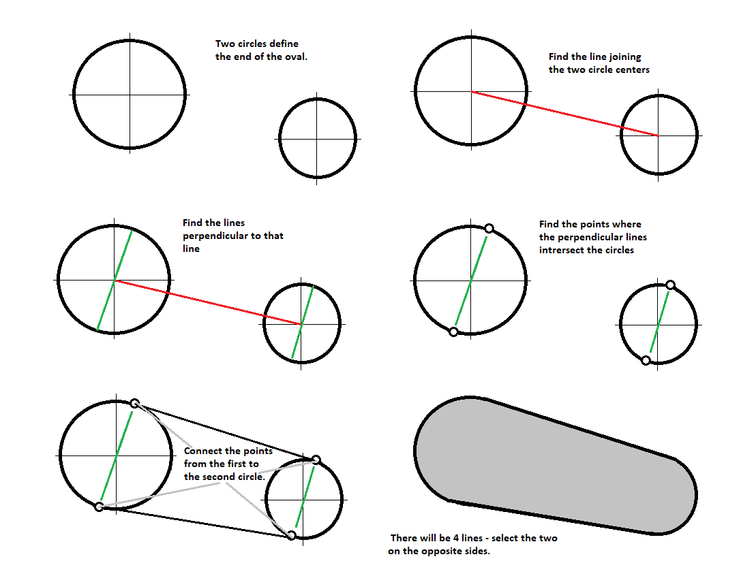

Slide 24
Organic Shapes
Geometric shapes are mathematically well-defined; organic shapes are not.
A precise definition of an organic shape is elusive, but they are irregular, sometimes random, often asymmetrical, and resemble forms found in nature: like leaves, amoebas, and river stones.
They often have soft, curving contours, and do not have the precise angles and symmetry associated with human-created objects and geometric shapes.

Slide 25
Smooth
A shape is smooth if one pixel on the outline is relatively near the previous and next pixel.
Nearness refers to a small distance compared to the size of the object or a pixel.
This is relative, but ½ the size of the object is not smooth, whereas 1/100 might be smooth. In between we’ll have to make up a criterion for deciding.

Slide 26
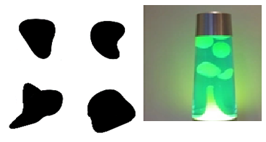
Blobs
A blob is a closed curve having random-appearing shape parameters and a smooth outline.
A good example might be an amoeba, or the melted wax shapes inside of a lava lamp.

Slide 27

Drawing a blob
I have two ways. This one is simplest.
The first way is to draw filled overlapping ellipses in the same location with different eccentricities. The shape of the ellipses and the offset from a central position are random numbers based on the object’s size.

Slide 28
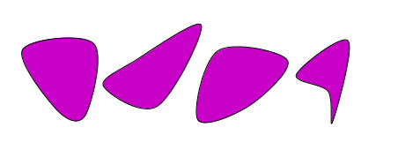
Drawing a blob
Second way uses a more complicated mathematical curve called a spline.
We might talk about this later.

Slide 29
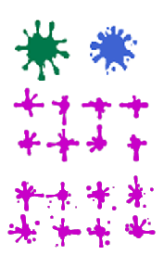
Splat
This is like a blob, but one that has fallen from some height.
Like paint splatters. The outline is more irregular than a blob and often has spatulate extensions.

Slide 30
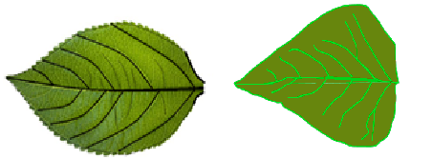
Natural Organic Shapes
Example: a leaf.
A digital artist could examine many leaves and note things like height VS length, color, outline features, and so on.

Slide 31
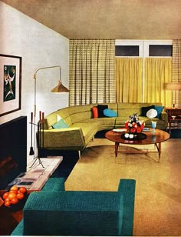
Invented Shapes
Artists and designers do this all the time.
For example, the design style that we call Midcentury Modern (1945-1965) makes extensive use of organic shapes.
The iconography of the time is easily identifiable, reminding us of the visuals in the Sean Connery James Bond films, which were filmed in that period.
The U of C hotel is that style.

Slide 32
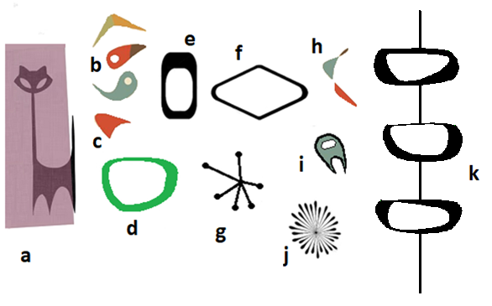
Midcentury Modern Graphics

Slide 33
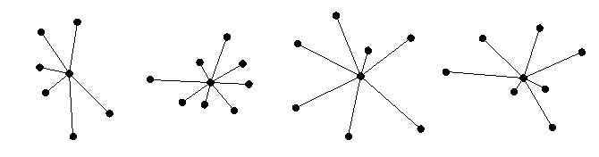


N-Flower

Slide 34
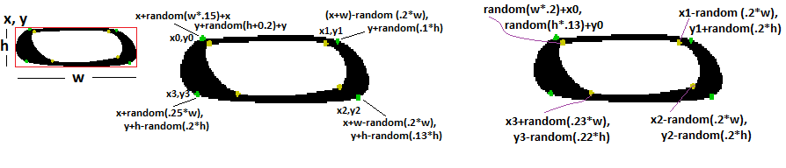

Zoop

Slide 35
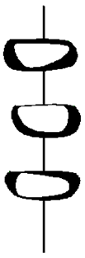
Zoop Pole

Slide 36
Deco
1910-20s.
(Arts décoratifs)
Characterized by its sleek, geometric shapes, bold ornamentation, and luxurious materials.
The intention was to create a sleek and anti-traditional elegance that symbolized wealth and sophistication.

Slide 37
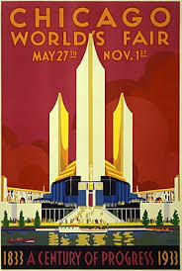

Deco

Slide 38
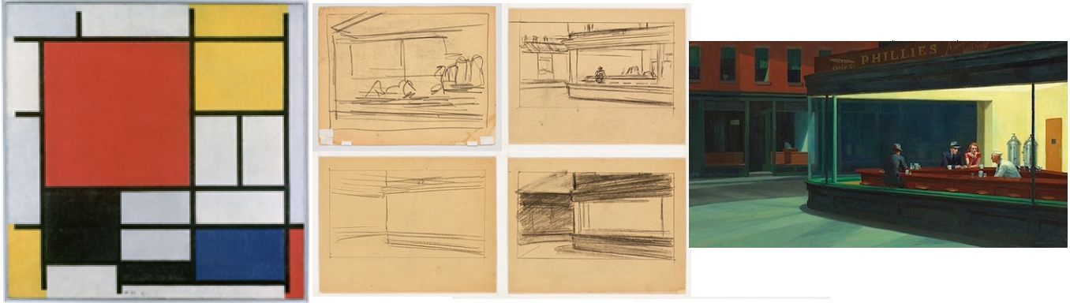
Finding Shapes and Patterns
If, as an artist, we begin with a digital image, how do we identify patterns?

Slide 39
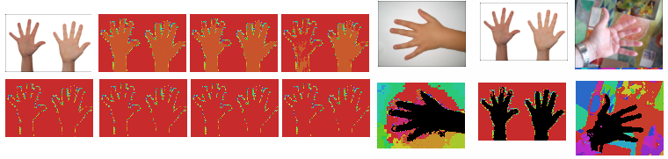
We could use colour
Occluded objects cause problems.

Slide 40
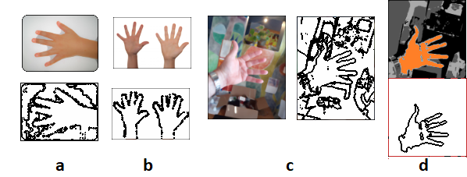
We could use boundaries

Slide 41
We could use Features
A feature is some information about the content of an object, a property that we can measure.
Scale dependent: area, perimeter, length, width
Scale Independent: Circularity, rectangularity, signatures, convexity

Slide 42
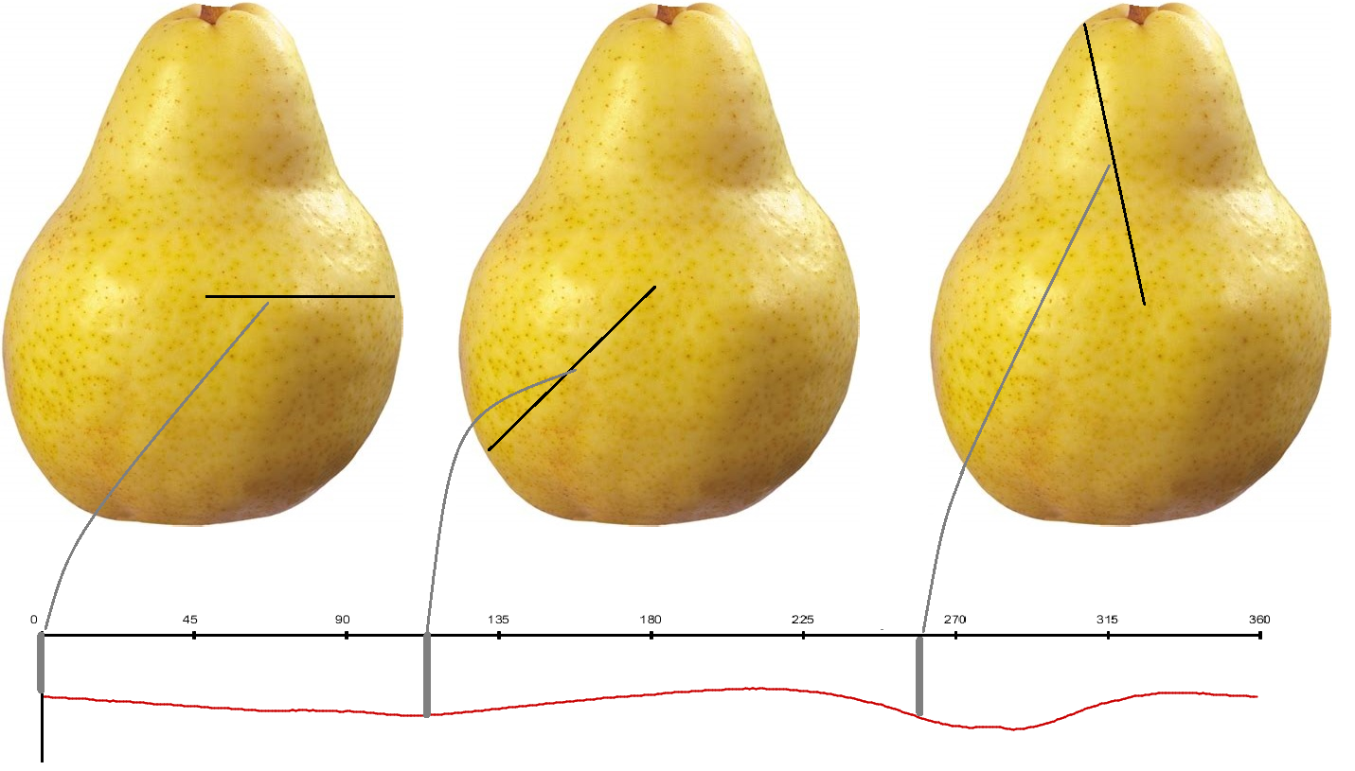
Signature
A signature is the set of distances from the center of an object to its outline as we look in angles from 0 to 359 degrees.
The signature is a curve, basically, but it does represent the object’s shape.

Slide 43
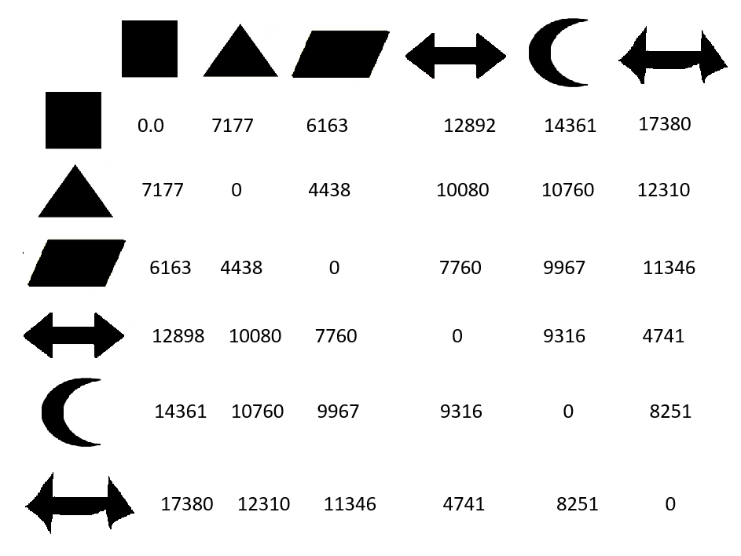
Signatures

Slide 44
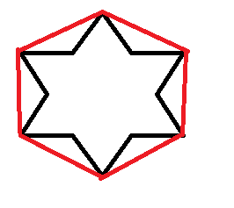
Convexity
If a polygon has the property that a line between any two points on the outline lies completely inside the polygon, then it is said to be convex.
A circle and square are convex, but the hand shapes are not.
The convex hull of a shape is convex polygon having the smallest area that can contain a set of points, like the vertices of the polygon.

Slide 45
Convexity
Convex area is simply the area of the convex hull, as opposed to the area of the polygon based on its vertices.
Convex perimeter is the perimeter of the convex hull of the polygon.
Ca = area/(convex_area – area);
Cp = perimeter/(convex_perimeter – perimeter);

Slide 46
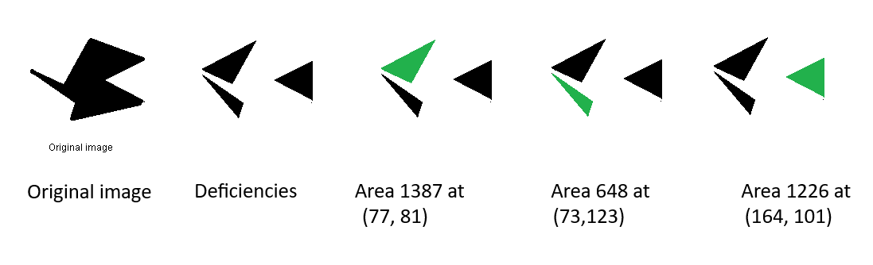
Convex deficiencies

Slide 47

Convex deficiencies

Slide 48
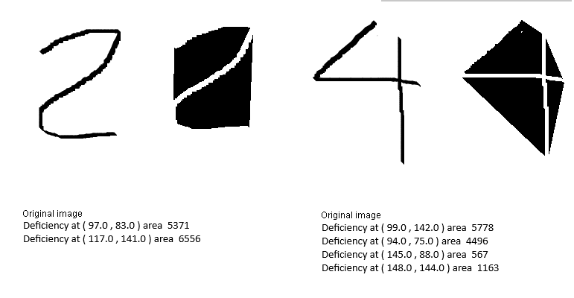
Convex deficiencies

Slide 49
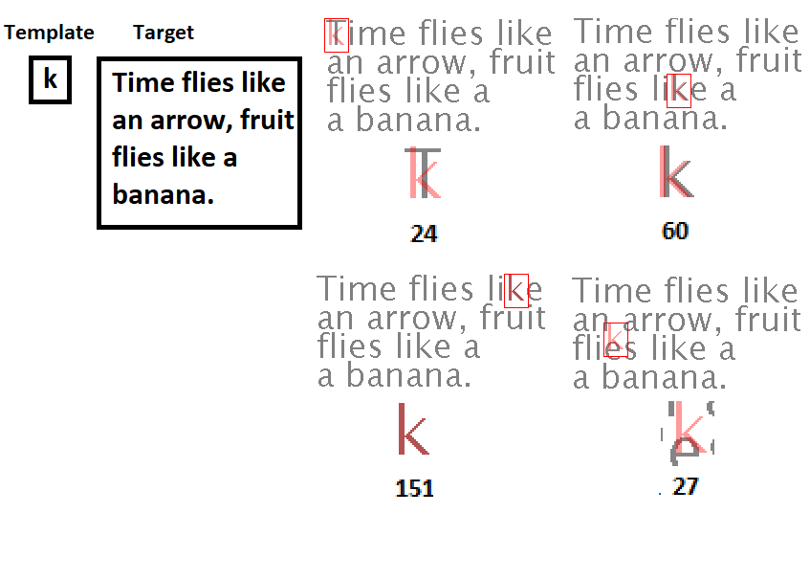
Templates
In this case we have a good example of the shape we want.

Slide 50
EG: Ghosts
This artwork begins with the image of a building. There are windows and an entrance, although not much can be seen inside of the building.
We’re going to locate some of the windows so that we can replace them with a new window that has a different image.
We could use a template to find some of the windows.

Slide 51
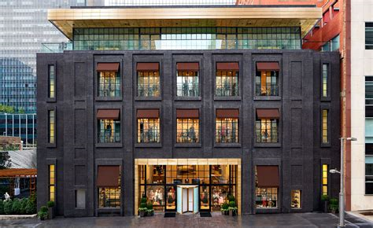
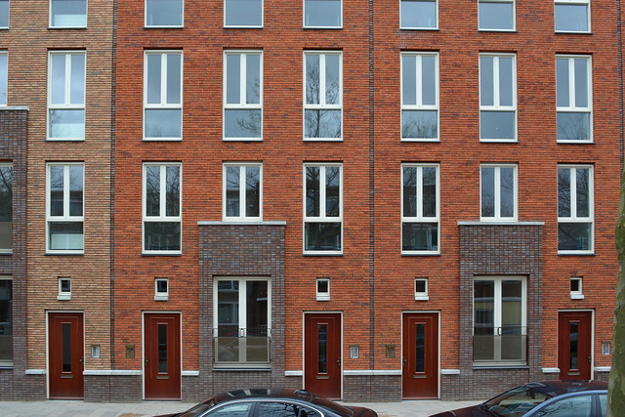
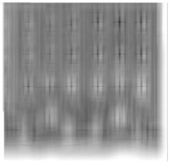
EG: Ghosts

Slide 52
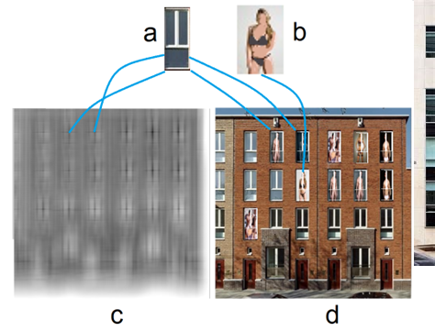
EG: Ghosts

Slide 53
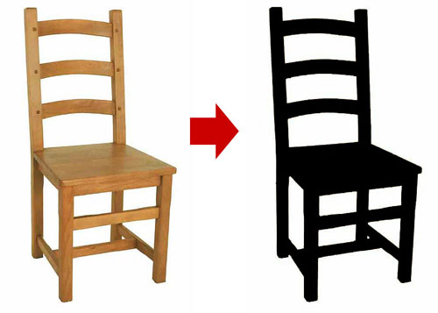
Decomposition

Slide 54
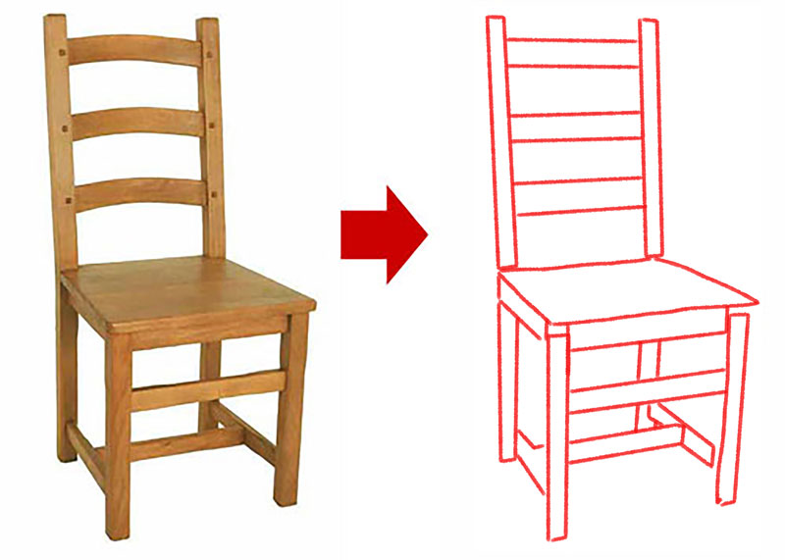
Decomposition

Slide 55
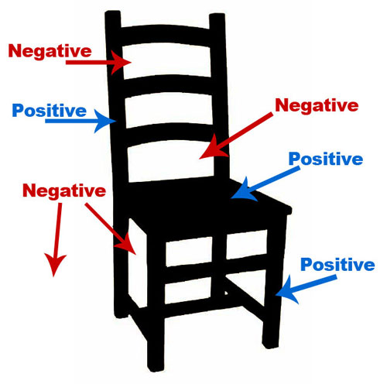
Decomposition

Slide 56
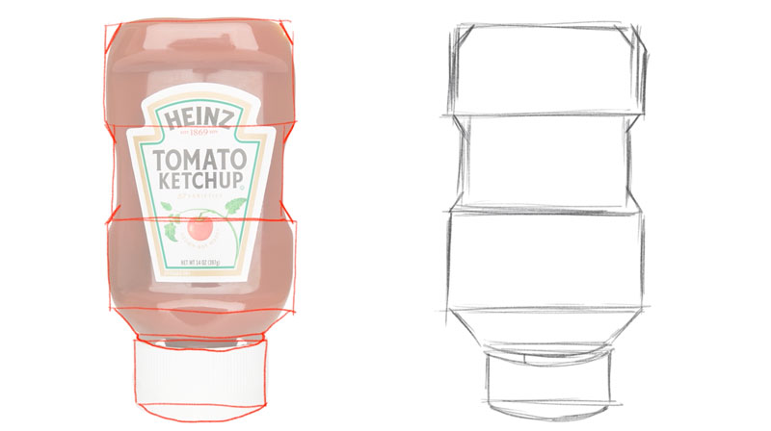
Decomposition

