Slide 1
Color II
Art 251

Slide 2
Colour Temperature
References color as warm or cool hues.
The term refers to how we feel about the colours.
But also:
Cool colours will appear to move to the back of a painting, whereas warm ones seem to be in front.
Daylight in the morning and evening has a "warmer" color temperature.
Objects like mountains far away in real life have a cool blue color due to atmospheric effects.

Slide 3
Colour Temperature
Colour temperature is somewhat subjective and not well quantified, so little effort has gone into digital implementations.
We do know that we can make an image or colour warmer by increasing the red component, and we can make it cooler by increasing the blue component.

Slide 4
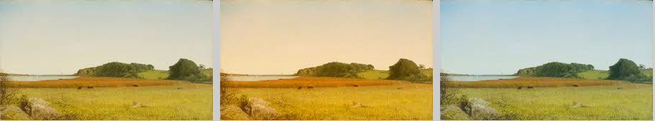
Colour Temperature
Original +20 degrees -20 degrees

Slide 5
Colour Temperature
Color temperature has various visual effects that we can play with:
It can create a sense of perspective
It can make the same object appear dull or bright
It creates and enhances contrast
Desaturated colours seem cool (E.G. pastel colors)
Warm colours can be a space seem bigger, while cool colours make it seem smaller
Colour temperature is relative – the same color will look different depending on what it’s next to.

Slide 6
For Programmers Only:
void temperature (PImage res,
float delta)
color p;
float r, g, b;
for(int i=0; i<res.width; i++)
for (int j=0; j<res.height; j++)
{
p = res.get(i,j);
r = red(p); g = green(p);
b = blue(p);
r = r + delta;
if (r>255) r=255;
else if (r<0) r = 0;
b = b-delta;
if (b>255) b=255;
else if (b<0) b = 0;
res.set(i,j, color(r, g, b));
}
}

Slide 7
Colour Variations - Tint
A tint is specifically the adding of pure white to some color.
When using RGB coordinates it is a matter of adding values to each of R, G, and B.
It’s not the same value, though. 255 is the maximum value of a coordinate.
Let’s call 255-R the headroom in the red color, which is to say it is the number of values remaining until it reaches the maximum. Each color has a different headroom in most cases, and the value we add to each is dependent on that.

Slide 8
Colour Variations - Tint
For each coordinate, the tint is determined, for some factor f between 0 and 1, as:
r = headroom(r)*f + r = (255 - r)*f + r
g = headroom(g)*g + g = (255 - g)*f + g
b = headroom(b)*b + b = (255 - b)*f + b
So each color coordinate has a different value added to it that depends on the color being modified. The factor f is the degree or amount of the tint, the greater the factor, the lighter the tint.

Slide 9
Colour Variations – Tint, HSB
When using HSB coordinates things are a little different. We have to modify only saturation and brightness.
The brightness is increased, but the saturation is decreased. We know that as saturation gets smaller, the color changes towards white.
The headroom for brightness is the same as for RGB, but for saturation is the difference between the current value and 0, or simply the saturation itself. So we have:
h = h
s = s – s*f
b = (255-b)*f + b

Slide 10
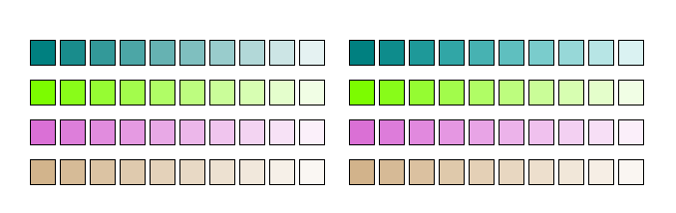
Example: Tints
RGB HSB
Teal
Lawn green
Orchid
Tan

Slide 11
Colour Variations - Shades
We get a shade from a color by adding black.
This is easy to do, because the headroom for each color value is the value itself: the distance to 0.
We can simply multiply each value by the specified factor f, where f is between 0 and 1. Smaller values of f make the shade darker.
r1 = r*f r1 = r – r*f
g1 = g*f OR g1 = g - g*f
b1 = b*f b1 = b - b*f

Slide 12
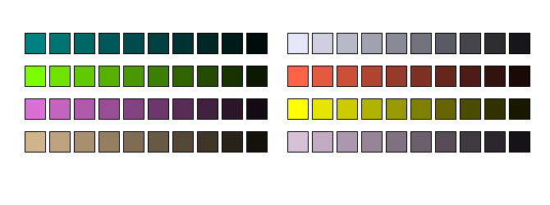
Shades
Teal
Lawn green
Orchid
Tan
Lavender
Tomato
Yellow
Thistle

Slide 13
Colour Variations - Tones
Tones are more complex visually, because they involve adding grey to a color.
Grey, of course, consists of white and black, both being components of both tints and shades. The result can be colors that are either lighter or darker than the original hue, depending on the type of gray you’re mixing it with.
r1 = r * f + (1-f)*grey
g1 = g * f + (1-f)*grey
b1 = b * f + (1-f)*grey

Slide 14
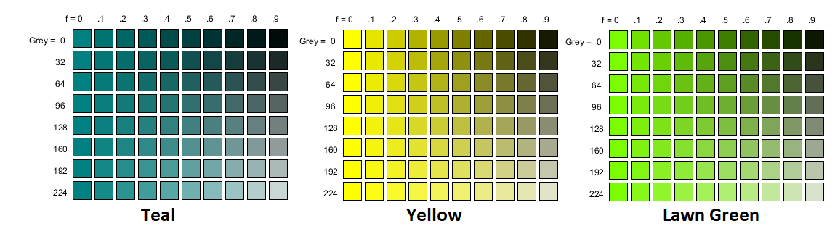
Tones

Slide 15
Colour Combinations
Artists have themes that involve specific palettes, or groupings of colours.
Sometimes colours go very well together, and sometimes they clash.
How do we select colours (digitally, automatically) that we know will be compatible with a given main colour?
We call this colour harmony, and usually means using a limited set of colours, We also want to balance saturated and muted tones and a matching of warm and cool colours.

Slide 16
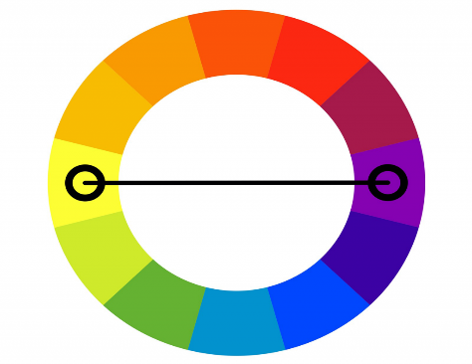
Colour Combinations - Complementary
Complementary colours are on opposite sides of the hue colour wheel.
Every pair of complementary colours has one warm and one cool colour. If you want a lively sunset or simply strong, vivid colours, this is what you want.
We can think of one of the colours as dominant, which we use in the larger areas of the work, and the second color will be more of an accent.

Slide 17
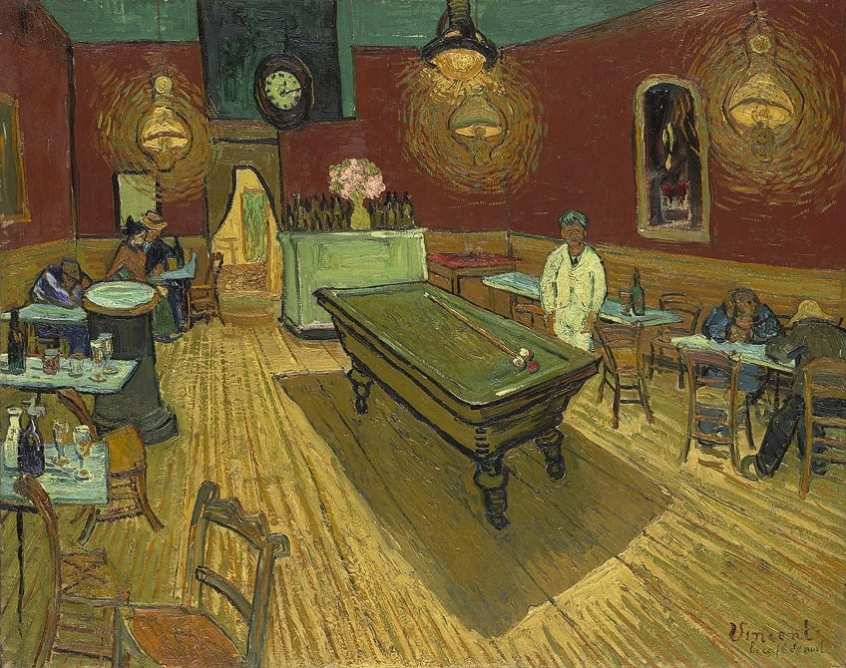
The Night Café (1888) by Vincent van Gogh.
This painting used red and green (complementary) to express what van Gogh called “the terrible human passions”.

Slide 18
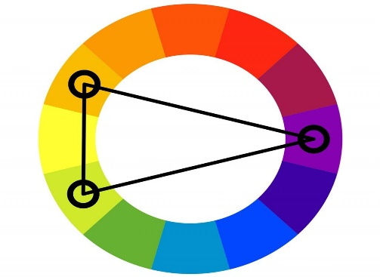
Colour Combinations – Split Complementary
There are three colours in this selection: a dominant colour, and two accents.
These colours are easy to use, and hard to get wrong.
Split complementary colour schemes draw attention to the work; the colours are generally in balance, having a mix of warm and cool shades. The combination can inspire complex emotions, since they combine well, and each colour inspires a different kind of emotion.

Slide 19
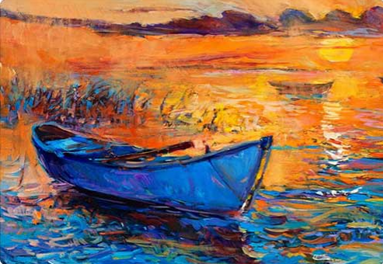
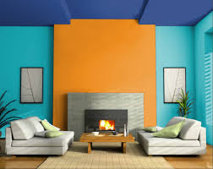
Split Complementary

Slide 20
Colour Combinations – Triadic
Triadic colors form a triangle an equilateral triangle, which has equal angles.
Thus for any one color there is only one way to form a triadic pattern. They tend to create an exciting and playful feel. When used properly, they can be fun and pleasing to the eye.

Slide 21

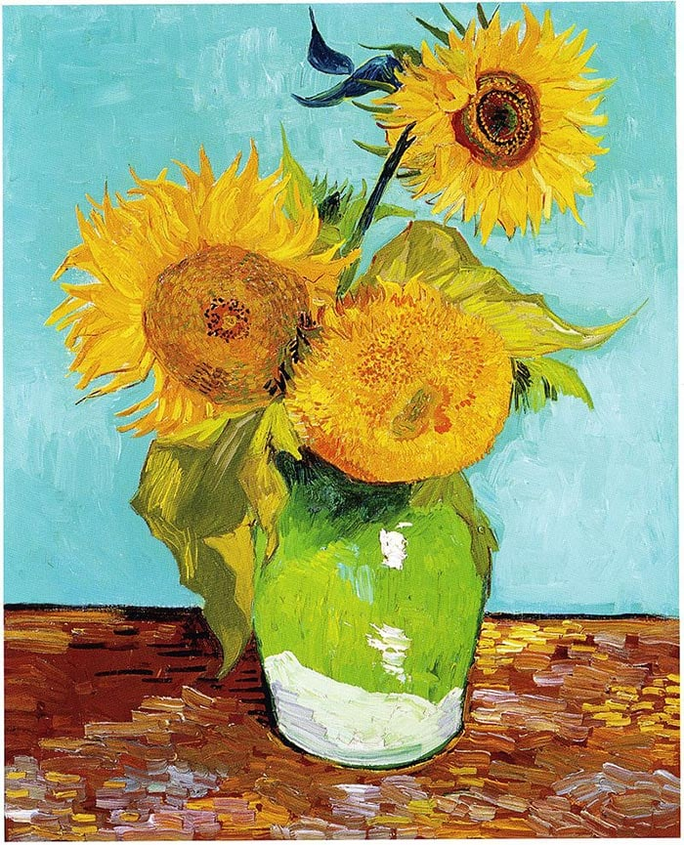
Triadic

Slide 22
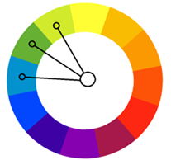
Colour Combinations – Analogous
Analogous colours are near each other on one part of the color wheel
The result of using this scheme is a calm, peaceful look.

Slide 23
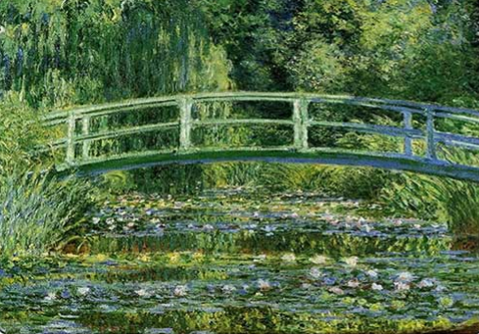
Analogous

Slide 24
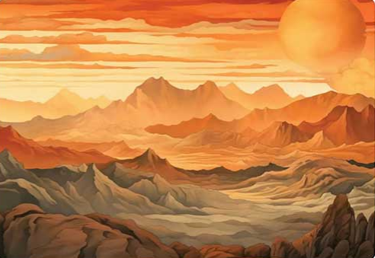
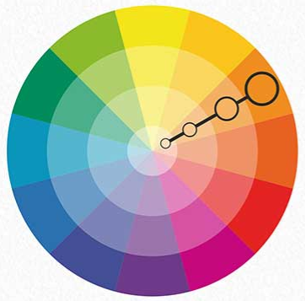
Monochromatic

Slide 25
Transparency or Alpha
There is actually a fourth color channel that we haven’t talked about, partly because it’s not really a color.
It’s called transparency, or sometimes alpha. It represents the degree to which the color hide what is behind it.

Slide 26
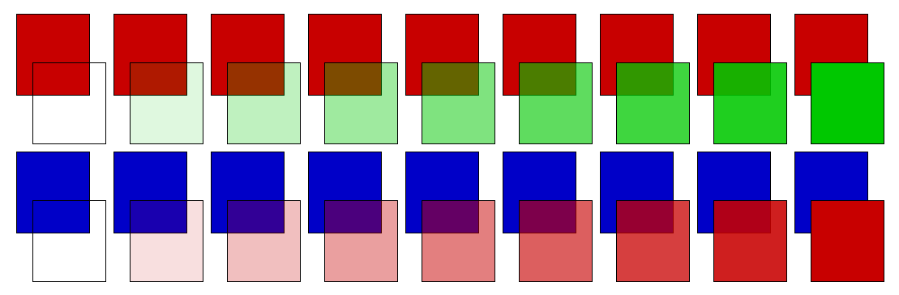
Transparency

Slide 27
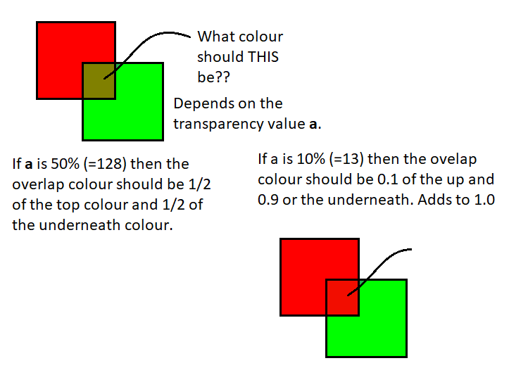
Transparency

Slide 28
Transparency
op = transparency
r = op*red(fg) + (1-op)*red(bg);
g = op*green(fg) + (1-op)*green(bg);
b = op*blue(fg) + (1-op)*blue(bg);

Slide 29
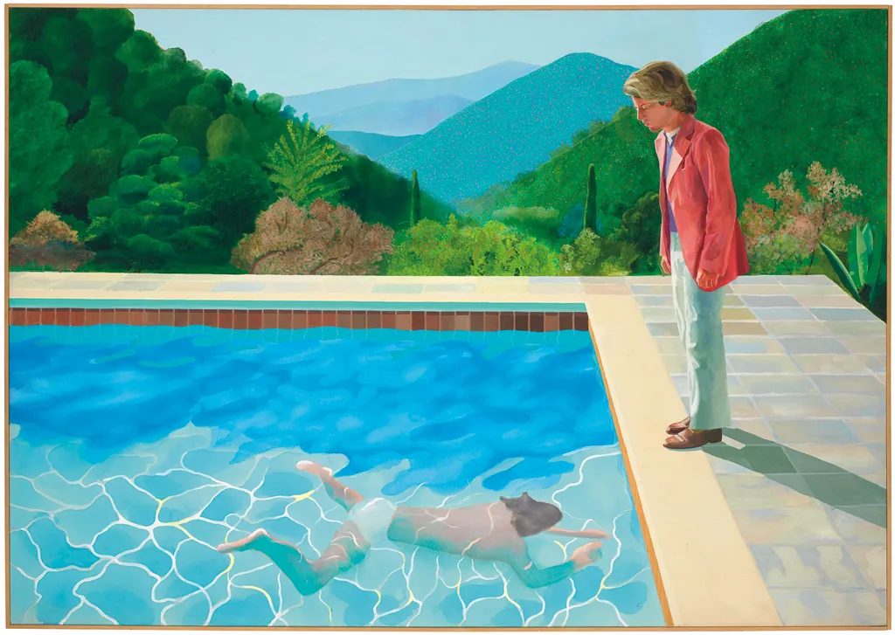
Transparency

Slide 30
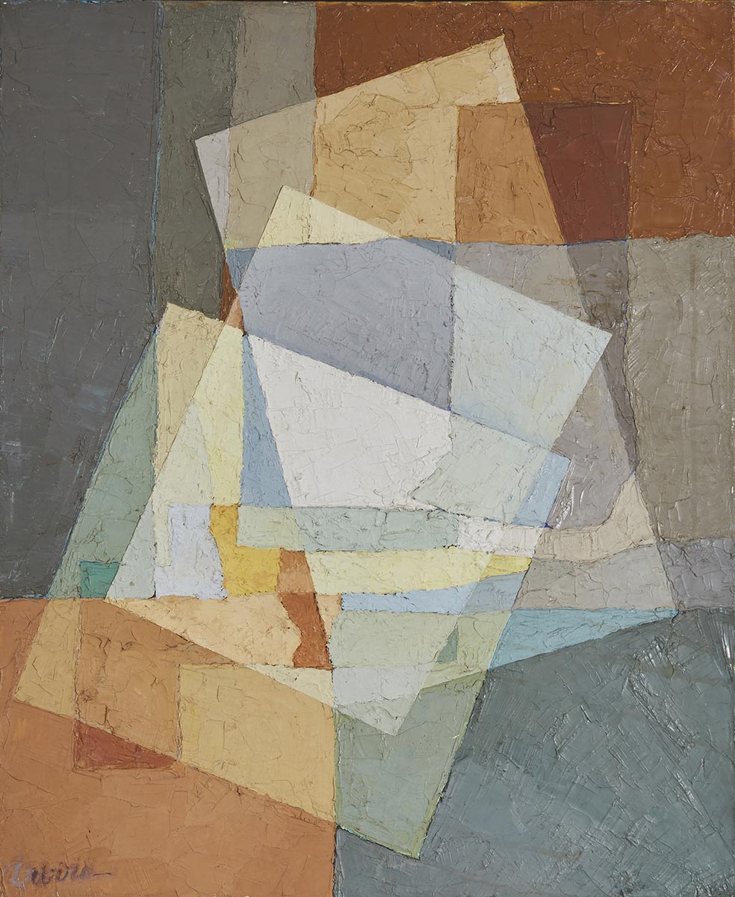
Transparency

Slide 31
Colour Quantization
Refers to the actual number of colours present.
In full RGB it is 256*256*256 = 16.7 million

Slide 32
Colour Quantization
We can reduce this. Why?
Well, it can look cool.

Slide 33
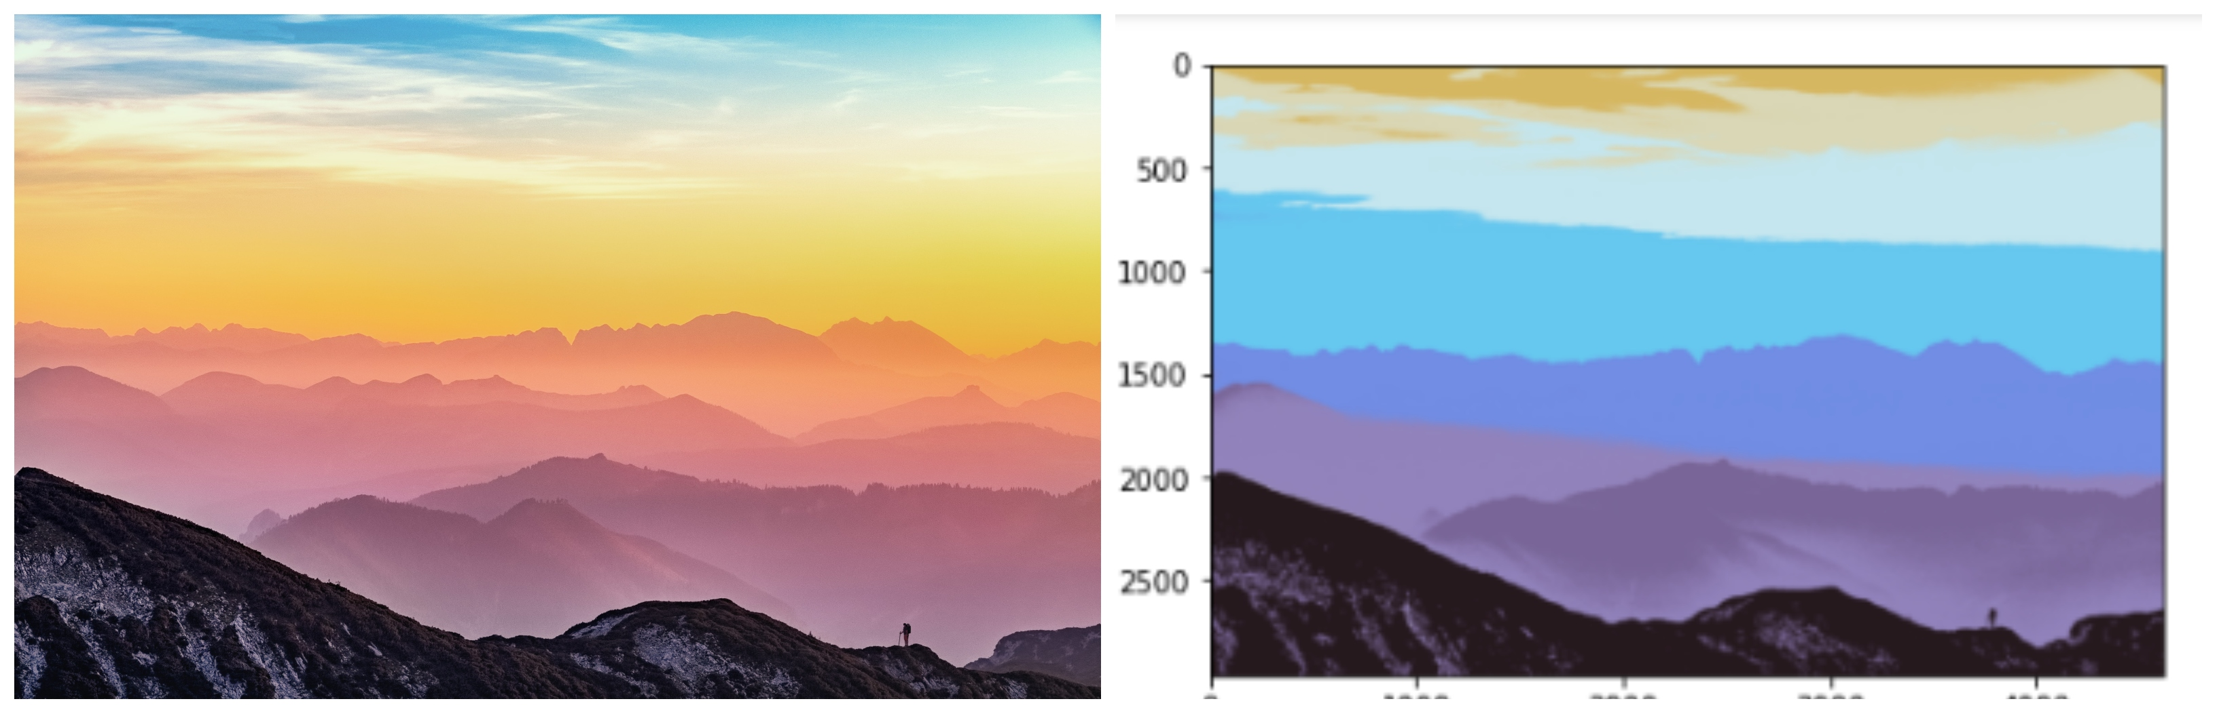
Colour Quantization

Slide 34
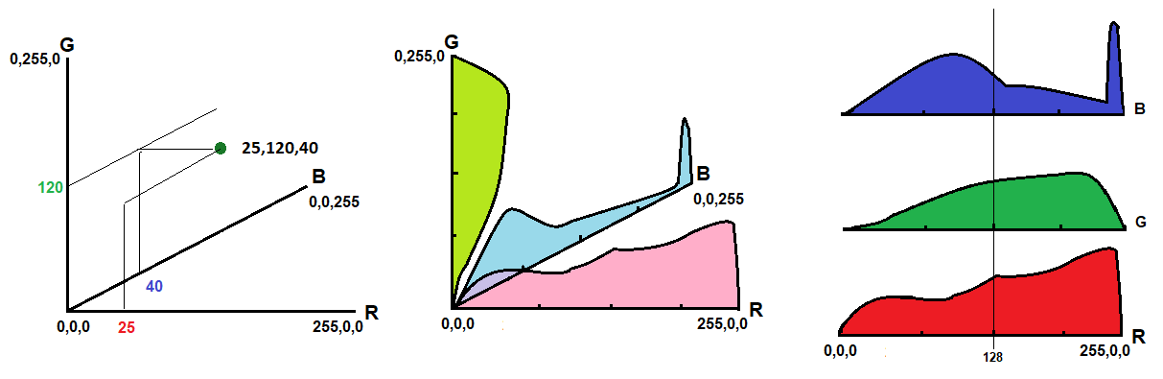
How? Split along any colour axis.
Colour Quantization

Slide 35
Colour Quantization
0 <= r < 128, 0 <=g < 128, 0 <= b < 128 => (64,64,64)
0 <= r < 128, 0 <= g < 128, 128 <= b < 192 => (64,64,192)
0 <= r < 128, 128 <= g < 256, 0 <= b < 128 => (64,192,64)
0 <= r < 128, 128 <= g < 256, 128 <= b < 256 => (64,192,192)
128 <= r < 256, 0 <= g < 128, 0 <= b < 128 => (192, 64 64)
128 <= r < 256, 0 <= g < 128, 128 <= b < 192 => (192,64,192)
128 <= r < 256, 128 <= g < 256, 0 <= b < 128 => (192,192,64)
128 <= r < 256, 128 <= g < 256, 128 <= b < 256 => (192,192,192)

Slide 36
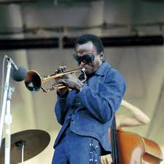
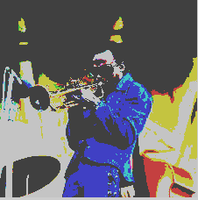
Colour Quantization

Slide 37
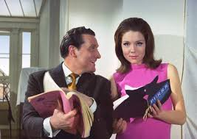

Colour Quantization

Slide 38
Median Cut
Divide the range at the median of the range.
Accounts for actual colours in the image.
Colour Quantization

Slide 39

Colour Quantization - median

Slide 40

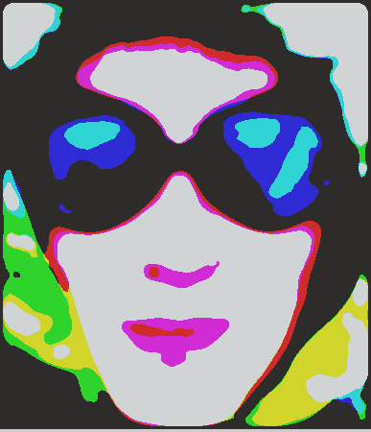
Smooth before quantizing …

Slide 41

Colour Quantization - median

Slide 42
Smoothing (reducing noise)
Colour images potentially have millions of numerical values that are possible, and noise can affect all channels differently.
The same colour can have different values in a captured image.

Slide 43
Median Filter
We know how to do a median filter on a grey image.
We can do the same on each colour channel.

Slide 44
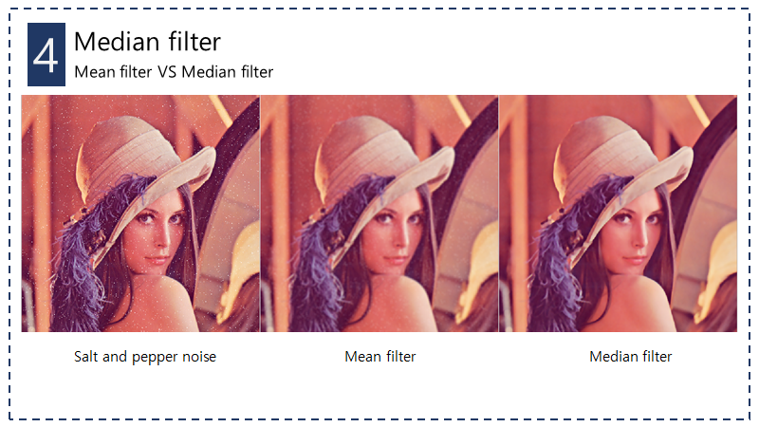

Slide 45
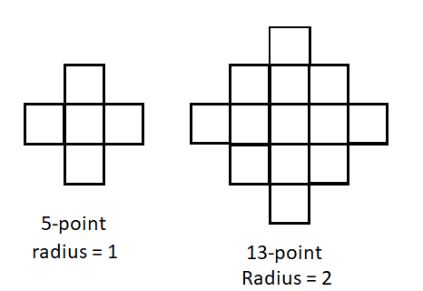
Median Filter
Size matters

Slide 46


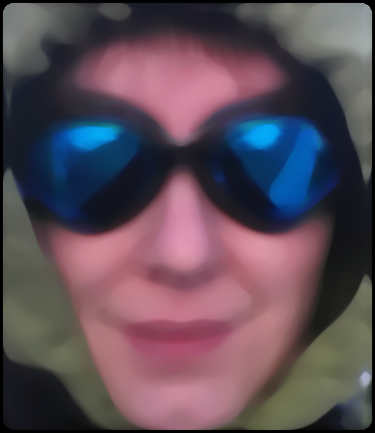
Original Radius 6 Radius 12

Slide 47
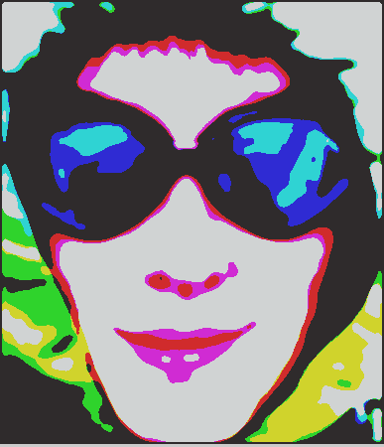
Original Radius 6 Radius 12

Slide 48
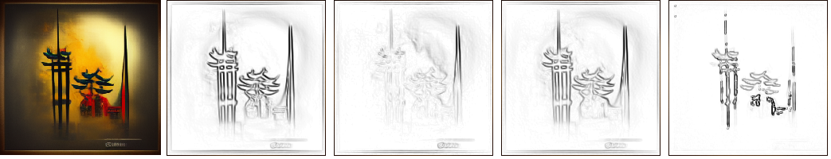
Colour Edges
We can simply apply an edge detector to each colour channel.
Original Red Green Blue Hue

Slide 49

Colour Edges
We can compute edges based on a specific color by defining the difference of a pixel from it’s neighbors as a 3D Euclidean distance from the target color, rather than a simple difference in values.
EG: Yellow edges

Slide 50
Cool colour psychology
The Land effect is interesting, because it suggests that all colors can be perceived if only two are present.
One model of color perception (the Retinex theory) suggests that the color we perceive is the product of the color that the object reflects and the color and intensity of the illumination of the illumination:
Resulting Image = Reflectance(r)∗Illumination(S)

Slide 51
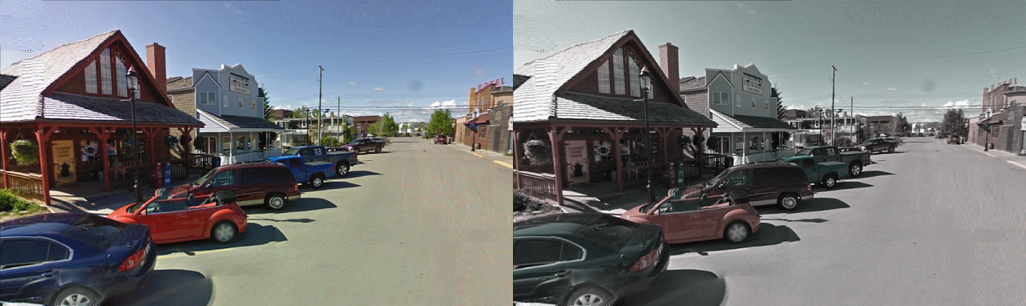
Land Effect
The red component is the same as the original red channel, while the white component is the average of the three RGB channels. The resulting image is simply the sum of the red and white components. We perceive colors in this image – there are only reds and greys.

Slide 52
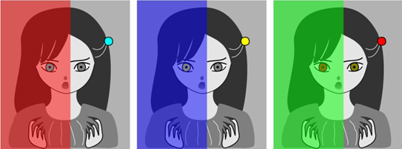
Effect of nearby colours
. All of the eyes in these images are the same color, which is (127,131,). They look very different because of the surrounding (illumination) color.
All of the eyes in these images are the same color, which is (127,131,). They look very different because of the surrounding (illumination) color.

Slide 53


Effect of nearby colours
All of the eyes in these images are the same color, which is (127,131,). They look very different because of the surrounding (illumination) color.

Slide 54
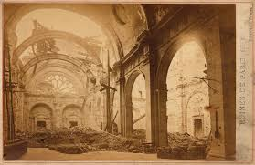
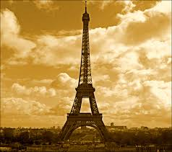
Example – Sepia tones
Sepia is a brownish color that many people associate with old photos They did not turn that color as they aged, though. The brown tint is the result of a chemical process used in the darkroom to prevent the photo from fading over time.

Slide 55
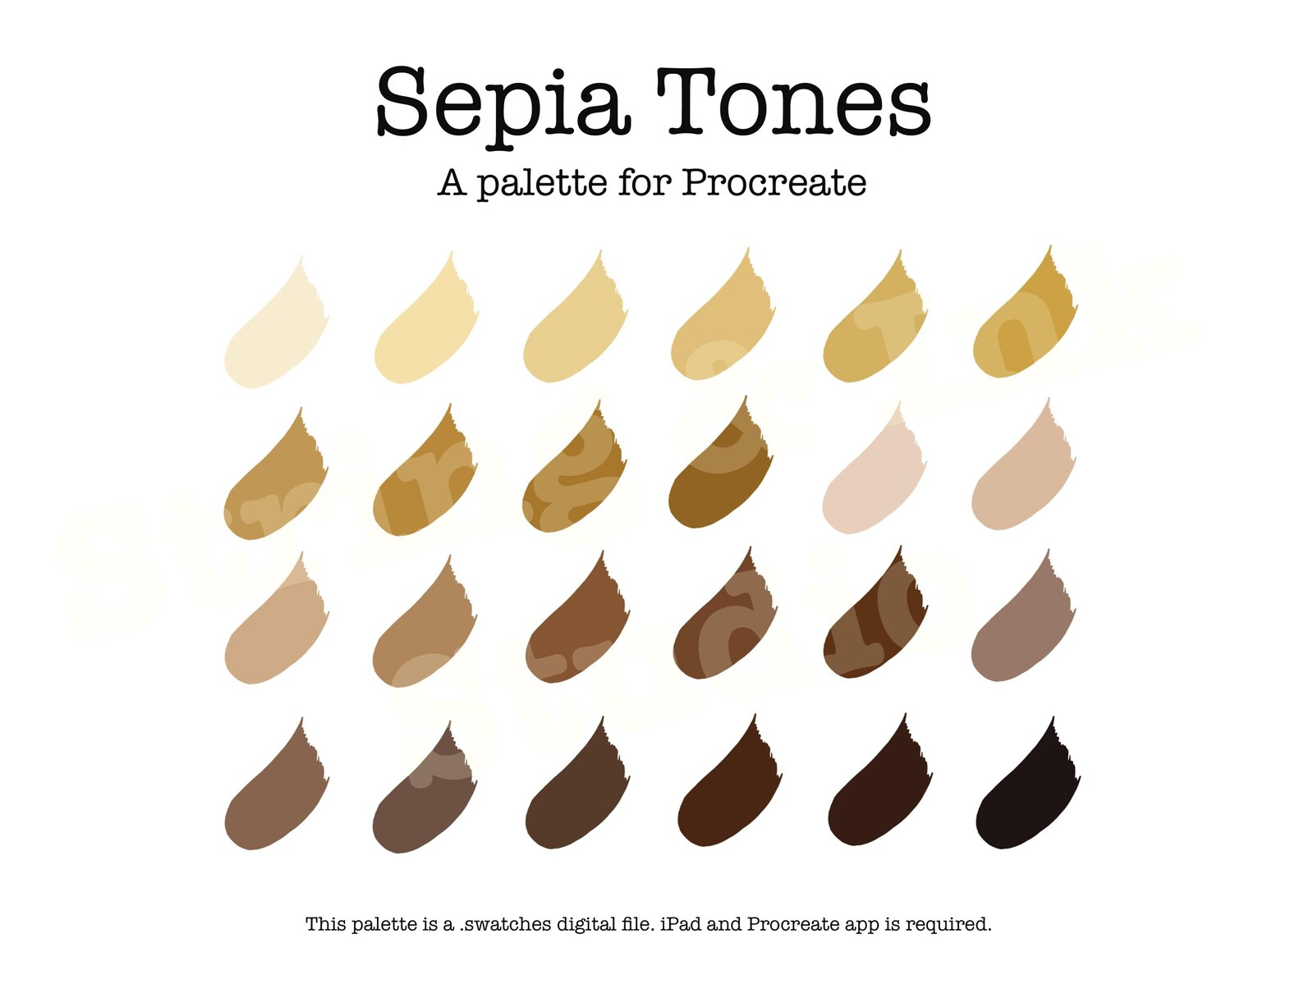

Slide 56
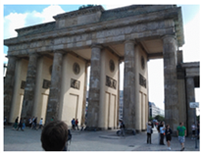
Example – Sepia tones
I’m going to create a sepia image from a colour photo I took.

Slide 57
Example – Sepia tones
The basic colour sepia has RGB coordinates (112, 66, 20).
I will set pixels having a brightness value smaller than t1 to this color. This is the darkest color in the photo, because it corresponds to the pixels with the smallest brightness.
For pixels between t1 and t2 we use the same hue, but decrease saturation (by 20) and increase brightness (by 30). For pixels between t2 and t3 we do that again, using the same hue, decreasing saturation (by 20) and increasing brightness (by 30).
Do that again for pixels with a brightness greater than t3, and the image is now complete.

Slide 58
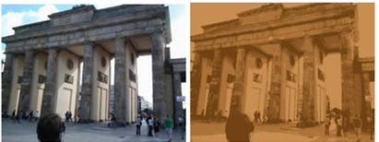
Sepia tones

