Slide 1
Color 1
Art 251

Slide 2
What is Color?
Color in reality is about the way that we humans perceive various frequencies of light, and how we perceive combinations of frequencies.
Color in art is about how we use those perceived frequencies and combine then to define shapes, create spaces, and – a fundamental aspect of art – to communicate emotions and create atmosphere.

Slide 3
Representations
A computer can only manipulate data that is in the form of numbers, and so we must have a way to represent a color as a number or collection of numbers.
We did that with value in by encoding a level of grey as a number.
We need a way to express color as a number.

Slide 4
Representation - philosophy
When we were children, we learned to identify colors by the names that people called them.
Blue was, well, blue. We were told it was blue. Because of human perception, even young children can determine that various kinds of blue are still blue.
But not all – blue has a transition into green, and at some point it’s hard to say whether it’s blue or not-blue (maybe green, in this case).

Slide 5

Blue
Not-Blue
Imagine that you have two different people looking at this.
Tell them to point out where the image stops being green and starts being blue.
People will nearly always indicate different locations.

Slide 6
Perception
Human colour perception is based on the three colour sensors in our eyes: sensors for red, green, and blue.
Our brain combines proportions of these three colours into all of the colours we can imagine.
How? We don’t really know.

Slide 7
RGB Pixel Values
A pixel is a color value.
We will represent every color we perceive as a combination of the three colours red, green, and blue.
The smallest amount of red we can see is none (0%) and the most is 100%, and the same is true for green and blue, then we can represent every color we can perceive as three numbers, the percentage of red, green, and blue at every point in our eye (on the retina).

Slide 8
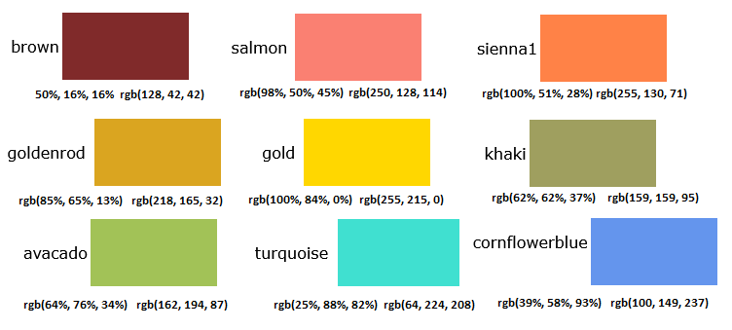
Named colors
Here are a variety of named colors and their percentage values of red, green, and blue (in that order) and the conventional RGB value used on computers.
If C is the color value of a pixel, then the component colors are red(C), green(C), and blue(C).

Slide 9
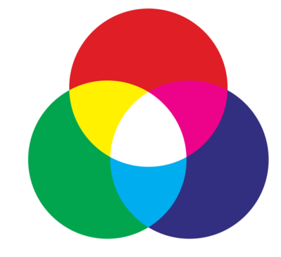
RGB
This is called additive colour.
It is not how artists usually think of colour.

Slide 10
Color Coordinates
In many programming environments each component will have a numerical value between 0 and 255, just like grey levels.
A red component of 10% or 0.1 would be, in this environment, a red value of .1*255 = 25 (or 26).

Slide 11
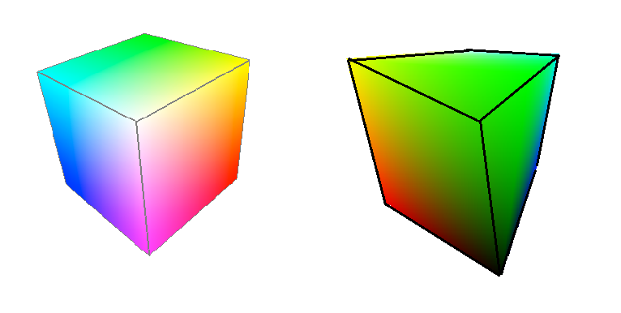
Coordinates
If we think of the three color components as three geometric axes, like x, y, and z, then all of the colors that are possible form a cube 255 units on each side.
The color black is at the origin, being (0,0,0). The other extreme is white, which is (255,255,255).
Along each axis one of the colors changes from 0 to 255.

Slide 12
Perception
The way that these colors appear to any person could vary, and by quite a lot, from how they seem to any other person, or any other creature.
An obvious example is that of red-green color blindness, where the sensors for red or green are missing, weak, or non-functional. If someone has no sensors for red, then they see the completely in shades of green and blue.
So we see that color perception is relative.

Slide 13
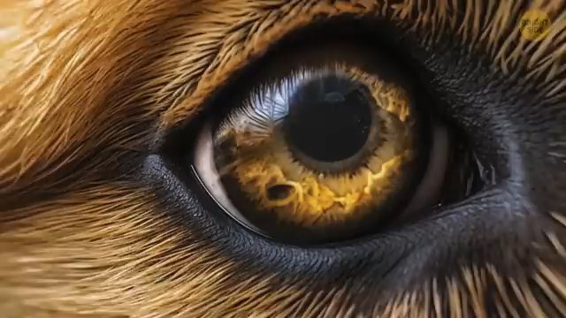
Animal Vision

Slide 14
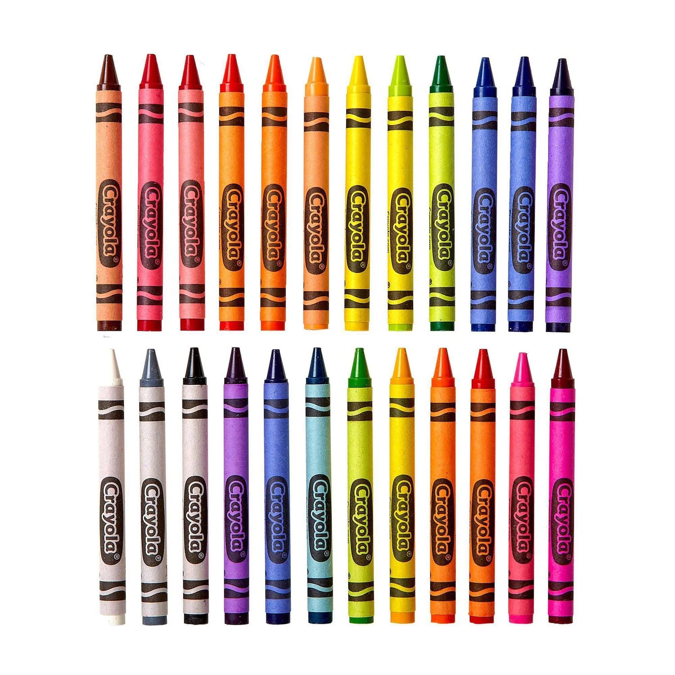
Names
If a child is given crayons, then the colors in that set will define to a great degree what colors they can use in an artwork.
A six-crayon box might have yellow, purple, red, green, blue, and black, and that would therefore be our spectrum, out palette.
Mom’s face might well be yellow and my dog purple, because they have to use what they have.
A box of colors allows them to define colors more precisely, because the colors are specified by using a name.

Slide 15
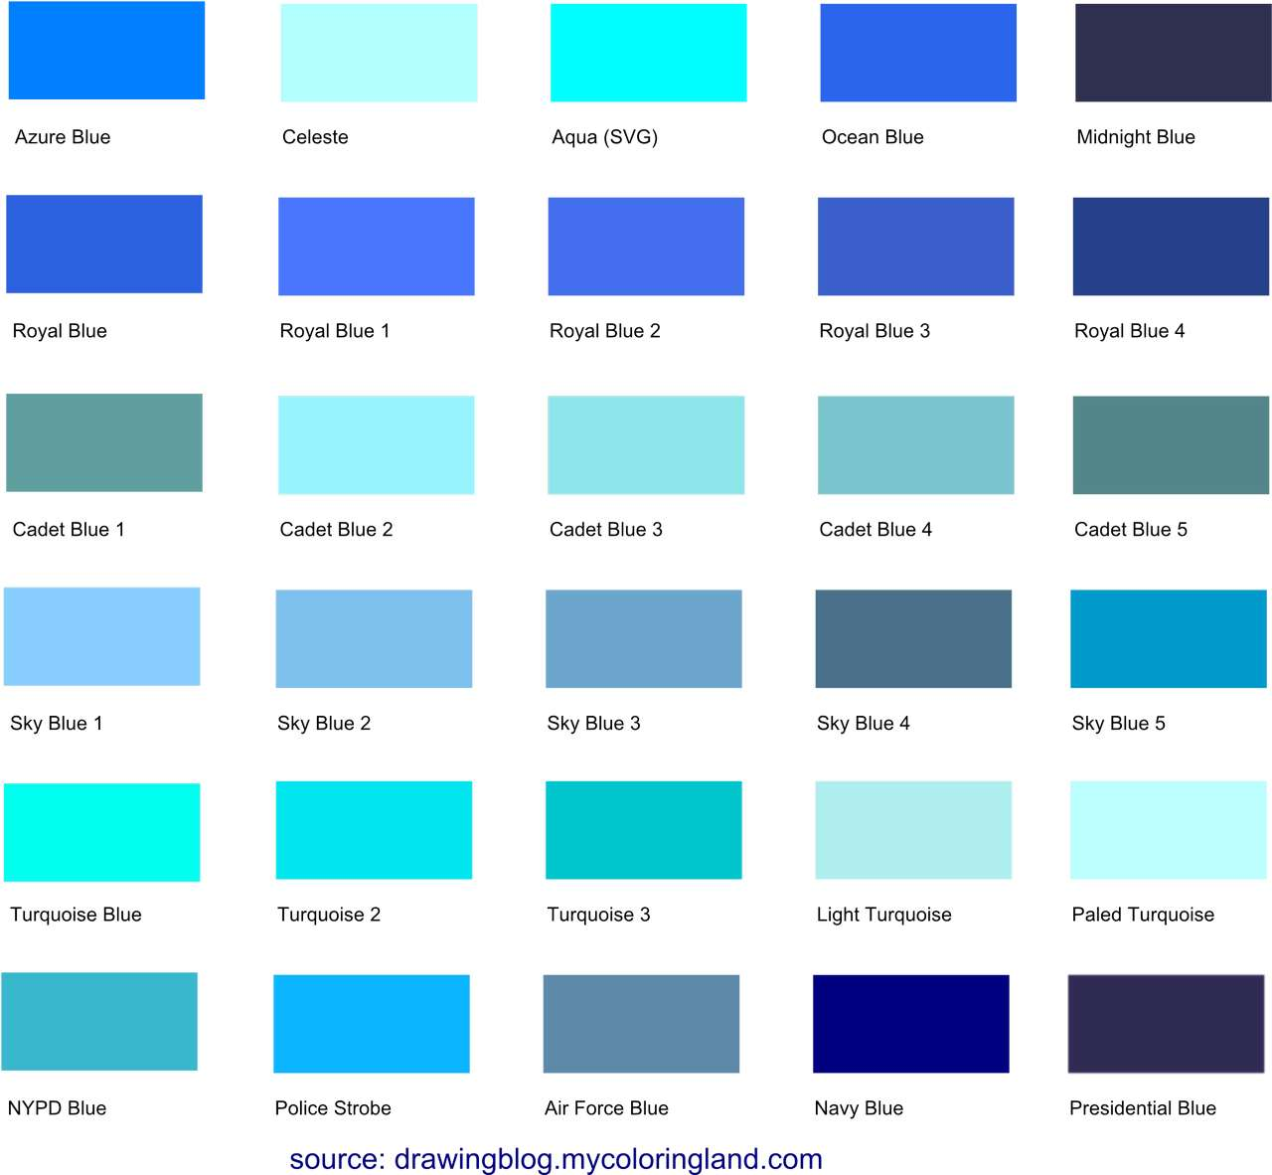
Defining Colors
When we look at an image, can we tell what pixels are blue?
How?

Slide 16
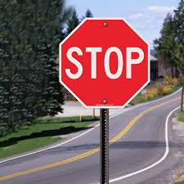
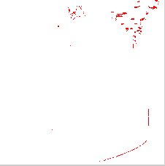
How about:
Select all pixels where the blue component is between >250

Slide 17

How about:
Select all pixels where the red component is >230
You see, white has a blue >230!

Slide 18
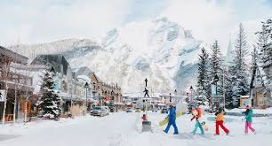

Colour selection is very messy:

Slide 19
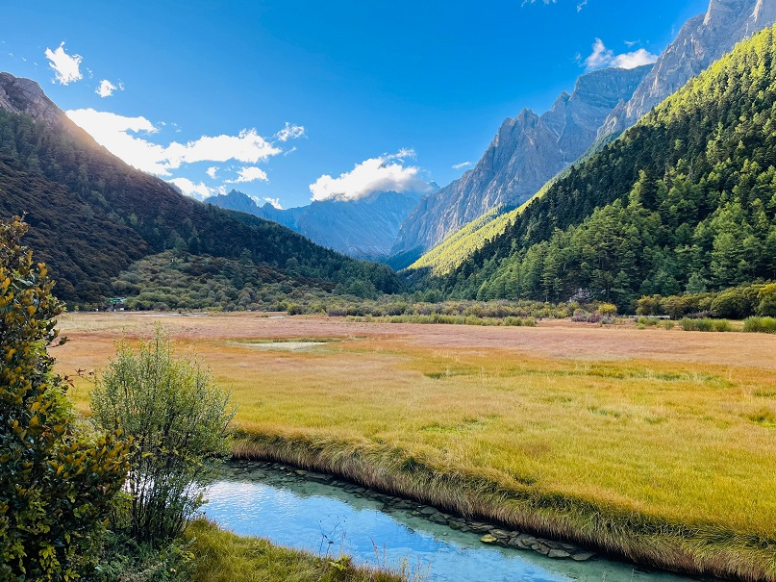
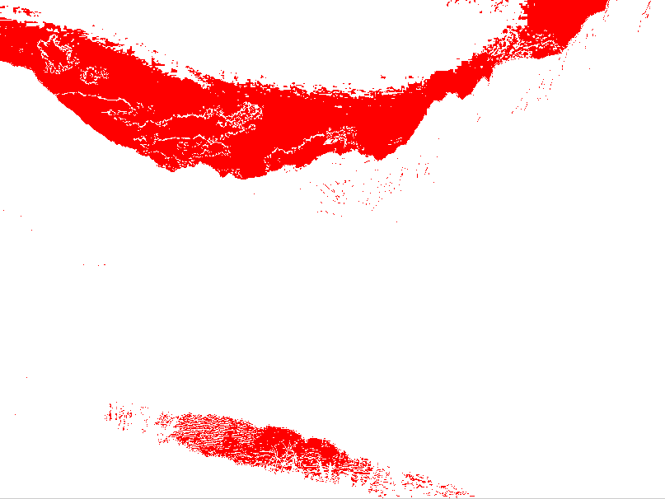
Colour selection is very messy:

Slide 20
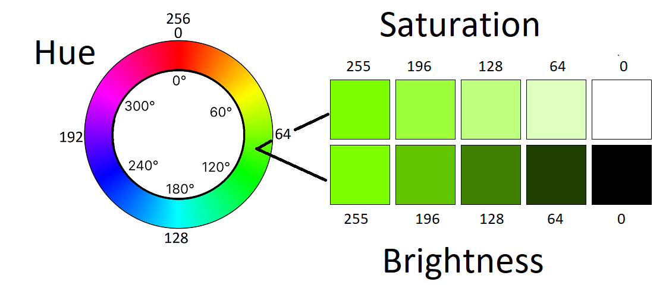
HSB
Hue
Saturation
Brightness

Slide 21
Hue
The H in HSB stands for hue, and this refers to the color.
It’s still a number, but each hue value is one identifiable color, beginning with h=0 as red. As h increases the red changes in nature so that it becomes the next color, orange, and then the next, yellow, and so on.
This means that the color blue is now a simple range of hue values, as defined by the individual artist. The value of the hue increases to its maximum, which is 255, and then back to 0. That means that if the color changes are to be smooth, a hue of 255 is right next to red, but from the other direction.

Slide 22
Saturation
The S in HSB stands for saturation, which is the amount of color, from a minimum of 0 to a maximum of 255.
As saturation gets smaller the color fades through pastels and to white.
Saturation can create the illusion of spatial depth. It can also draw attention to a specific point of focus.

Slide 23
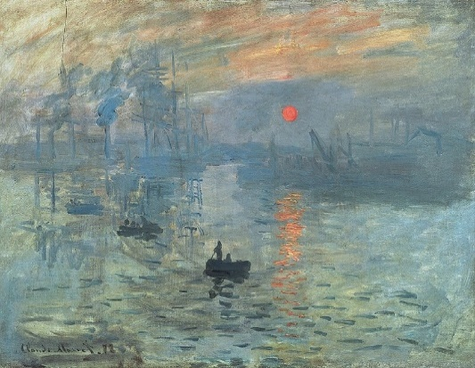
Saturation
An example of art that uses a high level of color saturation is Claude Monet’s Impression, Sunrise (1872)
There is a generally low color saturation, but higher intensity is evident in the sun, which becomes the focus of the painting.

Slide 24
Brightness
The B in HSB stands for brightness, which is what we have been calling value, from a minimum of 0 to a maximum of 255.
As the brightness value gets smaller, the color gets darker until it becomes black. This is how artists achieve low key and high key works.
Brightness changes add emphasis.

Slide 25
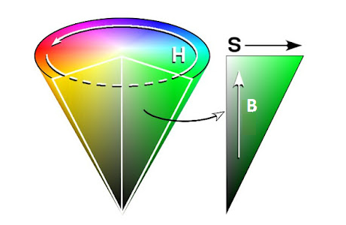
HSB Cone
HSB values form a cone.
The hue values form a circle; brightness is the vertical axis, and as saturation gets smaller the radius of the hue circle decreases.
This makes for a nice picture, but what it really means is that the hue value has less meaning as brightness and/or saturation gets smaller.

Slide 26
HSB Cone
Finding colours:
We now know that we can define blue as a pixel with hue coordinate between 240 and 250, or so.
But if the saturation if that pixel was, say, 10, then the hue would be meaningless because the pixel would look white.
If the same pixel had a brightness of 10, then it would appear to be black. Yes, it would still technically be blue, but not to the eye.

Slide 27
Paint – Subtractive Mixing
When using paints, we can mix the colours together to make different ones.
Mixing blue and yellow give a green colour, yellow and red give orange, and so on. We learned this process in school after we used crayons, and it lets us make any color we want, in principle.
It is interesting that it does not work the same way that mixing colours using a computer does. Mixing pigments is different from mixing light in pixels, because paint works by absorbing light.

Slide 28
RYB Color Model
In this model the primaries are red, yellow, and blue, which is probably what you learned in art school.
Mixing yellow and blue yields green, a characteristic of subtractive color systems, and is something that does not happen when using RGB.
Computer scientists and engineers, and not artists, devised the fundamentals of computer graphics in the 1960’s and 1970’s. RGB is logical based on how we detect color in our eyes, but it’s not intuitive for an artist.

Slide 29
RYB Color Model
There are not many computer implementations of RYB available that we can use as examples, and it’s difficult to find a correct algorithm for converting between RGB and RYB.
There are a few articles published, but too many of them have errors.
I’ll show you something that appears to work.

Slide 30
RGB to RYB
The variables r,g, and b are the color channels to be converted into RYB space. First, scale these to values between 0.0 and 1.0 by dividing by 255.0. Then remove the white from the color. White is min(r,g,b):
r=r/255; g=g/255; b=b/255;
w = min(r, g, b);
r -= w;
g -= w;
b -= w;

Slide 31
RGB to RYB
Next: remove yellow from the red/green channels.
Red/green creates yellow in RGB, and white has equal values of r,g, and b.
y = min(r, g);
r -= y;
g -= y;
We’ll add it back after converting.

Slide 32
RGB to RYB
The remaining green is now distributed between the new yellow component y and the blue channel (yellow+blue= green):
y += g;
b += g;

Slide 33
RGB to RYB
We now normalize again to keep the range 0.0 .. 1.0:
mg = max(r, g, b);
my = max(r, y, b);
if (my!=0)
n = mg / my;
r *= n;
y *= n;
b *= n;

Slide 34
RGB to RYB
Now we add the white back in and return the color, rescaled to 0..255:
r += w;
y += w;
b += w;

Slide 35
RGB to RYB
You don’t have to know this.
Just see how complex digital colors can be.

Slide 36
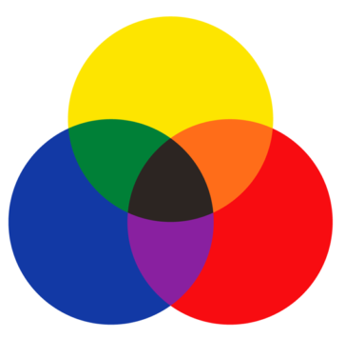
Mixing
Mixing RYB colors is not a matter of adding the components, as it is when using RGB; it is supposed to be a subtractive mixture.
If we simply add the components the brightness will increase, which is incorrect. We need an algorithm for the subtractive mixing process.

Slide 37
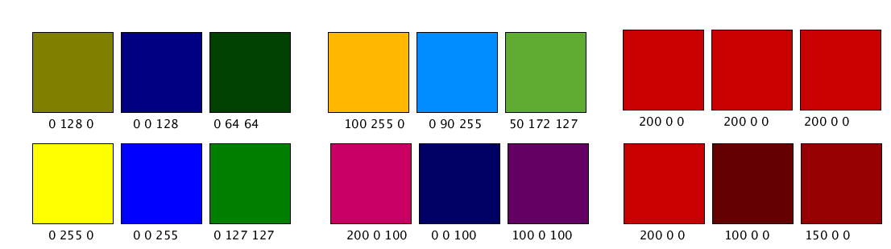
Mixing RYB
Here are some mixtures.
Note particularly that mixing two reds that are exactly the same gives the same color as the result, which is what we would expect.
The results are darker than the originals.

Slide 38
CMYK
The CMYK color coordinate space is also subtractive.
It’s used in computer printers to print color on paper, and it also has similarities to mixing paints.
The primary colors in this model are Cyan, Magenta and Yellow, and there is a black coordinate K.
.

Slide 39
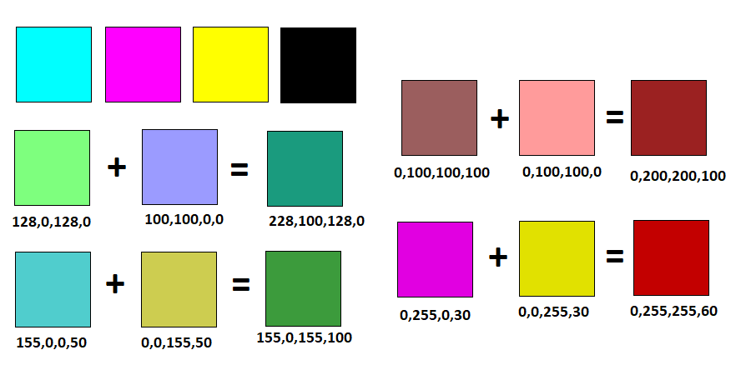
CMYK

Slide 40
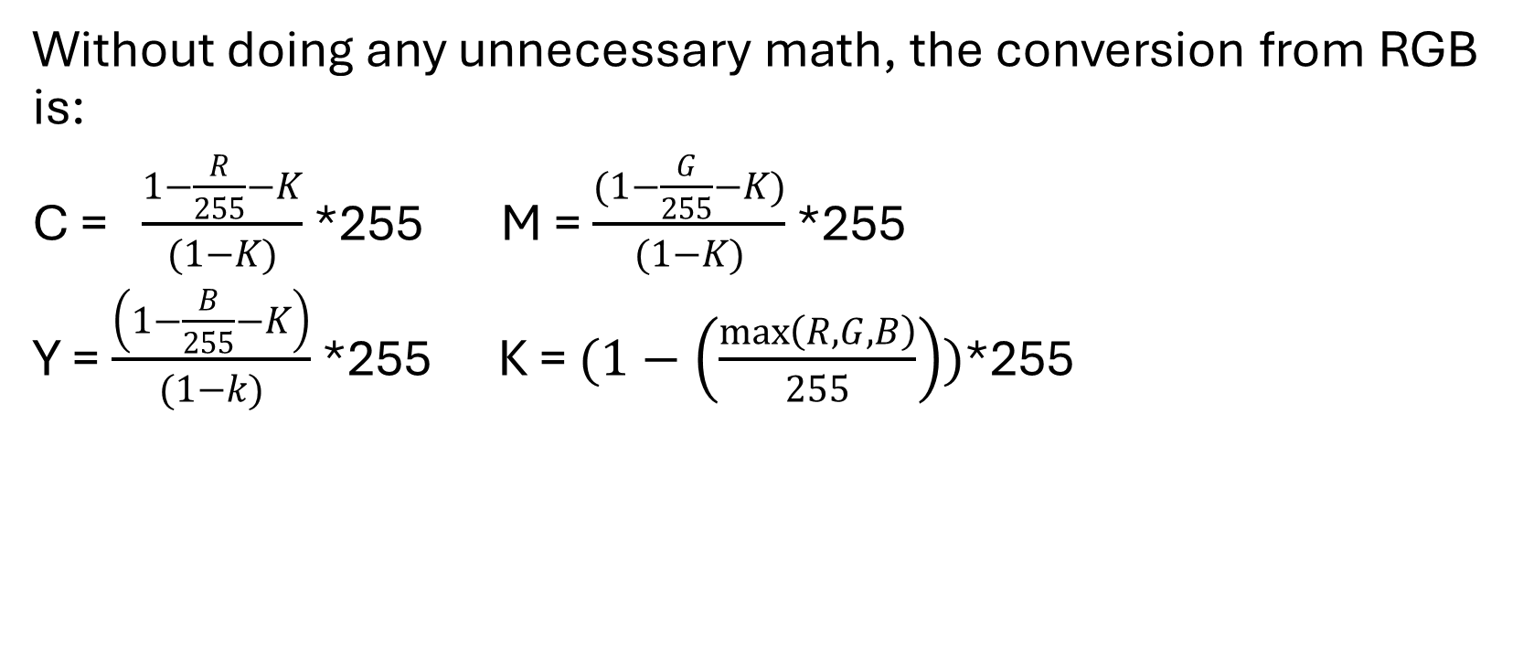
From RGB
Without doing any unnecessary math, the conversion from RGB is:
C = $\frac{1−\frac{R}{255}−K}{(1−K)}$ *255 M = $\frac{(1−\frac{G}{255}−K)}{(1−K)}$ *255
Y = $\frac{\left(1−\frac{B}{255}−K\right)}{(1−k)}$ *255 K = $(1−\left(\frac{\max\left(R,G,B\right)}{255}\right))$*255

Slide 41
White?
By the way, in CMYK there is no such colour as ‘white’.
White in CMYK is visually white if the background has no colour

Slide 42
Munsell colour
Albert Munsell, and artist, devised a system that tried to accurately describe the psychological experience of color, or in other words its perception.
Other systems describe the physics, more or less.
Munsell notation describes what color some object actually is. Which is to say, it is an effort to describe what people perceive when they look at the object.

Slide 43
Munsell
Munsell defined three attributes that sound very much like the HSB system; however, his work pre-dates HSB and computers, and in many ways differs from it.
The three values he named hue, value, and chroma.

Slide 44
Hue
The hue represents the color itself: green, blue, and so on.
These are not numbers they, are letter codes like R (red) and Yellow-Red (YR). There are 5 principal hues: Red, Yellow, Green, Blue, and Purple. There are 5 intermediate hues, each being half-way between two principal ones .
For example, YR is halfway in between Yellow and Red.
This give 10 hues, and each is broken into 10 sub-steps for a total of 100.

Slide 45
Value
Value is, as always, the lightness or darkness of the color.
Lighter colors have higher numbers. The range is 0-10.

Slide 46
Chroma
Chroma represents how strong the color is, similar to saturation.
It is also a number, typically between 2-14, with higher numbers representing stronger colors.
Interestingly, there is no upper limit to the chroma value. Some colors, fluorescent ones for instance, have chroma values in the 30’s. We can use this system to represent colors that cannot be displayed on a computer screen, and in fact some that would be difficult to actually use in reality. Think of them as theoretical in the higher range.

Slide 47
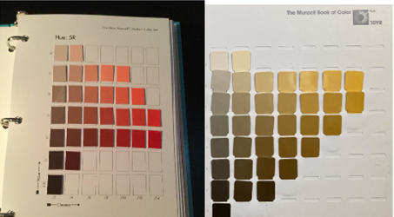
Munsell colour chart

Slide 48
Munsell
There are many of these charts, and because the numbers are perceptual a mathematical conversion is not really possible.
What we do is try to match RGB values to a Munsell colors, and then use interpolation to find the value in between.
Interpolation is a mathematical estimate of what value should be between two others given that we can find some pattern in those numbers. There is no formula to convert Munsell to RGB and back.

Slide 49
Colour from Value
We know how to convert a colour image into grey: use the HSB brightness value, or average three r, g, b channels. This conversion discards that colour (hue) component completely.
There can be many quite distinct colors have the same grey value by these methods. We’d expect that, because we’re throwing away 16 bits of data (the hue and saturation) for each pixel. That’s a lot of information.

Slide 50
Colour from Value
The problem of adding colour to a monochrome image is in principle, an impossible one.
But that won’t stop us ….

Slide 51
Pseudocolor (False colour)
Some images are intrinsically grey.
When taking photos in the infrared, as an example, the camera only captures the value of all frequencies as grey, and so it’s pretty easy to convert this into colour – simply map greys onto colours using a table.
The same is true of X-rays, CATscans, range images, and many others.

Slide 52
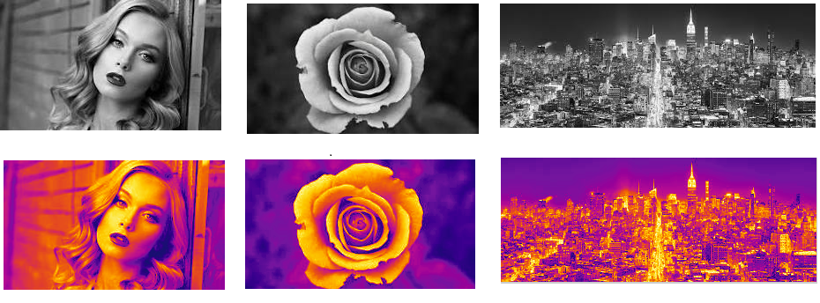
Pseudocolor (False colour)
We could map:
0 0 50 50
…
255 0 0
Called a look-up table

Slide 53
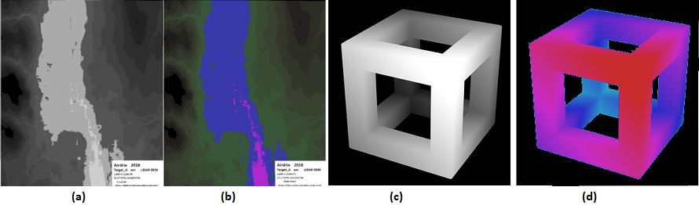
Pseudocolor (False colour)
Range image:
Pixels are distance, not colours.

Slide 54
By the way …
NASA Voyager images were grey, as are many space related images.
It had a series of color filters they could place in front of the lens to capture frequency dependent images.
Combining these can create a full color, image. Voyager would take a sequence of images of, for example, Jupiter through multiple filters. Of course, Voyager would move between images and so we had to align them and then the three colors are collected together into each pixel.

Slide 55
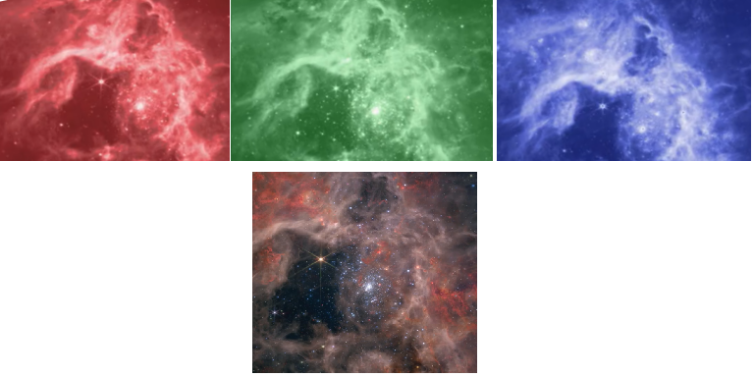
Here are the three monochrome images taken through color filters in a Hubble telescope image, and the color combination that results. NASA

