Slide 1
Value
Art 251

Slide 2
What is Value?
Value concerns how light or dark things are.
Value can be an overall aspect of a work, or it can vary from place to place, but in all cases the scale we use is from the darkest value, which is black, to the lightest, which is white.
Value underlies line and color, and getting the values correct might be more important than getting the colors correct.

Slide 3
Low Key
Works that consistently use dark values we call low key.
Such work can seem brooding, or mysterious, or even frightening.
Rembrandt was famous for low key paintings, and Yousuf Karsh used low key lighting for many of his famous photographs.

Slide 4
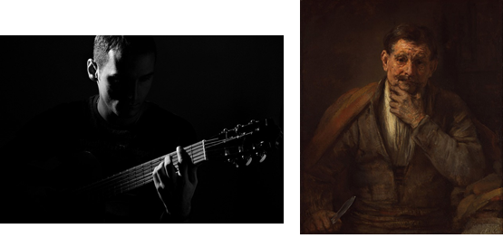
Low Key

Slide 5
High Key
Work that uses light, bright values is called high key.
We tend to see this as cheerful and happy.
In the excess the images are washed out and little remains except color or whiteness.

Slide 6
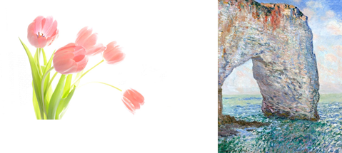
High Key

Slide 7
Pixel Values
A pixel is a color value.
In fact, it contains a red, green, and blue component, and the value of a pixel is the brightness or intensity of the pixel, irrespective of the color it represents.
While in chapter 2 a pixel could have two levels (black or white), now let’s think of it as a grey level, and it will have a value typically between 0 and 255.
Normally 0 represents black, and 255 represents white, but both the range and the value associated with any number can differ. Values in between represent various intensities of grey.

Slide 8
255?
The number 255 represents the largest number that we can represent in a single byte (8 bits), which is a standard unit of memory on a computer: one byte can store a single character.
8 Bits allows numbers between 0-255 (256 levels).
Human eyes can’t detect more levels than that anyway.
Extensions to larger ranges is pretty straightforward, and are usually meant to handle very specific devices and data sets, such as medical and astronomical data.

Slide 9
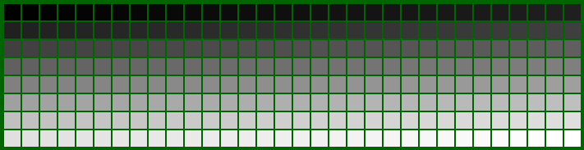
256 levels (values) of grey

Slide 10
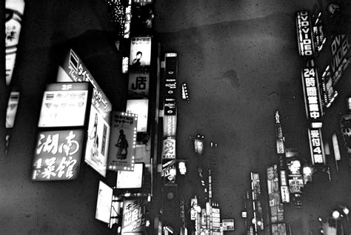
Grey level images
A grey level image contains only grey values, like an old black and white TV.
We can still see most objects very clearly.

Slide 11

Brightness
Colors can have very different hues and the same value.

Slide 12
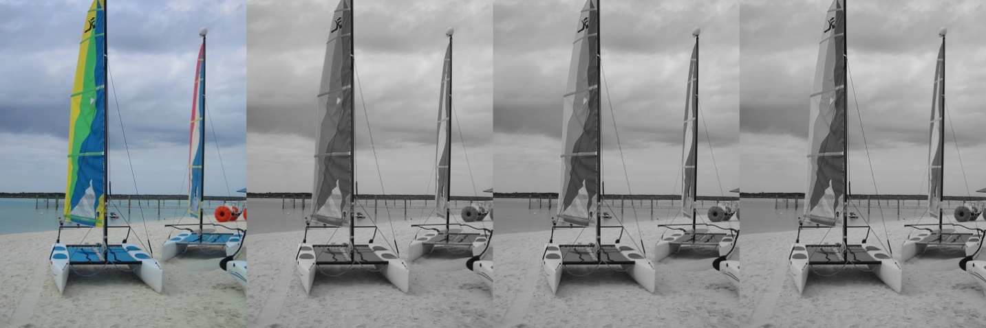
Brightness

Slide 13
Histogram
A histogram is a visual representation of the distribution of data.
Histograms are bar graphs that show how many data points fall into each range.
A grey level image can have 256 different values. This is the horizontal axis.
The height of the graph at any of those 256 points is the number of pixels having that value.

Slide 14
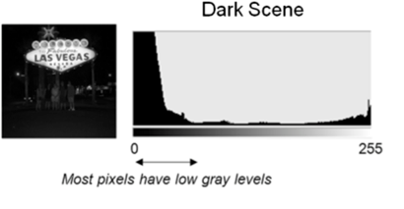
Histogram

Slide 15
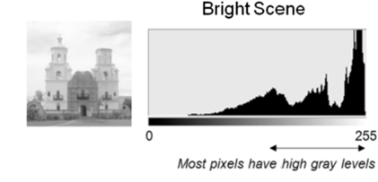
Histogram

Slide 16
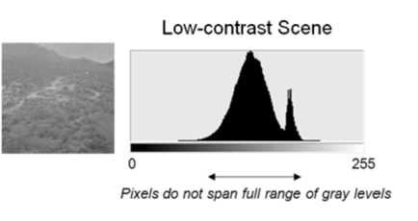
Histogram

Slide 17
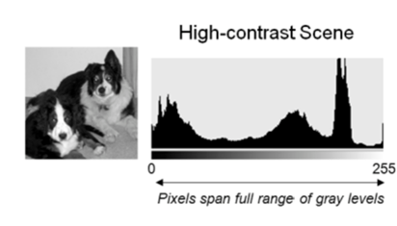
Histogram

Slide 18
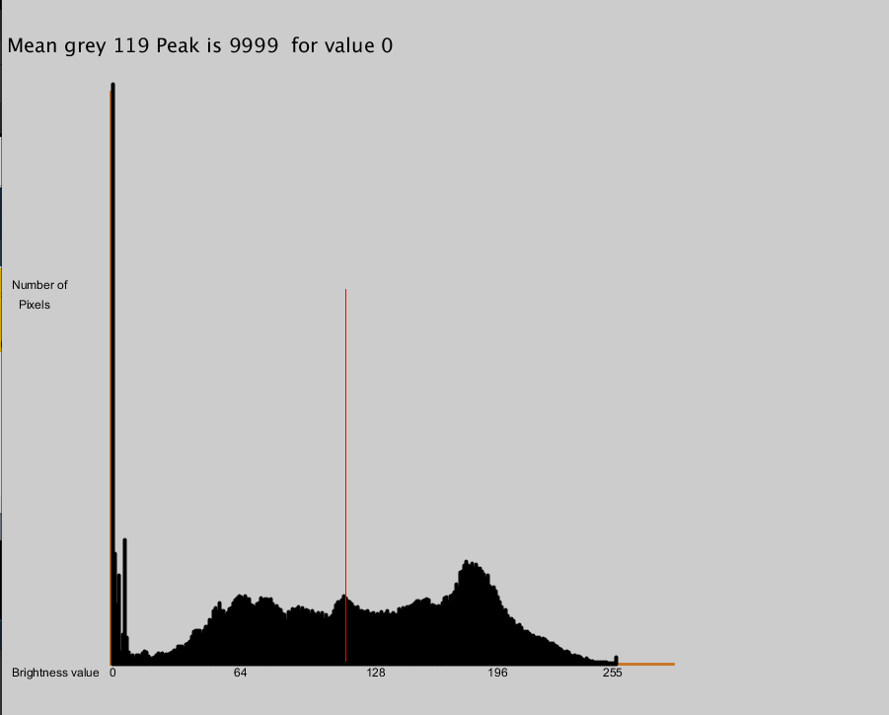
Histogram
A histogram does not indicate where pixels are, only how many have a particular value. What object has values of a specific value?

Slide 19
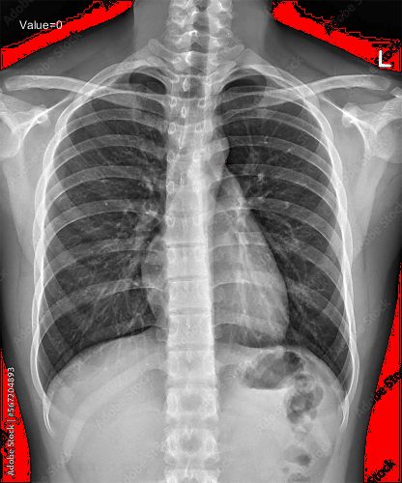
A histogram does not indicate where pixels are, only how many have a particular value.

Slide 20
A histogram does not indicate where pixels are, only how many have a particular value.

Slide 21
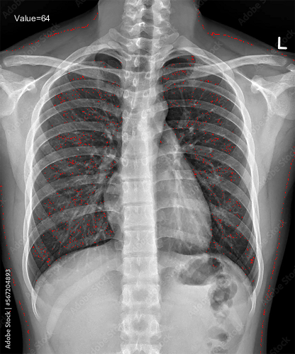
A histogram does not indicate where pixels are, only how many have a particular value.

Slide 22
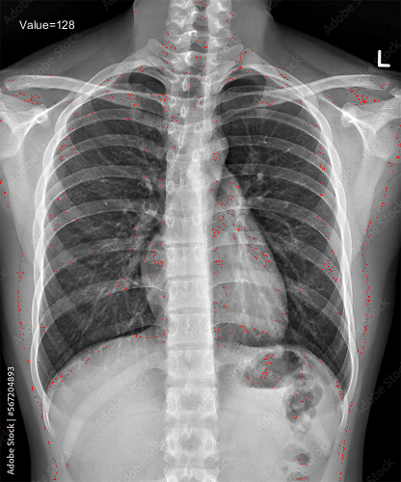
A histogram does not indicate where pixels are, only how many have a particular value.

Slide 23
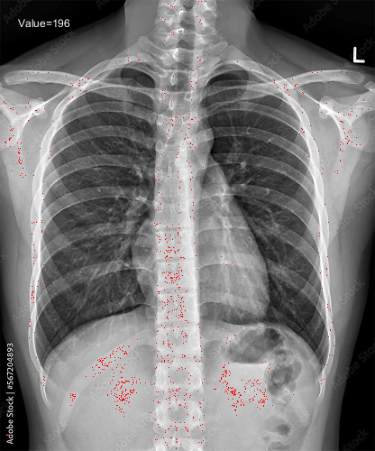
A histogram does not indicate where pixels are, only how many have a particular value.

Slide 24
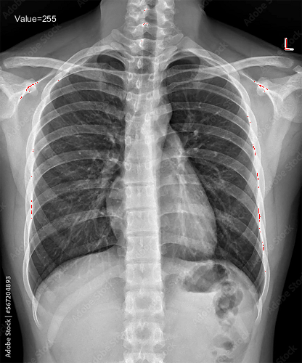
A histogram does not indicate where pixels are, only how many have a particular value.

Slide 25
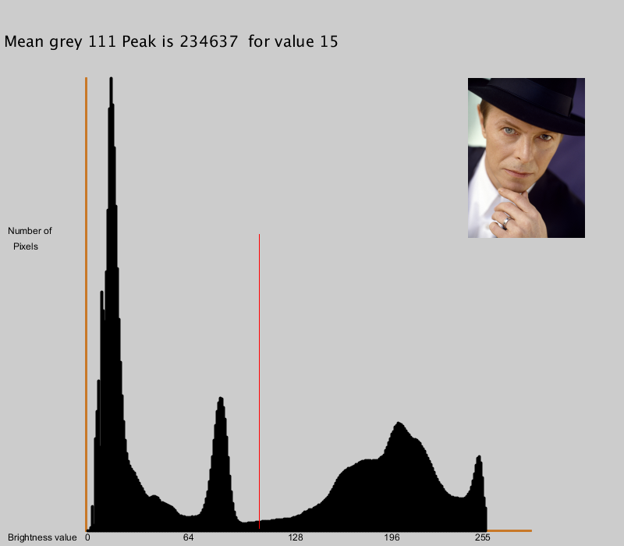
Histogram
There are 4 peaks in this histogram. What do they represent, if anything?

Slide 26
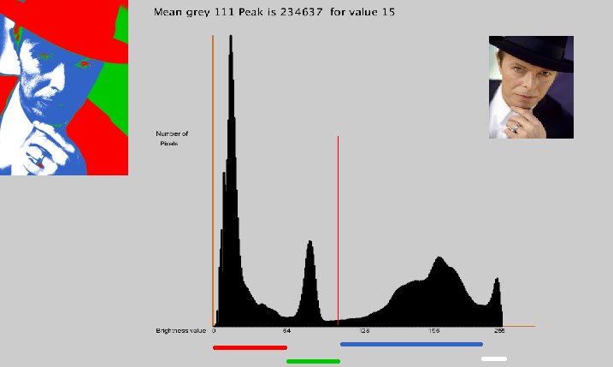
Histogram
See what the physical regions have in common

Slide 27
Contrast
Contrast is the range of grey levels that are occupied (I.E. have pixels with that level) compared with the total number of levels possible.
The idea is that there may be grey values at the bottom or top of the possible range that have no pixels belonging to them.
The fraction of the range that does have pixels is a measure of how much contrast is in the image. An image with low contrast can be either bright or dark, but the range of pixels is compressed into a smaller range than it needs to be. There are no pixels at the low and/or the high ends of the range. We could stretch the histogram by moving the lowest actual pixel values to the lowest possible ones, and doing that iterative up the brightness levels.

Slide 28
Contrast
An image with low contrast can be either bright or dark, but the range of pixels is compressed into a smaller range than it needs to be. (Low key)
There are no pixels at the low and/or the high ends of the range. We could stretch the histogram by moving the lowest actual pixel values to the lowest possible ones, and doing that iterative up the brightness levels.

Slide 29
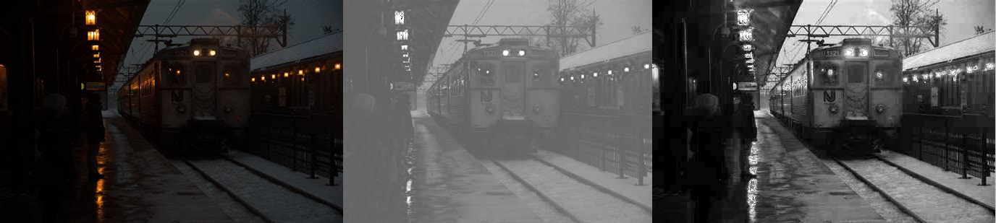
Contrast
Original Brighter More Contrast

Slide 30
Contrast - gamma
A commonly used enhancement in photography is called the gamma (g) correction or gamma transformation.
This raises each pixel to the g power: that is, for a pixel p new pixel is p^g .
The value of g is should usually be close to 1 or else the image quickly deteriorates. This was devised to correct for the fact that cameras and displays are often not able to capture or display values linearly; that is, the lighter values may be brighter than they should be, and the darker ones darker.

Slide 31
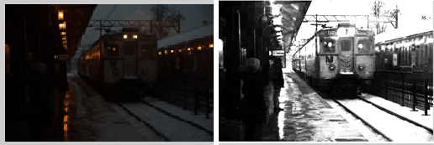
Contrast – gamma (1.6)

Slide 32
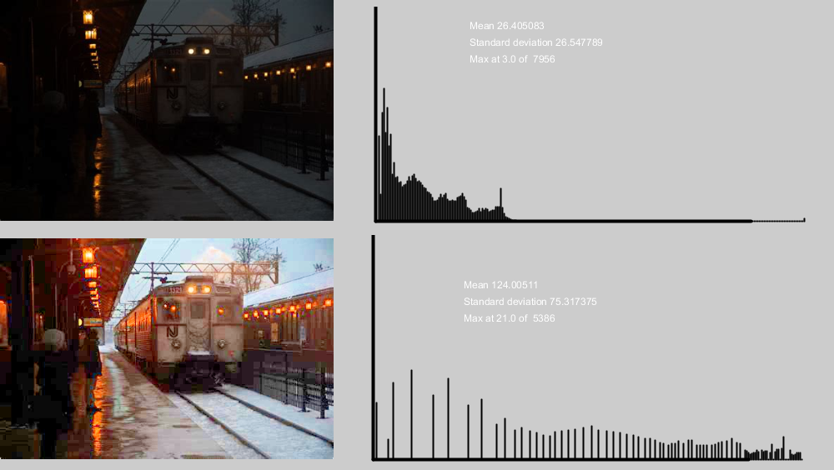
Contrast – Histogram Equalization
Change levels so the histogram is as flat as possible.

Slide 33
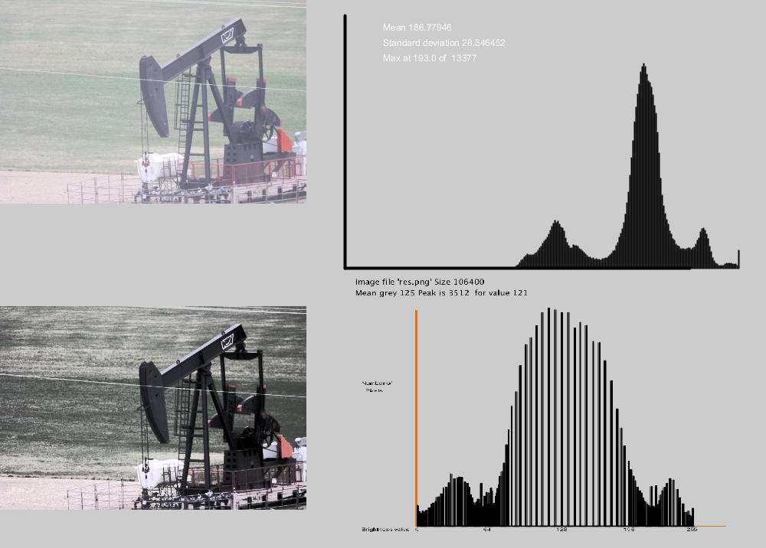
Contrast – Histogram Specification
Change levels so the histogram is near as possible to another one.

Slide 34
Thresholding – Extreme contrast
Change levels so that there are only two: black and white.
Very easy to do: look at every pixel and if it is less that T set it to black, otherwise set it to white.
Hard to do well. What value should we use for T?
There are obviously only 256 different thresholds possible.

Slide 35
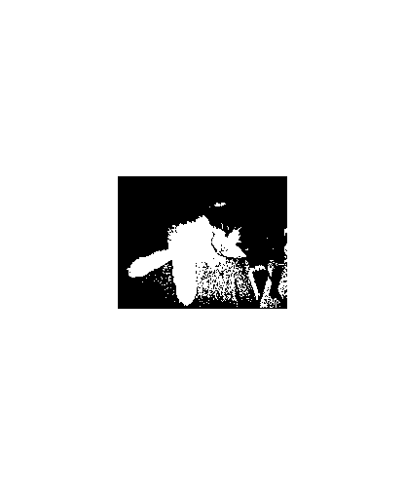
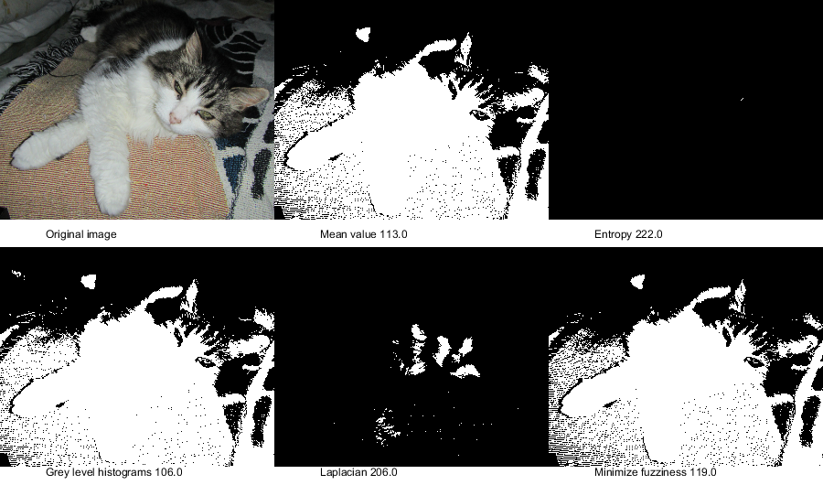
Thresholding – Extreme contrast

Slide 36
Regions
A region is an area having a similar grey value. It frequently represents a particular object in the image, and so is something that we want to treat as a single thing.
A region is a set of contiguous pixels of the same or similar value. It is possible to have multiple regions with the same value that are separate, which makes finding regions a little more difficult.

Slide 37
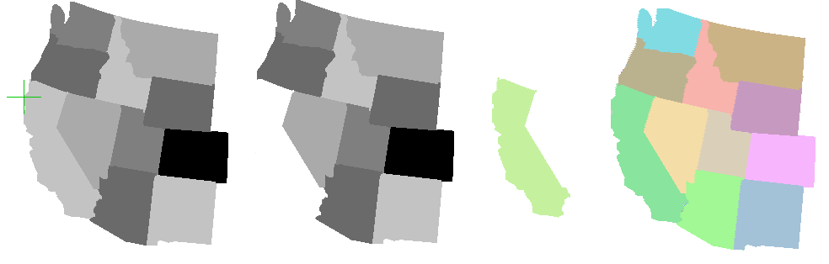
Regions

Slide 38
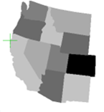

Regions
This is not as easy as you would imagine.

Slide 39
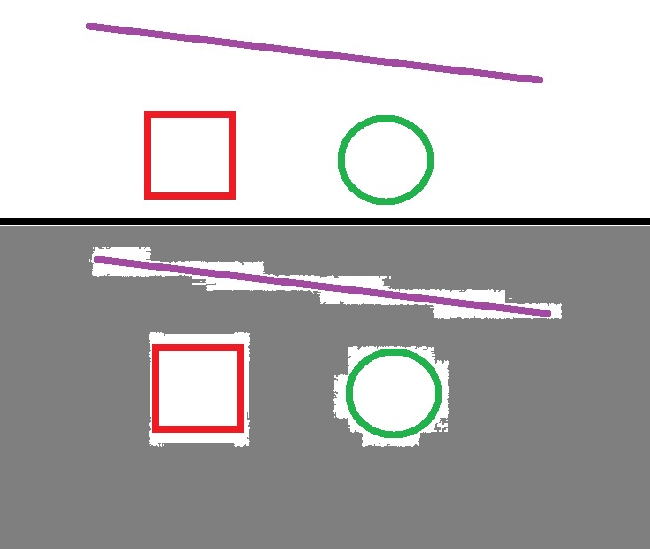
Why?
The way we store images is critical here.
Example:
JPG images, common on digital cameras, is terrible.

Slide 40
Why?
Why is JPG so bad?
Images are nearly always compressed in size.
This involves a loss/modification of pixel data, especially at boundaies.

Slide 41
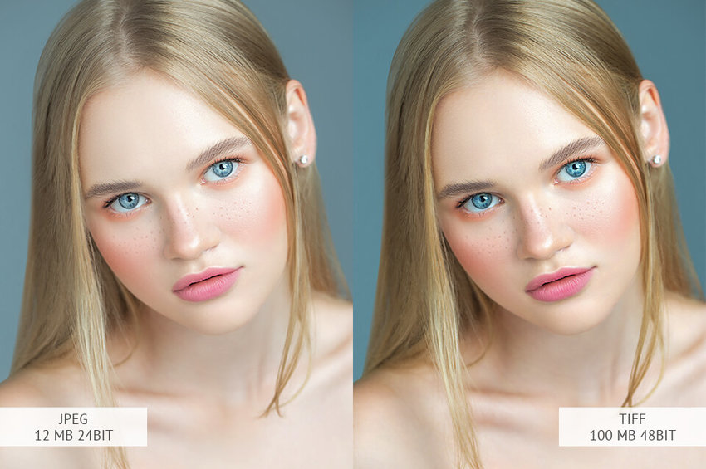
Why?
Don’t use JPG if possible.
Use PNG
TIF

Slide 42
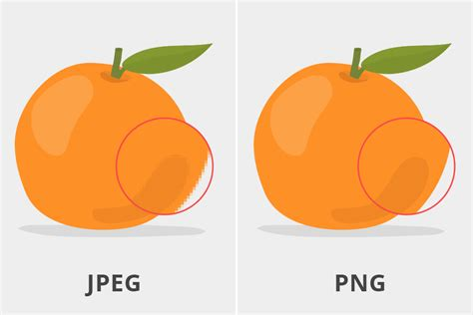
Why?
Don’t use JPG if possible.
Use PNG
TIF
SVG

Slide 43
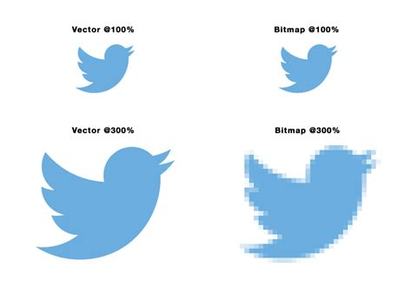
Why?
Don’t use JPG if possible.
Use PNG
TIF
SVG

Slide 44
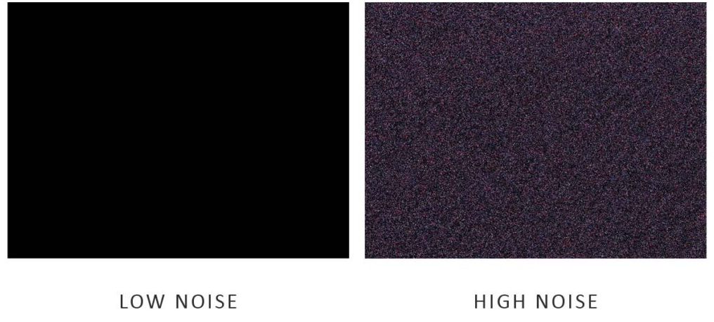
Noise
Anything in an image that you don’t want ☺
In practice, it is random variations in value. Usually results from lighting, sensor variations, external signals, vibration.

Slide 45
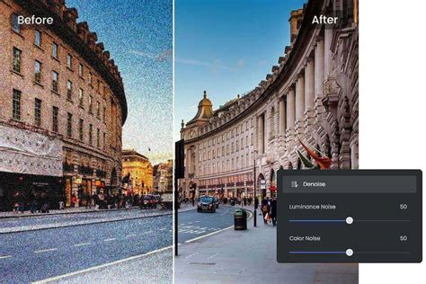
Noise
Sometimes made worse by image zoom.

Slide 46

Noise
We can reduce the noise by averaging nearby pixels.
Original Mean of 9x9 Median of 9x9

Slide 47
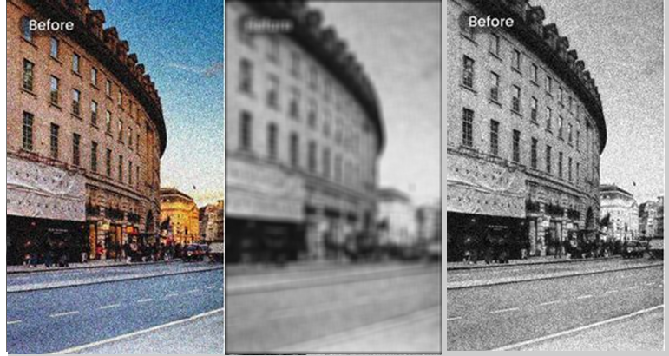
Noise
Original Mean Median
You can see the blurring effect of the mean here.

Slide 48
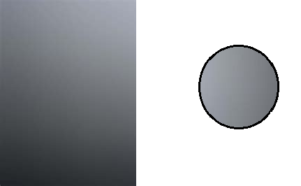
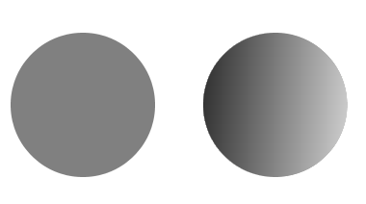
Gradient
A gradient is a gradual change in value across a physical area.
A value gradient can be created by starting at some (x, y) location with a value V and modifying the value as a function of distance from (x, y) in a specific direction.

Slide 49

Gradient
Gradients are often used in artworks as backgrounds, rather than using a solid color. The result has more impact that way.

Slide 50
Bi-level Display of Value
We can visualize different values using only black and white pixels. This is an interesting effect, and in the past, when printers only had black ink, to simulate levels of grey.
The basic idea is to replace each pixel in the grey image with a small set of black and white pixels arranged in a pattern that, from a distance, has the appearance of grey.

Slide 51
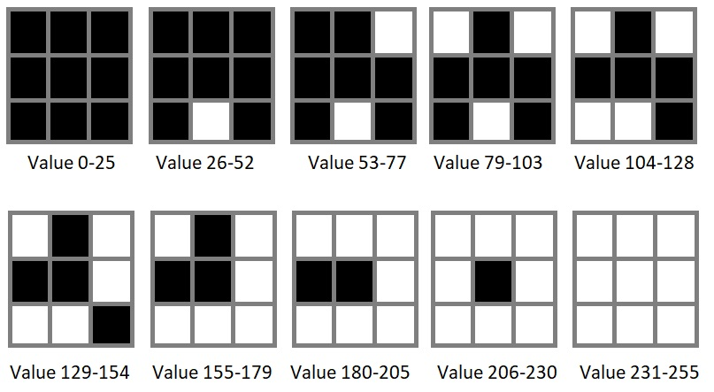
Bi-level Display of Value
Each pixel in the original image will be drawn as a square region of pixels in the result, and those regions will have black pixels arranged in a pattern or template.

Slide 52
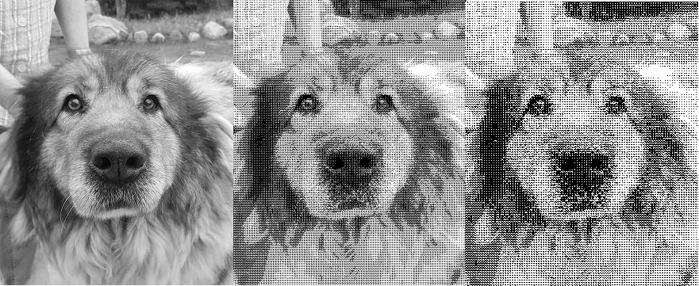
Bi-level Display of Value
Another method that has been used to create artistically interesting images is to replace a small region of the original image with a filled circle. The diameter of the circle increases as the value increases, making the area darker and darker. This is the classical method.

Slide 53
Dithering
Some definitions of dither include “ be unable to make a decision about doing something”, and “to be very nervous, excited, or confused.” It implies a kind of disordered behavior. Indeed, the origin of the word is the Middle English verb didderen, meaning "to tremble."
A dithering algorithm can randomly (or seemingly) place black pixels near pixels of specific values so as to visually simulate the greys.

Slide 54
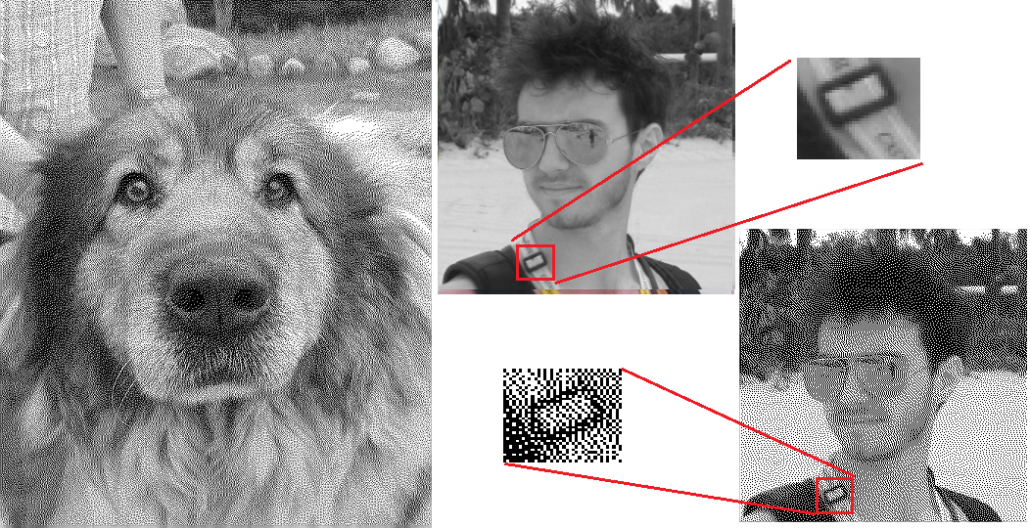
Dithering

Slide 55
Quantization
How many levels?
Default would be 256. But why not 32? 16? 4?
Let’s have N levels.
Then let T = 256/N
And set grey values between 0 and T to 0, between T+1 to 2*T to T, between 2T+1 to 3T to 2*T and so on.

Slide 56
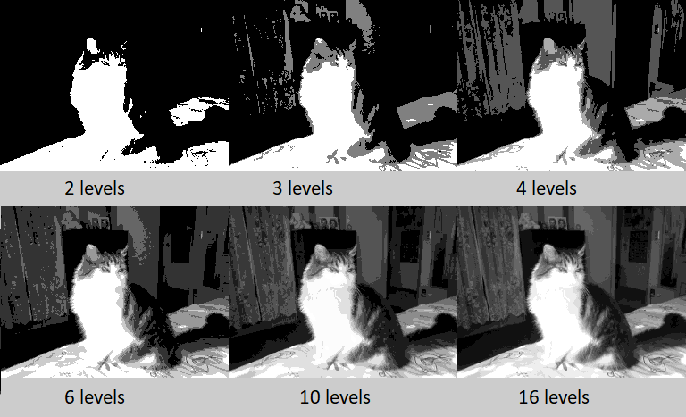
Quantization

Slide 57
Multiple thresholds

Slide 58
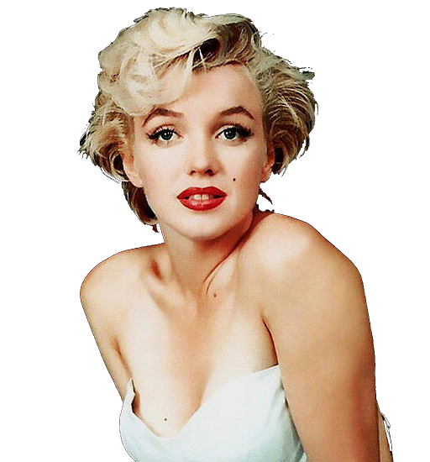
Example: Marilyn

Slide 59
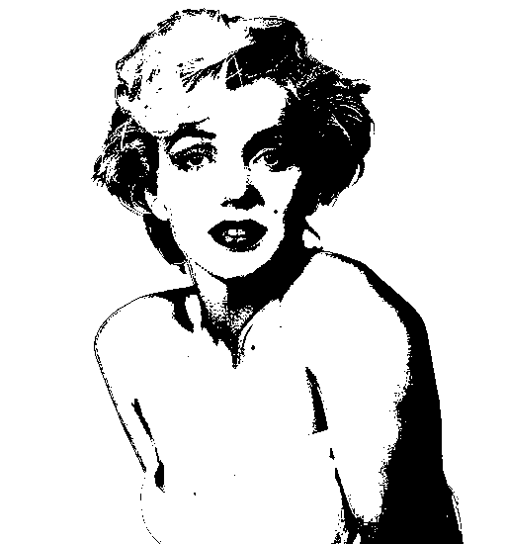
Step 1: Threshold
Black and white only.

Slide 60
This gives a lot of ‘fuzzy’ outline boundaries.
Can smooth it – median filter

Slide 61
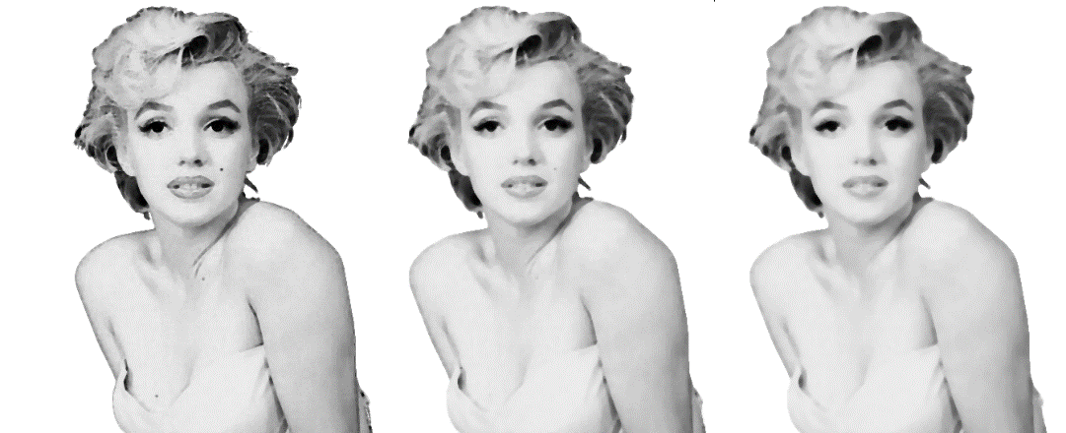
Size 2 Size 3 Size 4

Slide 62
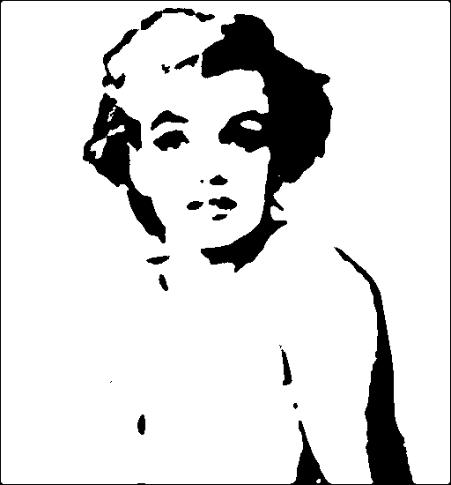
NOW Threshold after smoothing with size 4 filter.

Slide 63

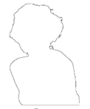
I don’t like the gaps in the outline. Threshold the original image, and extract the outline.

Slide 64
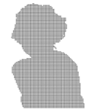
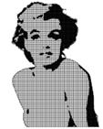
Fill the outline with a texture (halftone) and add it to the filtered image.

Slide 65
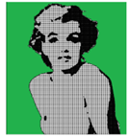
Let’s add a background.

Slide 66
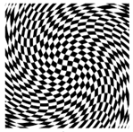
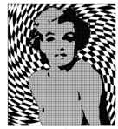
That was boring. Try this:

Slide 67
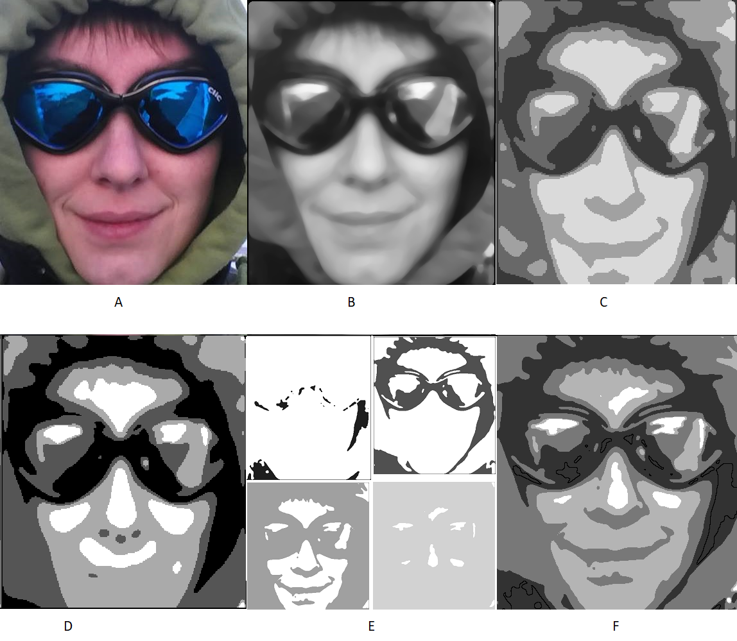
Smoothing and quantization can yield interesting results.

