Slide 1
Value Editing
GIMP

Slide 2
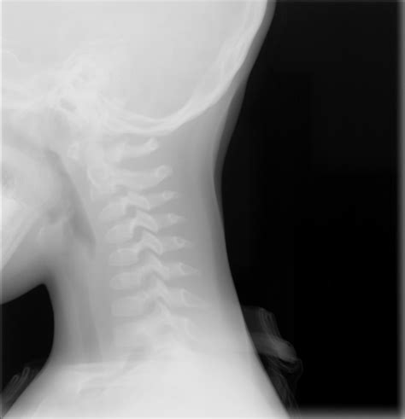
GIMP – Gnu Image Manipulation Package
Adjusts greys (and colors)
Can use to ‘enhance’ images.

Slide 3
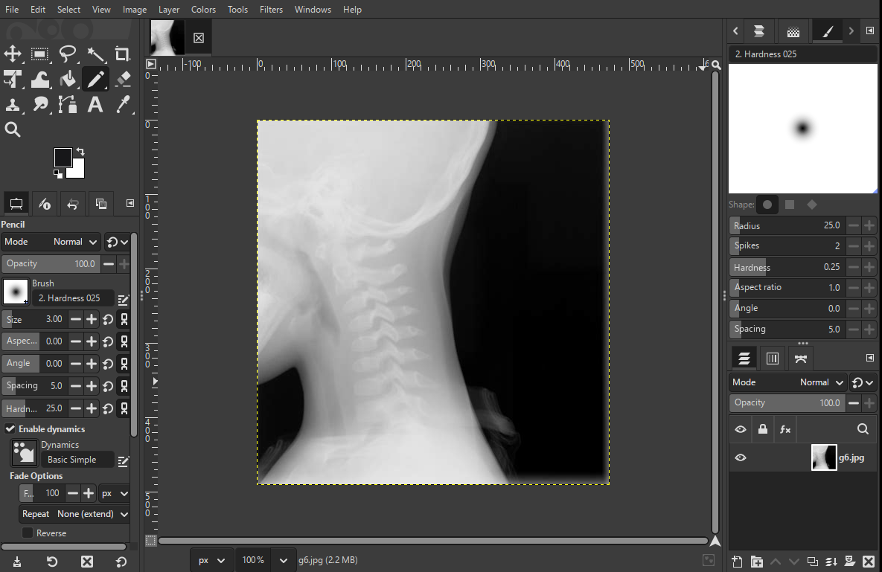

Slide 4

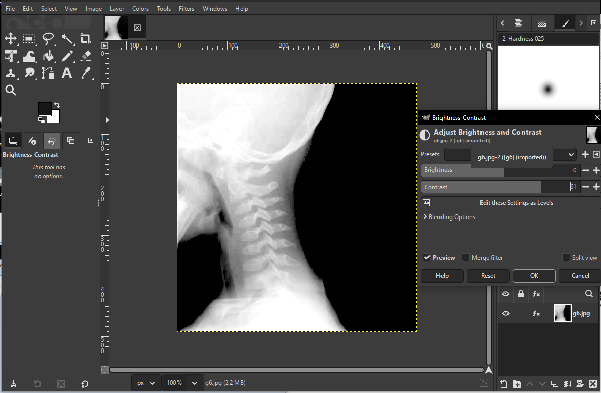
Contrast

Slide 5
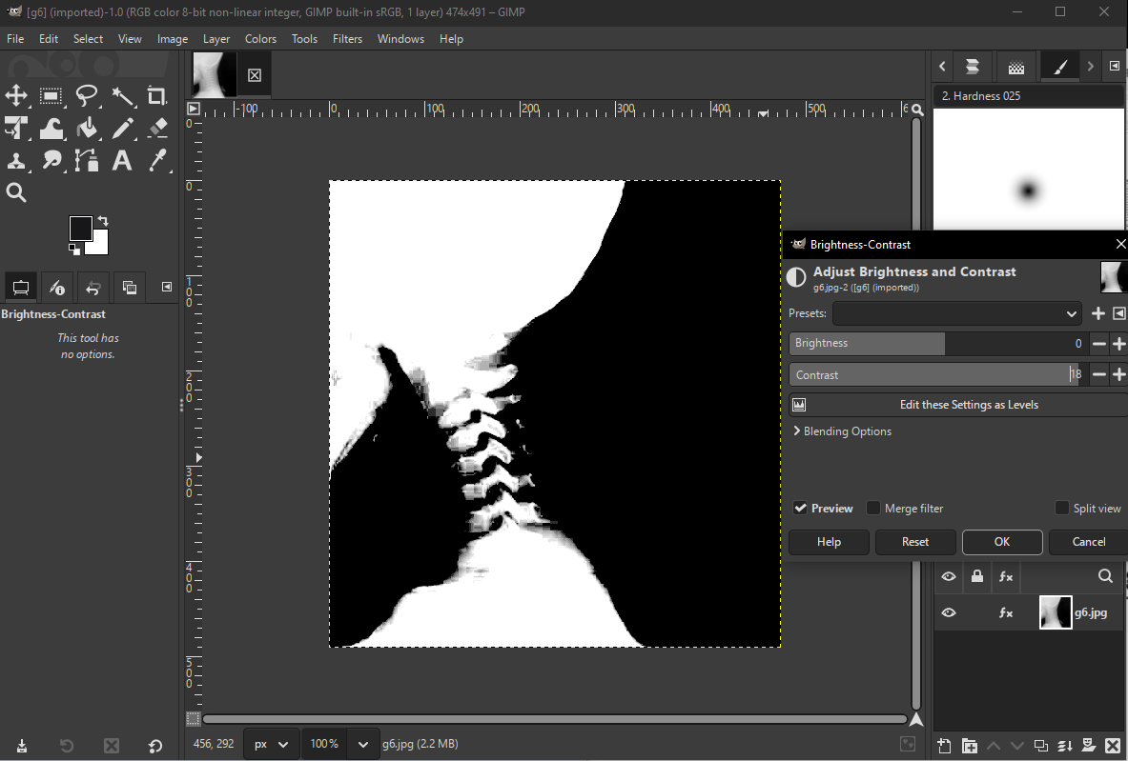
Contrast

Slide 6
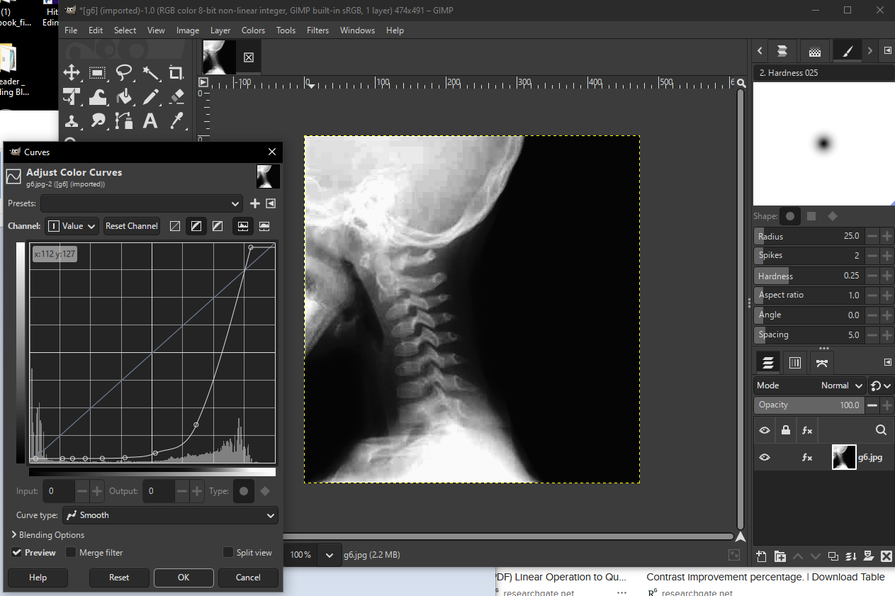
Drawing with Paint

Slide 7
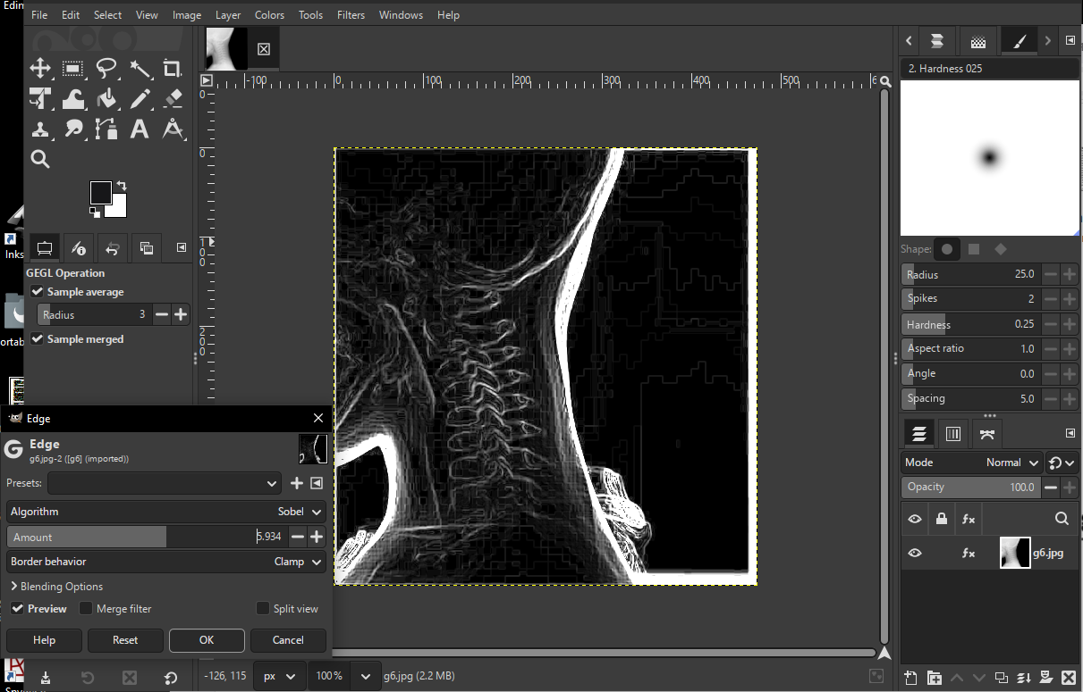

Slide 8
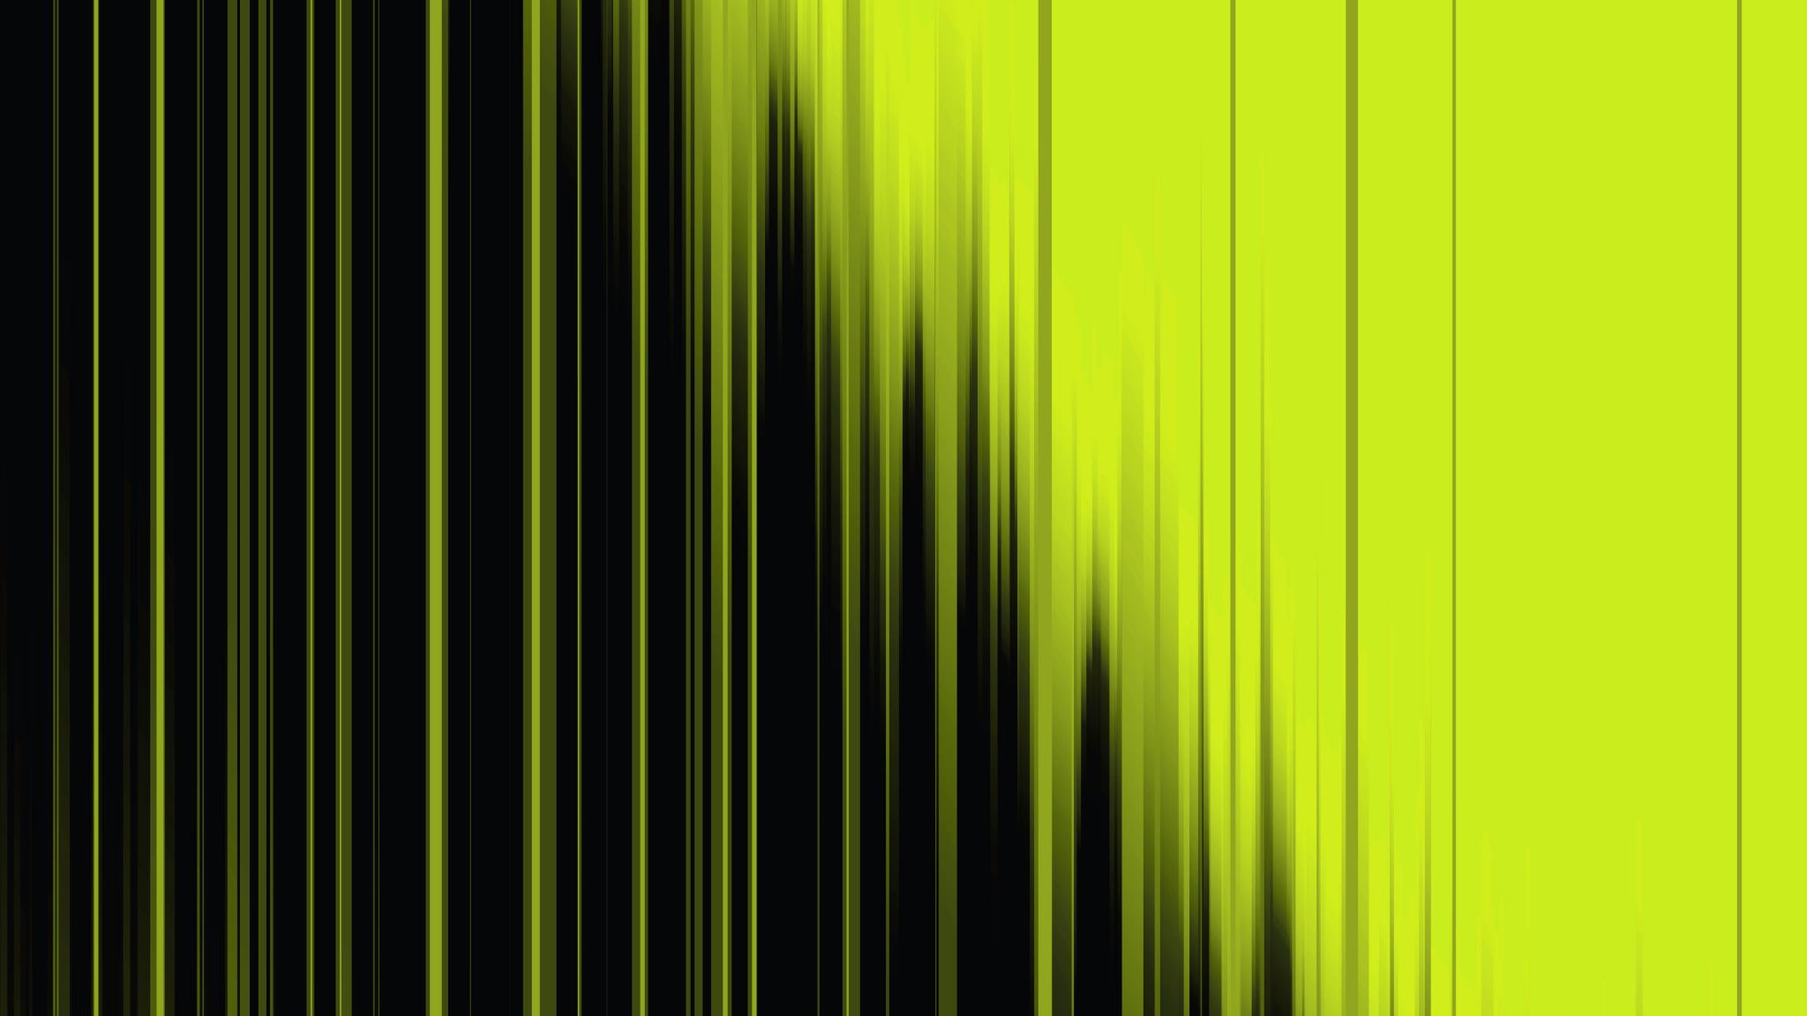
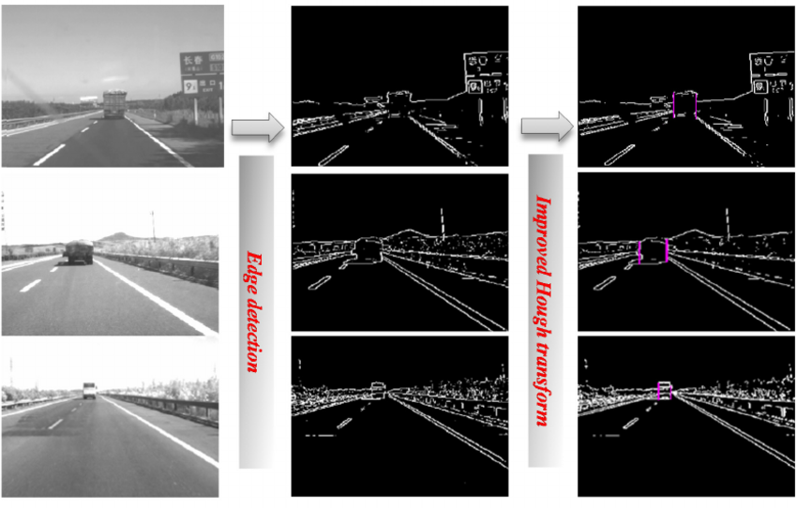
Edges

Slide 9
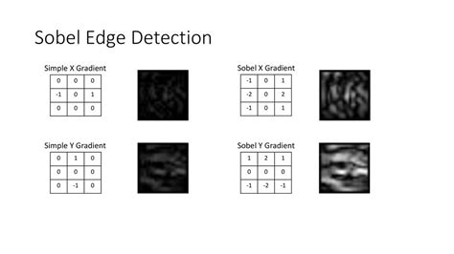
Edges/Boundaries happen where pixel values change quickly over space.

Slide 10
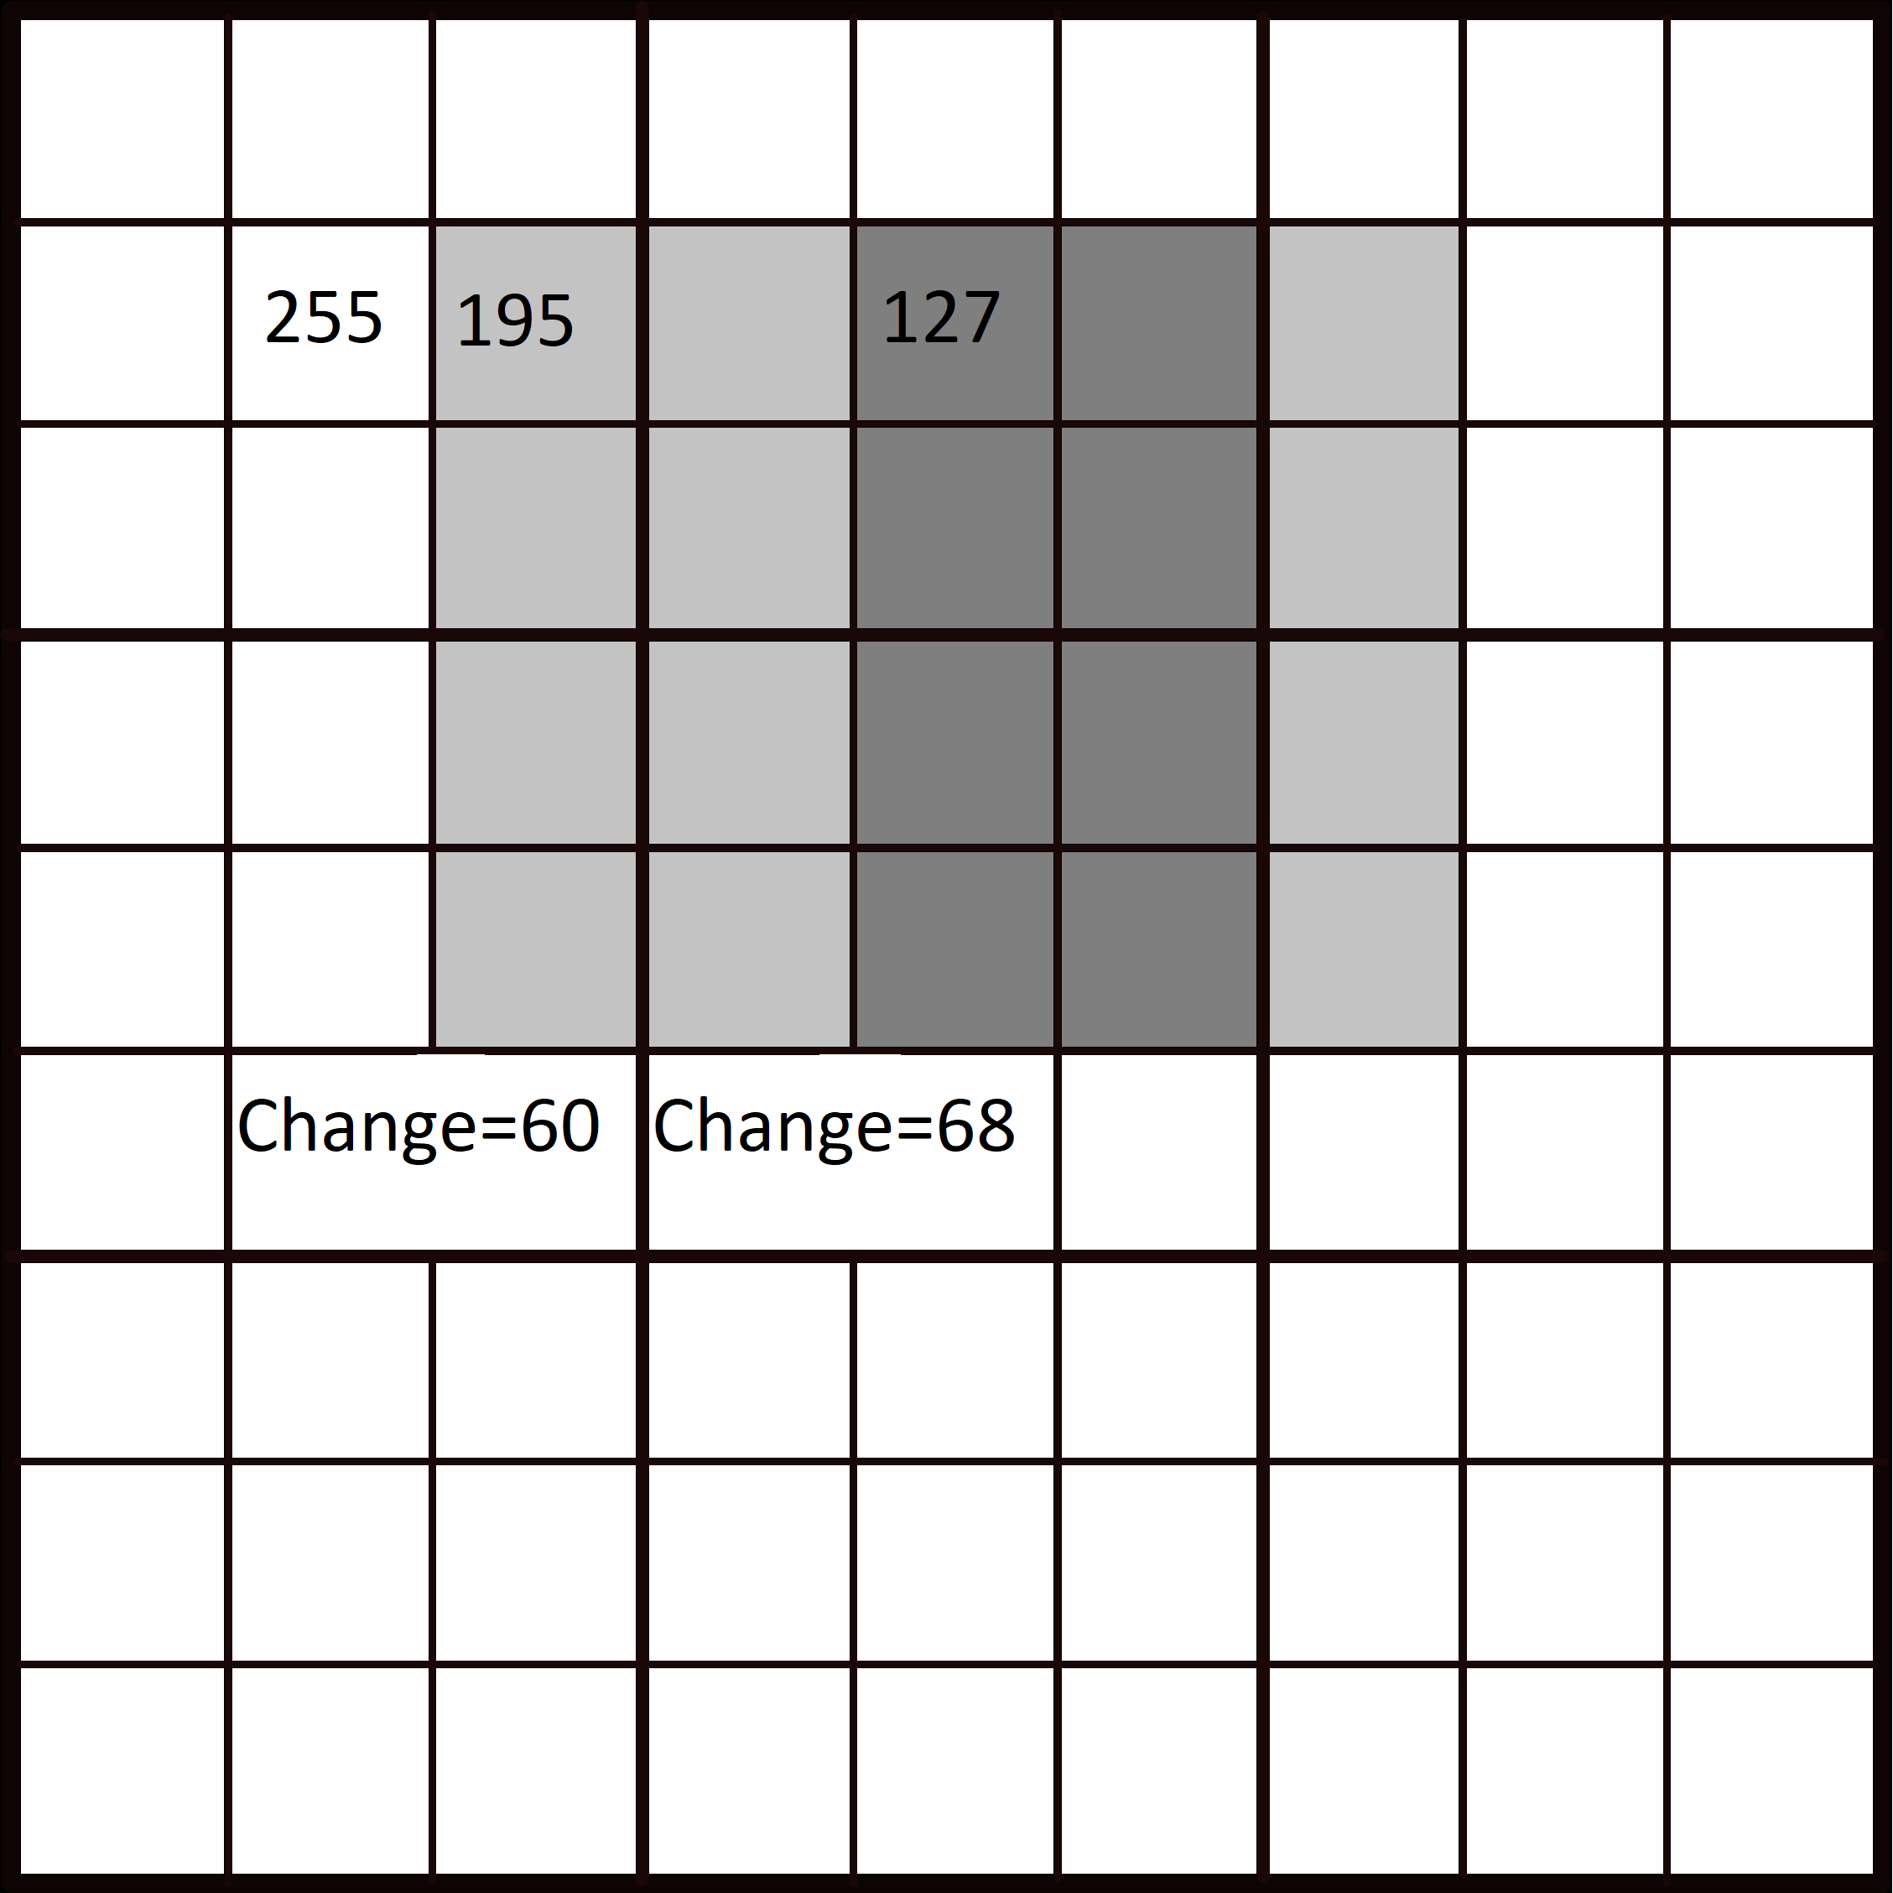

Slide 11
