Slide 1
Digital Drawing
Part 1 - Paint

Slide 2
Drawing with Paint
Simplest Windows tool.
Illustrates the drawing tools common to nearly all software.

Slide 3
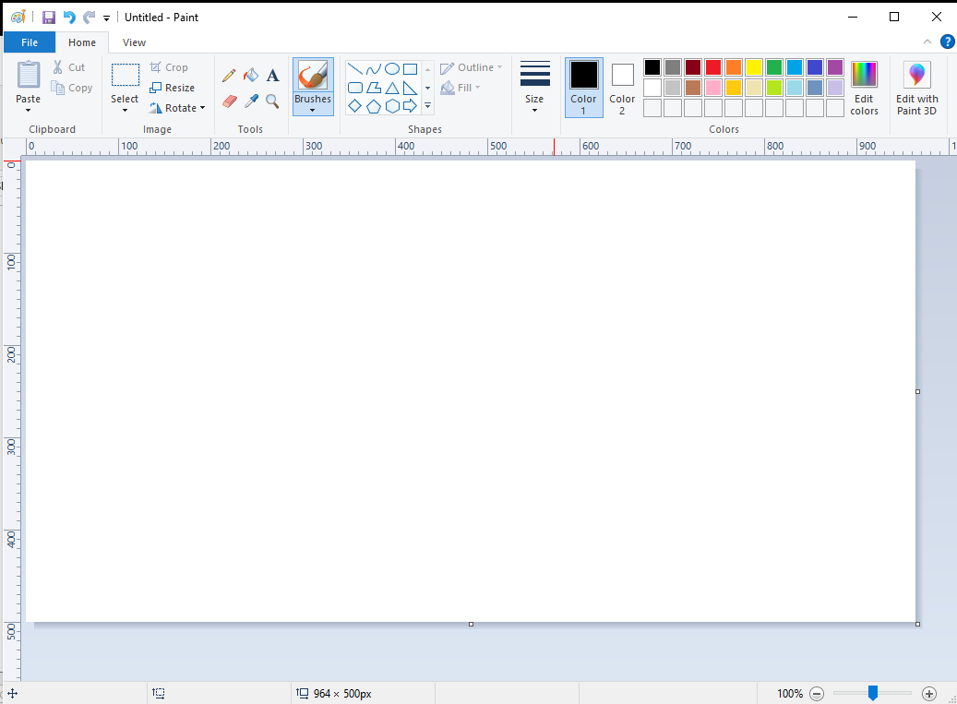
Drawing with Paint

Slide 4
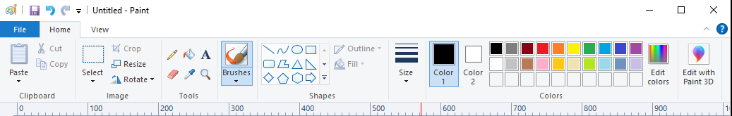
Drawing with Paint
Ops Actions Shapes Thickness Colors

Slide 5
Drawing with Paint
Walkthrough

Slide 6
Drawing with Paint
In this drawing we’ll use:
Pencil Fill
Line Eraser
Curve

Slide 7
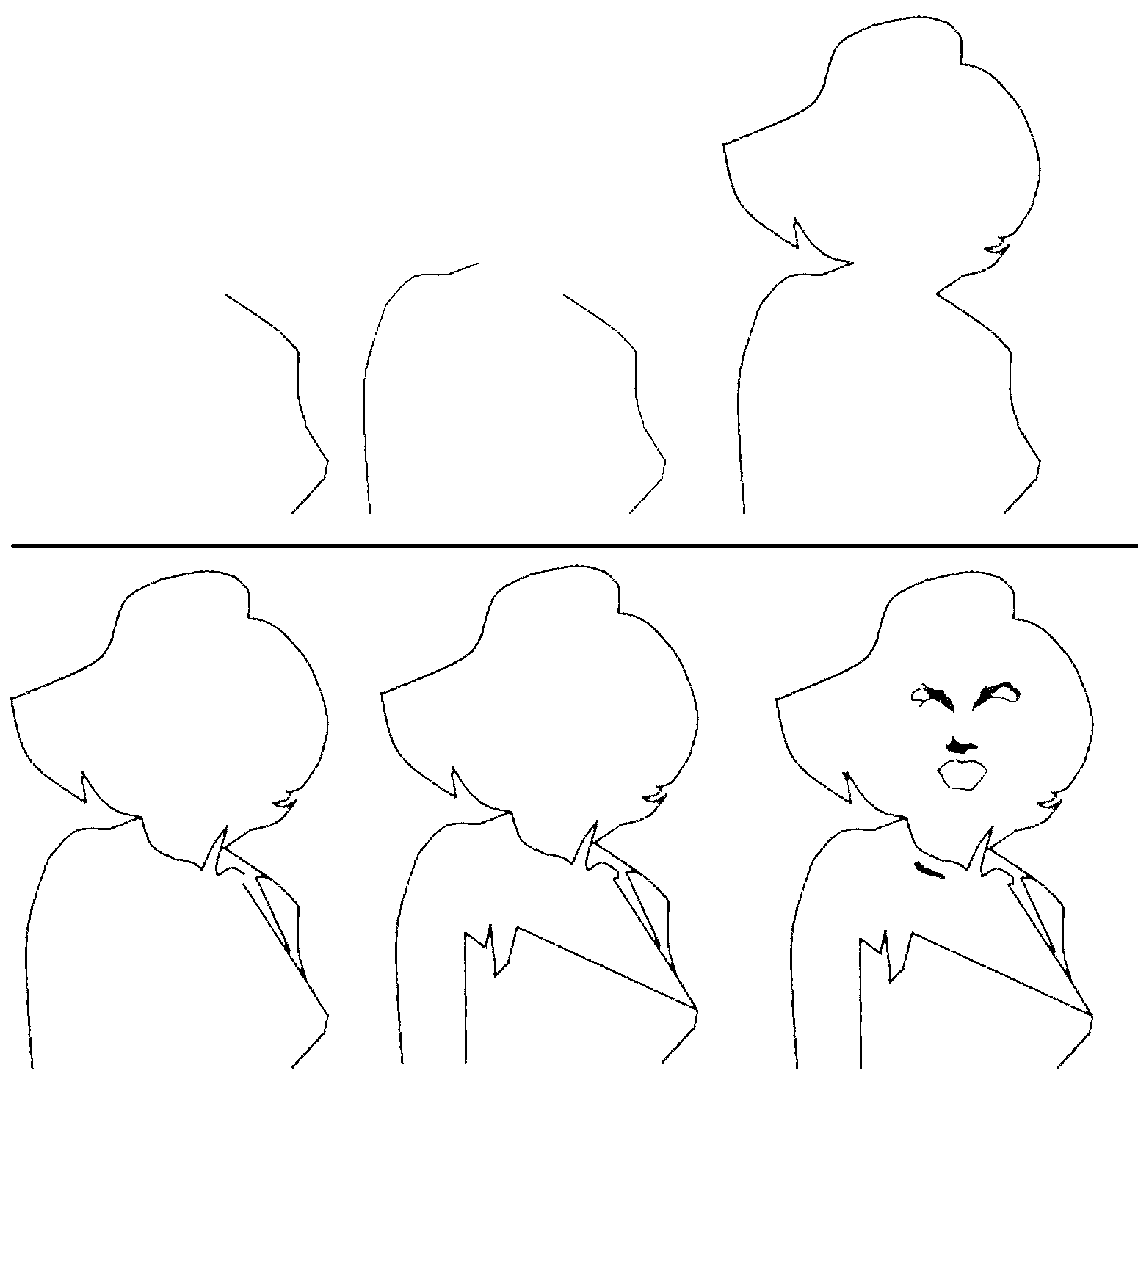
Drawing with Paint
Curve
line
pencil

Slide 8
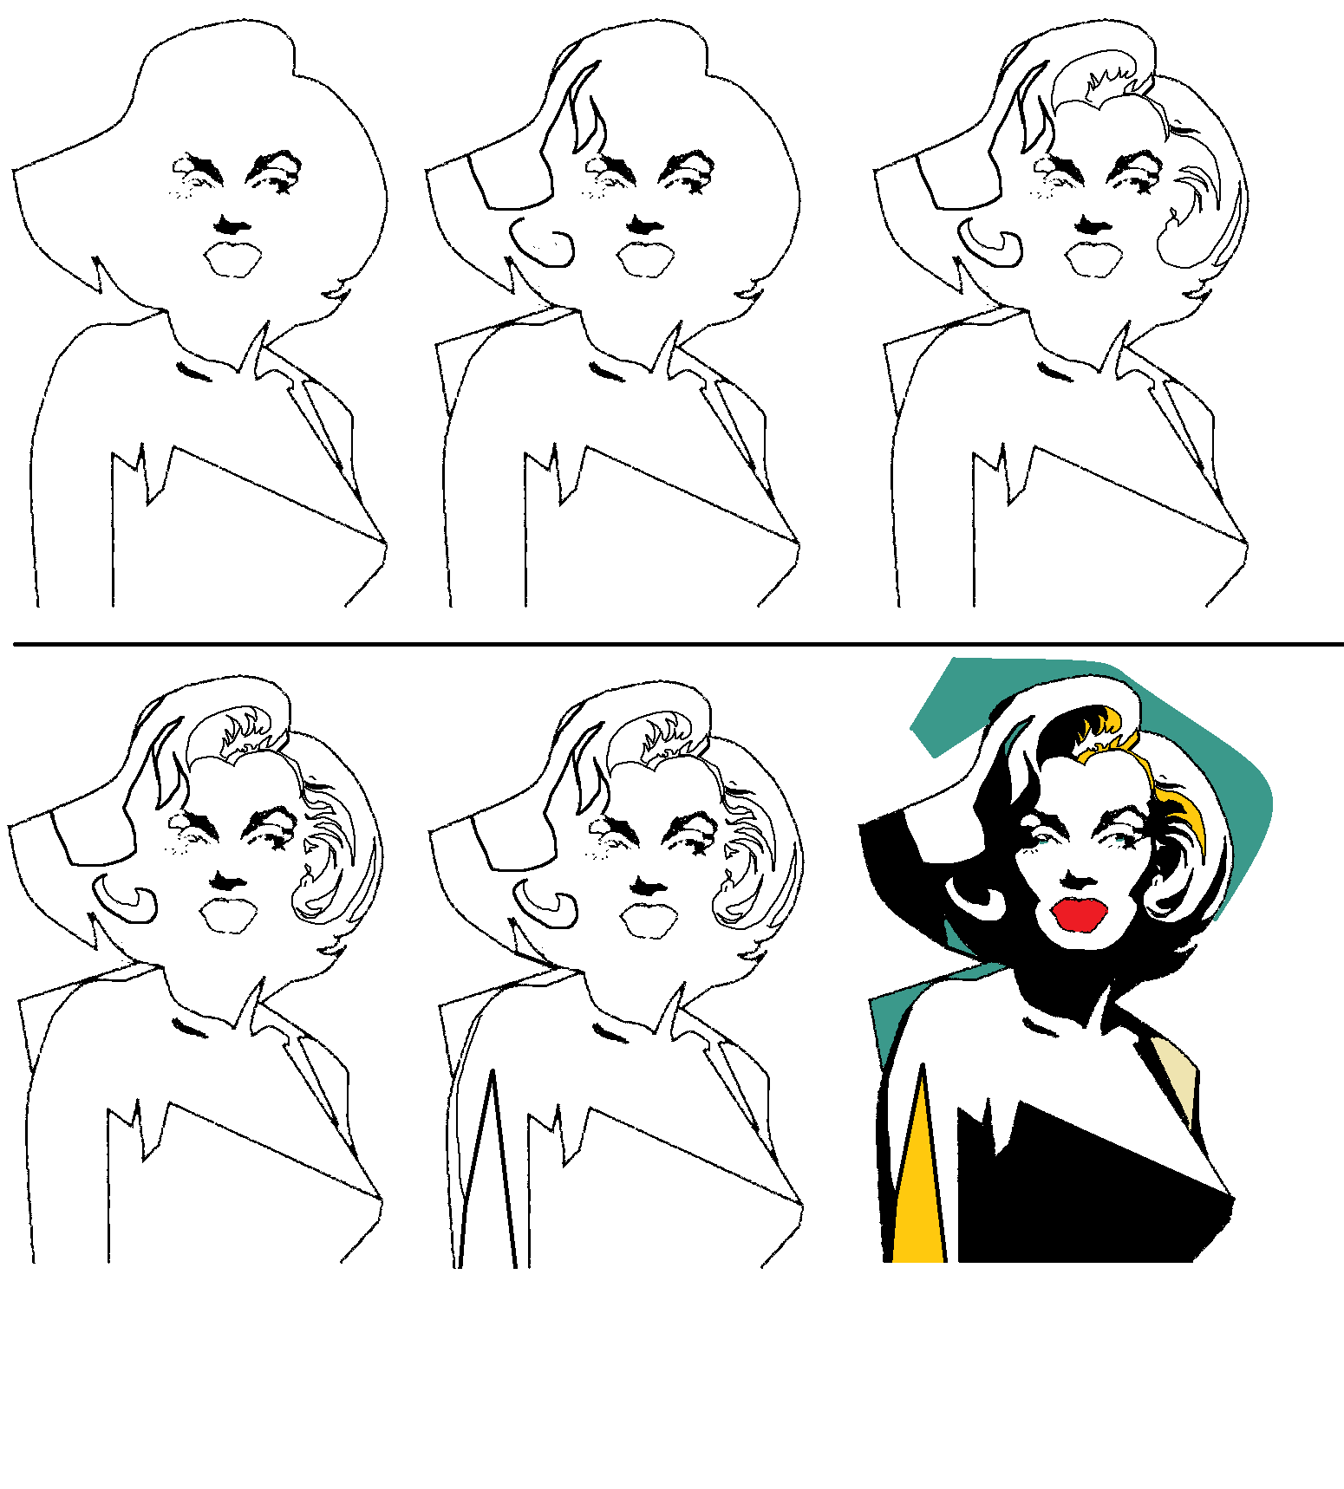
Drawing with Paint
Fill

Slide 9

Drawing with Paint

Slide 10
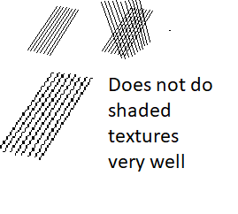
Drawing with Paint
Can set or measure RGB or HSB
Can resize, rotate 90 degrees

