Slide 1
Art 251
Introduction to Digital Arts
Dr. J. R. Parker

Slide 2
Introduction to Digital Arts
Seven elements of Art:
Line
Value
Color
Shape
Form
Texture
Space

Slide 3
Seven elements
We are going to look at each element from the perspective of digital images.
An artist uses pencil, pen, brush etc. and physical contact. Previously.
A digital artist uses virtual spaces, code, design.

Slide 4
Line
The first element: line.
Review:
All elements of a computer image consist of pixels, small areas, dots, spots, or however one wishes to describe it.
A pixel is the smallest addressable unit in an image. That is, it can be uniquely located using a horizontal coordinate value X or i, and a vertical coordinate value Y or j.
We usually specify these values as integers, precisely because they are the smallest addressable unit, and so there can be no pixel between two adjacent pixels.

Slide 5

Line
A human artist does not use coordinates when drawing.
The line element in art is used to define overall shape, delimit boundaries, create textures, and generally render visual aspects of any scene.

Slide 6

Line
It is created by touching an instrument to a drawing surface and moving the instrument in a desired direction.

Slide 7
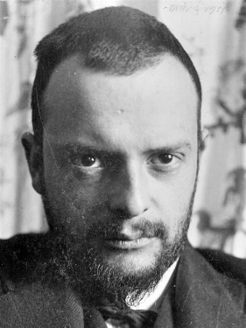
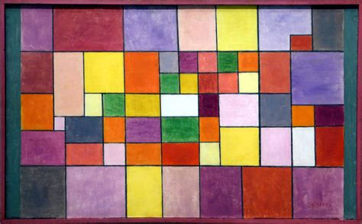

Line
Paul Klee : “A line is a dot (a pixel) that went for a walk”.
The ‘dot’ leaves a copy of it behind, in each previous position, and must (in the computer context) move from one pixel coordinate to an adjacent one

Slide 8
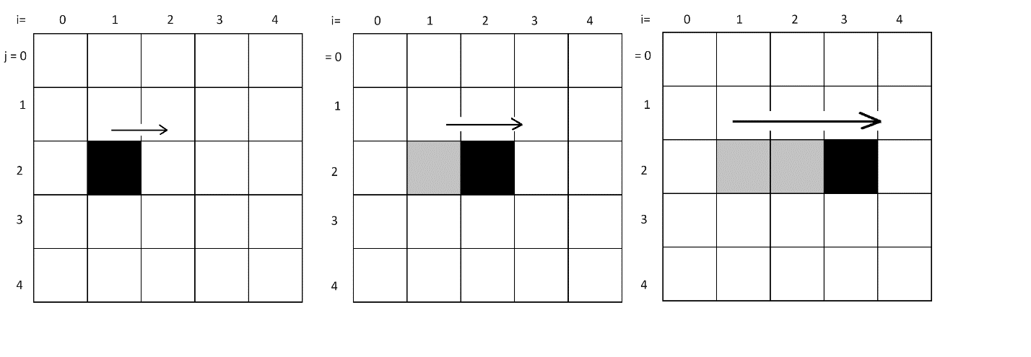
Line
Consider a pixel at some location specified by coordinates (i,j).
If it is ‘walking’ to the right, we get the situation seen in here. The line will end up being horizontal, starting at (i,j), and proceeding to (i+1,j), (i+2,j) and so on.

Slide 9
Draw a Pixel
When we wish to draw a pixel, we’ll say:
drawPixel x y
which will set the pixel at (x,y) to blacl.
We’ll draw lines by setting ‘connected’ pixels

Slide 10
Line
A line can be straight or curved.
A straight line can have any orientation or direction, and this is often indicated as an angle.
It is a set of pixels where the next pixel is a fixed direction from the last one.

Slide 11
Line
A curve is more difficult to define and draw, but essentially does not have that property.
All other types of lines are just variations of these two.
Jagged lines, for example, are really just collections of regular lines of different angles joined end to end.
Broken lines are straight lines with a common direction and a fixed sized gap between them.

Slide 12
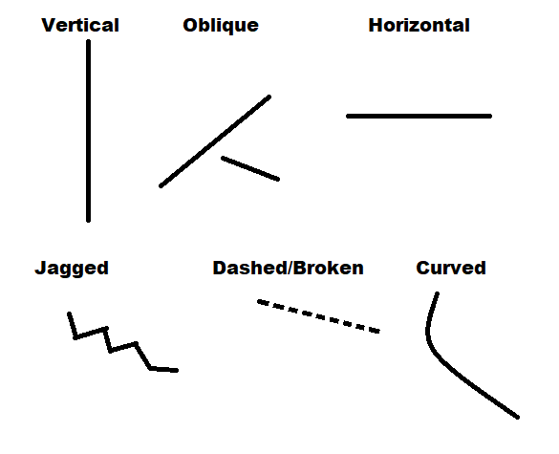

Slide 13
Vertical Line
When we draw such a line, we can draw the start and end points first; by that we mean set them to black, given that the background is white.
Assume that we have an operation called drawpixel that sets a specified pixel to black. A first step in this line program would be:
drawPixel 100 100
drawPixel 100 111
This sets the start and end pixels.

Slide 14
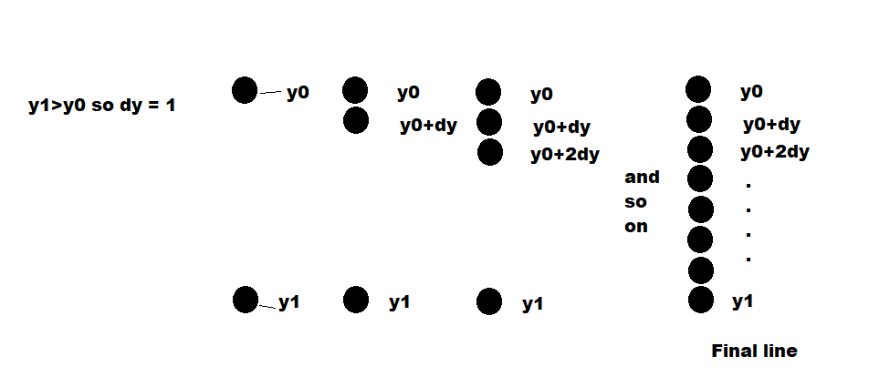
Vertical Line
Now begin at the start point and draw adjacent vertical pixels unto we get to the end point.

Slide 15
Line
That only works for a vertical line.
Basically high school level math:
We will be setting pixels between the points (x0,y0) and (x1, y1) as before, but the orientation is arbitrary.
The is a mathematical relationship that tells us when a point equation of a line lies on a line: if the equation is true (left side = right side) for some value of x and y, then (x,y) is on the line.

Slide 16
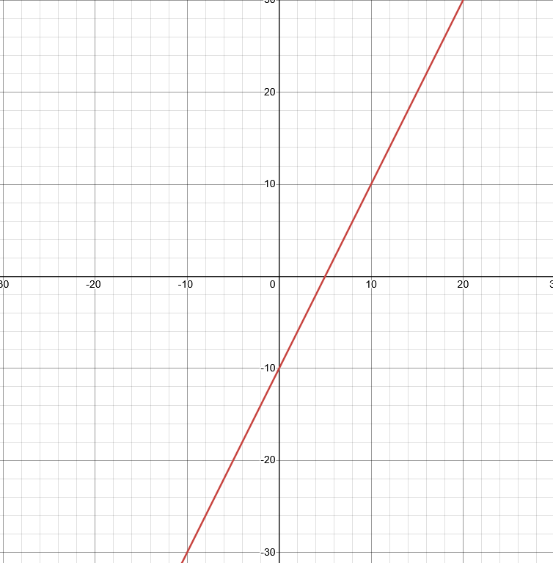
Line
(math)

Slide 17
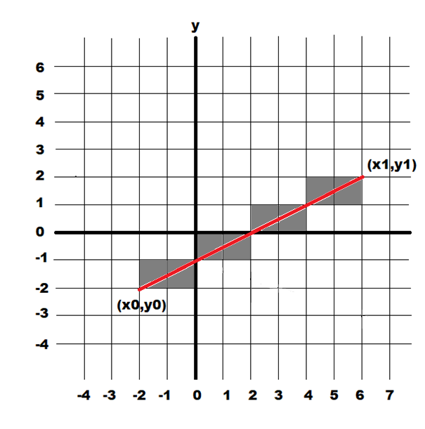

Line
$Pixel values are integers$.
We call this a discrete line,
as opposed to continuous.
We draw this by setting the
pixels nearest to the line.

Slide 18
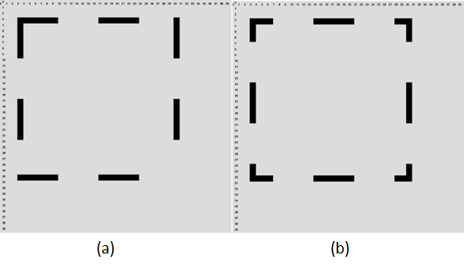
Dashed Line
The length of the dashed part is some number of pixels N, and the gap is the same.
Draw N pixels as black
Skip N pixels
Repeat until the needed number of pixels has been set.

Slide 19
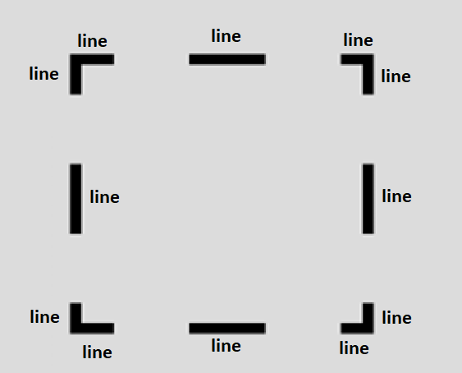
Dashed Line
A dashed line consists of many normal straight lines.
A straight line consists of many pixels of the same color.
SO we have a hierarchy: dashed line -> line -> pixel

Slide 20
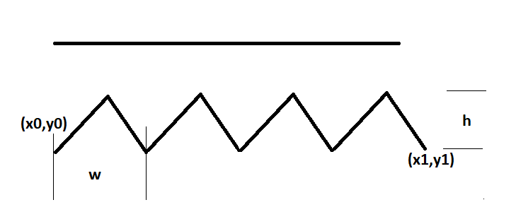
Jagged (zig-zag) Line
Much harder to define and to implement.
Some possible parameters for such a line.
We could just put down a pencil and draw this.

Slide 21
Jagged (zig-zag) Line
A human artist would not be as precise as the computer.
… and may use different parameters.
Example:
From (x0,y0) to (x1,y1) we want to draw 4 peaks (zigs?)

Slide 22
Jagged (zig-zag) Line
From (x0,y0) to (x1,y1) we want to draw 4 peaks.
The value of w would therefore be the distance between (x0,y0) and (x1,y1) divided by 4.
It can get more complicated though.

Slide 23
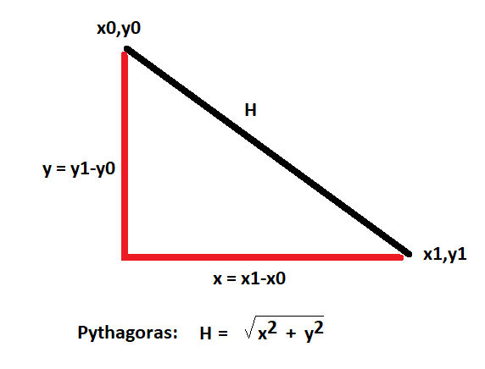
Distance
The distance between any two points (x0,y0) and (x1,y1)
Make a right triangle between the two points and use the Pythagorean theorem to find the hypotenuse H.
The distance between the two points is H.

Slide 24
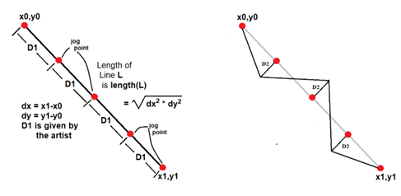
Jagged (zig-zag) Line
We could specify D1 and D2.
Say what?
D1 is w/2
D2 is h/2

Slide 25
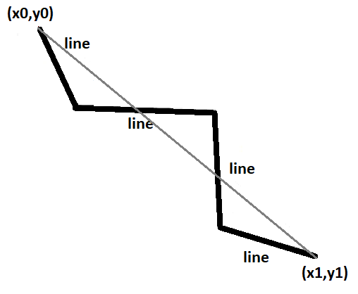
Jagged (zig-zag) Line
In any case, we once again use a line to make a jagged line.
The hierarchy is:
Jagged line -> line -> pixel

Slide 26
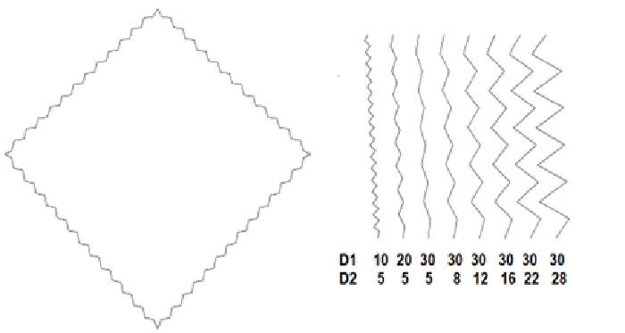
Jagged Lines
We can now say:
jagged x0 y0 x1 y1
to draw a jagged line. It will need other parameters.
Jagged line -> line -> pixel

Slide 27

Variable Thickness Lines
One way to do this is to change drawPixel or make a new version,
Right now drawPixel sets a single pixel to black.
We could, instead, draw a small circle. Which is what a pixel is.
But now we can change the size.

Slide 28
What is a Circle?
How is it defined?
How can we draw one? Which pixels do we set?
What are the parameters of a circle?
( What do we need to know which circle )

Slide 29
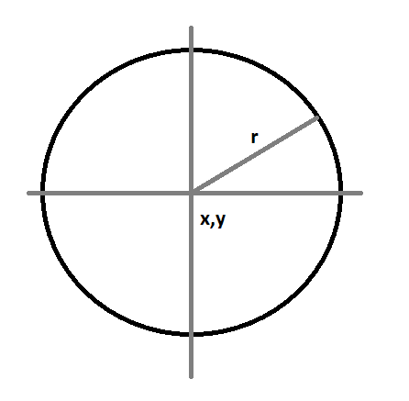
Circles
A circle has a centre and a radius, and that’s how we specify it.
But how do we draw it?

Slide 30
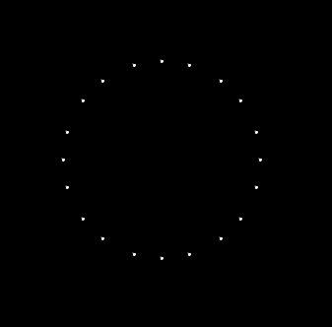
Circles
A circle is defined as the set of points (pixels) that are a distance r from the centre (x,y)
But because pixels are discrete points, some will not be exactly the distance r from the centre.
These points are exact.

Slide 31

Circles
What we’d have to do is set pixels that are a distance r from the centre plus or minus some error value.
Here is r +- 0.5

Slide 32
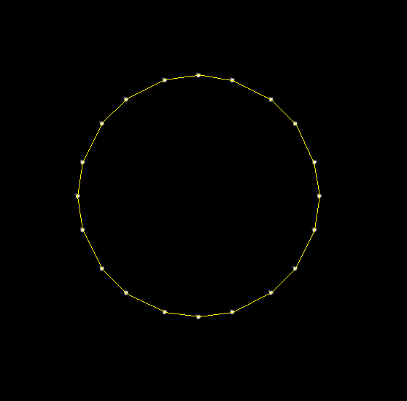
Circles
We could also draw lines between the exact points...

Slide 33

Math
An artist should understand a little geometry.
A digital artist should know a little more, if possible.
Computers do everything with numbers. It will do the computation, but the artist has to tell it what to compute.

Slide 34
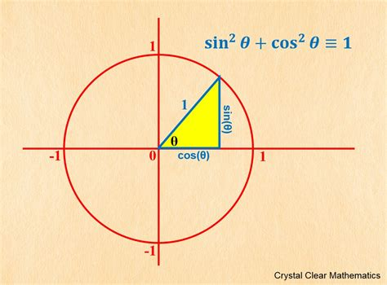
Math - Circle
The best ways to draw a circle require a bit more math.
Look at the image.
High school stuff you probably thought you’d never need again.

Slide 35
Math - Circle
The distance between the centre (cx, cy) and any point (x,y) on the circle is r (in this case 1).

Slide 36
Math - Circle
The radius r is the hypotenuse.
The angle to (x,y) makes a triangle.
We know what r is and what cx and cy are.
What are x and y for any angle?

Slide 37
Math - Circle
cos (θ) = x/r
So x = r * cos(θ) for any r and θ
Similarly
y = r*sin(θ)
Sin and cos can be found in tables or on your calculator.

Slide 38
Curves, Curved Lines
A curve is an object similar to a line, but that does not have to be straight.
Math: A curve is the image of an interval to a topological space by a continuous function.
Art: Put a pencil on the paper and move it, maintaining contact with the paper.

Slide 39
Curve
A line that bends continuously and has no straight parts.
That word straight again.
The curve is the most effective device for leading the eye to centres of interest.

Slide 40
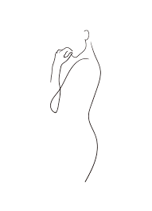
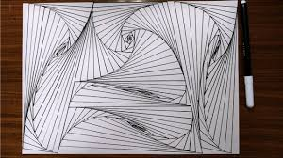
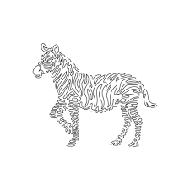

Curves

Slide 41
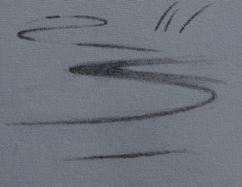
EG. Eye lead in

Slide 42

Curve

Slide 43
How Can We Draw A Curve
Part of a circle is a curve.
Part of an ellipse is a curve.
A curve should be smooth and continuous.
Let’s start at (x,y) and ‘go for a walk’.

Slide 44
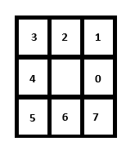
How Can We Draw A Curve
After x,y we need to set another pixel.
One that is ‘adjacent’ to it. We’ll call that a neighbouring pixel, or just a ‘neighbour’.

Slide 45
How Can We Draw A Curve
Pixels are:
Adjacent if they are a neighbor, distance between them less than 1.4
Connected if there is a set of adjacent pixels having the same colour.

Slide 46
How Can We Draw A Curve
Start at x,y

Slide 47
How Can We Draw A Curve
Pick a direction (0 .. 7) and set the pixel in that direction.

Slide 48
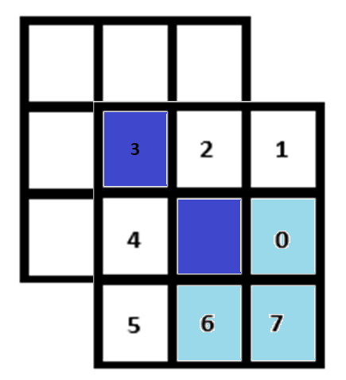
How Can We Draw A Curve
Can use a pixel on either side of direction 7, but we need to be consistent.

Slide 49

How Can We Draw A Curve
The pixels that get set depend on the KIND of curve. Direction is consistent.

Slide 50
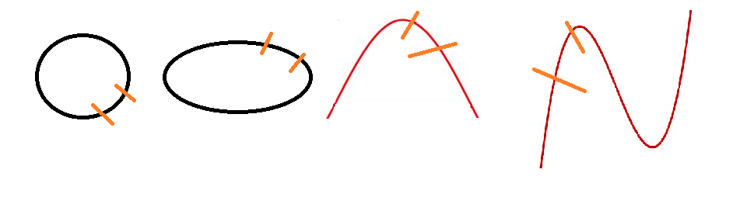
How Can We Draw A Curve
KIND of curve? Is it part of a circle? Part of an ellipse? A sine or cubic?
The drawing system will do the hard work. Artist specifies the basic shape.

Slide 51
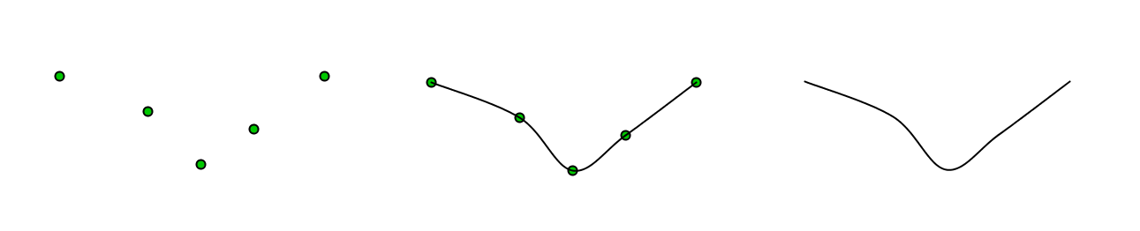
How Can We Draw A Curve
We can select some pixels that define a curve, and draw a smooth curve that passes through all of them.
The pixels we selected are called control points The curve is a spline curve.

Slide 52
How Can We Draw A Curve
We can select some pixels that define a curve, and draw a smooth curve that passes through all of them.
The pixels we selected are called control points The curve is a spline curve.

Slide 53
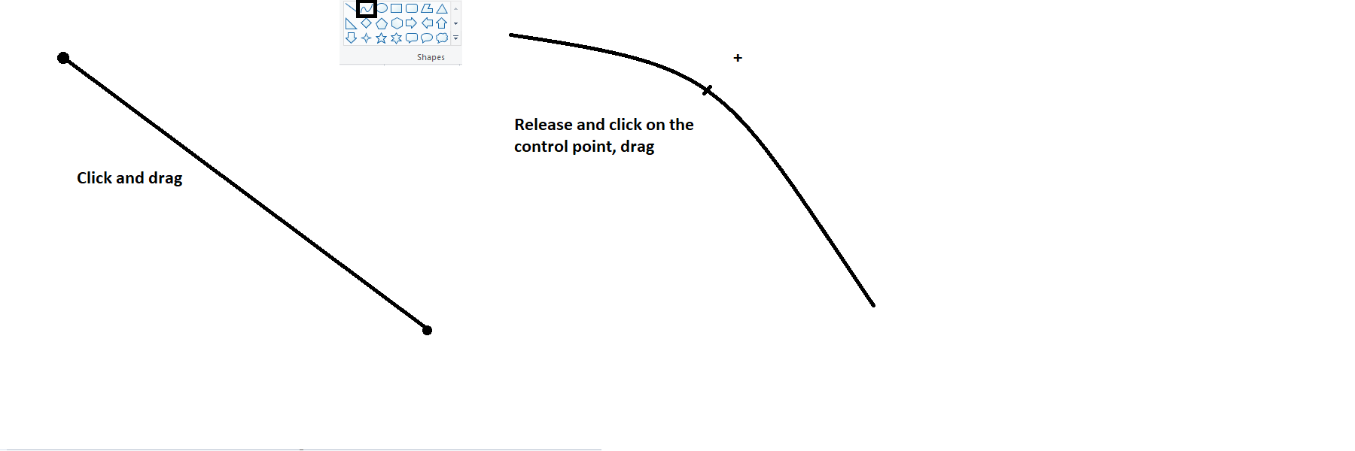
How Can We Draw A Curve
Draw a curve in Paint.

Slide 54
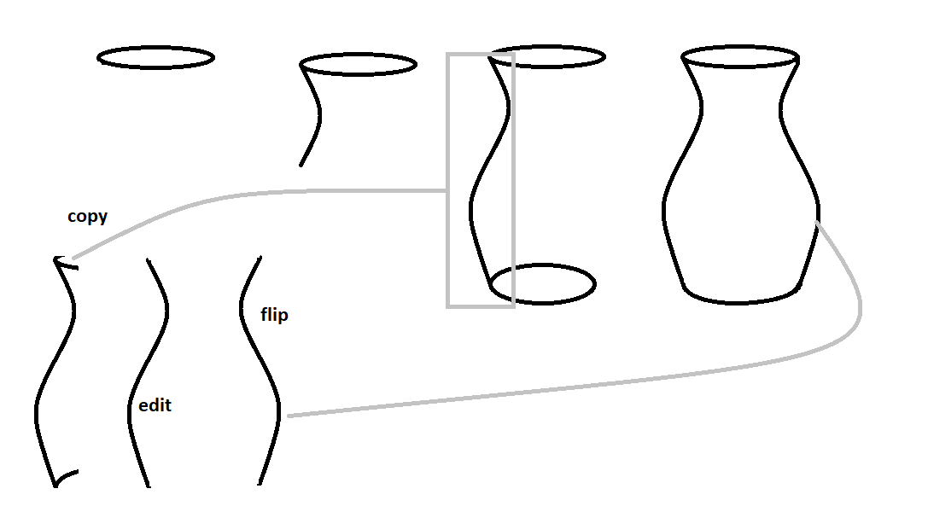
How Can We Draw A Curve
A vase

Slide 55
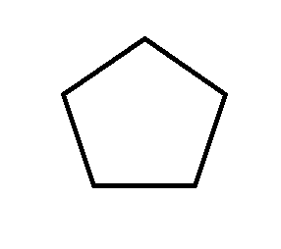
Tracing
The reverse of drawing lines and curves: given an image, can we find curves within it? Sure, approximately.
We start at any point, look for adjacent
pixels that could form a line and collect
them into a set. Stop when no more are
found and start another line from there.

Slide 56
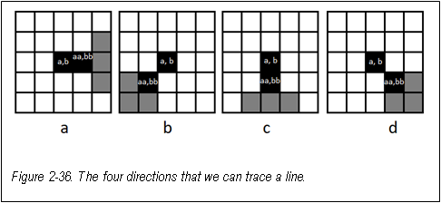
Tracing

Slide 57
Tracing

Slide 58

Turtle Graphics
Turtle graphics
EG: https://blockly.games/turtle?lang=en&level=10
A turtle graphics system uses a simple device (turtle) to draw lines and shapes.
The turtle is the name for a graphics cursor, like a pen or pencil.
You can place the pen on the paper (pendown) or lift it (penup)

Slide 59
Turtle Graphics
Turtle graphics
You can place the pen on the paper (pendown) or lift it (penup)
Moving when the pen is down will draw.
Moving when the pen is up will not draw.
The turtle starts out facing 0 degrees.
We can turn by an angle

Slide 60

Turtle Graphics
Let’s draw a square
moveto 300 300
pen down
forward 100
turn 90
forward 100
turn 90
forward 100
turn 90
forward 100
turn 90

Slide 61
Why?
moveto 300 300
pen down
forward 100
turn 90
forward 100
turn 90
forward 100
turn 90
forward 100
Place to start the square UL
pen down
forward pen down to 400 300
turn right/clockwise= down
Draw right side
Turn right again=left
Draw bottom
Turn right again
Draw left side

Slide 62
Turtle Graphics
There is a current (x,y) where the turtle is at all times.
drawpixel x y becomes
moveto x y x,y are coordinates
current becomes x,y
moveby 1 0 1,0 if offset from current
current becomes x+1,y
The turtle is the name for a graphics cursor, like a pen or pencil.

Slide 63
Turtle Graphics
pendown
forward 30
turn -100
forward 30
turn 140
forward 30
turn -100
forward 30
turn 140
forward 30
turn -100
forward 30
turn 140
forward 30
turn -100
forward 30
turn 140
forward 30
turn -100
forward 30
turn 140
forward 30
turn -100
forward 30
turn 140
forward 30
turn -100
forward 30
turn 140
forward 30
turn -100
forward 30
turn 140
forward 30
turn -100
forward 30

Slide 64
Turtle Graphics
That’s boring.
pendown
repeat 9 -- Do the following 9 times
turn 140
forward 30
turn -100
forward 30
end -- end of the repeated commands

Slide 65

Basic Turtle Drawing
We can draw black regions by:
repeat
Finding a black pixel
Put the pen down
Draw right as long as the pixels underneath are black
(… or those coordinates should be black in our artwork)
Lift the pen
end

Slide 66
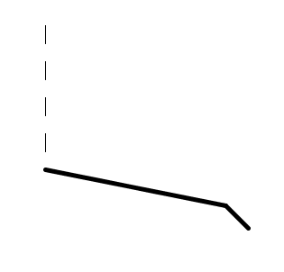
Basic Turtle Drawing
clear
moveto 100 100
pendown
moveby 0 20
penup
moveby 0 20
pendown
moveby 0 20
penup
moveby 0 20
pendown
moveby 0 20
penup
moveby 0 20
pendown
moveby 0 20
penup
moveby 0 20
pendown
thickness 5
moveto 300 300
moveby 25 25

Slide 67

Basic Turtle Drawing
moveto 300 300
pendown
repeat 9
turn 140
forward 30
turn -100
forward 30
end

Slide 68
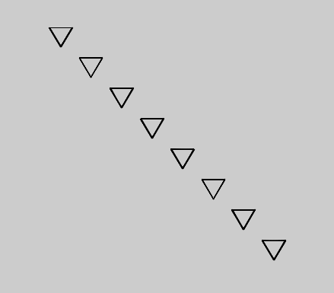
Basic Turtle Drawing
moveto 300 300
repeat 8
pendown
repeat 9
turn 120
forward 30
turn 120
forward 30
turn 120
forward 30
end
penup
moveby 40 40
end
.

Slide 69
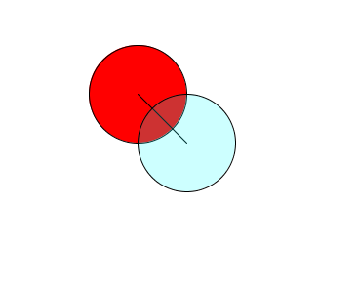
Basic Turtle Drawing
clear
if 1
fill 255 0 0
end
if 0
fill 0 255 0
end
moveto 300 300
pendown
assign x 100
assign y 300
circle x
fill 0 255 255 50
moveto 350 350
circle 100

