Slide 1
Art 251
Introduction to Digital Arts
Dr. J. R. Parker

Slide 2
Digital?
Numbers.
It’s all about numbers.

Slide 3
Computers
Computers are not especially ‘smart’ machines.
They actually do very few things, and very simple things. Add, multiply, move data around, store and fetch numbers.
They do them VERY quickly though.

Slide 4
Pencil Art/ Digital Art
To make art using a pencil means mastering some techniques of hand-eye coordination and perception.
You need to transform what you see and perceive into pencil marks using methods you have learned.
To make art using a computer means mastering some techniques programming and math.
You need to transform what you want to do into steps the computer can execute.

Slide 5
Computers Only Use Numbers
Everything on a computer is represented as a number.
Grade 3 math:
There are (usually) 10 digits (digit means finger, remember?)
0 1 2 3 4 5 6 7 8 9
These are decimal numbers.
Also known as base 10.

Slide 6
Digital Arts
Recall that
721 = 7*10² + 2*10¹ +1*10⁰
That’s base 10.

Slide 7
Digital Arts
BY THE WAY:
Not all number systems are positional.
Non-positional number system is also known as non-weighted number system. Digit value is independent of its position.
Roman numerals
I=one V=five X=ten L=50 C=100 D=500 M=1000
6 is VI 9 is IX 14 is XIV 39 is XXXIX

Slide 8
Digital Arts
Binary is the system that underlies modern digital computers.
Binary is base 2. Why? In electronics things ae ON (1) or OFF(0)
EVERYTHING is ultimately represented as a binary number on such a computer.
Binary numbers are base 2, and use 2 as the exponent. There are only 2 digits, 0, and 1. So:
1011₂ is 1*2³ + 0*2² + 1*2¹ + 1*2⁰
=1*8 + 0*4 + 1*2 + 0
= 8+2 = 10₁₀.

Slide 9
Digital Arts
Other useful bases:
Base 8 or octal: each 3 binary digits (bits) can be represented as one octal digit. So 111 is one octal digit (=7) and long binary numbers can be represented in base 8: 221328
Is 010 010 001 110 010 2

Slide 10
Digital Arts
Why are we doing this?
Computer folks use binary and octal, and sometimes you will encounter it in code and documentation. You should know what it means.
Base 8:
000 = 0₈ 100 = 4₈
001 = 1₈ 101 = 5₈
010 = 2₈ 110 = 6₈
011 = 3₈ 111 = 7₈ 101111 is 101 111 = 57₈
1000 = 8₈ Shorthand

Slide 11
Digital Arts
Why are we doing this?
Hex is commonly used in code and especially web pages to represent numbers, especially colors.
Base 16 or hexadecimal (hex):
We need more digits, so we use
The letters
A=10, B=11, C=12 D=13 E=14 F=15
00 = 0₁₆ 22 = 34₁₆
09 = 9₁₆ 101 = 5₈
0D = 13₁₆ 110 = 6₈
13 = 19₁₆ 111 = 7₈
1000 = 8₈
The binary number 110100101010 cane be broken into groups of 4 bits:
1101 0010 1010
and each group is one hex digit!
1101 = 13 = D
0010 = 2
1010 = 10 = A
So the number is D2A₁₆

Slide 12
Digital Arts
Other useful bases:
Base 16 or hexadecimal or hex: each 4 binary digits (bits) can be represented as one hex digit.
Base 16 needs 16 digits, and they are
0 1 2 3 4 5 6 7 8 9 A B C D E F
Where A in hex is 10 in decimal, etc. Powers of 16 are used instead of powers of 10.
So: 1A in hex is A (=10) plus 1*16 = 26 base 10.
2A in hex is A (=10) plus 2*16 (=32) = 42 base 10

Slide 13
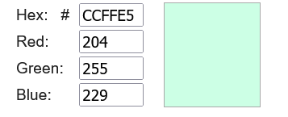
Digital Arts
Why hex? Computer guys like to abbreviate and find easy ways to do stuff. Hex numbers have smaller strings and convert into binary easily.
Example: Colors in web pages are often given in hex.

Slide 14
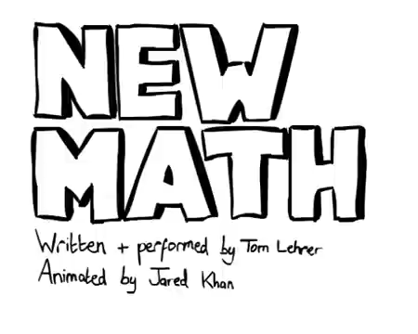
Digital Arts

Slide 15
Digital Arts
To make art with a computer we must be able to express our artistic desires using numbers.
Only numbers.
This is a problem in representation.
EG How can we represent a color as a number? A Picture? A video or sound?

Slide 16
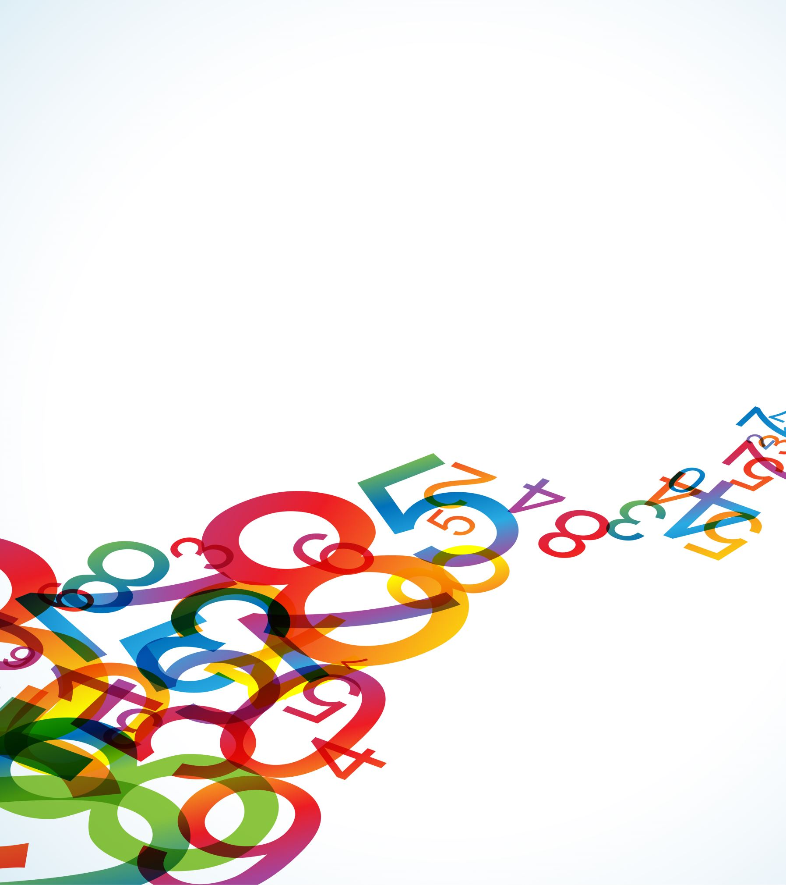
Digital Arts
First:
We can represent characters (‘a’, ‘b’, etc) as numbers pretty easily. Let ‘a’=1, ‘b’=2 and so on.
But what is ‘;’? Or ‘<‘?

Slide 17
Digital Arts
Upper case? Digits?
We Need some rules for a reasonable representation.
That’s always the basic problem: what rules are reasonable for this kind of information?

Slide 18
Digital Arts
Rule 1:
Lower case letters will be next to each other. Consecutive numbers.
Rule 2:
Upper case letters will be next to each other. Consecutive numbers.
Rule 3: Digits will be next to each other.

Slide 19
Digital Arts
Rule 4:
Difference between lower and uppercase will be 1 bit
Rule 5:
Special characters can be anyplace, but should fill in gaps in the code.
Rule 6: Communication codes will be at the low-end of the values, between 0 and 31.

Slide 20
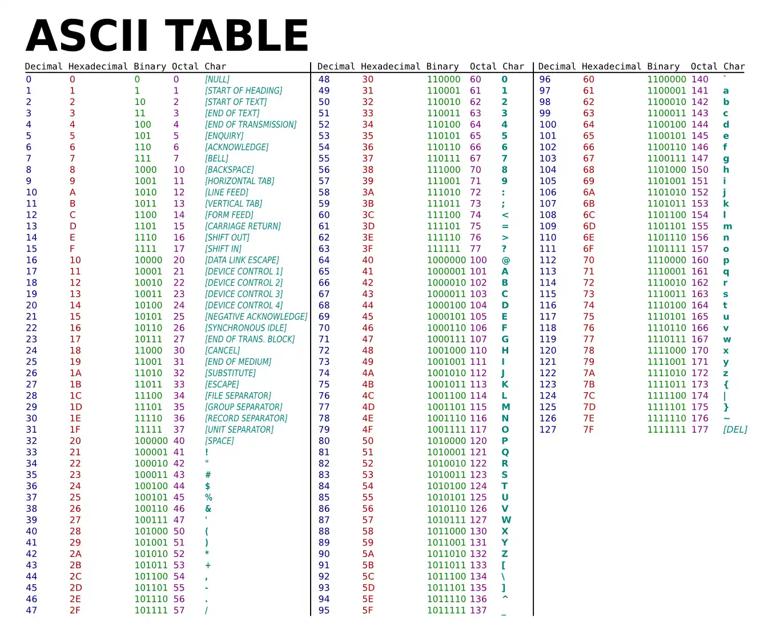
Digital Arts
ASCII has been replaced by longer code for modern uses.

Slide 21
Digital Arts
The digits are characters, but they represent numbers.
The character ‘2’ represents the number 2, but the code for ‘2’ is not 2.
To get the digit value, subtract the code for ‘0’ from the code for the given digit.
The code for ‘0’ is 48. The characters coded 51 56 55 ( which are ‘387’ )
Become 51-48, 56-48, and 55-48 as numeric values, which is 3 8 7 or 300 + 80 + 7 = 387.

Slide 22
Digital Arts
In a representation, one thing takes the place of another.
The ascii value 66 is a number, but it represents the character ‘B’ in ASCII.
We need to know WHAT representation (code) is being used. They are in some sense arbitrary.
Really?

Slide 23
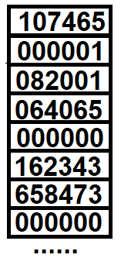
Digital Arts
Computer memory contains nothing but numbers. Memory can be thought of as a sequence of locations or places where numbers are stored.
What do these numbers mean?

Slide 24
Digital Arts
What do these numbers mean?
We can’t know without more information. The content of a memory location depends completely on context.
Basically: what did we put there? That’s what it is.

Slide 25
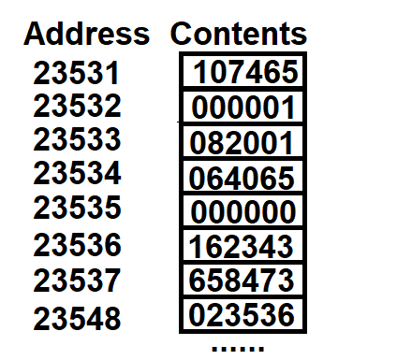
Digital Arts
By the way, memory locations can be accessed using a number – its address.
So here, the contents of location 23432 is 1.
Of course, these are decimal numbers, and the actual contents would be binary.

Slide 26
Digital Arts
The critical thing to learn here is that a memory location is a number, and we can be certain what that number means unless we know the context – what was it when it was stored there.

Slide 27
Digital Arts
That seems odd, doesn’t it?
We could guess sometimes.
We probably should not.
Probably an
integer
Probably 2
characters
Probably an
integer
Probably an
address

Slide 28
Digital Arts
Representation is at the heart of informatics, and oddly at the heart of art as well.
Artists create visual representations.

Slide 29
Digital Arts
Artists create visual representations.
A character is a symbol, also called a glyph.
A word is a collection of characters that represents something in the world.

Slide 30
Digital Arts –
Visual Representations on a Computer
The basic display on a computer is a monitor. It uses lcd or led technology to display images.
It does not actually display characters except as an image of the visual form of that character (unlike a typewriter)

Slide 31
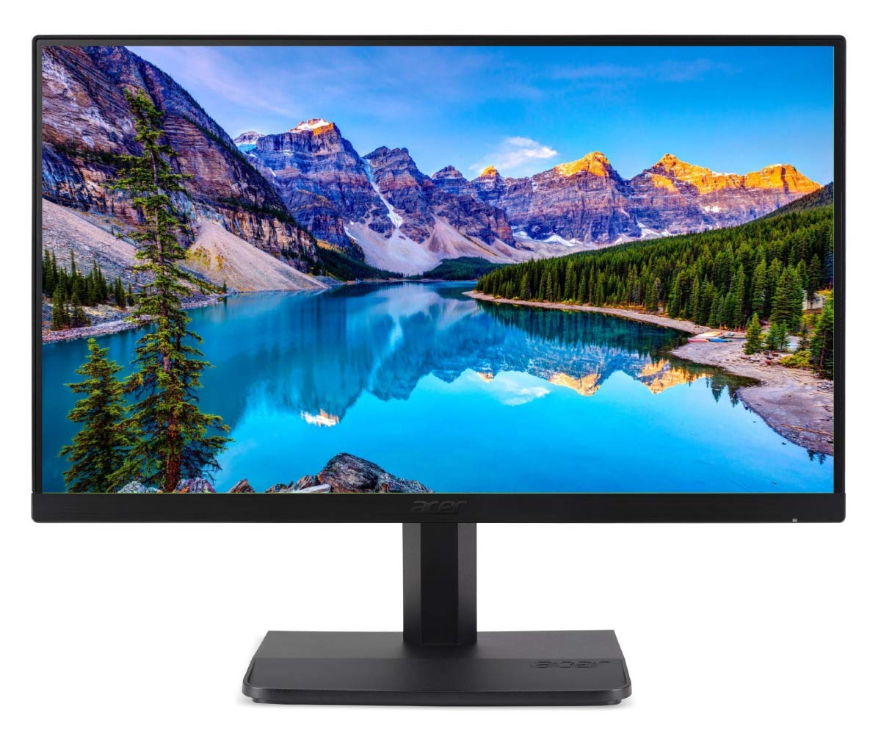
Digital Arts
Here’s one.

Slide 32
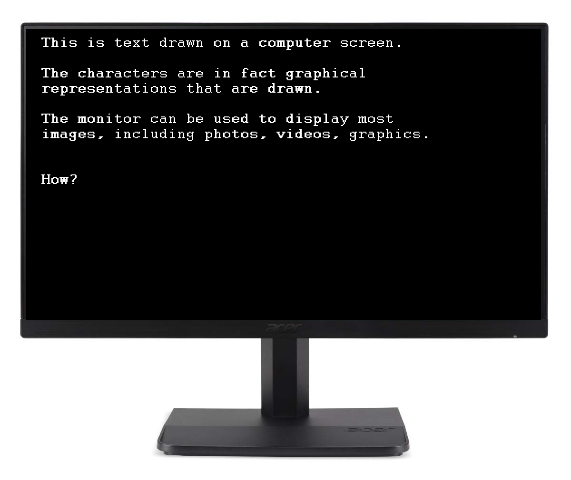
Digital Arts
Here’s one.

Slide 33
Digital Arts
The upper left corner is the arbitrary starting point – it could have been the centre, lower left, or anyplace.
This is called the origin.

Slide 34
Digital Arts
Each location on the screen is a coloured point (circle or rectangle)
When seen from a distance, it forms what our eye sees as a picture

Slide 35
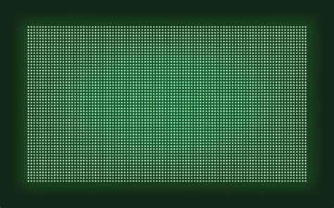
Digital Arts
Any location on the screen is identified by two numbers:
The row and column index

Slide 36
Digital Arts
The origin is at row=0, column=0.
We refer to that as (0,0)

Slide 37
Digital Arts
The point to the right of the origin is (1,0), column=1 row 0.
As we go right (in the X direction as we say) the column index increases.

Slide 38
Digital Arts
The point below the origin is (0,1), column = 0
row = 1.
As we go down (in the Y direction as we say) the row index increases.

Slide 39
Digital Arts
These locations on the screen are called picture elements, or pixels.

Slide 40
The pixel is the essential element of all digital art.
This course is about pixels.

Slide 41

Digital Arts
Each pixel is associated with a location (x,y) or (column, row)
And a value.

Slide 42
Digital Arts
The value is the brightness or colour at that point.
It can vary between minimum brightness and maximum brightness. These will be numbers.
Thus, the value of a pixel will be a number. That number represents brightness or colour.

Slide 43
Digital Arts
The screen is therefore a 2D collection of numbers, in fact.
When displayed, this becomes an image.
Let’s imagine that the minimum value is 0=black, and the maximum is 1=white

Slide 44
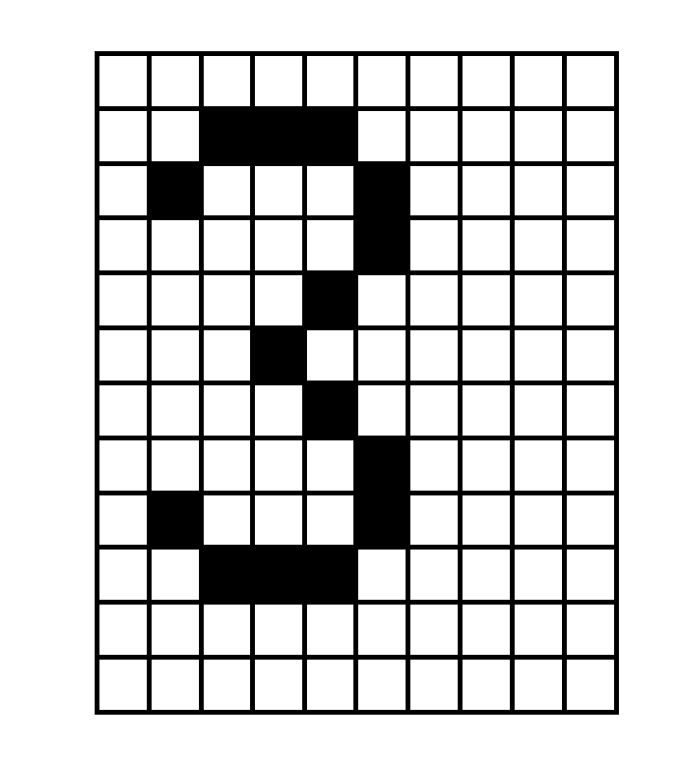
Digital Arts
There are only 2 values for brightness.
Here is an image.
We call this a bi-level image because it has 2 levels. Duh.

Slide 45
Digital Arts
This is what a computer draws when a ‘3’ is supposed to appear on the screen.
It’s a graphical representation of the character ‘3’
ALL characters have such a representation.

Slide 46
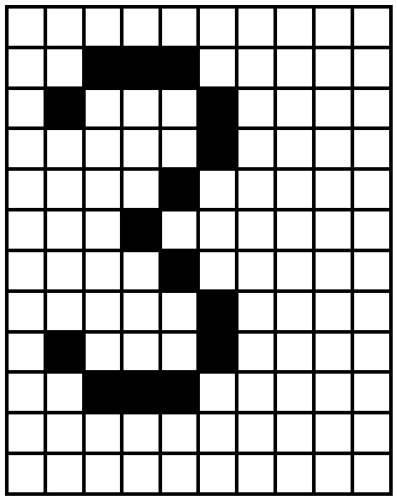
Digital Arts
0 1 2 3 4 5 6 7 8 9
0
1
This is a 9x11 image that has the graphical representation of the character ‘3’.
The pixel at (2,2) is white
The pixel at (3,9) is black
2
3
4
5
6
7
8
9
10
11

Slide 47
Digital Arts
0 1 2 3 4 5 6 7 8 9
0
1
It is very important to note that there can be no value between any two adjacent pixels.
Nothing between (2,2) and (2,3).
Pixels are discrete.
2
3
4
5
6
7
8
9
10
11

Slide 48
Digital Arts
0 1 2 3 4 5 6 7 8 9
0
1
When we draw pixels by setting them, it is obvious that there is no value between two adjacent pixels.
What if we capture pixels using a camera?
2
3
4
5
6
7
8
9
10
11

Slide 49
Digital Arts
Next class – Sampling, images, image files?

Slide 50
Generative Art
Within the larger category of New Media/Art
Art that uses an artist created algorithm (NOT AI).
Algorithm.

Slide 51

Digital Photography
SONY - 1981, the first prototype digital camera, the Mavica.
570*490
50 still frames
floppy 3.5" disks
CCD sensor

Slide 52
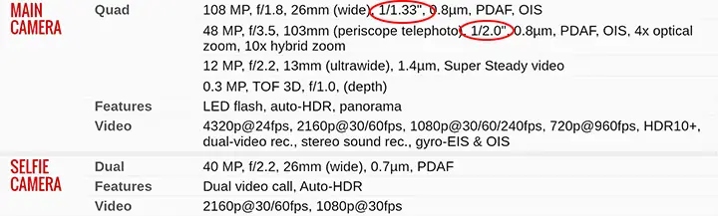
Digital Photography
Things have obviously gotten better.
These days the majority of photos are taken with cell phones.

Slide 53
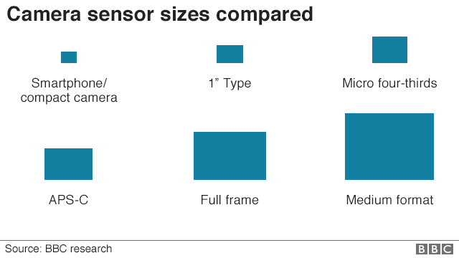
Digital Photography
The sensor is the electronic device that detects light and makes an image.
The optics will focus the image onto the sensor.

Slide 54
Computer Graphics
That’s when you use a program to draw things for you.
Like Paint and Photoshop.

Slide 55
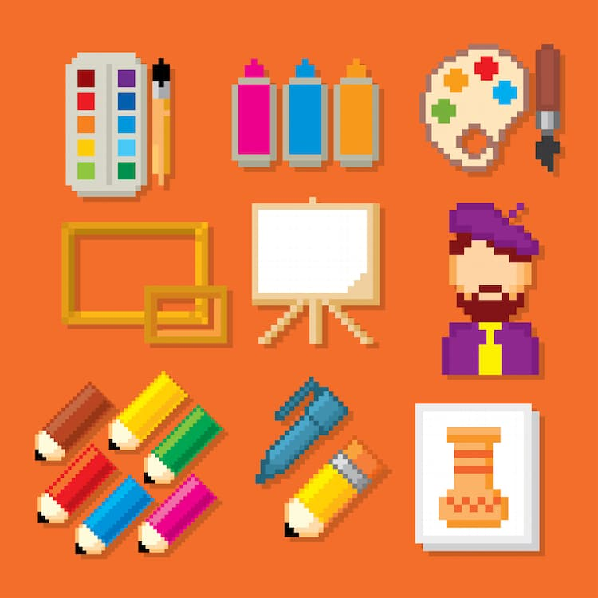
Pixel Art

Slide 56
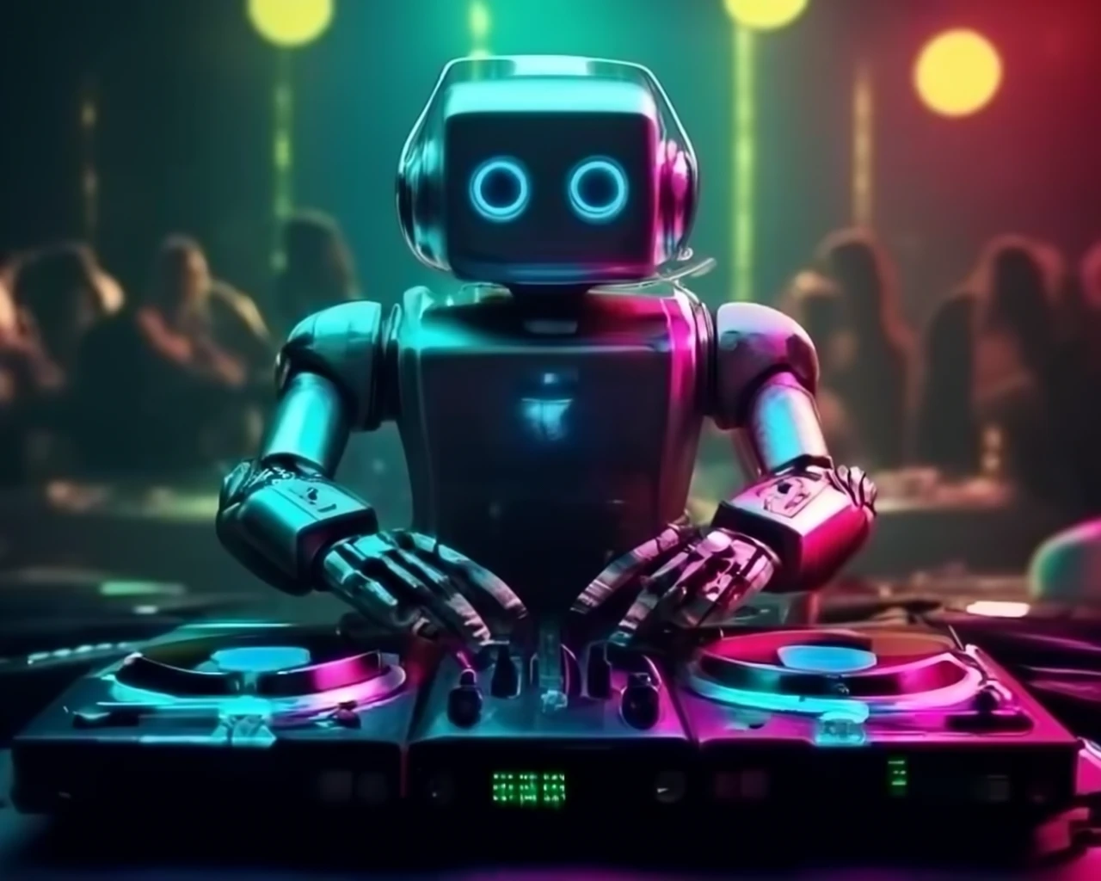
AI Generated Art

Slide 57
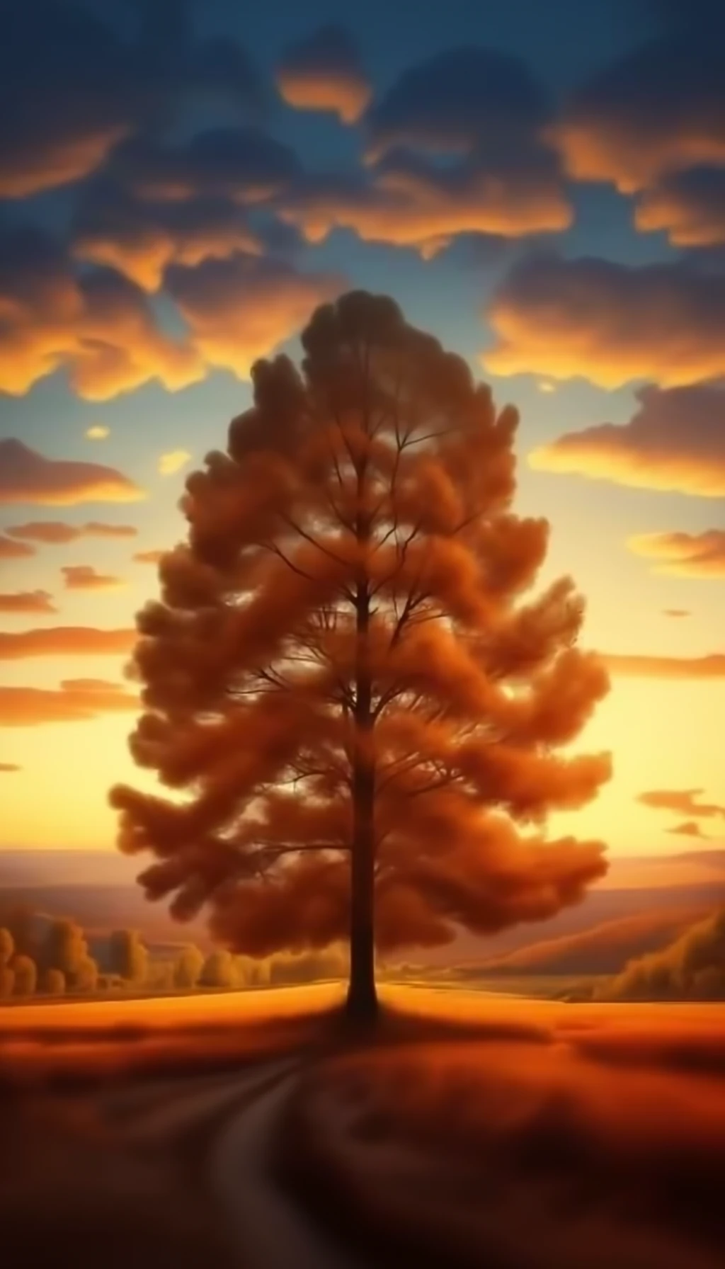
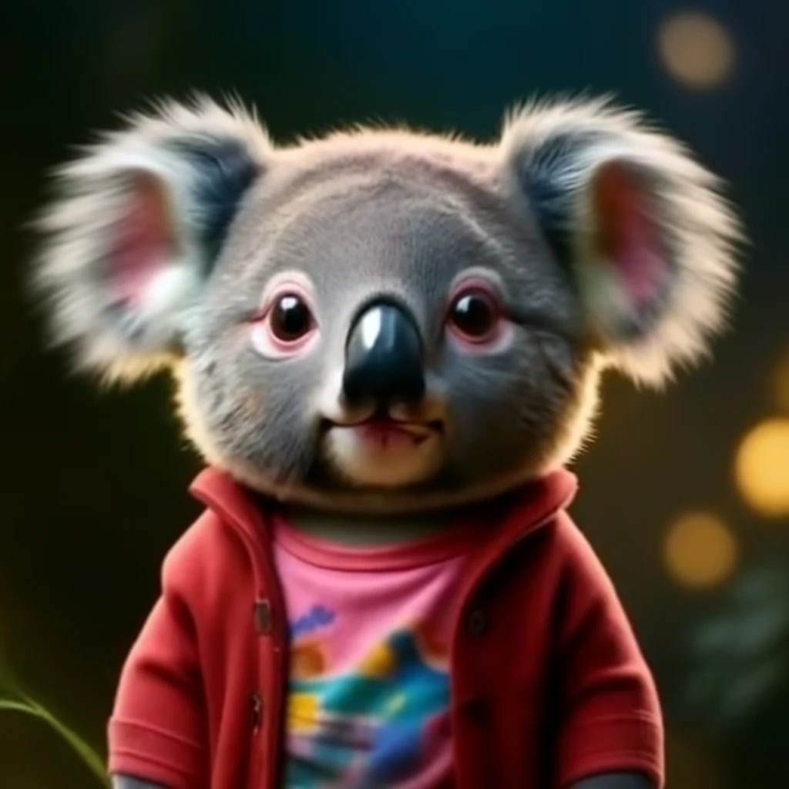
AI Generated Art

Slide 58
AR (Augmented Reality) Art
Computer-generated images, videos, or effects are superimposed over a user's real-world view.

Slide 59
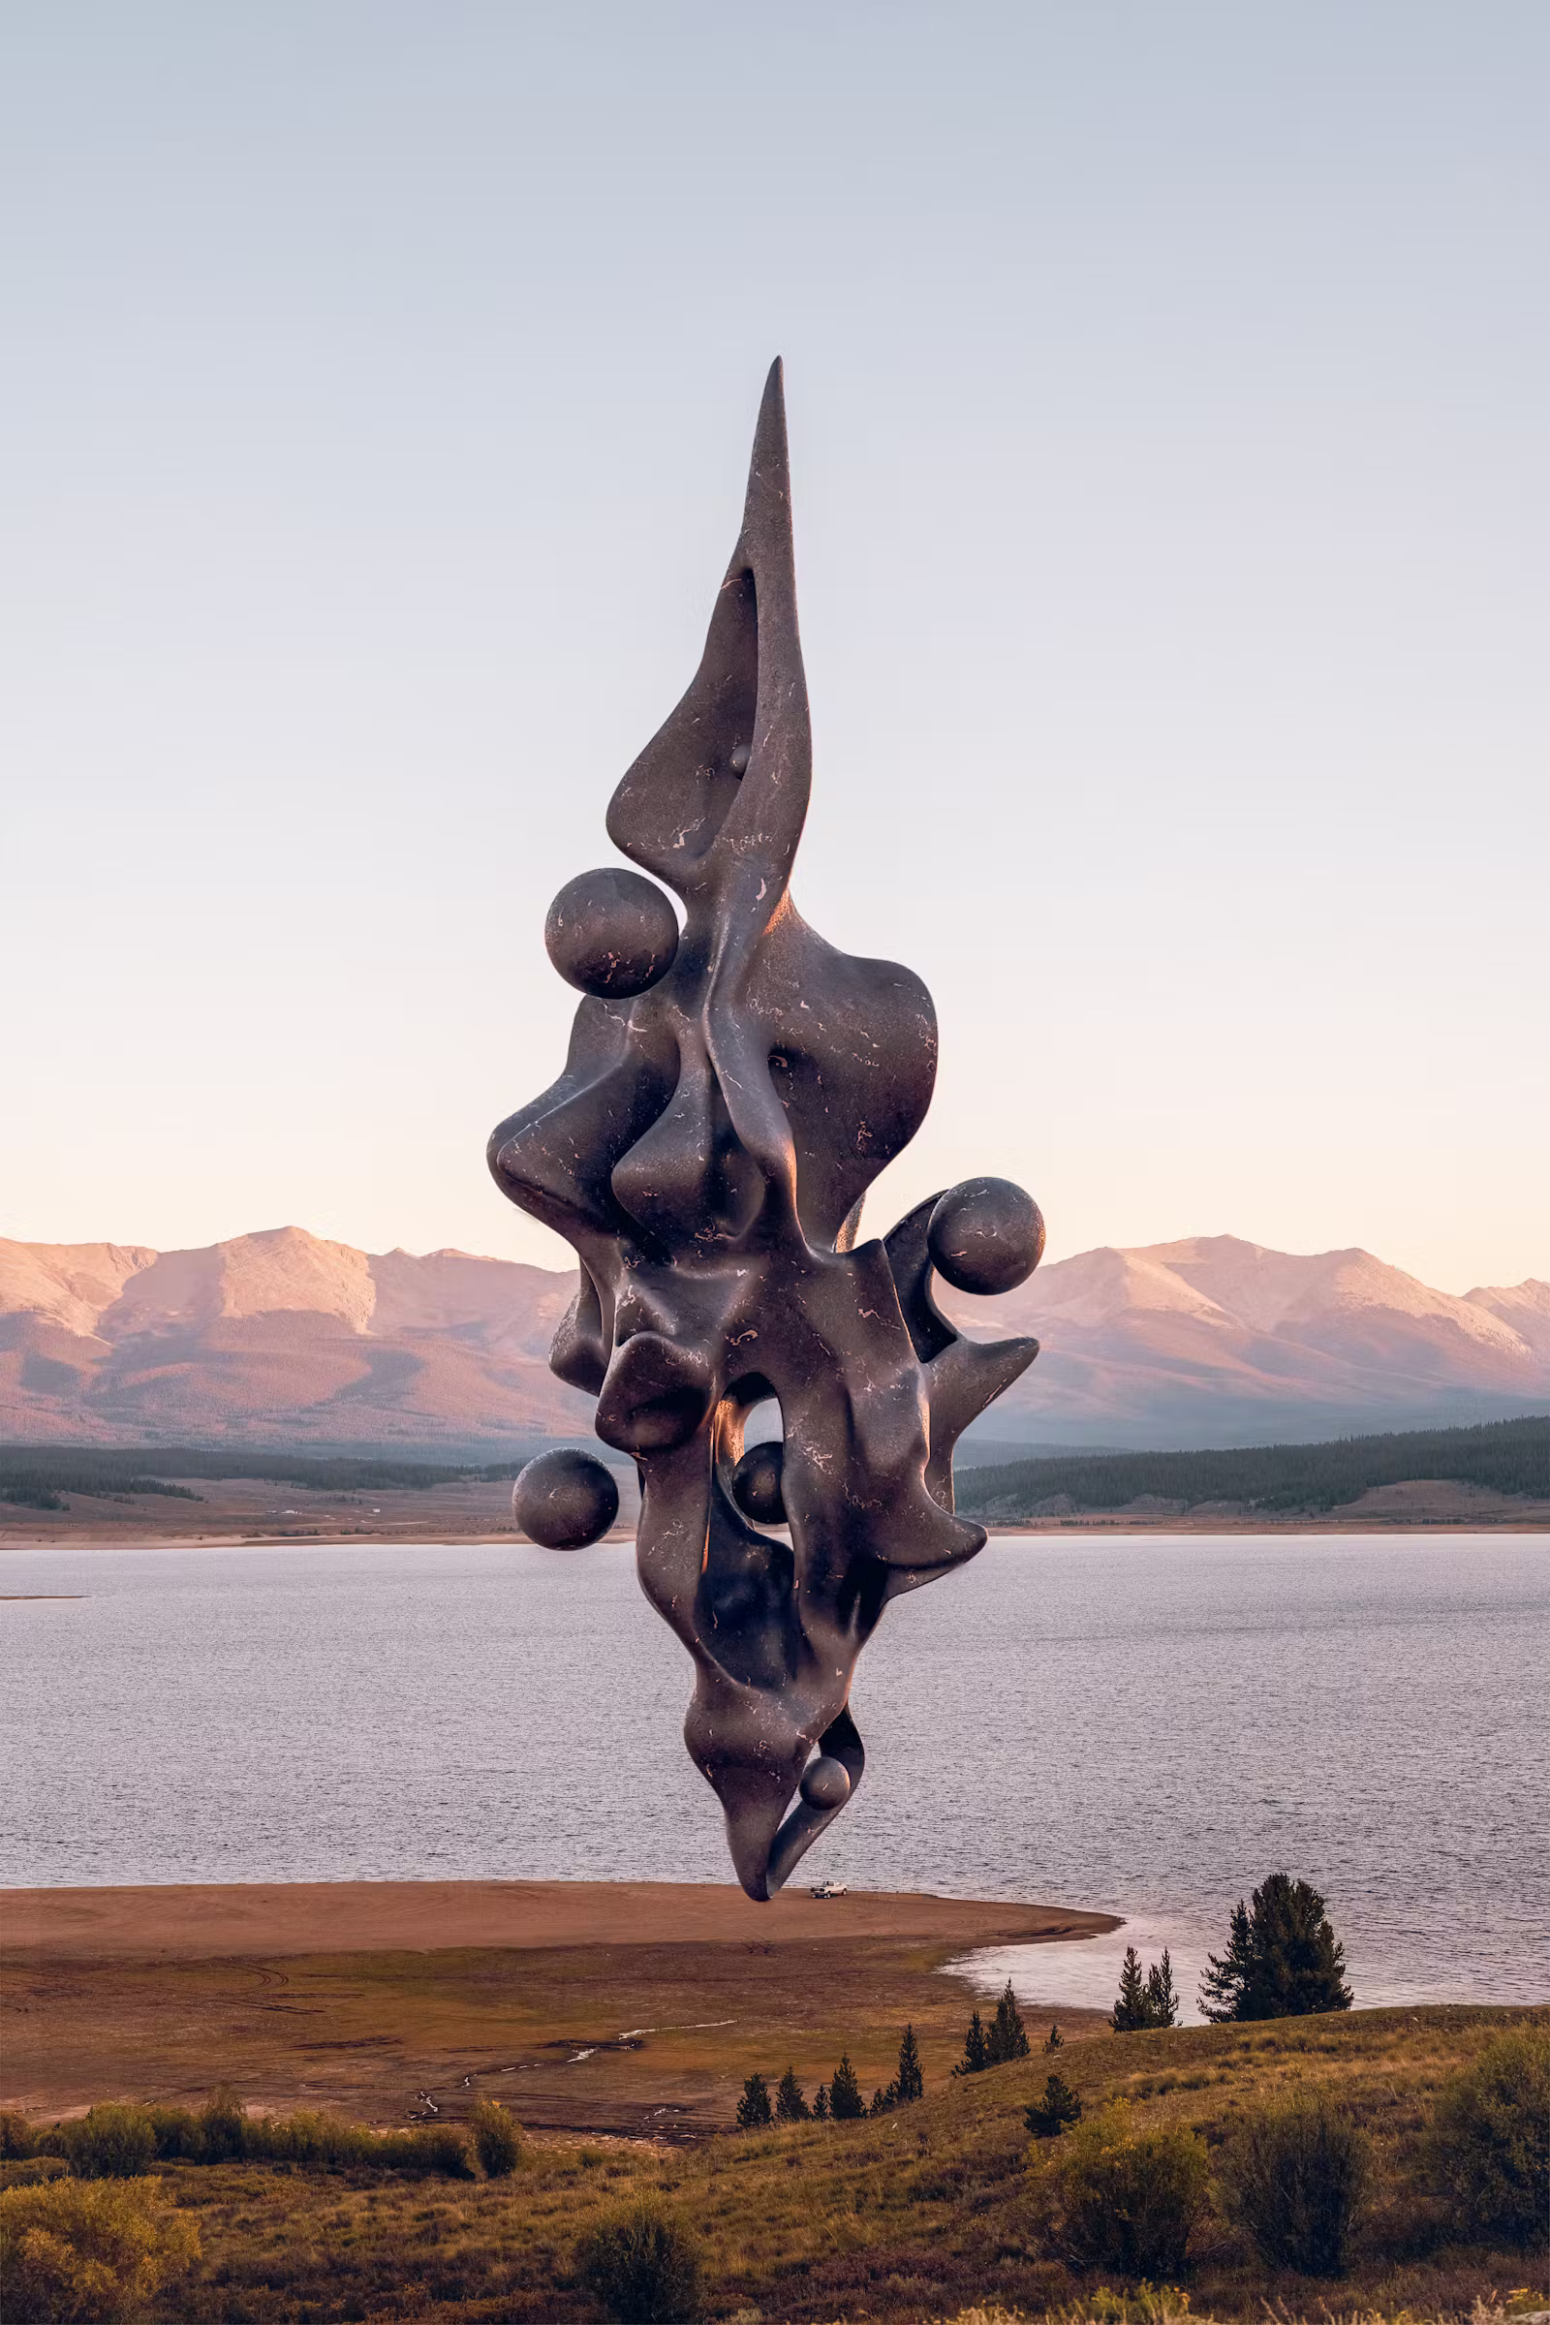
AR (Augmented Reality) Art

Slide 60
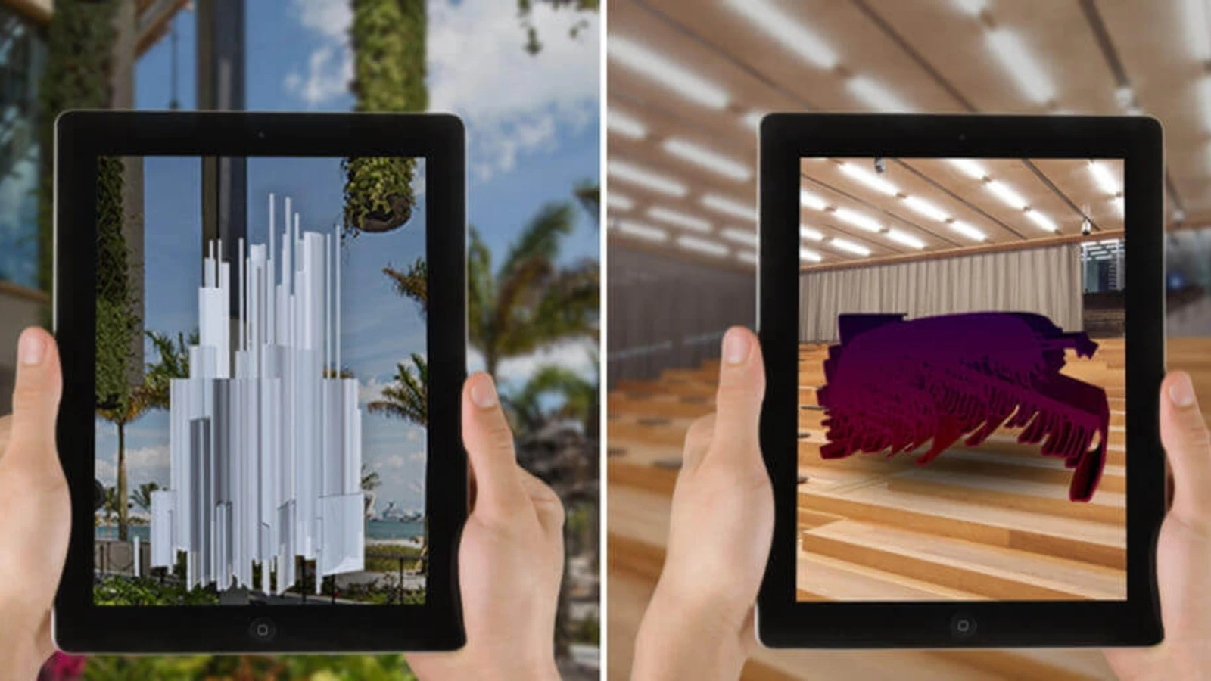
AR (Augmented Reality) Art

Slide 61
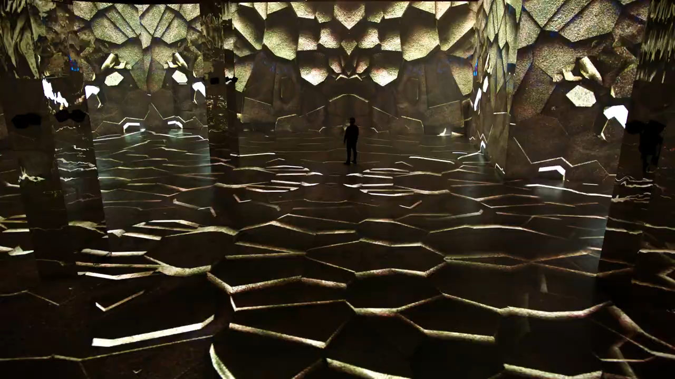
AR (Augmented Reality) Art

Slide 62
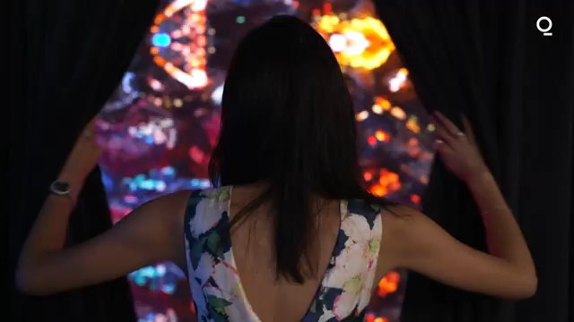
AR (Augmented Reality) Art

Slide 63
AR (Augmented Reality) Art

