Slide 1
Art 251
Introduction to Digital Arts
Dr. J. R. Parker

Slide 2
Dr. J. R. Parker
Room AB 606
jparker@ucalgary.ca
403 220 6784

Slide 3
Introduction to Digital Arts
Technical instruction and creative opportunities in the media arts, in addition to examination of historical, theoretical and critical context.

Slide 4
Introduction to Digital Arts
Digital art, or the digital arts, is artistic work that uses digital technology as part of the creative or presentational process. It can also refer to computational art that uses and engages with digital media.

Slide 5
Digital Arts
Within the larger category of New Media/Art
Any creative practice that uses digital technology as an essential part of the artistic process.
Generative art
digital photography
computer graphics
pixel art
AI-generated art
AR art

Slide 6
Digital Arts
Digital? What is a digit?
A finger or a toe.
They were used for counting, so a digit is also a number. A symbol that represents a number:
0 1 2 3 4 5 6 7 8 9

Slide 7
Digital Arts
The ten digits are ten fingers, ten characters.
If we had 8 fingers then there would be 8 digits.
Computers only have 2 fingers,
so digits are only 0 or 1.
ON or OFF. True or False.

Slide 8
Digital Arts
Computers can only manipulate numbers.
Computers nearly always use electricity.
In electric circuits, things can be ON or OFF.
So almost all computers use
binary numbers for everything.

Slide 9
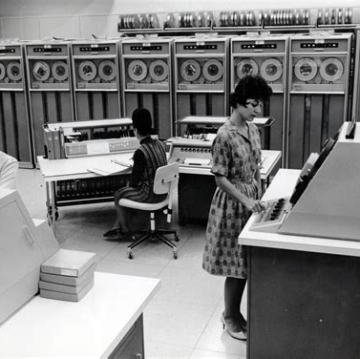
Digital Arts Usually Use Computers
So it really begins in the 1960s, when computers became important.
But originally, they were clumsy.

Slide 10
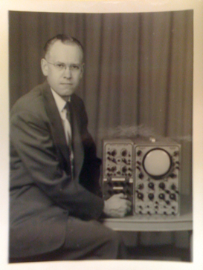
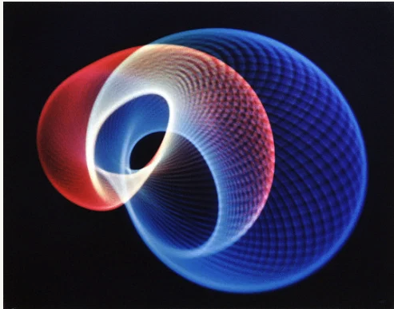
Artist: Ben F. Laposky
American mathematician, artist and draftsman
1952

Slide 11
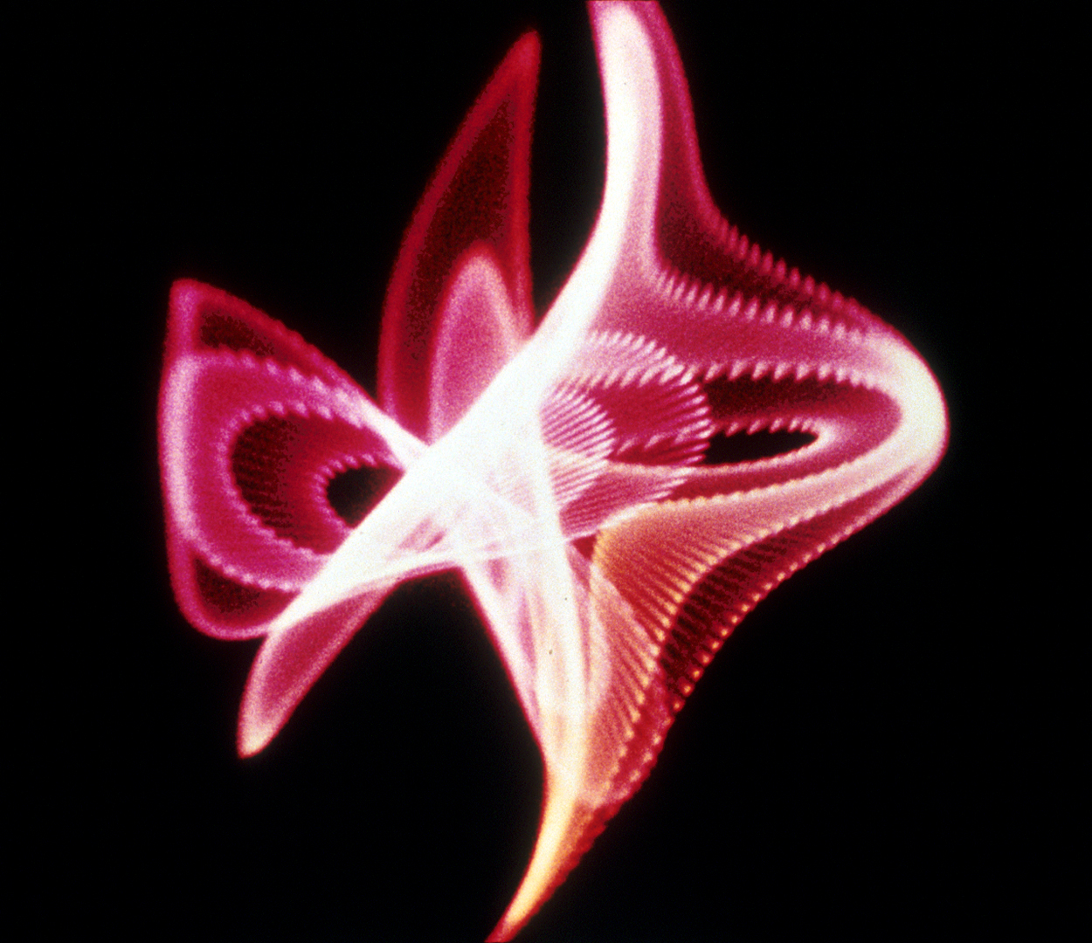
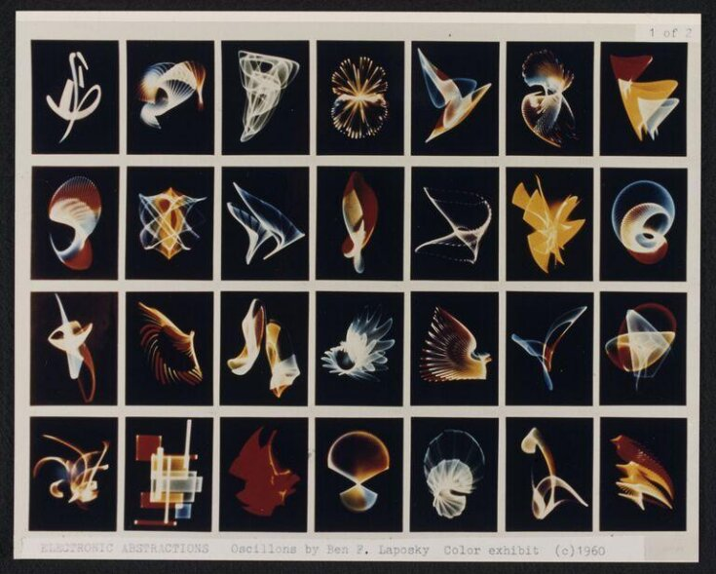

Slide 12
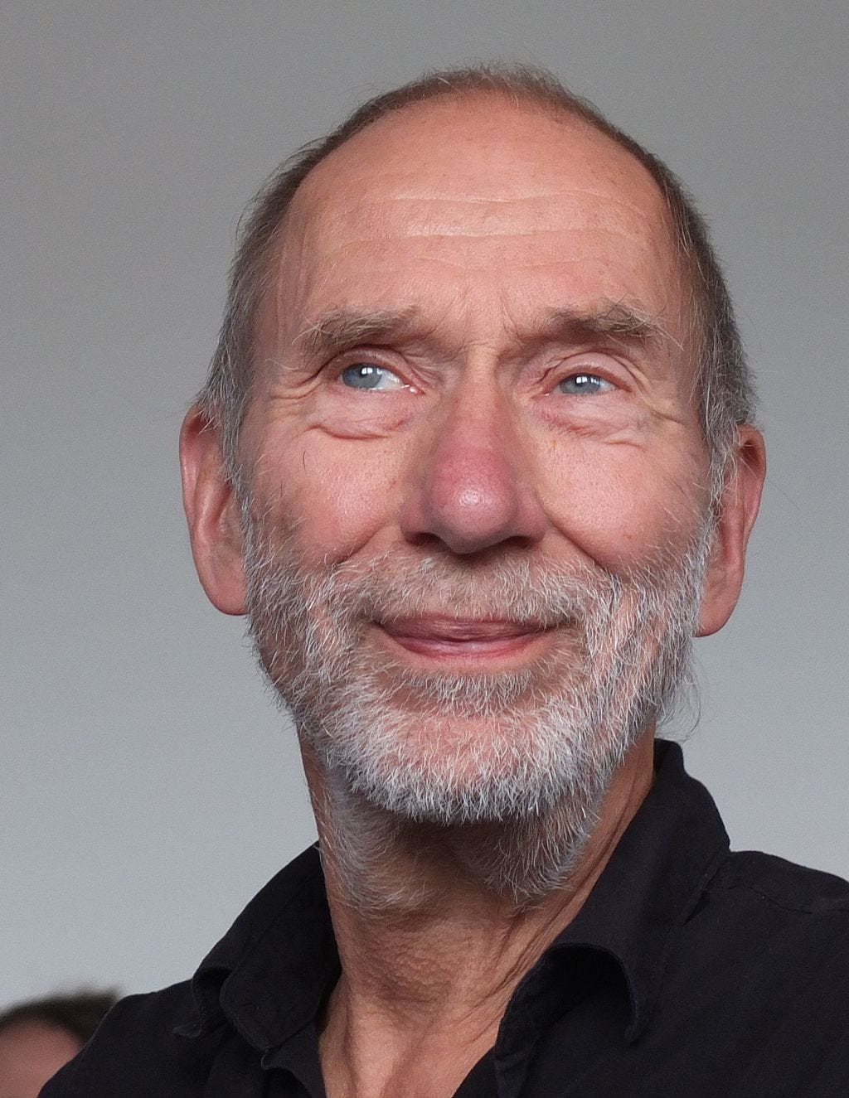
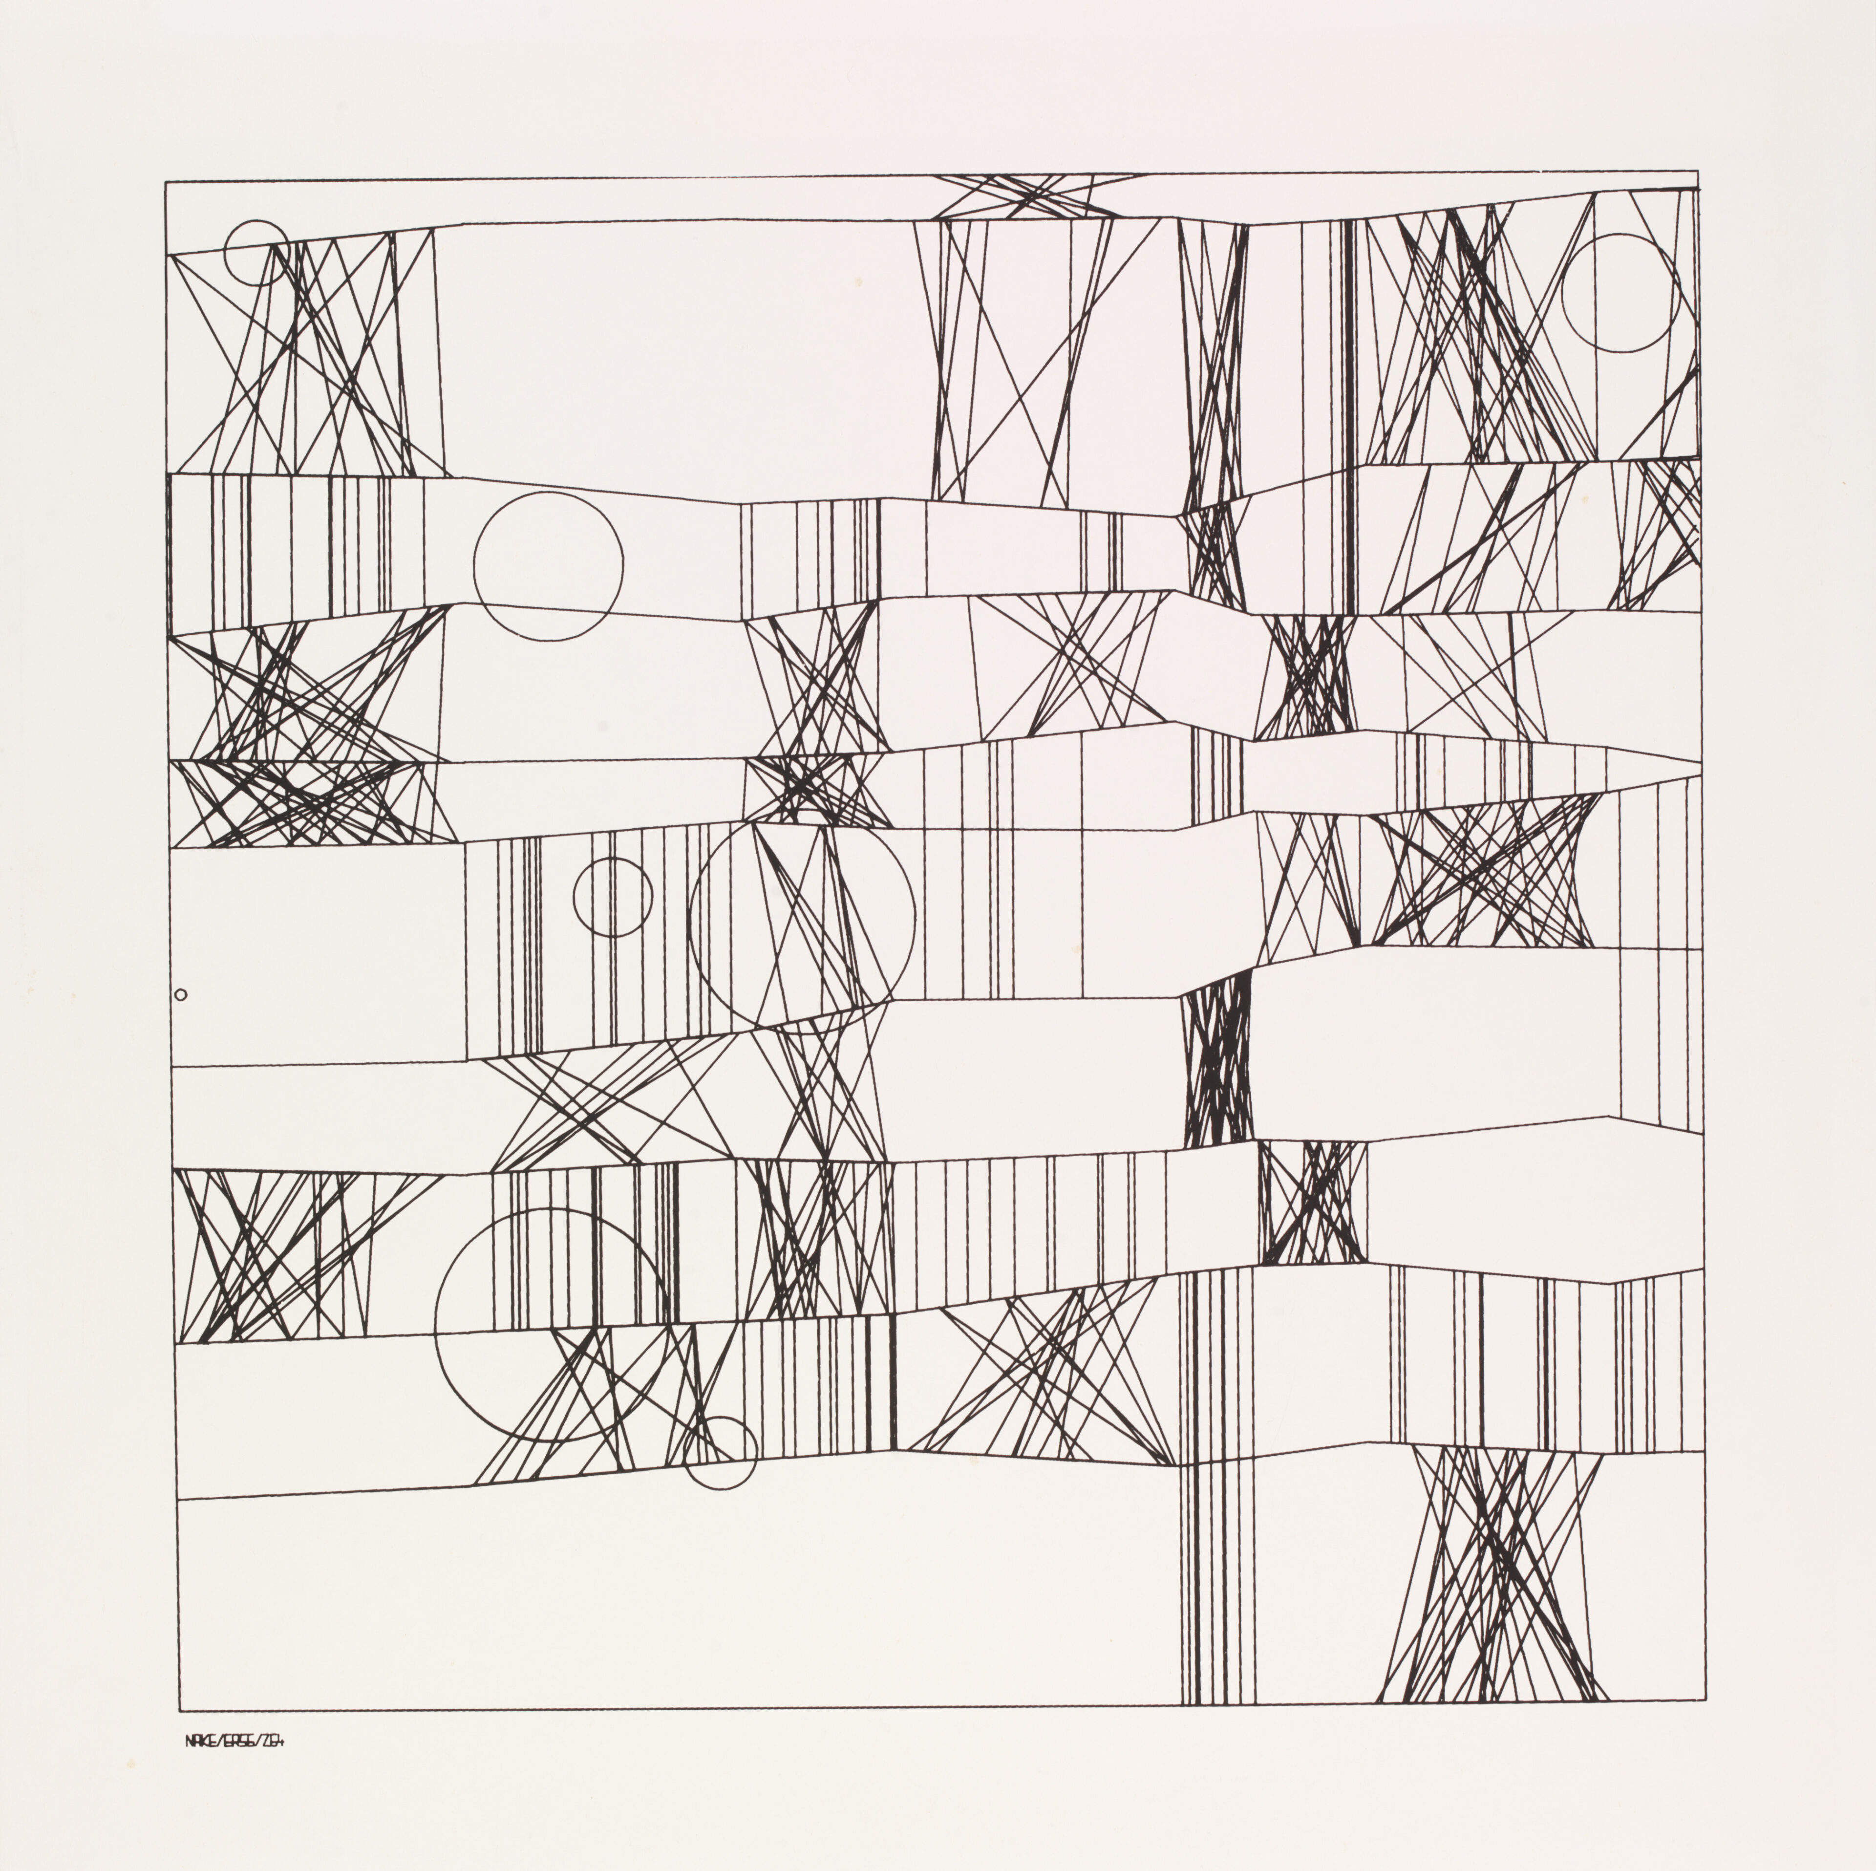
Artist: Frieder Nake
German mathematician and computer scientist
1965

Slide 13
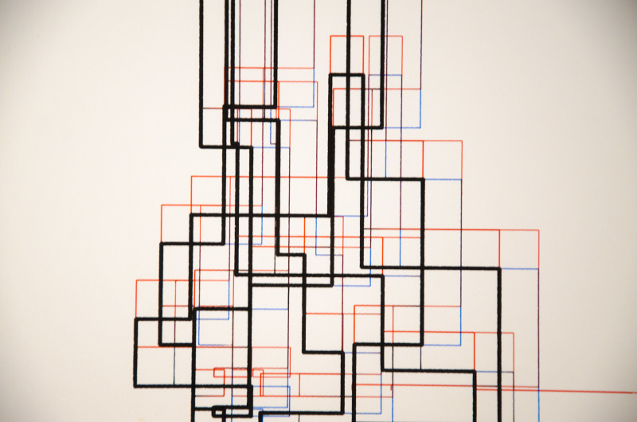
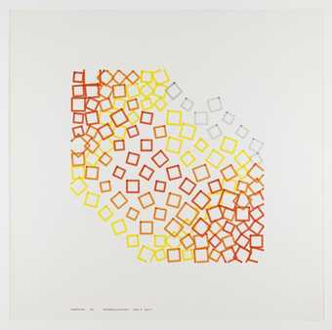
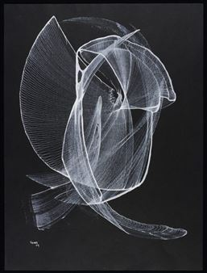
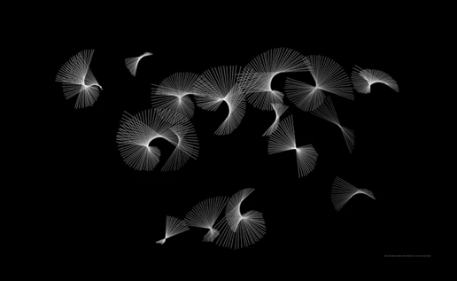

Slide 14
Digital Arts
At the beginning the digital artists were engineers and computer scientists as a rule.
Artists did not yet understand the technology and so didn’t adopt it.
This mimics what happened when photohgraphy was invented.

Slide 15
Artists and programmers
Both groups are creative, imaginative, intelligent, energetic, industrious, competitive and driven. But programmers, in my [vast world-embracing] experience, tend to be painstaking, logical, inhibited, cautious, restrained, defensive, methodical, and ritualistic. Their exterior actions are separated from their emotions by enough layers of logical defenses that they can always say "why" they did something. Artists, on the other hand, seem to be freer, alogical, intuitive, impulsive, implicit, perceptive, sensitive, and vulnerable. They often do things without being able to say why they do them, and one usually is polite enough not to ask.
("Collaborations with Artists — a Programmer's Reflections," Nake & Rosenfeld, GRAPHIC LANGUAGES, North Holland Publishing Co. 1972).

Slide 16
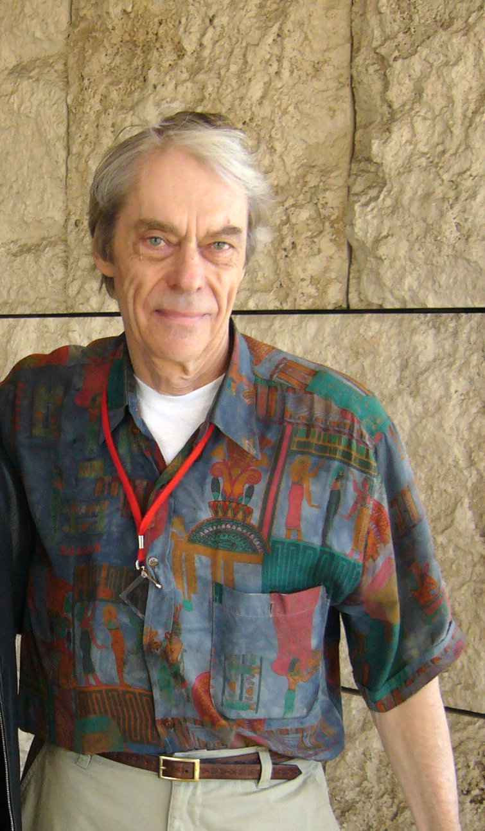
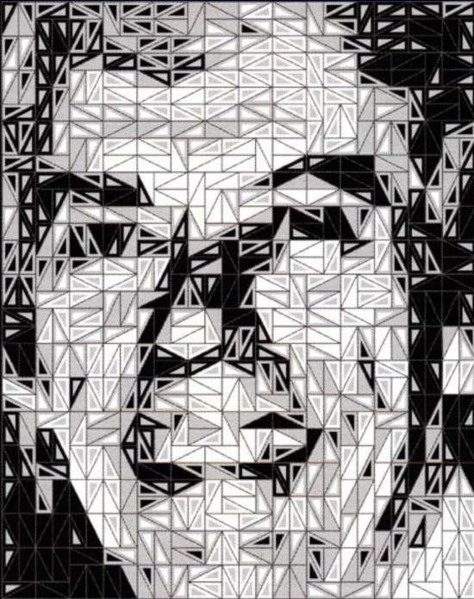
Artist: Ken Knowlton
American computer graphics pioneer, artist, mosaicist.
1966

Slide 17
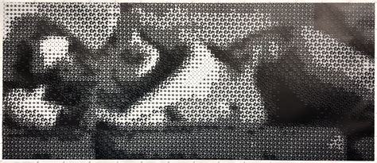
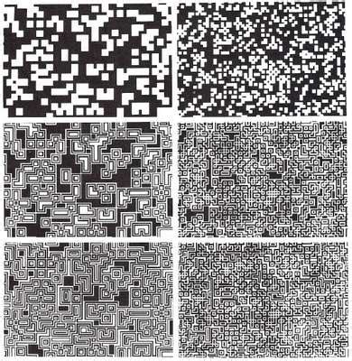
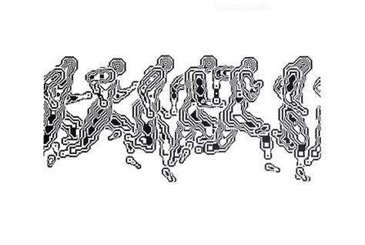

Slide 18
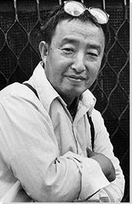
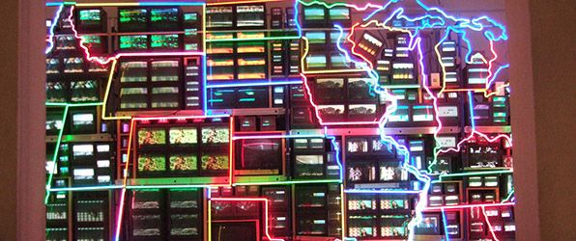
Artist: Nam June Paik
"the father of video art,“
Korea
1984

Slide 19
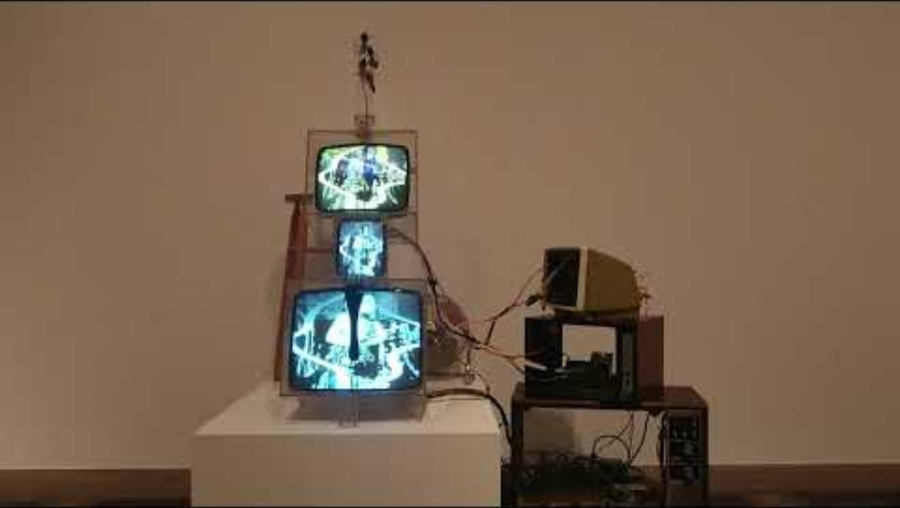

Slide 20
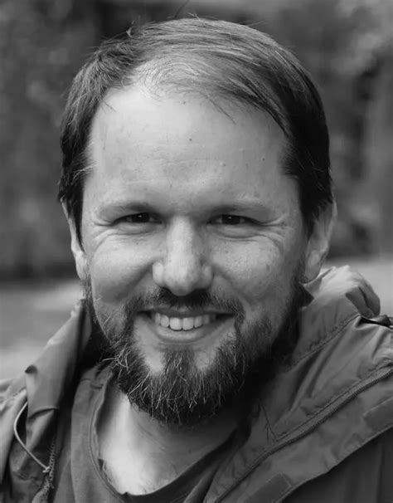
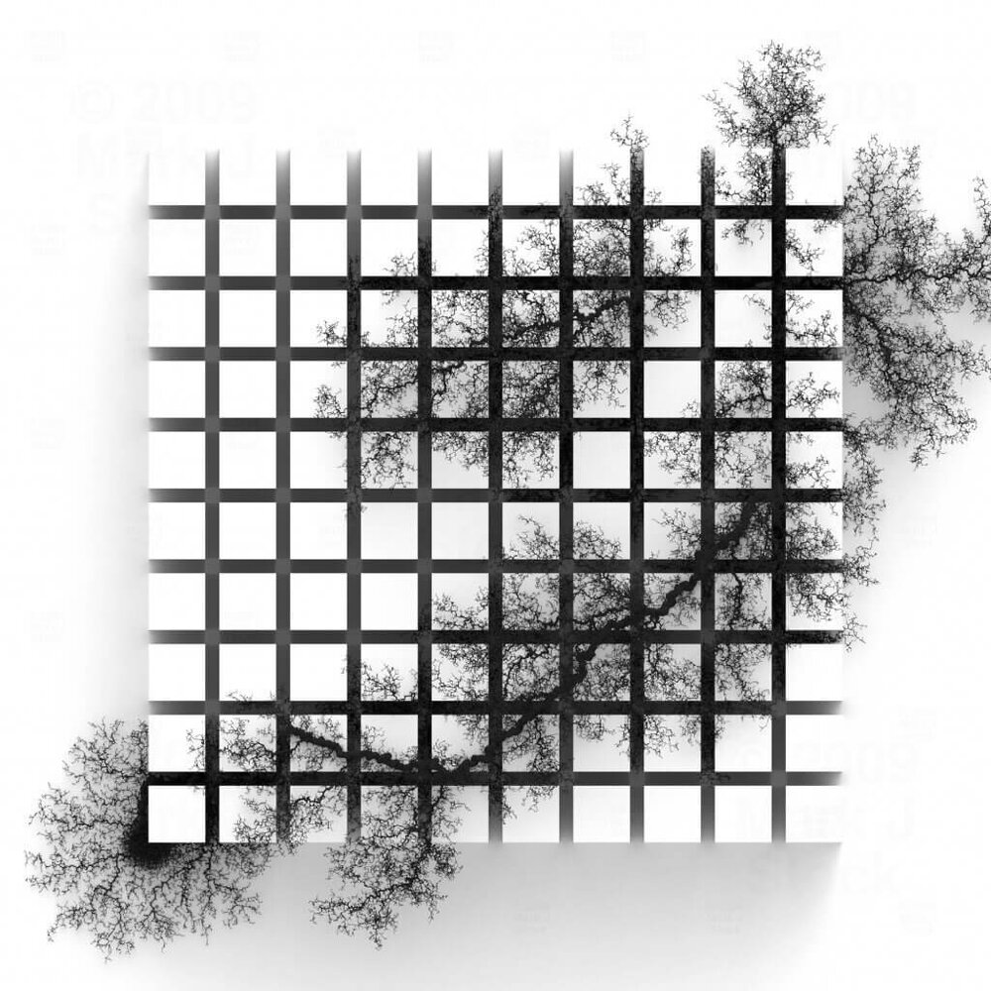
Artist: Mark J Stock
Artist, scientist, and programmer.
2000

Slide 21
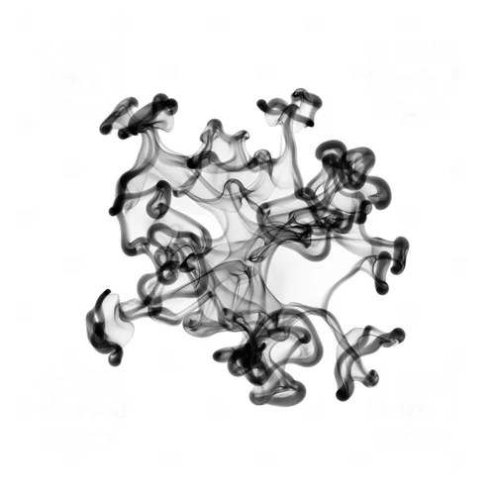
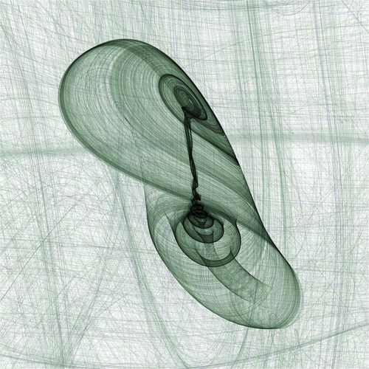
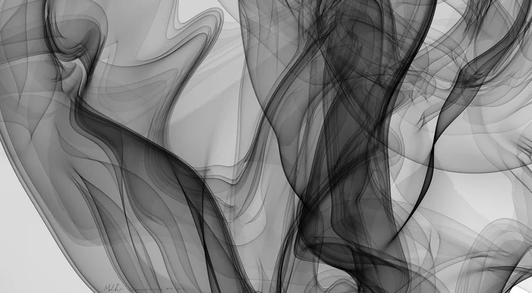

Slide 22

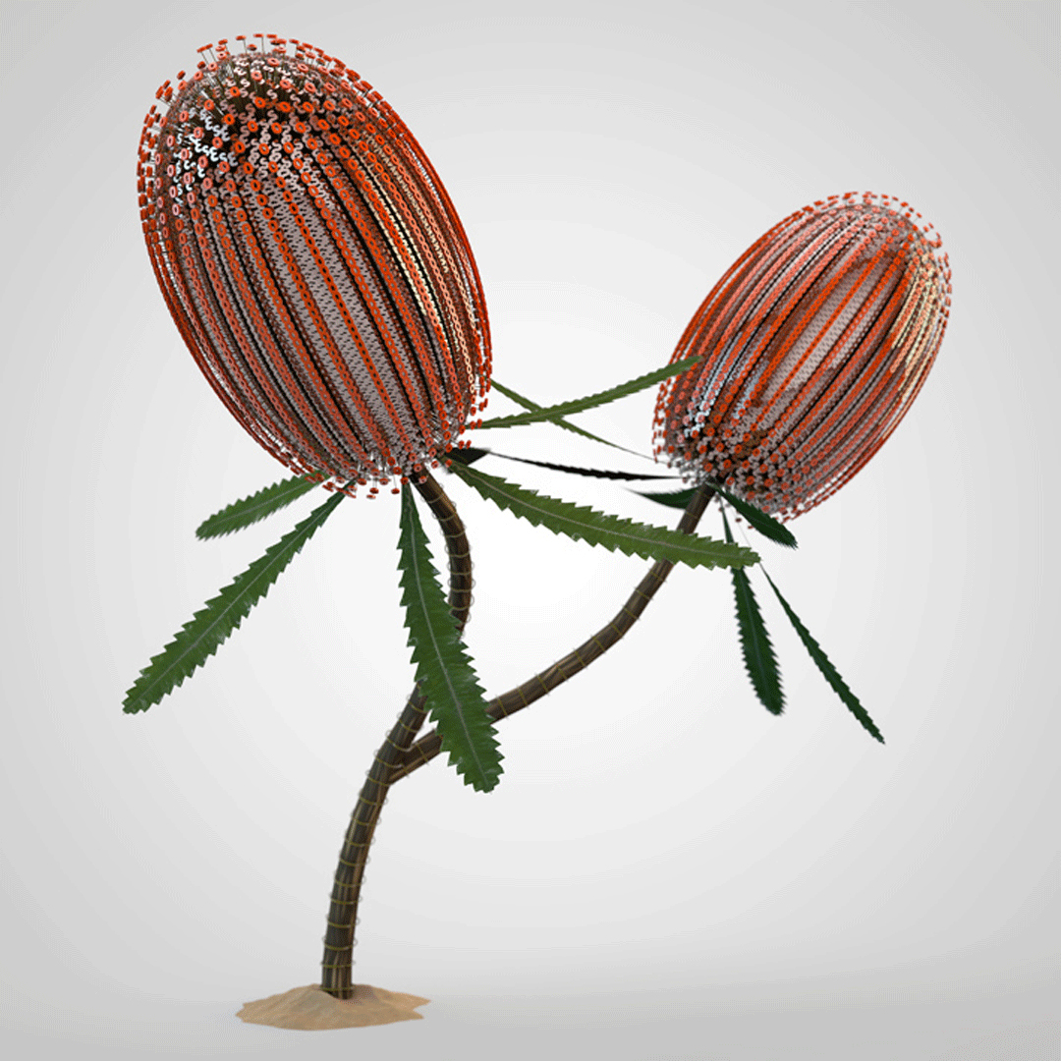
Artist: Jon McCormack
1980s-2000

Slide 23
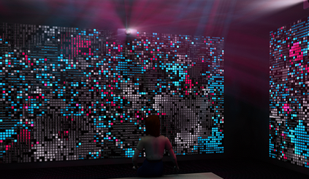




Slide 24

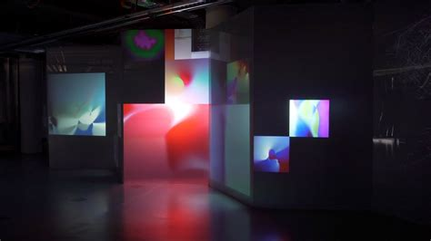
Artist: Zach Lieberman
American new media artist, designer, computer programmer 1980s-2000

Slide 25
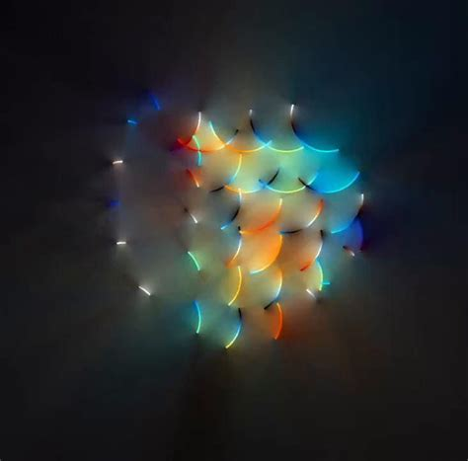

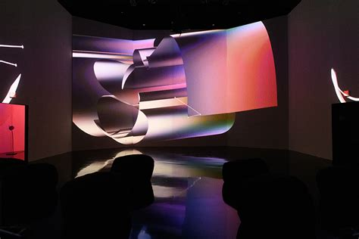

Slide 26
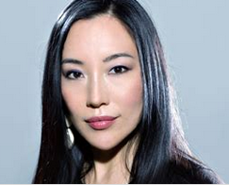
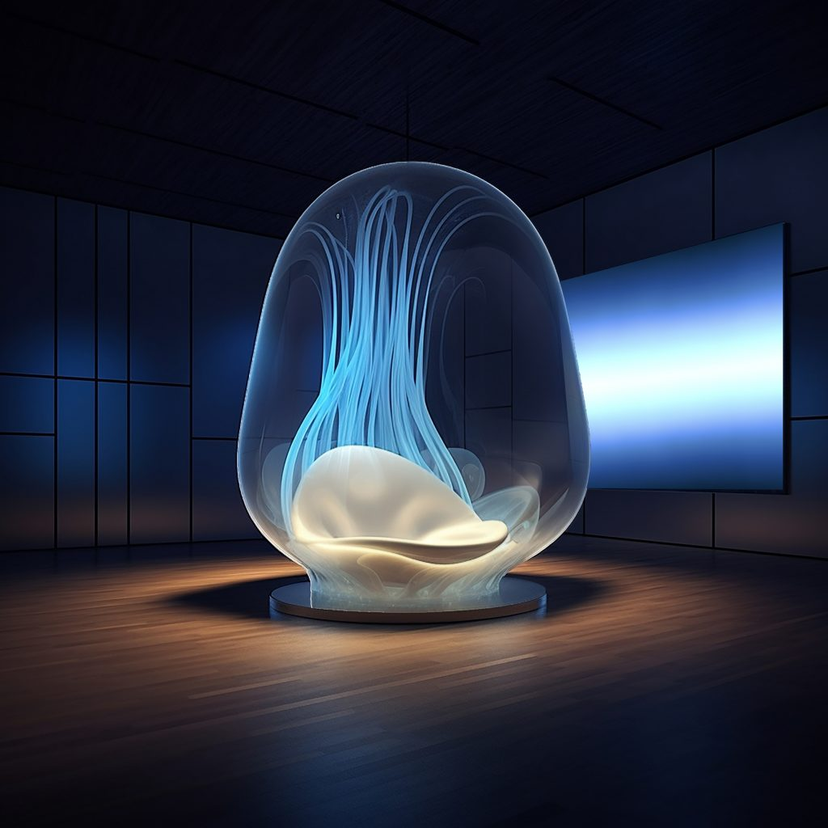
Artist: Christa Kim
Canadian new media artist. Techism.

Slide 27

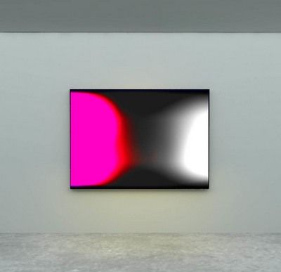
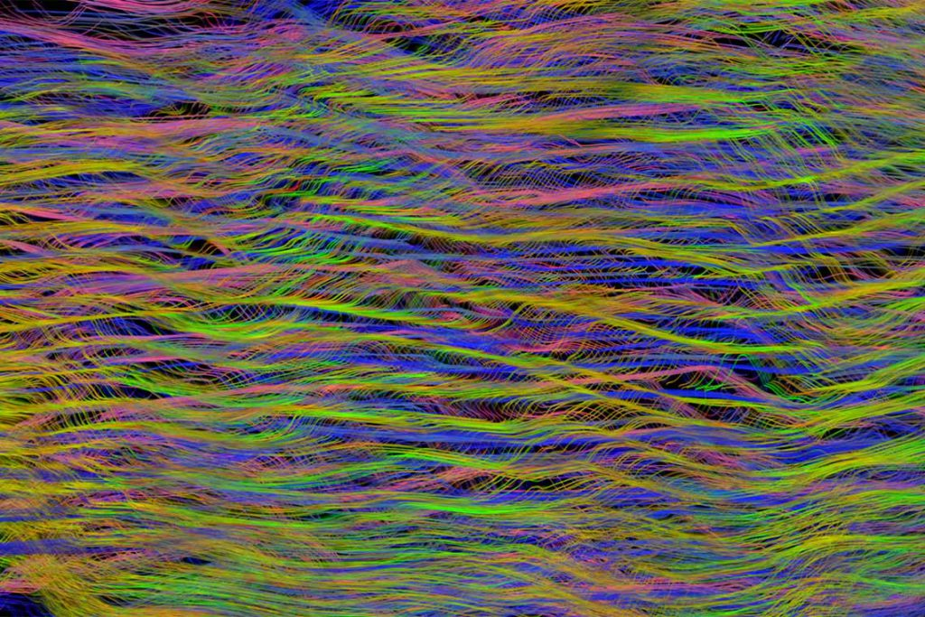

Slide 28

Artist: Emily Xie
NYC artist.

Slide 29
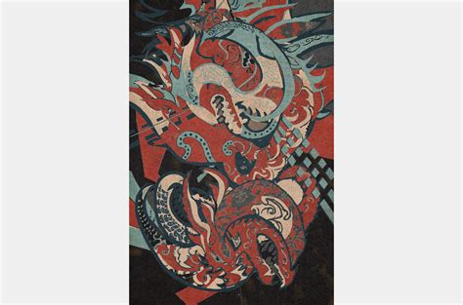
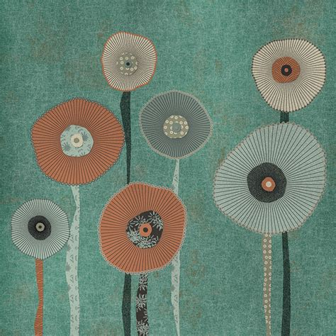
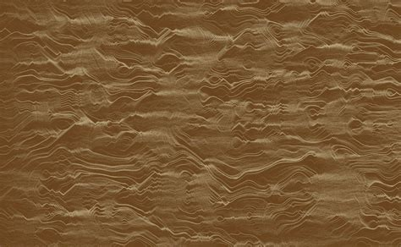

Slide 30
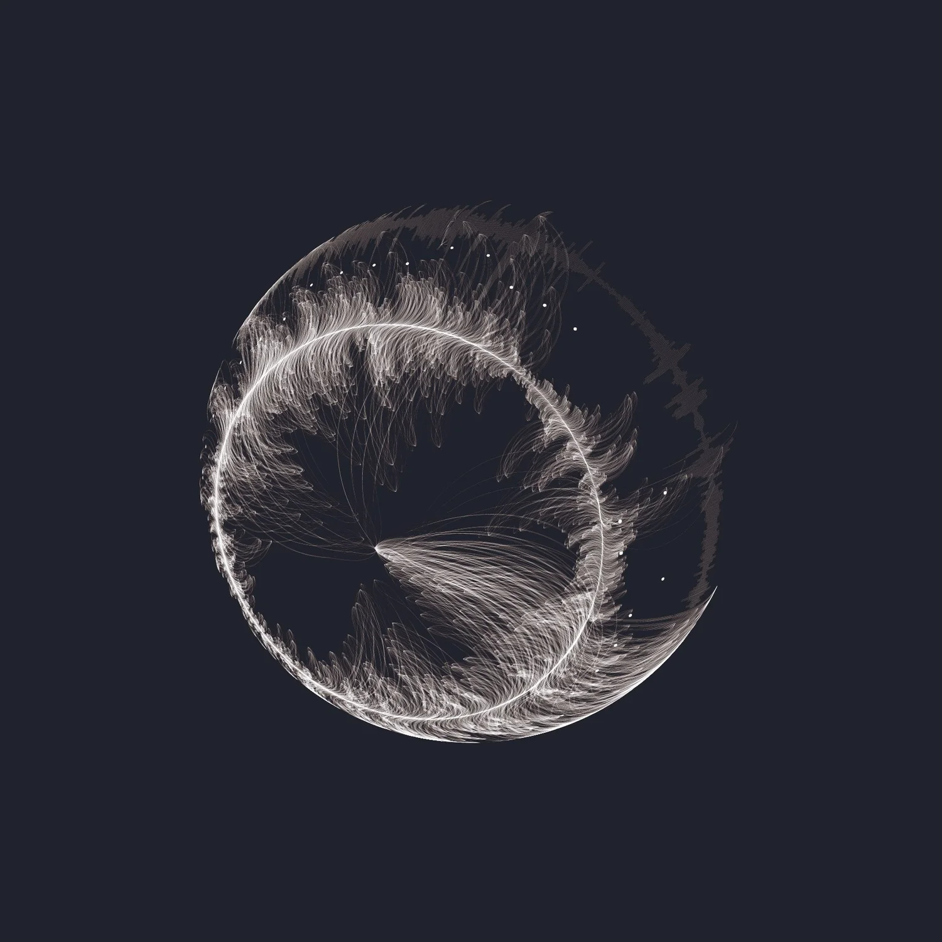
Artist: Tiziana Alocci
Data Artist. London.

Slide 31
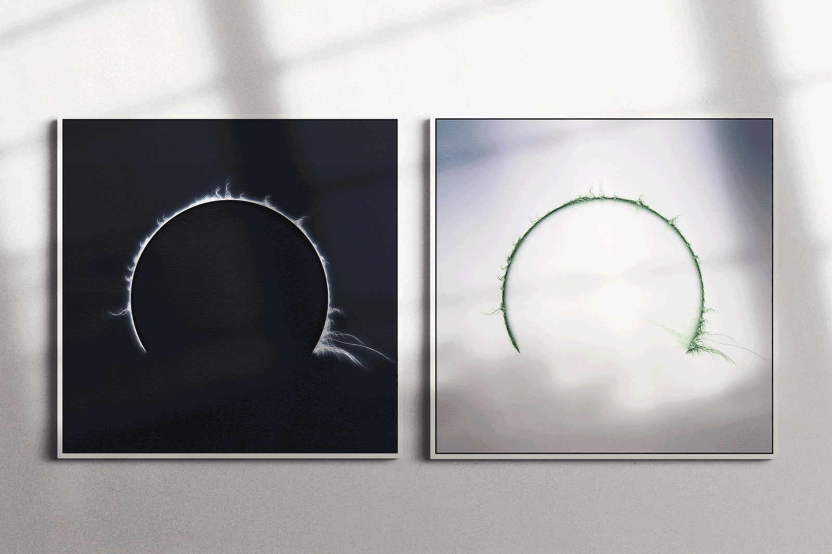

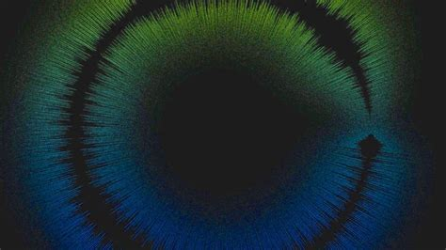

Slide 32
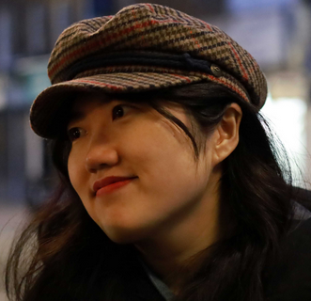
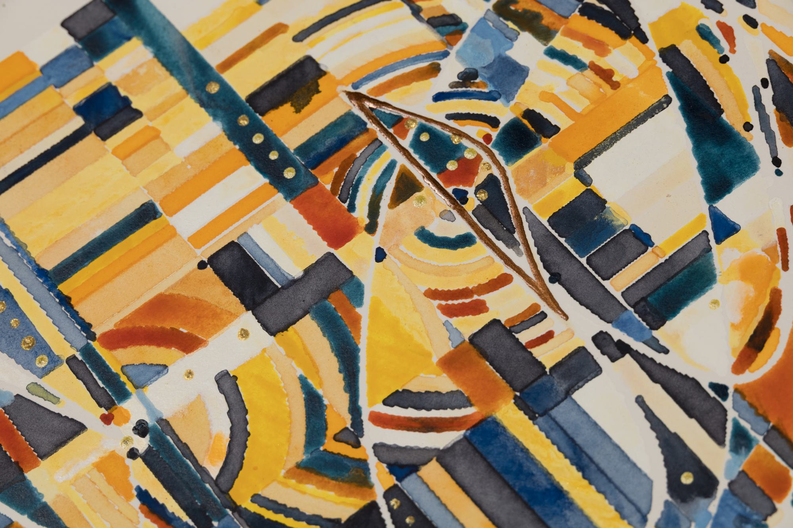
Artist: Licia He
Generative Artist. Chinese.

Slide 33
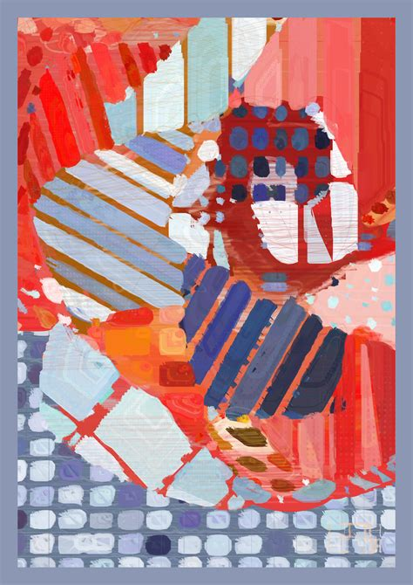
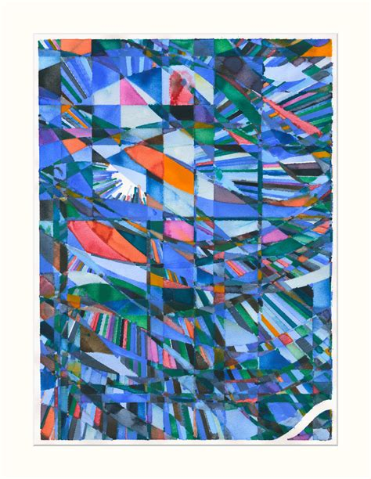
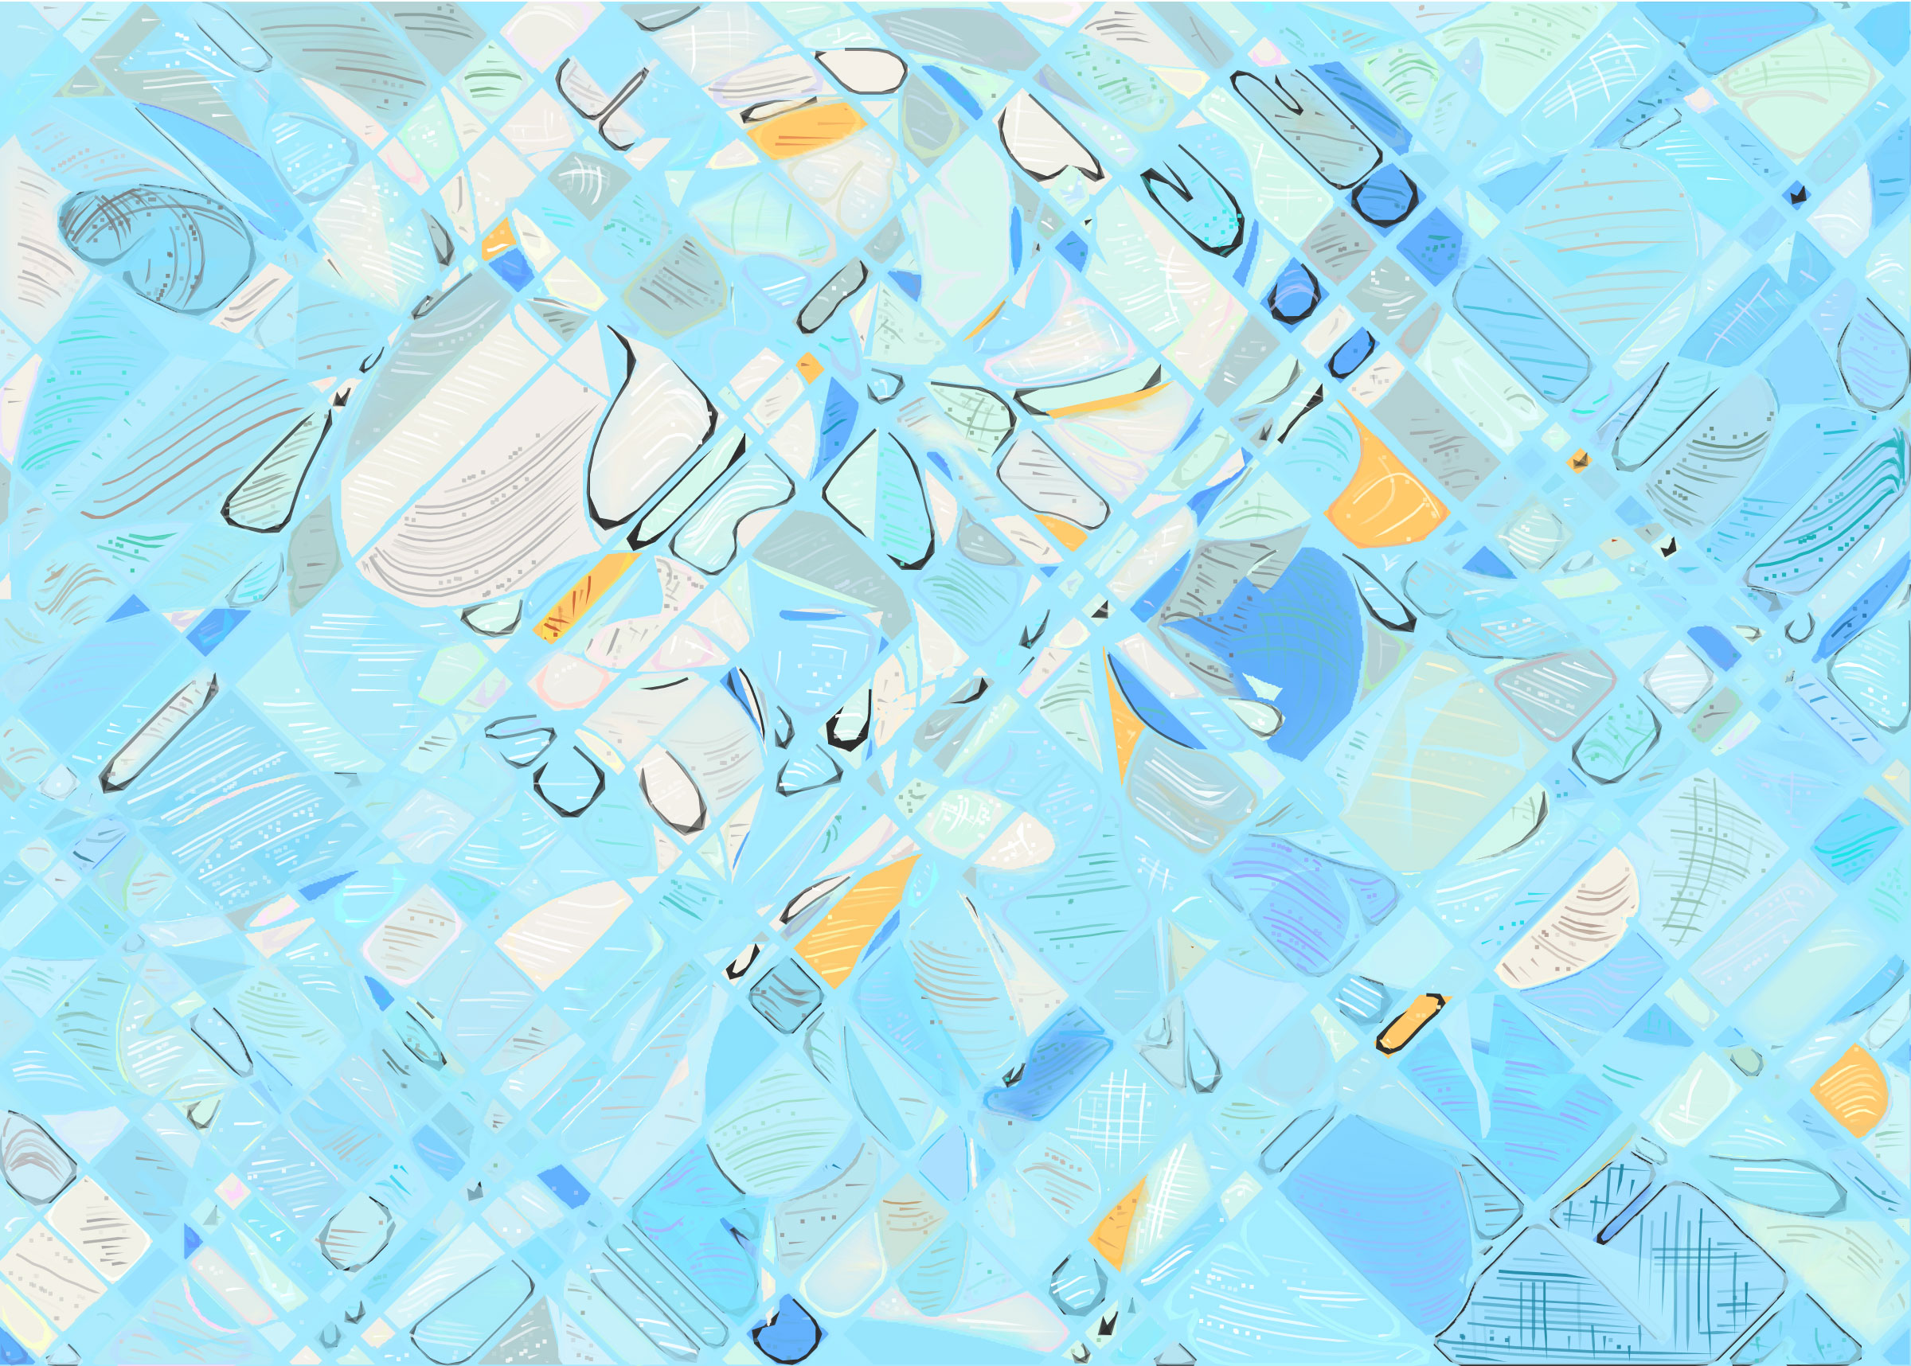

Slide 34

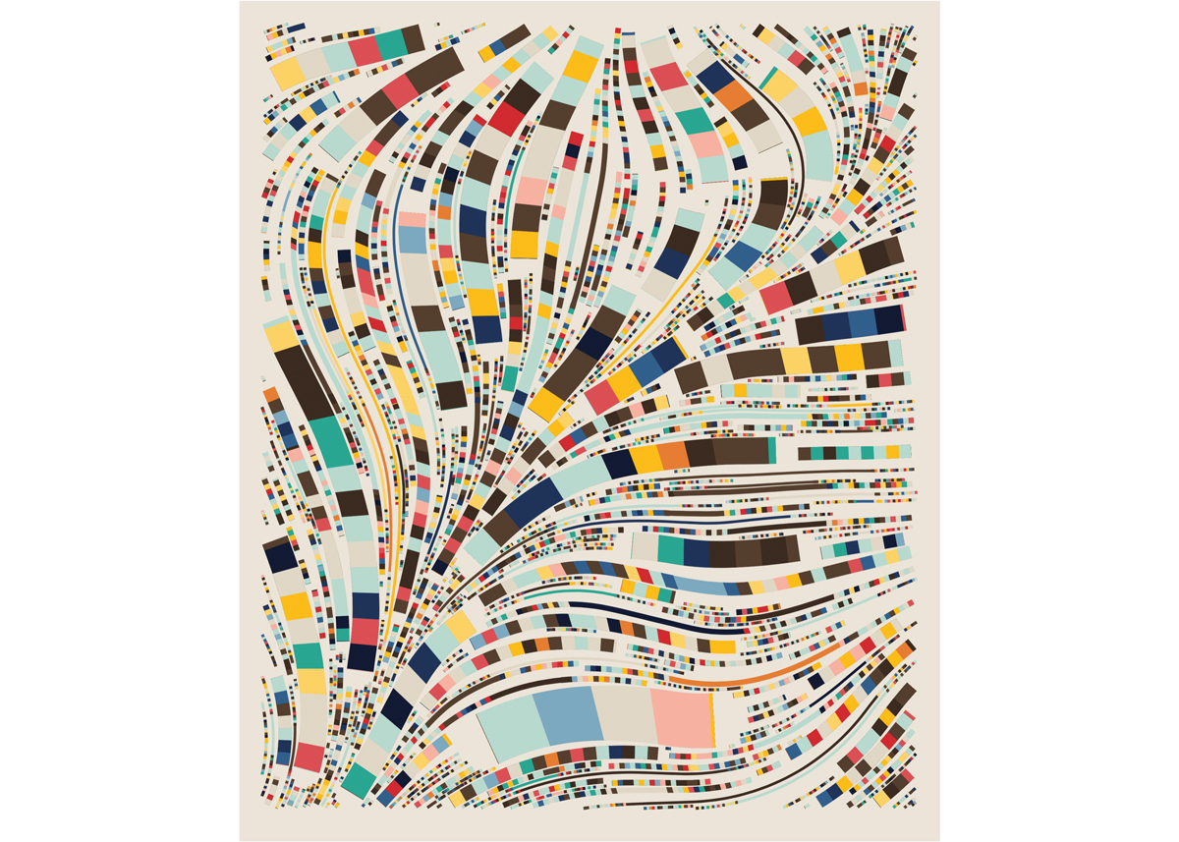
Artist: Erick Calderon
Generative Artist. NYC.

Slide 35
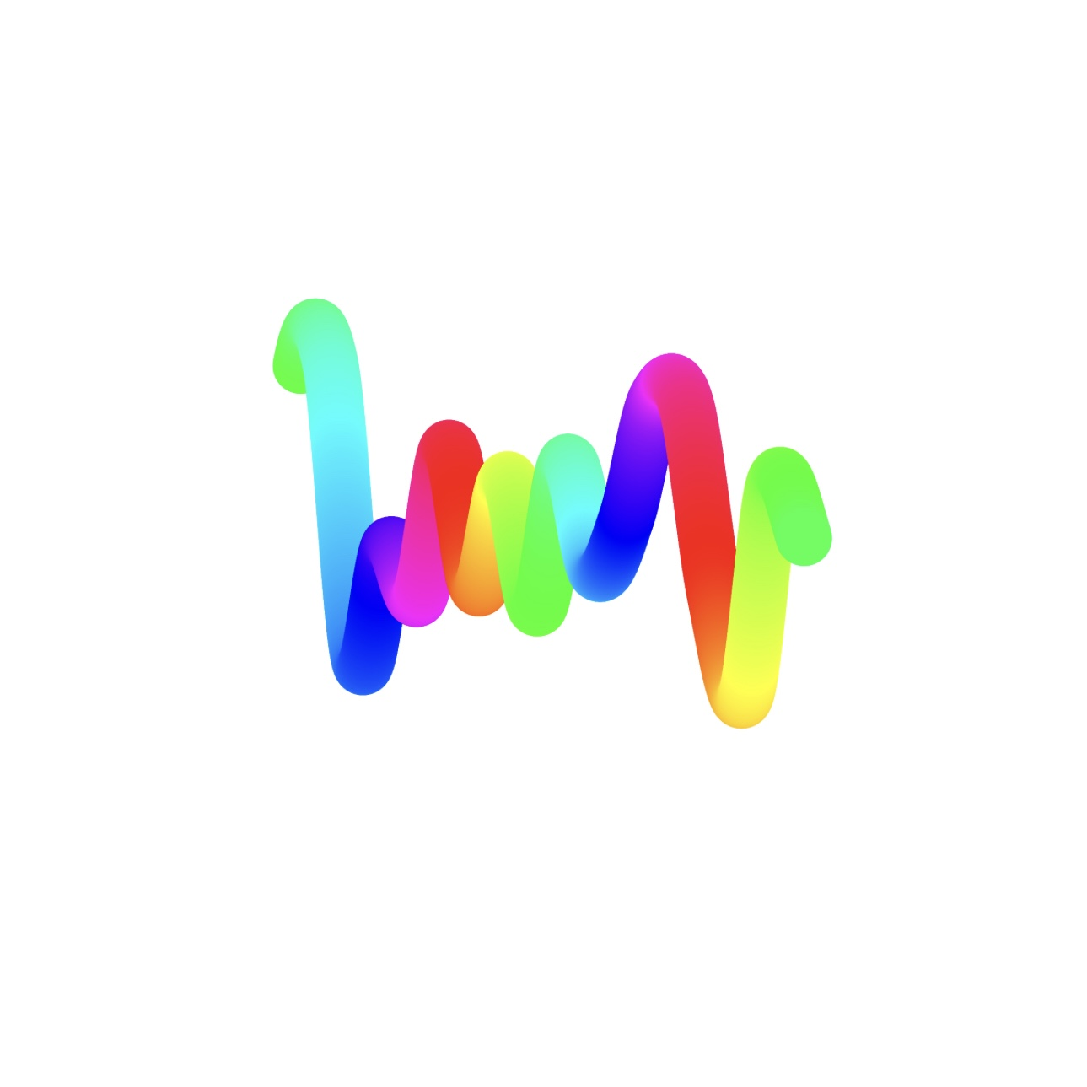
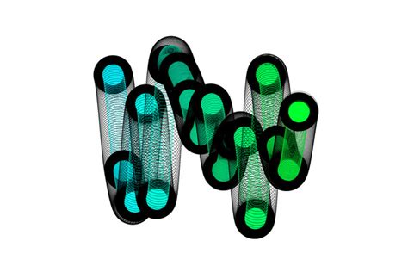
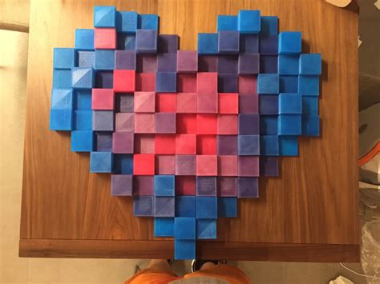

Slide 36
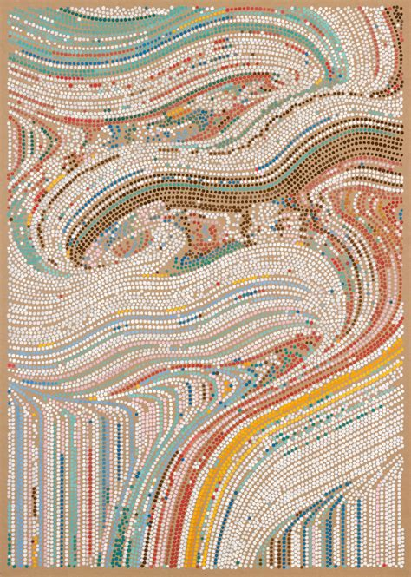
Artist: Tyler Hobbs
Generative Artist. Austin.

Slide 37
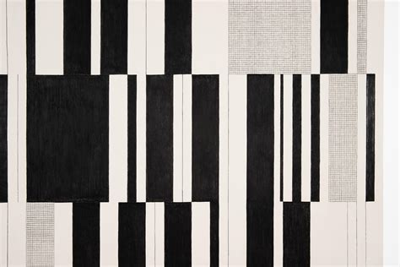



Slide 38


Artist: Dmitri Cherniak
Generative Artist. Canada.

Slide 39




Slide 40


Artist: Matt DesLauriers
Generative Artist. Canada.

Slide 41




Slide 42
We will learn:
Technology and methods – HOW it is made.
Algorithms
Graphics in discrete spaces
Basic underlying ideas, both art and science.
Geometry
Process – starting, thoughts, design

